Slide 1
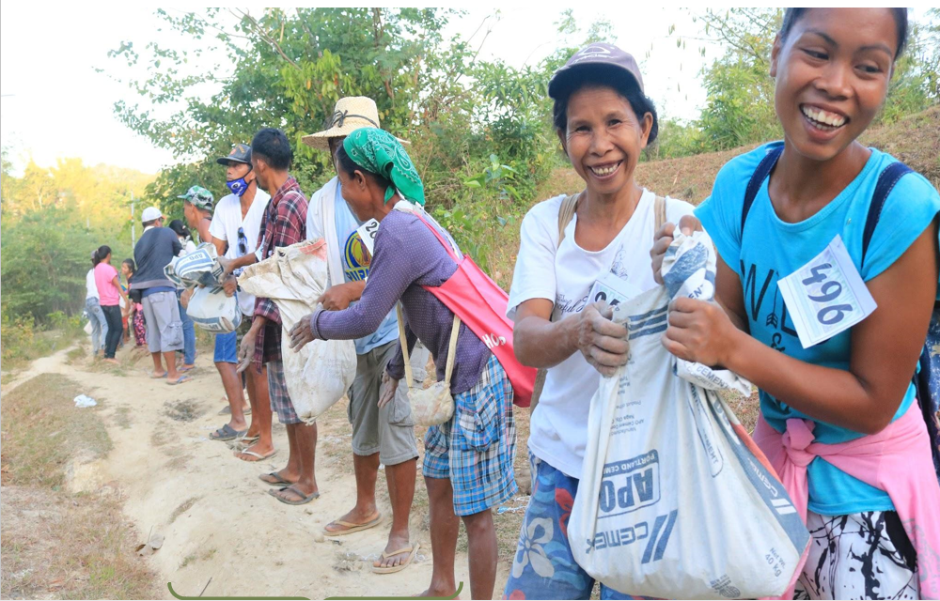
MOVING FROM ACCESS TO BASIC SERVICES TO SUSTAINABLE LIVELIHOOD DEVELOPMENT
Learning Session
February 23, 24 and 26, 2021 8 – 11am

Slide 2
Objectives:
Learn about various international, regional and local experiences with Community Driven Development – Local Economic Development (CDD-LED) programs and models;
Discuss operational considerations when transitioning from current CDD model to focus on livelihoods; and
Identify key features of LED, in order to prepare the operational field guides for the NCDDP-AF
KALAHI-CIDDS NCDDP-AF, the NCDDP-NPMO, in partnership with the World Bank.

Slide 3
Agenda Outline
Day 1
Global experiences on Local Economic Development and Community Driven Development
Resource Persons: Ashutosh Raina (World Bank); Parmesh Shah (World Bank)
Day 2
Session 1: Philippine Experience in Community Economic Development
Resource Person: Dan Songco
Session 2: Lessons Learned on Community Driven Enterprise Development (CDED) in the Philippines
Resource Person: Edmon Monteverde (DSWD-SLP)
Day 3
The way forward: Determining Key Design Features of LED Modality under
NCDDP-AF
Small group and breakout sessions
Detailed agenda to follow

Slide 4
February 24, 2021
8:00-8:30 am:
Opening program:Prayer
Introduction
8:30-8::45 am: Message from Janmejay Singh, Practice Manager for Social Sustainability and Inclusion Global Practice
8:45–9:15 am: Philippine Experience in Community Economic Development: Policy and Operational Implications to be presented by Dan Songco
9:15-:9:45 Learning from CDED Pilot-testing to be presented by Edmond Monteverde
9:45 -10:45 Discussion
10:45-11:00 Wrap up

