Slide 1
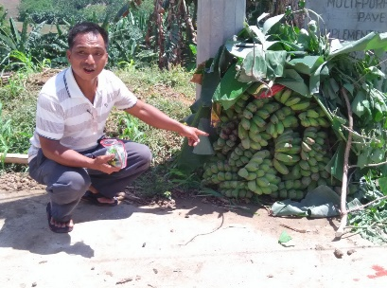
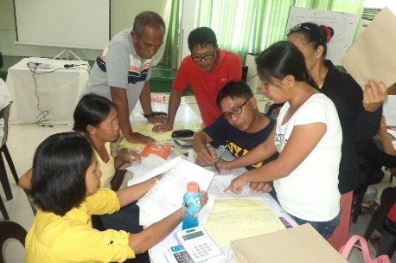
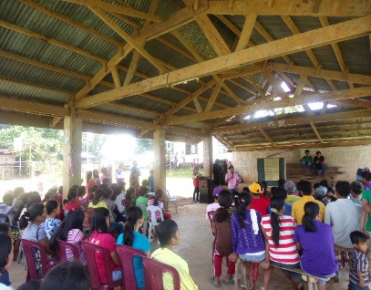
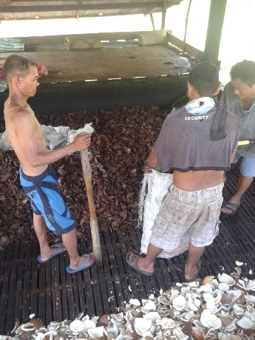
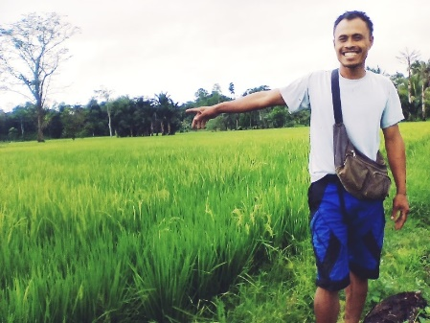
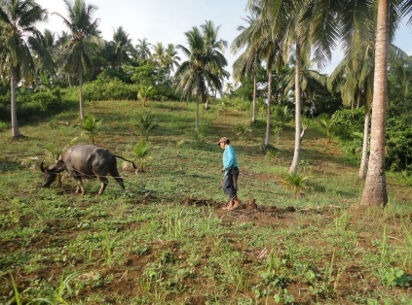
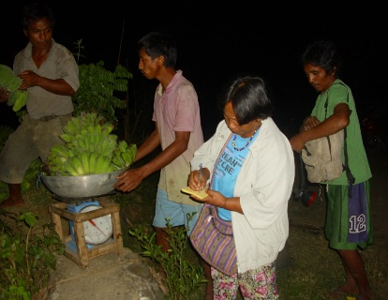
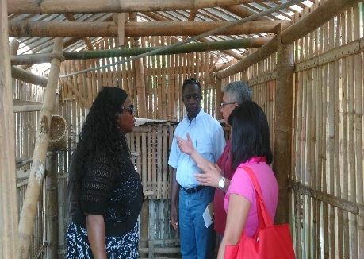
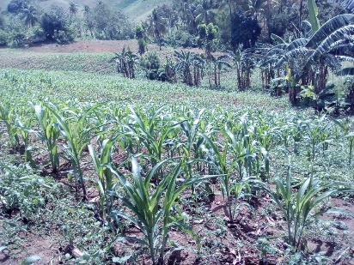
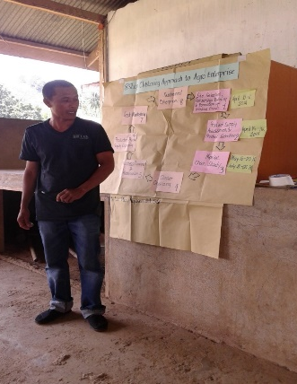
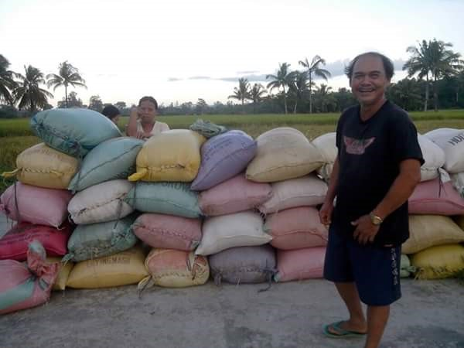
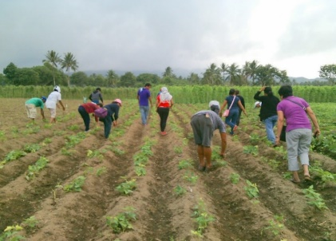
JSDF-CDED: Community Enterprise Development as Pathway Out of Poverty

Slide 2
BASIC INFORMATION OF THE PROJECT
Recipient Grant Amount: US $2,929,000
Project Duration: 4 years (July 2012-June 2016) with 9 months extension (November 2016-August 2017
Project Launch: November 29,2013 (MOA Signing)
Implementing Agency/Joint Implementation: DSWD through SLP and six municipal local government units and Civil Society Organization

Slide 3
PROJECT BACKGROUND
Community Enterprise Development as Pathway Out of Poverty
The JSDF-CDED project utilized the Community Driven Enterprise Development (CDED) framework which was developed through the joint effort of the DSWD, the World Bank, and Japan International Cooperation Agency.
It is an approach that enables the poor to transition and participate in the local economic activities and systematically link to business development services and microfinance institutions.
The CDED framework is a multi-stakeholder process that involves a tripartite relationship among the government, private sector, and the communities.
The said approach was possible through the Convergence Strategy of the DSWD’s key programs that includes KALAHI-CIDDS, Pantawid Pamilyang Pilipino Program, and SLP.

Slide 4
STAGE 1 Social Preparation
STAGE 2 Business Development
Step 2.1
Shortlisting & Selecting the Product
Step 2.2
Conduct of Value Chain Analysis
STAGE 3 Business Planning and Operations for Community Driven Enterprises
Step 3.1 Organizing the Producer Cluster
Step 3.2 Developing the Market
STAGE 4 Sustaining and Scaling-Up the Community Driven Enterprises
Step 4.1 Enterprise Planning for Scale-Up
Step 4.2 Provision of Project Sub-Grants
Step 2.4
Meeting of the LTWG for the Flagship Product
Step 3.3 Work & Financial Planning for Production/Operations
Step 2.3
Conduct of Initial Feasibility Study
Step 1. 1 Organizing & Capacity Development for Field Implementers
Step 1.2 a. Conduct of Area Assessment
Step 1.2.b. Building Partnerships
Step 2.5 Accessing & Mobilizing the Enterprise Resources
Step 3.4 Increasing Productivity
Step 3.5 Test Marketing
Step 3.6 Setting-up Business Operations
Step 3.7 Launching of the Enterprise
Step 3.8 Actual Production/ Operations
Step 3.9 BDS on Specialized Training
Step 4.3 Periodic Evaluation of the Business
Step 4.4 Program/Policy Advocacy for the Integration of CDED in the LED Pan or AIP
CDED FRAMEWORK

Slide 5
THE AGRO-ENTERPRISE (AE) CLUSTERING APPROACH
Basic Structure of the AE Approach
The Clustering Approach as a Farmers’ Journey
The innovative method of organizing farmers into small groups called “ enterprise or producer clusters” where the enabling process for market preparedness and engagement takes place.
Diagram grabbed from the Clustering Approach to Agroenterprise Development for Small Farmers.

Slide 6
THE AGRO-ENTERPRISE CLUSTERING APPROACH

Slide 7
PROJECT DESCRIPTION
Community Enterprise Development as Pathway Out of Poverty
Promotes and supports enterprise activities at the community level through the provision of business skills training and increased participation in the value chains.
Encourages local governments and stakeholders to promote local economic development through the sustainable use of local resources, adoption of inclusive economic growth strategies, and promotion of a policy environment that is conducive for community driven enterprises.

Slide 8
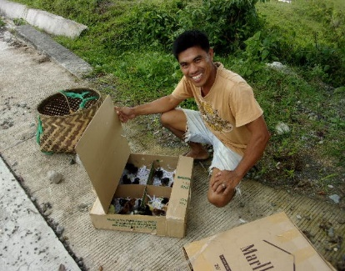
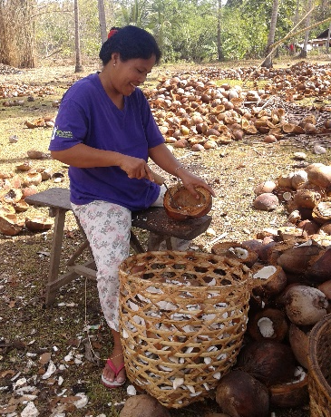
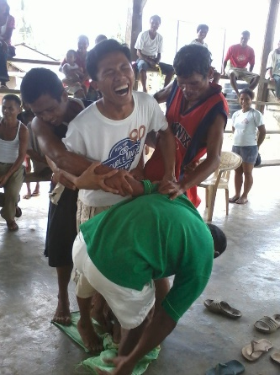
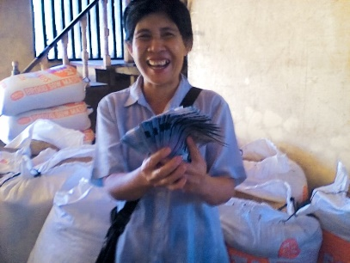
PROJECT OBJECTIVE
To improve the livelihood and quality of life of poor households in municipalities through increased income and access to financial services, development of community-driven enterprises linked to markets, and local economic development support.

Slide 9
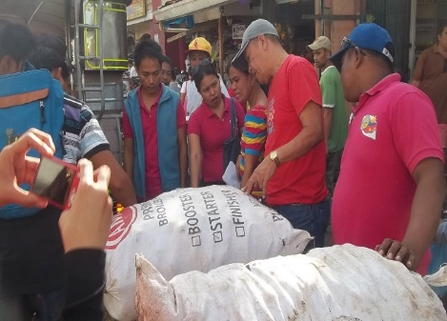
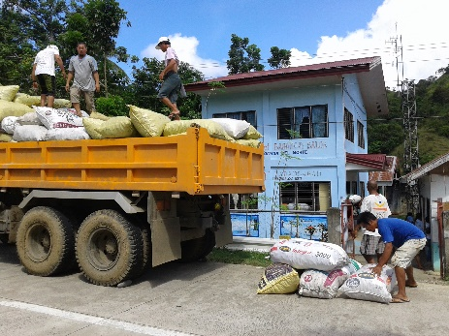
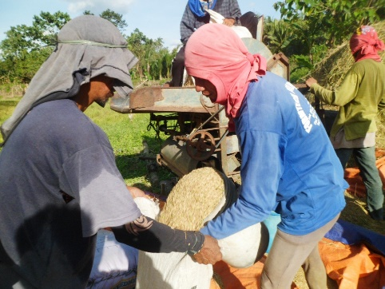
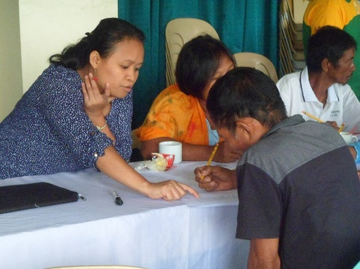
PROJECT COMPONENTS
Component 1: Community Enterprise and Value Chain Development
Component 2: Access to Financial Services
Component 3: Market Integration and Local Economic Development
Component 4: Project Management, Monitoring and Evaluation and Knowledge Dissemination

Slide 10
Component 1: Community Enterprise and Value Chain Development
Involves Social Preparation and Community-based Mobilization and Capability Building
OBJECTIVE: To increase the income of the poor households in the target communities.
OUTPUTS:
Community-based organizations formed/strengthened
Organized community-based enterprise groups provided with capability building and start-up grants
Completed mapping and organizing of value chain of common products
Training for small producers to consolidate their production to meet market requirements
Enhanced capability on business/enterprise development planning and management
Business plans approved for financing by microfinance/lending institutions

Slide 11
Component 2: Access to Financial Services
Involvement of the Microfinance Institutions (MFIs)/Business Development Service Providers (BDS)
OBJECTIVE: To increase access to financial services (microcredit, savings promotion, micro insurance, or remittance services)
OUTPUTS:
Increased provision of financial services for poor households
Increased savings, insurance coverage, access to microcredit, and remittance services of household members
Financial literacy training

Slide 12
Component 3: Market Integration and Local Economic Development
Focuses on the linkage of products to institutional buyers, and assisting LGU to identify policies and programs that support the project through its local development plan.
OBJECTIVE:
To develop one local product that is linked to an institutional market
To facilitate the preparation of an annual local economic plan that clearly shows the government support
OUTPUTS:
Completed mapping of the institutional markets
Developed community enterprises linked to institutional markets
Developed and adopted local economic plan that supports community enterprises
Delivered training courses on the promotion and practice of local economic development planning

Slide 13
Component 4: Project Management, Monitoring and Evaluation, and Knowledge Dissemination
DSWD’s management, monitoring, and evaluation of the project through the development of a project management system
OBJECTIVE:
Effective and efficient project management that leads to timely delivery of quality outputs and attainment of developing outcomes.
OUTPUTS:
Developed project operations manual, technical and training sub-manuals
Produced and disseminated knowledge products
Completed and disseminated impact evaluation
Submitted periodic progress and financial reports
Completed mid-term evaluation report
Submitted audit reports and completion report
Submitted implementation completion report

Slide 14
SELECTION OF PROJECT MUNICIPALITIES
Criteria:
1. Poverty incidence higher that the national average of 20.9%;
2. Presence of MFIs that are willing to work with poor households;
3. Local government units willing to adopt local economic plan in support of the community enterprises; and
4. High potential for business/enterprise that could be linked to market.

Slide 15



PROJECT LOCATION & SUB-PROJECT
Project Location: Paracelis, Mt. Province, CAR
CEA: Paracelis Abat Farmers Development Association
Sub-Project: Construction of PAFDA Multi-Purpose Agro Enterprise Consolidation Center
Product & Activity: Banana (Saba) Consolidation and Marketing
Project Location: Libon, Albay, Region V
CEA: Libon Camote Growers Association
Sub-Project: Construction of Single Storey Building for Consolidation, Processing & Storage; Nursery for Cuttings
Product & Activity: Sweet Potato (Kamote) Consolidation, Marketing and Processing
Project Location: San Remigio, Antique, Region VI
CEA: San Remigio Association Cooperative
Sub-Project: Construction of CSF for Production of Native Chicken and Feed Milling
Product & Activity: Native Chicken Production and Marketing

Slide 16



PROJECT LOCATION & SUB-PROJECT
Project Location: Siayan, Zamboanga Del Norte, Region IX
CEA: Siayan JSDF-CDED Farmers Association
Sub-Project: Construction of Warehouse Building and Drying Pavement
Product & Activity: Native Corn Production and Marketing
Project Location: Sindangan, Zamboanga Del Norte, Region IX
CEA: Sindangan CDED Farmers Association
Sub-Project: Construction of Warehouses, Solar Dryers, and Kiln Coco Dryer
Product & Activity: Copra Consolidation and Marketing
Project Location: La Paz, Agusan Del Sur, CARAGA
CEA: La Paz JSDF-CDED Farmers Association
Sub-Project: Construction of Warehouse & Rice Processing Center
Product & Activity: Palay Consolidation and Marketing

Slide 17
PROJECT IMPLEMENTATION AND MANAGEMENT STRUCTURE
PinoyME
(National Consultant)
Program systems development and institutionalization
Program Dev’t like enhancement of field guide, RMF, conceptualization of baseline data gathering
Manualization
Knowledge management
Network development and management,
Cap. Bldg for staff, key stakeholders, MFIs, BDS providers for cascading to participants
JSDF-CDED
National Program Management Staff Office (NPMO)
National Livelihoods Technical Working Group (NTWG)
Overall Project Manager
Coordination with national government agencies & advocacy functions
Monitoring and evaluation of on-site implementation
Guidance on internal cooperation
Manualization incl. development of knowledge products
Fund management & reporting
National policy making and coordinative body
Strategic guidance in the development & pilot testing of CDED
Program implementation and supervision
Over-all supervision
Quality control
High level technical assistance (business mentoring, market matching, etc.
Monitoring and evaluation
SLP Regional Project Management Office (RPMO)
Implements directives
Supervise the MPMT
Optimum use of funds
M&E functions
TA to MPMT
Manages partnerships
Facilitates issue resolution
Municipal Inter-Agency Committee
Process facilitation and capacity building
Program and systems development
Training and mentoring
Technical assistance
Network development
Market linkages
Access to finance
Municipal Oversight and advisory committee
Local Consultant
Municipal Project Management Team
Local Technical Working Group (LTWG)
Ground level implementation
Training and technical assistance to beneficiaries
Coordination with local government agencies, BDS providers, MFIs
Project facilitator & monitor
Policy making and coordinative body for the project
Project
Area/Participants
(Pilot Municipalities, Community Enterprise Associations, Cluster Groups, Farmer-Entrepreneurs)
Notes:
NPMO- overall project manager

Slide 18
CHALLENGES
Capacity Gaps
Limited Project Implementation Period
Hiring and Operations of Local CSOs
Mobilizing Credits for Farmers and Enterprises
Completion of Sub-Project Proposal Requirements
DSWD Accreditation of Civil Society Organizations
Effect of Natural Disasters and Pest Infestations
Community Enterprise Association (CEA) Farmers’ Membership, Engagement and Retention

Slide 19
LESSONS LEARNED & INSIGHTS
Potential for Local Econmic Development
Participatory Enterprise Development
Local Government Participation
Learning by Doing Approach through the Regular Conduct of Field Implementers’ Workshop
Competencies and Convergence
Project Management Structure
Installation of Guidelines and Manuals
Role of National CSOs and Local CSOs
Sustainability

Slide 20
THANK YOU!

