Slide 1
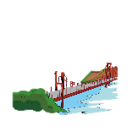
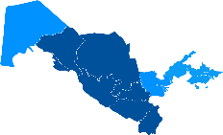
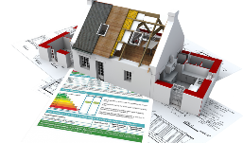
Ministry of Economic Development and Poverty Reduction of the Republic of Uzbekistan
THE RURAL INFRASTRUCTURE DEVELOPMENT PROJECT. ACHIEVEMENTS TO DATE
Rural Infrastructure Development Project is considered as the first-ever CDD Project in Uzbekistan
100 mln USD
82 mln USD
1.6 mln USD
Schools
Clean drinking water
Project implementation period: 2020-2024
28
104
14 community operated drinking water supply organizations to be created
Kindergartens
Drainage system
15
1
Internal roads
Bridges
56
3
Facilitation: PIU vs NGOs
ACTED (France), ISW (Canada), CEED (Bulgaria)
Electricity supply
Medical institutions
29
3
5
regions
176 “Mahalla Development Units” (MDUs) established and include about
5,320 members
~US $500.000
per village
239 subprojects identified and prioritized by
176 villages
21
districts
50%
of MDU members are female
~ $160
per capita
306
villages

