Slide 1
Social Dimensions of Climate Change
Issues and Roles for Communities

Slide 2
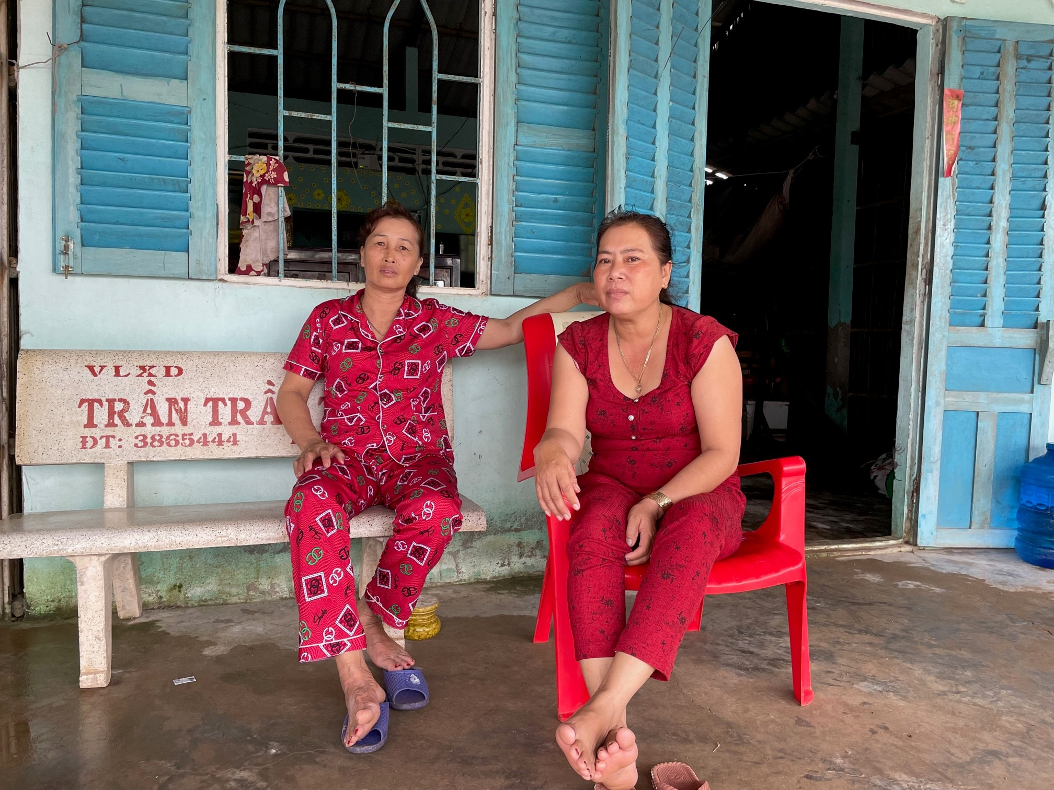
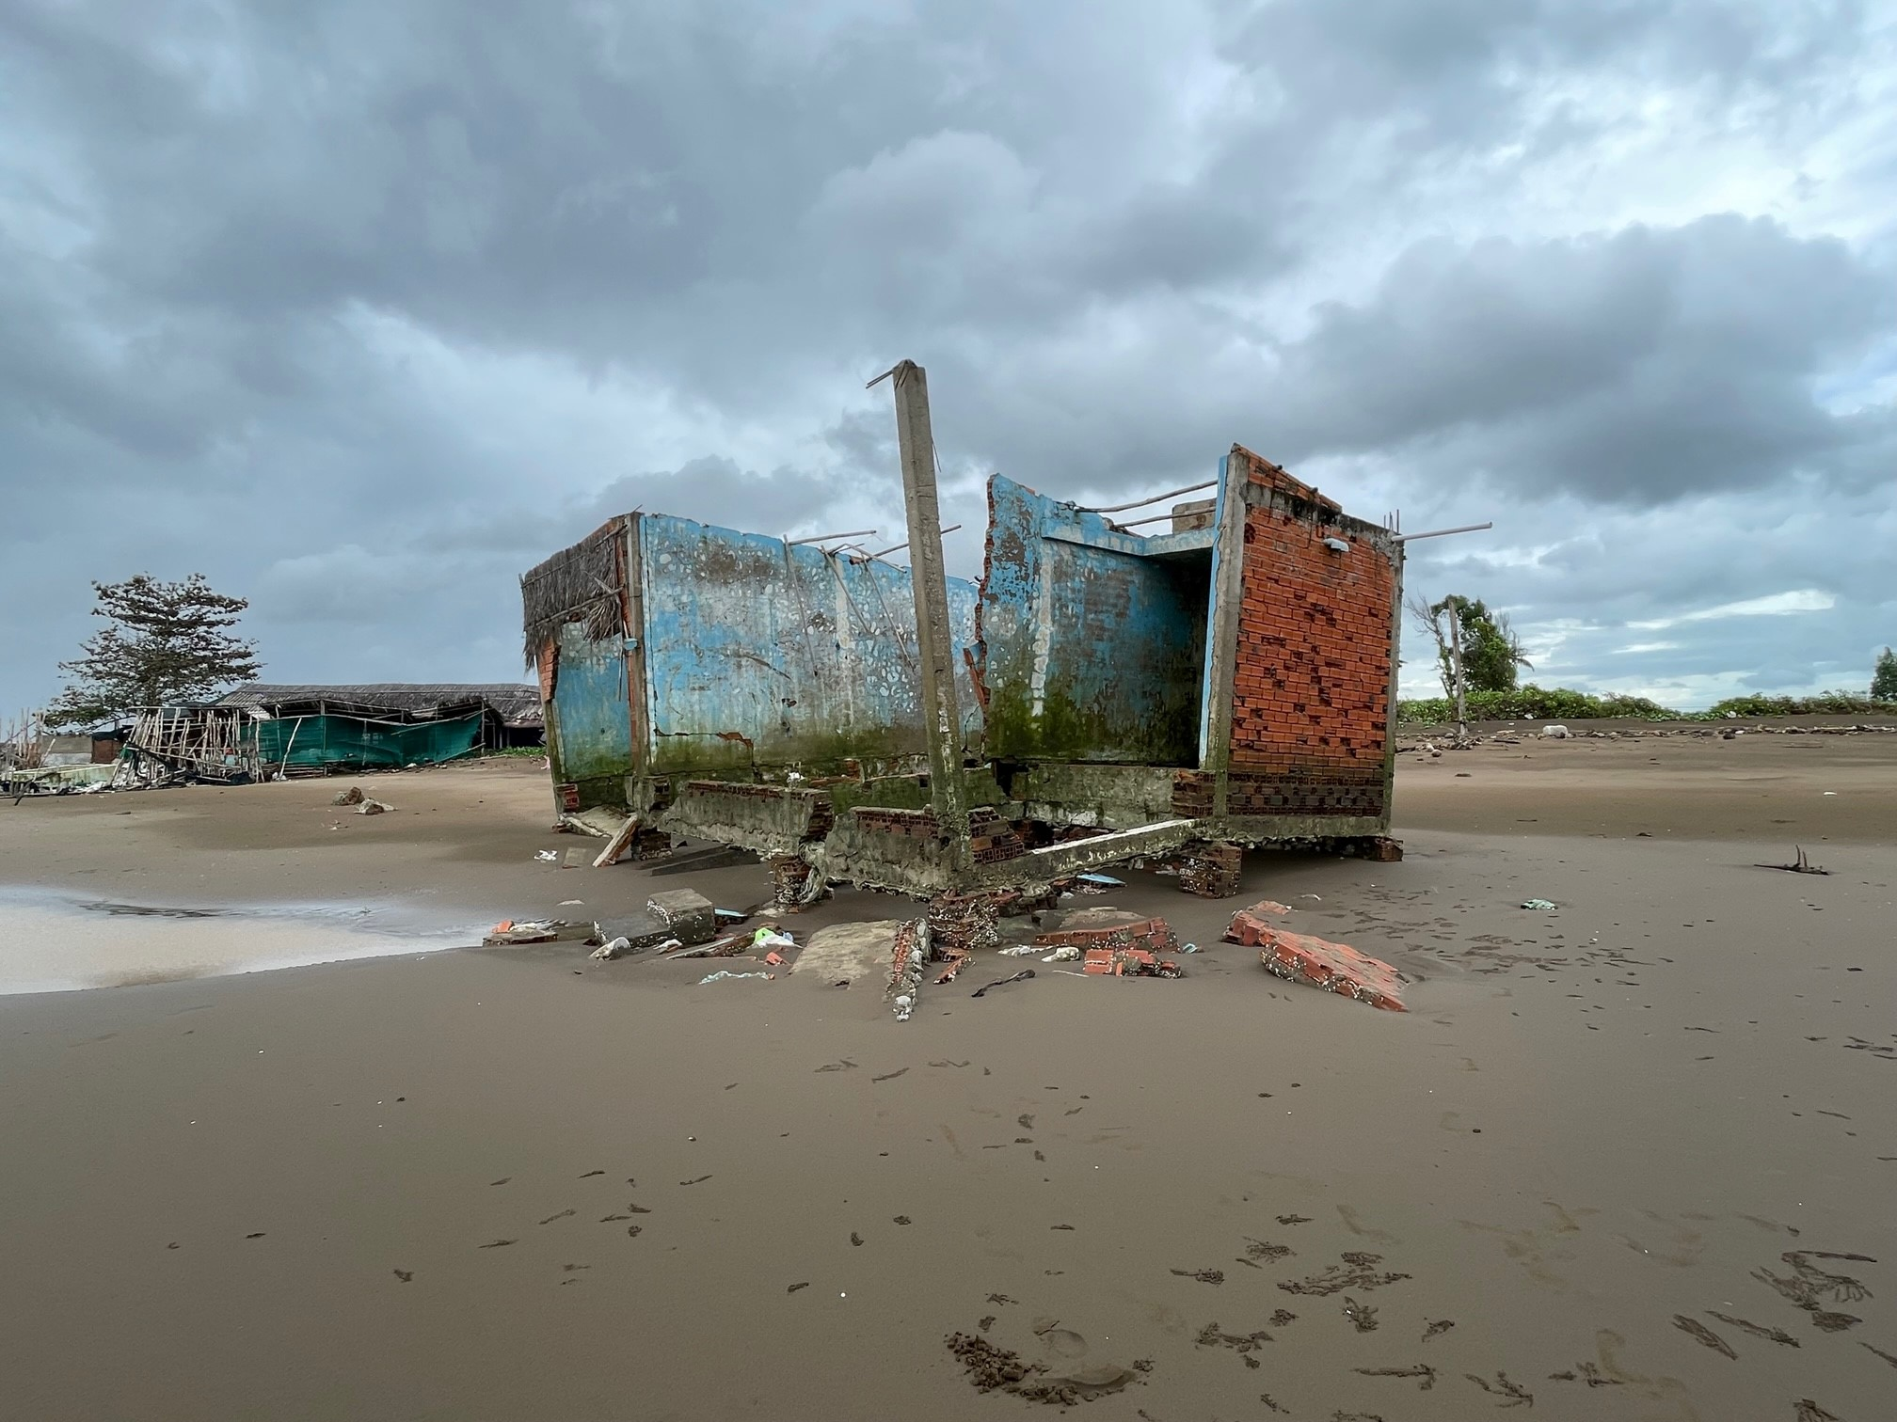
Story of Climate Impacts
“It becomes very difficult to live here, we plan to sell our land to pay the debts from our failed shrimp farming and find work elsewhere” Ms. Ly (Soc Tranc, Vietnam)

Slide 3
Climate Change Impacts
Asia and Pacific is the most vulnerable regions in the world: 5 of the top 15 countries worldwide most affected by extreme weather events
Projected temperature increase of 4 degrees will have dramatically negative impacts on agriculture production and is expected to increase rural poverty
~25% of global GHG emissions and increasing; but also transitioning
Estimated 3.3% reduction in GDP by 2050 due to climate change
03
Source: ADB 2017. “A Region at Risk: The Human Dimensions of Climate
Change in Asia and the Pacific”

Slide 4
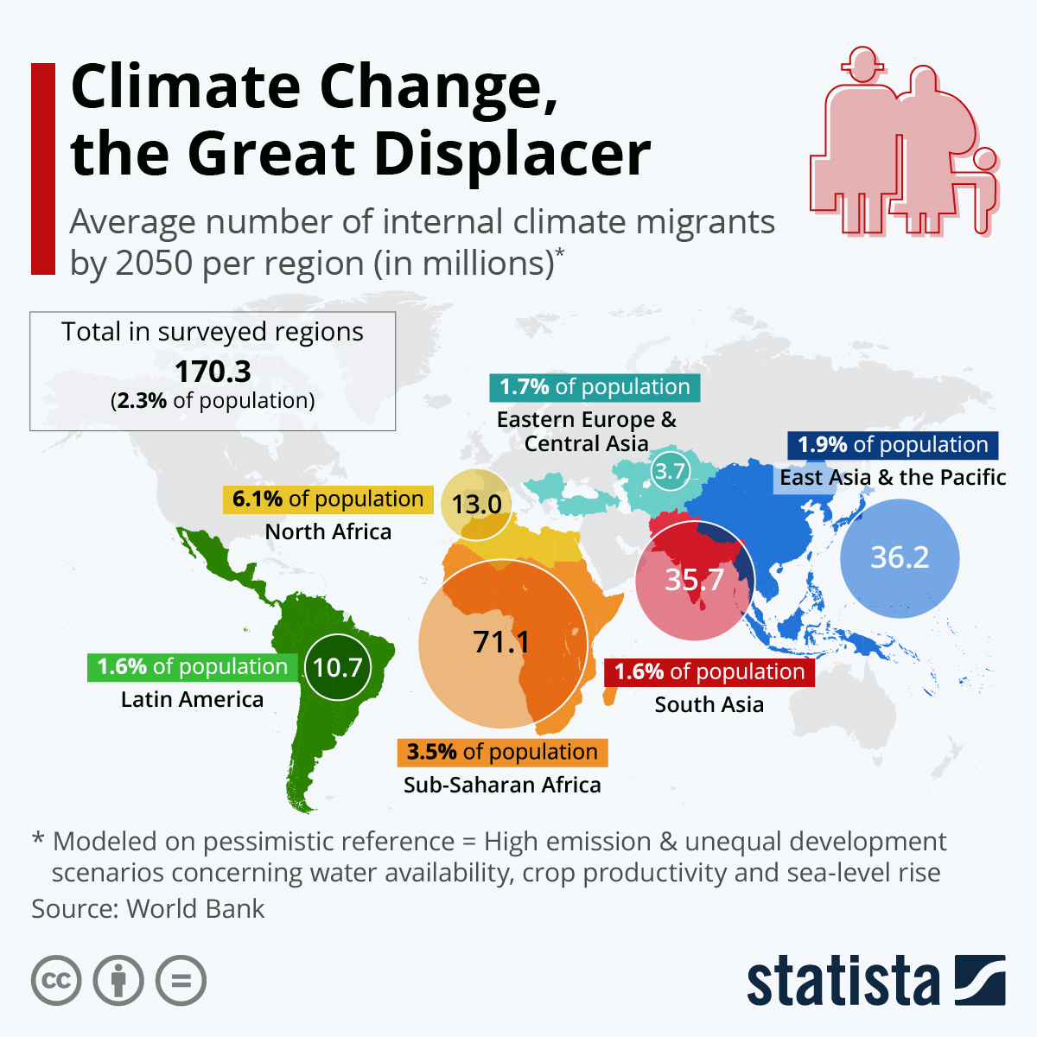
The Great Migration
Estimated 49 million people in Asia and Pacific could migrate from climate “hot-spots” by 2050, in absence of concrete climate and development action

Slide 5
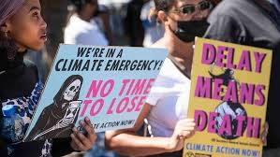
Global Climate Discussions
COP 27 highlight the needs to rapidly transition to low carbon development to avert climate crisis
Highlight the importance of mobilizing finance for climate mitigation and adaptation
Only less than 10 percent of climate finance flows to local level
Social dimensions are often sidelined in the conversation but it is changing
Ensuring that transition to decarbonization of energy system is ‘just’ (Just Transition)
Loss and damage fund

Slide 6
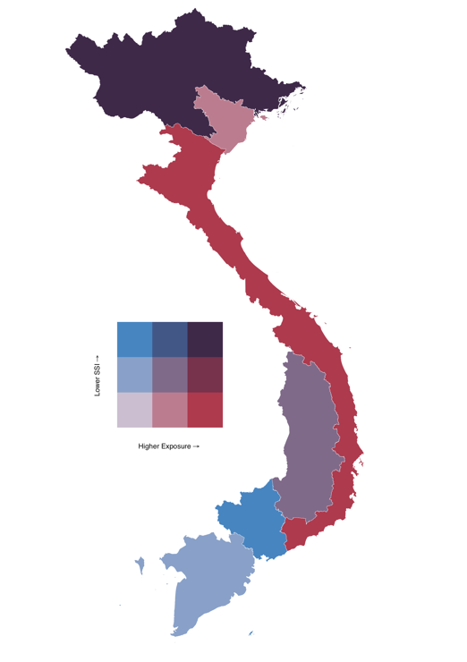
Disproportionate Impacts of CC
Communities’ climate vulnerabilities are influenced by multidimensional factors (e.g. poverty, access to resources, geography, gender, ethnic identities, among others)
Different social groups have different adaptive capacities to cope with climate change impacts
Vietnam: Climate Exposure & SSI Risk

Slide 7
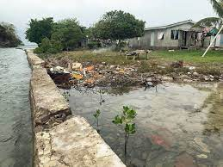
Potential Disproportionate Access to Benefits
Without social consideration, initiatives to mitigate and adapt to climate change might exacerbate existing inequalities and lead to maladaptation
Potential uneven access to benefits from climate change initiative (e.g. carbon payments, access to capacity building, information, etc.)
Maladaptation: adapting to sea level rise but neglect social context (example: seawall dams in Vanua Levu Island, Fiji)

Slide 8
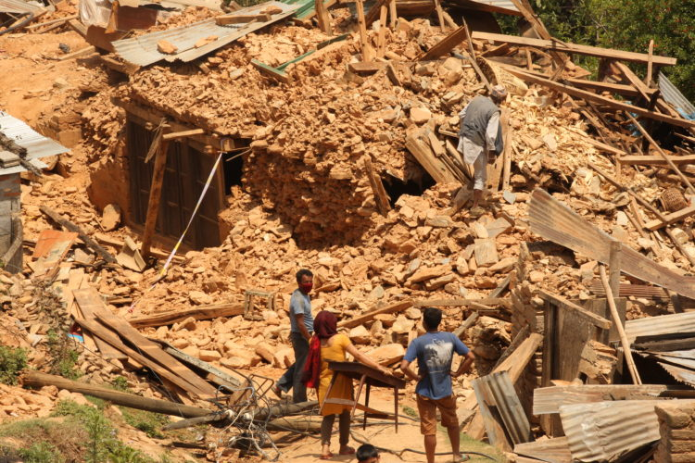
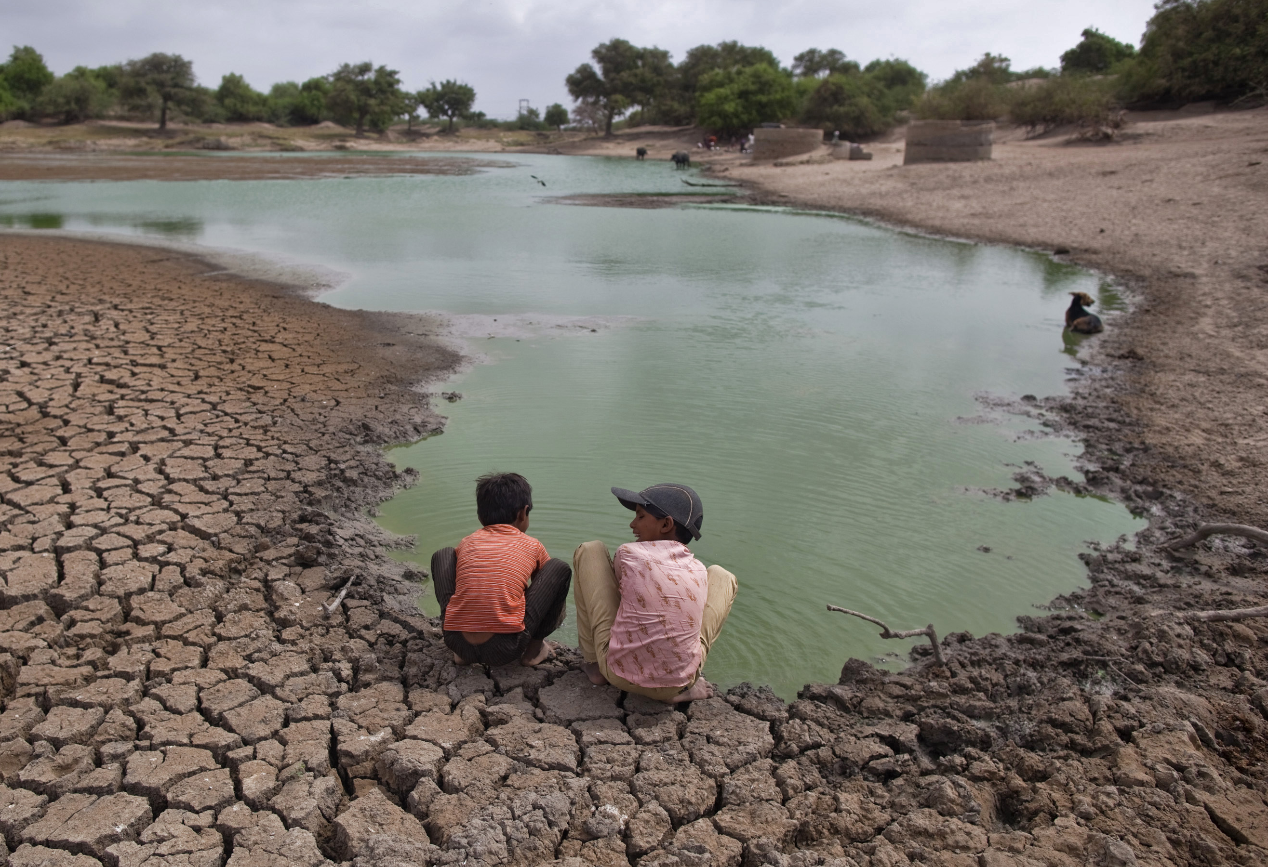
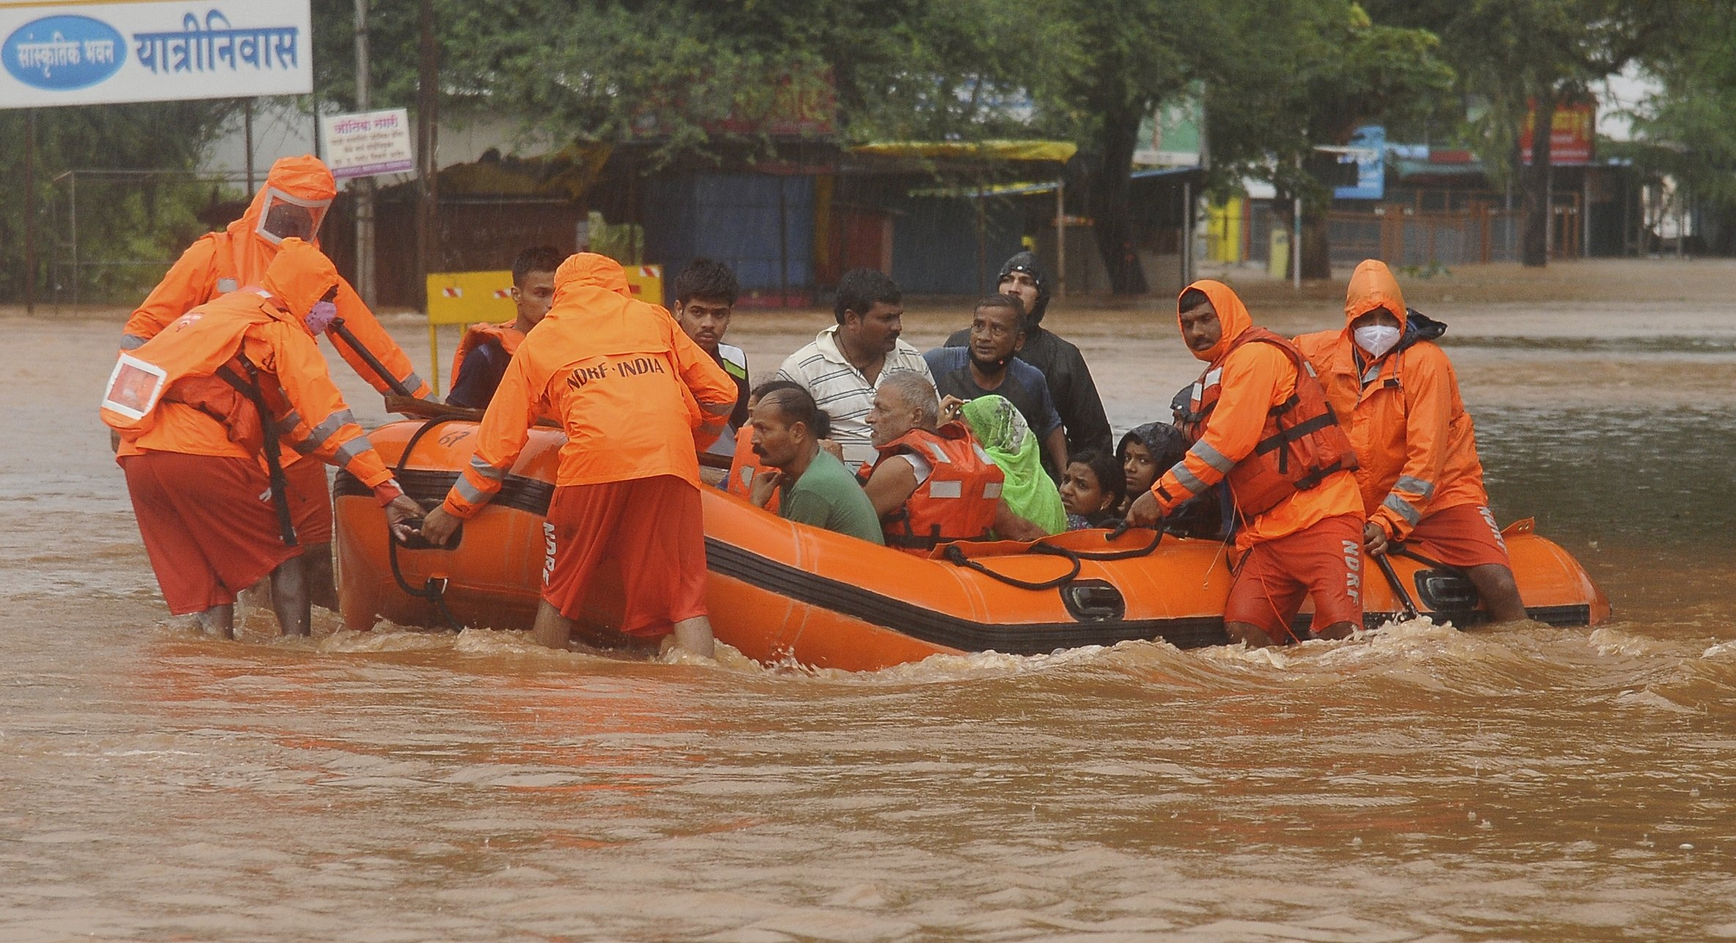
Why Local and Community Led Climate Action is Crucial?
Impacts of climate change are felt first by communities and most vulnerable groups
Responses to a changing climate start with communities through local action
Communities have the knowledge, roles and agencies to contribute to climate actions
8

Slide 9
Development
Strategies
Adaptation
strategies
Mitigation
strategies
Climate Resilient Development
Climate resilient development: combining climate adaptation and mitigation strategies to support sustainable development for everyone
Co-benefits: positive secondary effects generated from adaptation and mitigation initiatives (e.g. cleaner air, energy security, green livelihoods, biodiversity improvement, social inclusion/empowerment)
Climate Resilient
Develop.
Co-benefits
Mitigation-adaptation continuum*
* Adapted from Mitchell and Maxwell (2010)
Notes:
As seen here, especially in the community level, development, mitigation and adaptation strategies are closely overlap. Mitigation can reduce vulnerability by reducing the adverse climate change impacts, whereas adaptation may also reduce the such impacts but reduce the sensitivity to impacts.
When adaptation and mitigation done in synergy, it will lead to climate resilient development and generate co-benefits

Slide 10
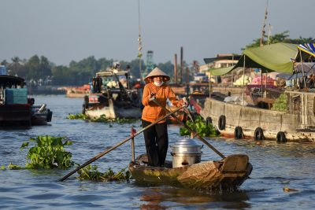
Building Community Climate Resilience
Community climate resilience:
Communities’ ability to anticipate, prepare for, and respond to hazardous events, trends, or disturbances related to climate impacts so that all members of society may develop or maintain the ability to thrive (‘no one left behind’)

Slide 11
How Can CDD Support Community Led Climate Actions?
CDD features lay a strong foundation for community climate resilience
Addressing poverty issues and broader inclusion issues, which are underlaying factors of climate vulnerabilities
Empowering vulnerable groups to ensure benefits are shared with poor & vulnerable groups
Bottom up approach to strengthen community resilience anchored in identifying localized impacts & responses informed by all com. group
Enhancing social learning and regulatory feedback for sound governance (e.g. participatory scenario planning and citizen engagement)

Slide 12
Entry Points for Community Led Climate Resilience
Entry Point 1:
Natural Resources Management
Entry Point 2:
Infrastructure
Entry Point 3:
Sustainable
Livelihoods
Strengthening communities’ capacity and institution needs to be embedded in all entry points

Slide 13
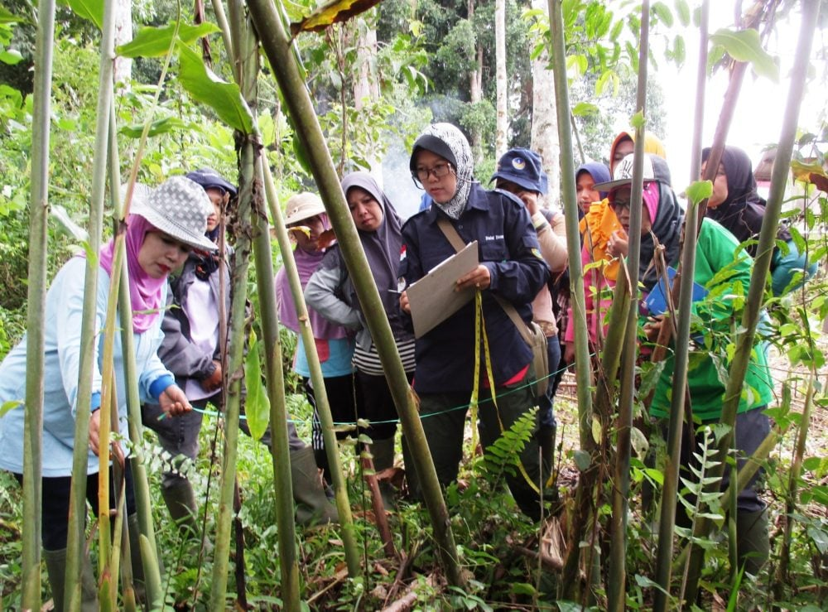
Natural Resources Management
Community Approach to Natural Resources Management
Community based forest management (example: social forestry in Indonesia; joint forest management in India)
Community based mangrove management (e.g. Philippines, Indonesia, and Myanmar)
Sustainable pastureland management (e.g. Mongolia)

Slide 14
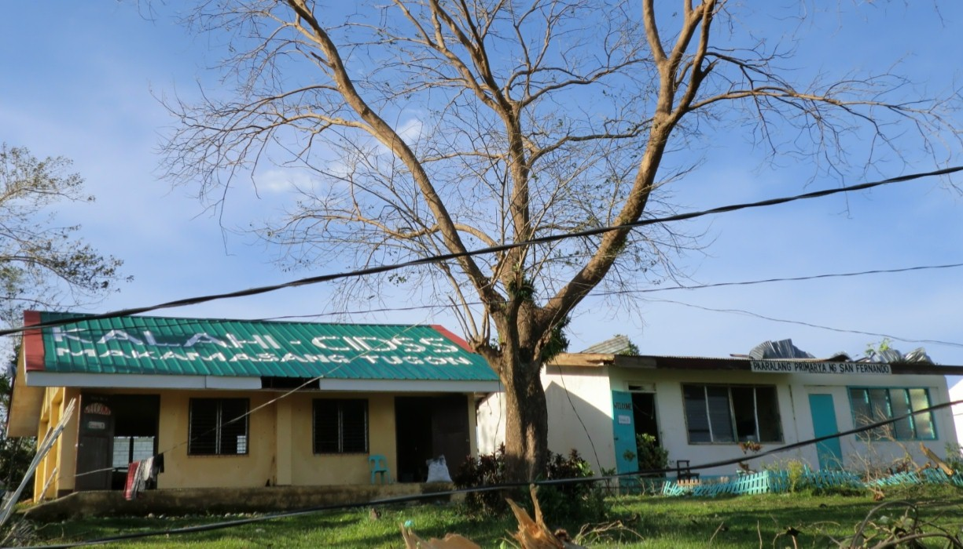
Infrastructure
Investments in community climate resilient infrastructure, such as:
Small scale infrastructures that utilize climate resilient materials and design
Water catchment/protection, irrigation to cope with climate impacts
Disaster response: (1) Disaster response structure, inputs and capacity (2) Rapid & responsive procedures post-disaster that account for needs of vulnerable groups & women
Energy: community renewable (biogas, solar, microhydro and wind) to increase communities’ energy access and energy security

Slide 15
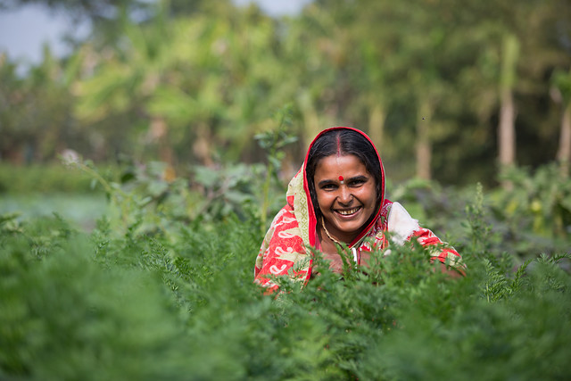
Sustainable Livelihoods
Climate smart livelhoods:
Natural resources-based livelihood support (example: Non-Timber Forest Products)
Agriculture based livelihood support: climate smart agriculture
Livelihood diversification:
Livelihood diversification to include options that are less climate sensitive and capacity-building support to saving/ loan groups helping communities better manage the risks during climate extreme events (e.g. pastoral communities in Kenya and Ethiopia)
Source: Cordaid

Slide 16
Facilitating Locally Led Climate Actions
Climate resilient planning
Informed planning combining scientific (climate risks and vulnerability assessment) and local knowledge
Participatory processes to analyze climate risks, identify appropriate responses and reinforce community resilience
Localized Climate and Development Responses
Implementing responses to address climate risks and vulnerabilities (e.g. infrastructure, NRM, livelihoods)
Building climate response capacity (institutions including social capital, community mobilization)
Safety net/cash transfer for DRR
Multilevel and Multisectoral Linkage
Creating linkages with multi-level governance and sectors for climate smart investments
Enable access to resources and finance for local climate action (e.g. incentive mechanisms)
Ensure broader environmental integrity to address climate risks (e.g. landscape approach, integrated spatial plan - to avoid leakage and maladaptation)

Slide 17
Questions?

Slide 18
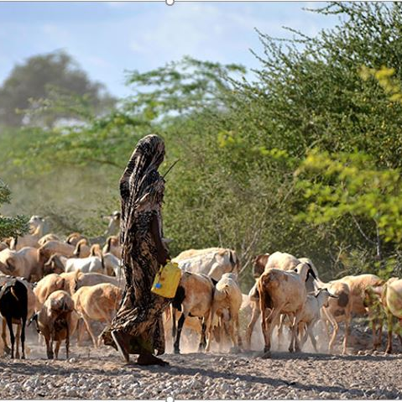
Example FLOCCA
Kenya’s Financing Locally-Led Climate Action delivers the first, national scale model of devolved climate finance:
National scale program that builds the vertical linkages between local govts and national entities for improved MRV on climate investment
Participatory Climate Risk Assessment assesses local priorities on risk and understands/strengthens local/traditional knowledge integrated with climate science
Focus on most vulnerable counties and the most vulnerable within those counties
Strengthens capacity of county and local govts to collaborate in joint decision making with their citizens

