Slide 1
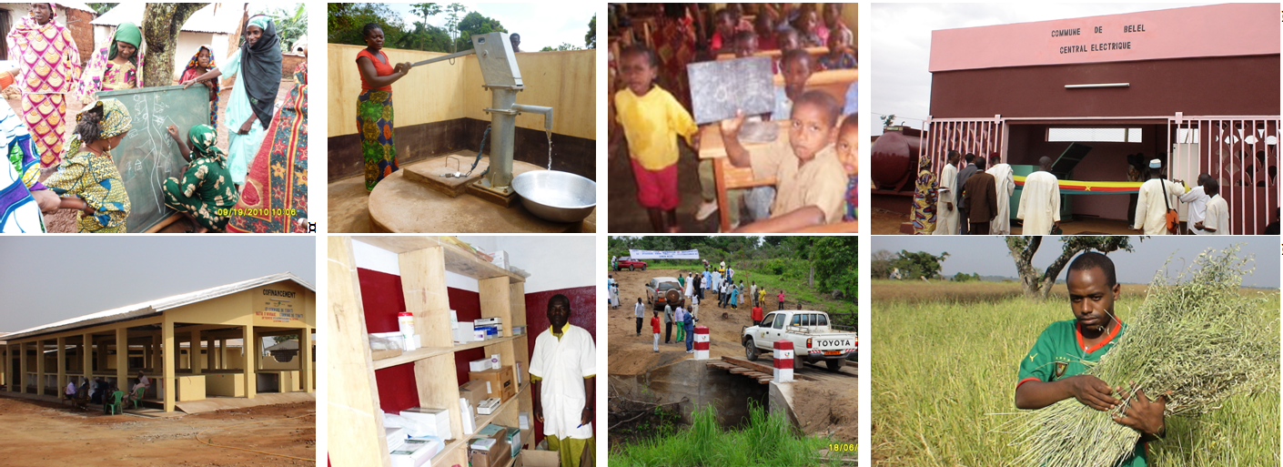
Community Development Program Support Project Programme National de Développement Participatif (PNDP)
Mainstreaming Citizen Engagement through Participatory Programs: The Case of Cameroon
Washington, November 30, 2017
Notes:
SVP revoir pour que toutes les slides ait le meme style et soiet coherentes (meme type de police, et meme “politique”, par exemple sur les bullet points)
SVP evitez trop de couleur differentes, des couleurs c est bien, trop de couleurs ca n’aide pas la lisibilite.

Slide 2
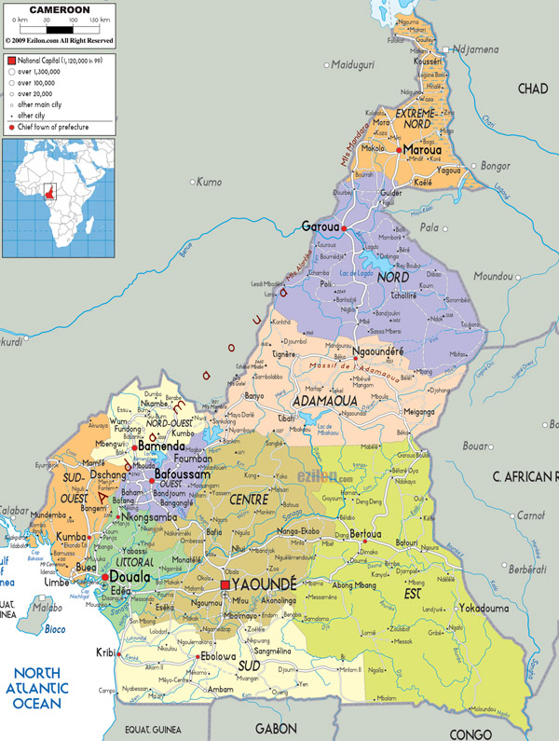
CAMEROON
Located in Central Africa
Border countries: the Central African Republic, Chad, Congo-Brazzaville, Equatorial Guinea, Gabon and Nigeria.
Surface area: 475,442 Square kilometers (km2).
Population: 23.4 million (UN estimates)
Administrative facts:
Number of regions: 10
Number of districts: 58
Number of communes: 360

Slide 3
PNDP: Background & Context
1994: Decentralization was incorporated in Cameroon’s revised Constitution
2004: World Bank initiated its support to the decentralization process through phases of community-driven development projects using a series of project (SoP) consisting of three four-year phases:
1st Phase (2004 – 2009) US$20 million : Initiation phase in 151 communes in 6 regions, with the objective to assist the government in setting up and implementing a decentralized financing mechanism to ensure participatory community development in rural areas.
2nd Phase (2010 - 2013) US$40 million: Extension phase to 329 communes in all 10 regions, with the objective to improve the delivery of specified basic social services (health, education, water and sanitation) in targeted communes and to extend the ongoing process in support of decentralization to new regions. This phase was also supported by the AfD (French Development Agency)
Notes:
Texte peut etre plus court et en plus gros, a l extreme on pourrait dire (i) Decentralisation (lois, decret, renforcement de capacities, etc) (ii) Approche participative (incl. Grants to local councils) (iii) Local PFM (software, capacity-building, transparency; etc)

Slide 4
PNDP: PHASE III 1/2
The third phase of the PNDP (2016 – 2019) $70 million is the consolidation phase with the objective to strengthen local public finance management and participatory development processes in communes for the delivery of quality and sustainable social and economic infrastructure.
100% coverage of all 360 communes in both urban and rural areas
Focus on the poorest and vulnerable population in Adamaoua, North, Far-North and Eastern regions (regions affected by the presence of refugees)
Support to the decentralization process with: (i) capacity building activities and (ii) local public financial management system
Continued partnership with the French Development Agency
Notes:
Texte peut etre plus court et en plus gros, a l extreme on pourrait dire (i) Decentralisation (lois, decret, renforcement de capacities, etc) (ii) Approche participative (incl. Grants to local councils) (iii) Local PFM (software, capacity-building, transparency; etc)

Slide 5
PNDP: PHASE III 2/2
Component A
LOCAL DEVELOPMENT SUPPORT
Component B
LOCAL DEVELOPMENT SUPPORT
Component C
COORDINATION, MANAGEMENT, M&E COMMUNICATION
A.1: Local Development Investments for Communes
B.1: Institutional support to the decentralization process
A.2: Targeted Investments for the Poorest and Vulnerable Populations
in the Adamaoua, North, Far North and Eastern regions
B.2: Capacity Building
B.3: Local Public Financial Management System
Notes:
Texte peut etre plus court et en plus gros, a l extreme on pourrait dire (i) Decentralisation (lois, decret, renforcement de capacities, etc) (ii) Approche participative (incl. Grants to local councils) (iii) Local PFM (software, capacity-building, transparency; etc)

Slide 6
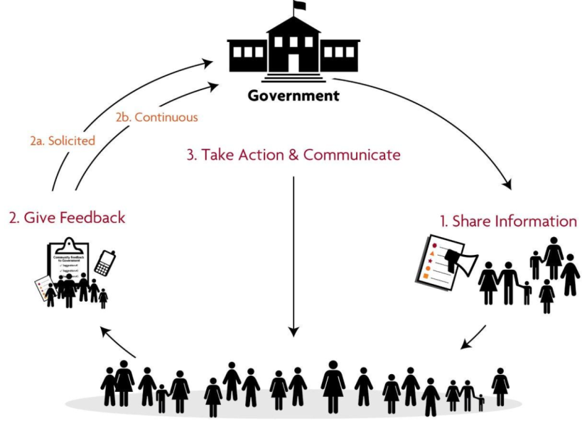
PNDP Citizen Engagement: overview 1/2
Citizen Engagement = Two-way interaction between citizens and governments or the private sector, which give citizens a stake in decision-making with the objective to improve intermediate and final development outcomes
CE is about creating feedback loops between citizens and governments, to determine if citizen voices have been taken into account

Slide 7
PNDP Citizen Engagement: overview 2/2
PLANNING
IMPLEMENTATION
EVALUATION
CONSULTATION
Signature of a convention with Communes
Villages assemblies to prepare the Communal Development Plan (CDP) and commune’s budgets.
PARTICIPATORY MONITORING
Supervision committees
Monitoring of CDP by COGES (implementation committees)
Quarterly Feedback of the CDP’s monitoring committees during village assemblies.
Communication on the budget execution of communes through quartely commune reports, coordination committees, local councils
-social audit done jointly with communes for the performance grant.
GRIEVANCE REDRESS MECHANISM (GRM)
GRM established as part of the M&E through a Call center, E-mails, walk-in, etc…
BENEFICIARIES’ SATISFACTION
Surveys on citizen satisfaction on service quality every two years at the commune level.
Results disseminated
Citizen feedback on project implementation through the local committees (COGES & CC)
COMMUNICATION
(Commune websites, commune quarterly reports, Community radios and regional TVs)
Mainstreaming Citizen Engagement through Participatory Programs: The Case of Cameroon

Slide 8
PNDP Citizen Engagement: Performance-based Grants 1/2
Piloting of a performance-based grants in addition to the grants based on objective criteria (km2, pop.). => to incentivize local governments
Sets of indicators related to:
good governance (e.g. effective functioning of the local councils, traceability and control of finances)
participatory approaches and transparency,
pro-activeness (e.g. improvement in local tax collection).
Every year, 3 local governments are selected per region, out of which 2 represent the best performing in their category (in terms of budget turnover) and 1 displays the most progress compared to the previous year.
The evaluation is also a learning exercise for all through a social audit based on a participatory process involving the communes and local stakeholders (line agencies, civil society organizations, etc.).
Results are published both through the project website and the governor’s office.

Slide 9
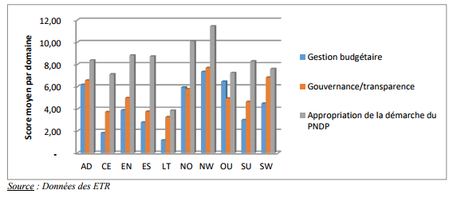
Performance evaluation for 2017: a wakening calls for mayors
PNDP Citizen Engagement: Performance-based Grants 2/2

Slide 10
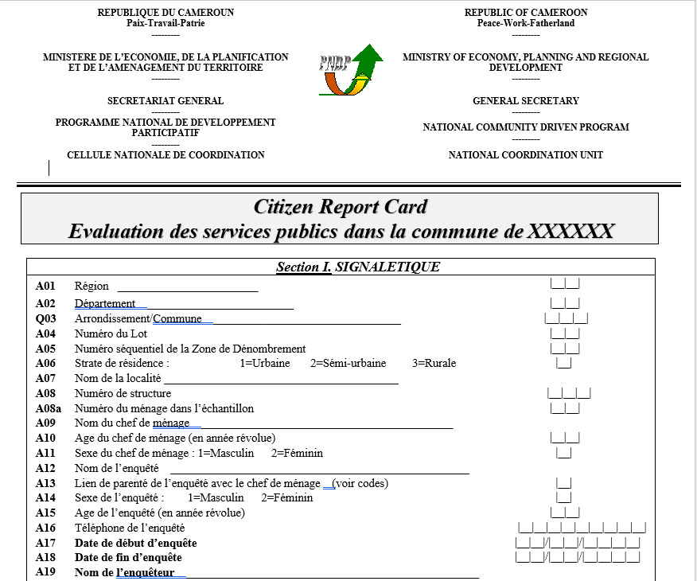
CDPSP Citizen Engagement: Scorecard
Community Scorecards assess the satisfaction of a relevant sample of users and citizens with regards to service delivery for which the local governments has a role, ranging
from basic social services (education, health, and water),
to local government’s services like (civil registry, tax administration, etc.).
Results will be discussed with the local committees, local councilors and deconcentrated service providers to identify solutions over a given period.
Over 50,000 households completed the scorecard in 160 communes in the 10 regions

Slide 11
CDPSP Citizen Engagement: Grievance Redress Mechanism
To receive “real-time” feedback from its beneficiaries, the CDPSP established a strong GRM. The grievances can be sent to the CDPSP through a variety of different channels:
Directly at a regional office
free hotline number
PNDP website
Letters
Locally through the committees and focal points.
Registration:
Walk-in, M&E Specialist, Call Center
Immediate treatment of simple grievances
Transmission of grievances to the dedicated service

Slide 12
PNDP Citizen Engagement: Overall Objective
Improvement of citizen satisfaction as a result of their involvement in the choice of project
Adequacy between investments and citizen formulated needs
Better coordination of public interventions at the grass-roots level
Enhancement of the commune funds (local tax mobilization)
Greater transparency in the local public finance management
Strengthening the interaction between citizen-local authority
Building trust between citizens and the State

Slide 13
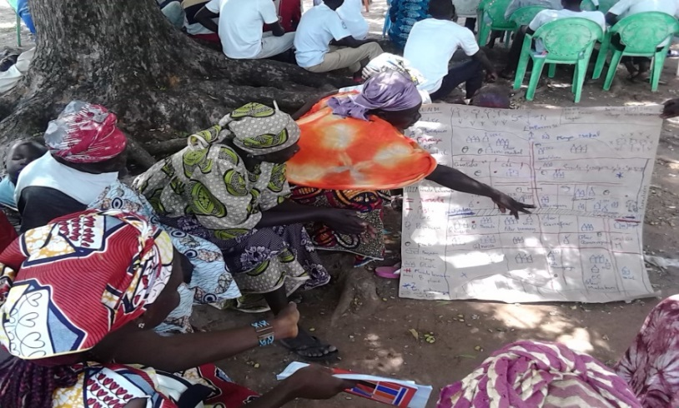
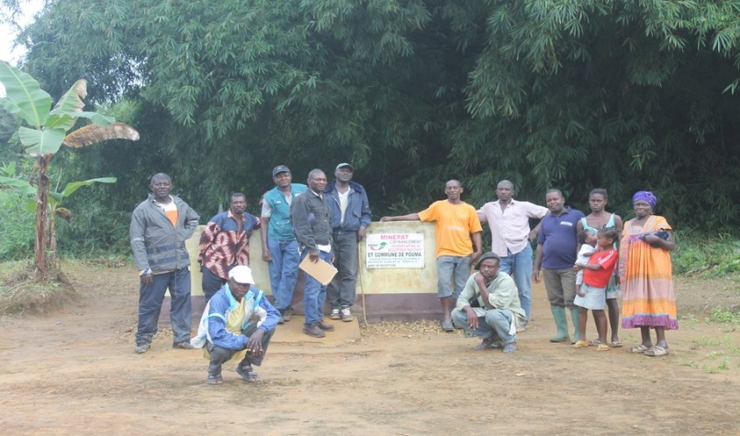
PNDP: Planning activities 1/2
Support:
Technical Assistance for participatory planning
Financing micro-projects
Results:
328 councils out of the 360 councils have Commune Development Plans (CDP) elaborated through a participatory approach;
Nearly 4,000 microprojects in sectors such as education, hydraulic, electrification, health, etc. have been co-financed by the Program and Communes, contributing to improve the living conditions of over 3 million people;
A group of women during a planning exercise, and just beside, a group of men and youths.

Slide 14
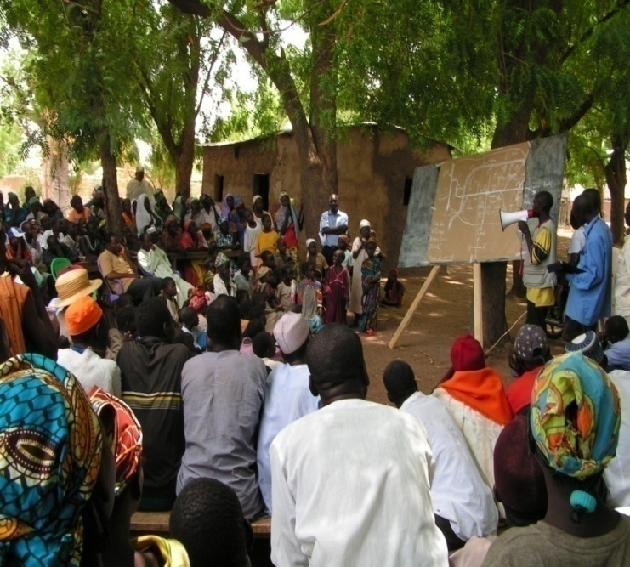
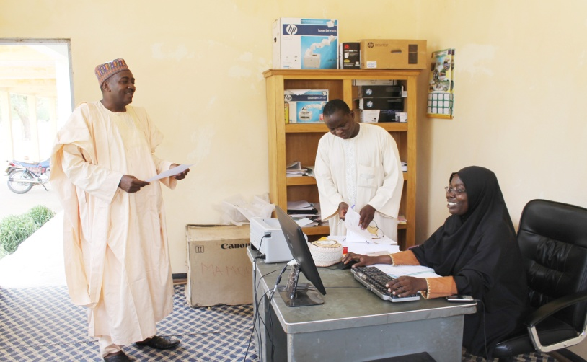
PNDP: Planning activities 2/2
Fostering social dialogue between the populations and the development’s actors (diagnostic and planning purposes)
Setting up a knowledge bank reflecting the overall preferences during the project’s design stage, with a view to arriving at a reasoned and responsible decision-making ;
Assisting projects’ identification and planning ;
Supporting the readiness process of council projects: feasability studies, etc;
Strengthening the regular feedback loop and interaction mechanisms between elected representative at the commune level and citizens at village level.

Slide 15
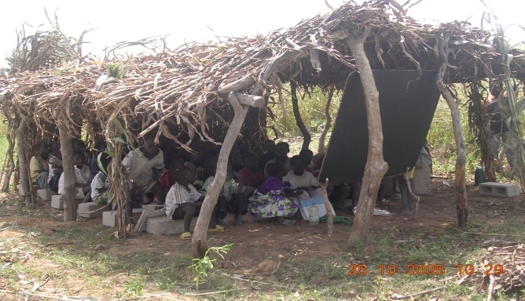
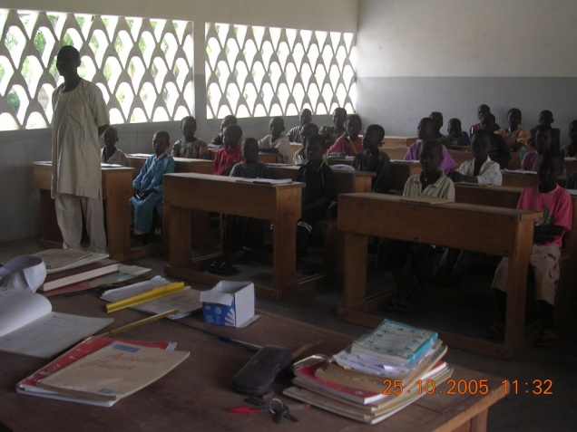
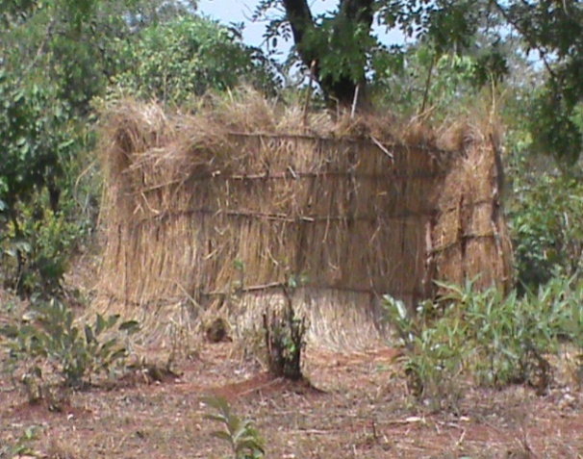
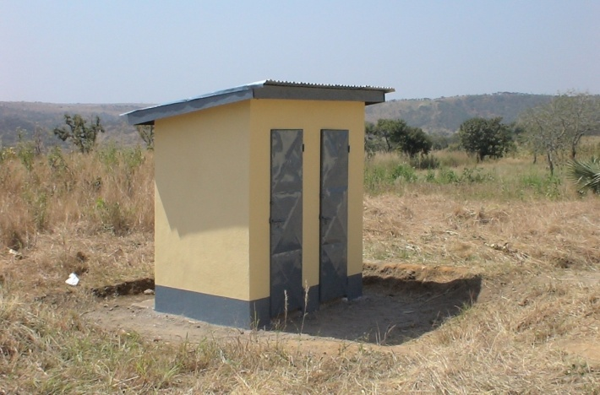
PNDP: Some Results 1/2
BEFORE AFTER

Slide 16
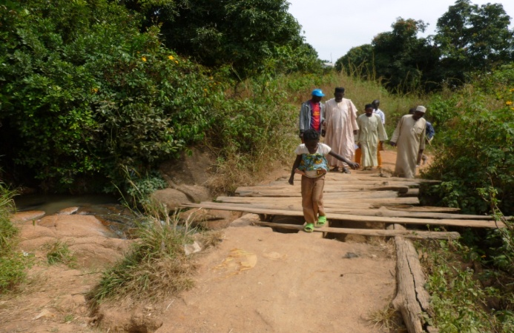
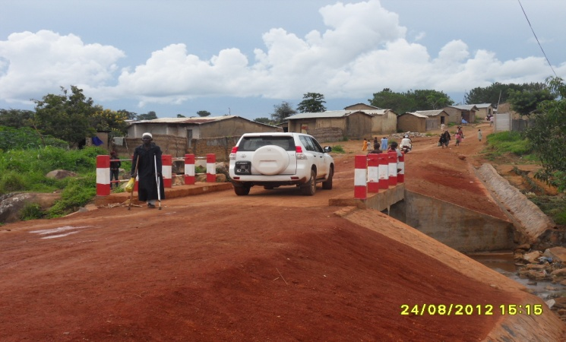
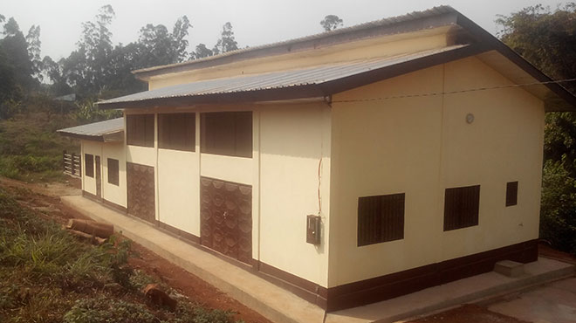
PNDP: Some Results 2/2
BEFORE AFTER
A modern slaughterhouse in Bangou

Slide 17
THANK YOU

