Slide 1
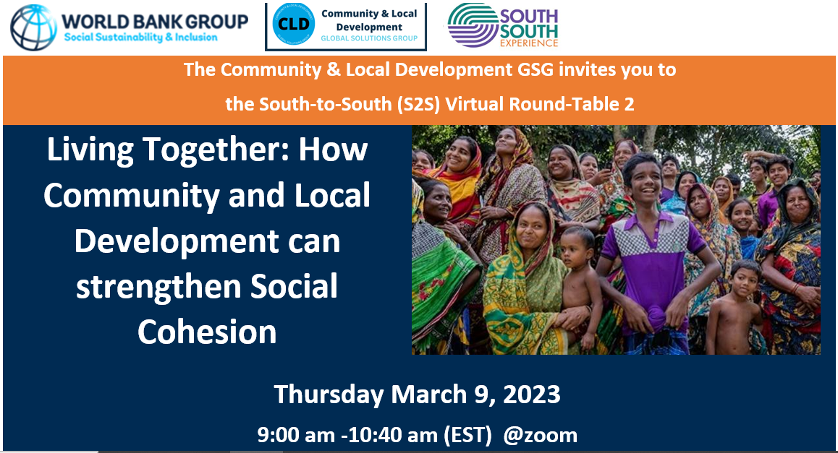

Slide 2
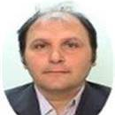

Moderators
Nicolas Perrin is Lead Social Development Specialist, Social Sustainability and Inclusion for West Africa, where he leads the Social Sustainability and Inclusion regional Community and Local Development operational program to support the stabilization of major Fragility, Conflict and Violence affected hotspots in Lake Chad, Sahel and the Gulf of Guinea. Nicolas has joined the Bank in 2003 and has worked across the globe on a large number of operations and analytical work on regional integration, community and local governance, cultural heritage and climate resilience.
Patrick Barron is the World Bank’s Global Lead for Social Cohesion and Resilience within the Social Sustainability and Inclusion global practice. He was previously lead regional advisor on fragility, conflict, and violence for Asia. After working for local NGOs in Cambodia and China, he joined the World Bank where he ran the Bank’s conflict and peacebuilding programs in Indonesia and worked across the region with a particular focus on Southern Thailand, Myanmar, the Philippines, and Afghanistan. He is also the author of two books including Contested Development (Yale University Press), (awarded International Development Book of the Year), and, most recently, When Violence Works: Postconflict Violence and Peace in Indonesia (Cornell University Press).

Slide 3
Why care about fragility, conflict, and violence?
Sources: World Bank. “Pathways for Peace: Inclusive Approaches to Preventing Violent Conflict”;
GSDRC. 2015. “Exclusion as a cause and consequence of violent conflict”.
3

Slide 4



Social cohesion is key to ending and preventing FCV
Social cohesion can contribute to conflict resilience
Conflict escalation is substantially more likely where there are deep-set, frequent, unsolved disputes within and between local communities, particularly if few institutions exist (formal or informal) that can facilitate non-violent resolution.
Strengthening social cohesion to promote stability means addressing local disputes, and/or supporting non-violent conflict-resolution mechanisms that are perceived as fair/legitimate.
Responding to fraying social cohesion is important to prevention
Exclusionary identities and broadening social cleavages can benefit violent actors and become levers of mobilization.
A key priority is to ensure that interventions do not reinforce exclusionary practices, fuel new grievances, and thereby exacerbate fragility.
Social cohesion can help communities achieve broader development outcomes
Communities’ capacity for collective action is an important determinant of how they manage shared resources, adapt to new challenges, and cope with shocks, including those related to climate change and migration.
Improving service delivery has proven easier in contexts characterized by higher levels of trust and civil engagement.
Social cohesion also contributes to economic developments by facilitating investments within and between communities (which require trust).

Slide 5

Defining social cohesion
“Social cohesion is a sense of shared purpose, trust and willingness to cooperate among members of a given group, between members of different groups, and between people and the state.”
Horizontal social cohesion
Bonding among individuals within a given community
Bridging between individuals across distinct communities
Vertical social cohesion
Linking between citizens and people/structures in a position of power (formal or not, government or not)
But social cohesion is not an unambiguous public “good” – communities can be cohesive but inequitable.

Slide 6
Cohesion as a source of resilience for FCV programming
Practices of mutual help, solidarity and collective action at community level are an often unrecognized source of strength in FCV contexts
CLD programs can leverage this to deliver in difficult environments
Mindanao
Ukraine
Yemen
Madagascar
Brazil
Three projects have aimed to increase trust and cohesion amongst Muslims, Christians and IPs through consensus building and collaborative contact
Plus focus on vertical cohesion between remote, conflict-affected communities and government.
Participatory approaches ensure conflict-affected and vulnerable populations are able to participate in decision-making and monitoring.
Income generating opportunities are expected to improve social cohesion and integration.
ASA looked at community structures, including informal sources of governance, as sources of resilience and potential entry points for CDD project
Primary data collection along with review of secondary data
New lending operation, drawing on strong community practices of mutual help
Supports enhanced partnerships between communities, local elected leaders, and regional government
Youth engagement through music and art promotes social cohesion by countering the influence of violent organizations, facilitating “collaborative contact”, and enabling productive interactions between municipal government and vulnerable communities.

Slide 7
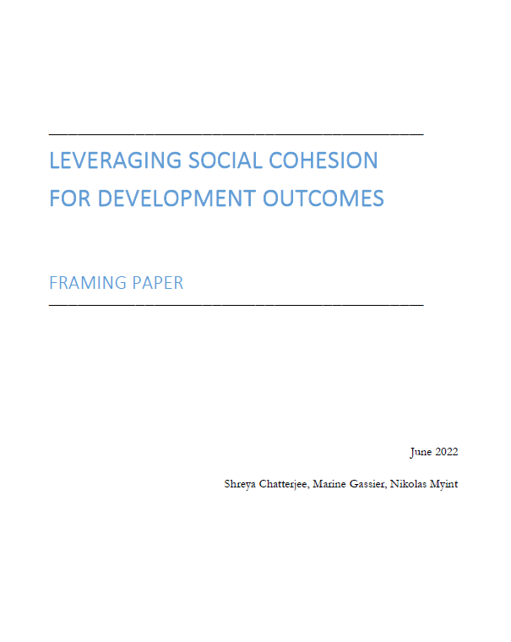
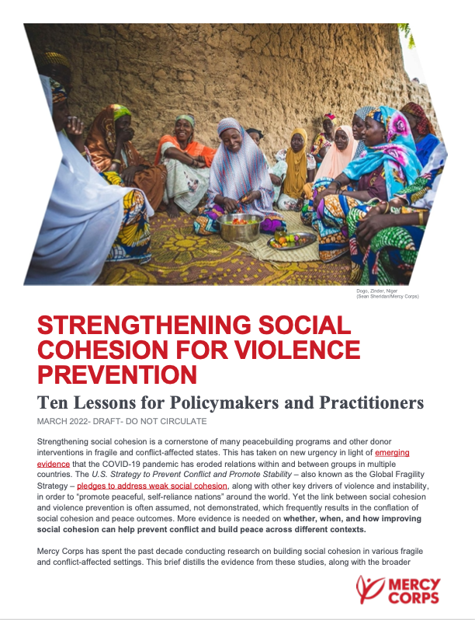
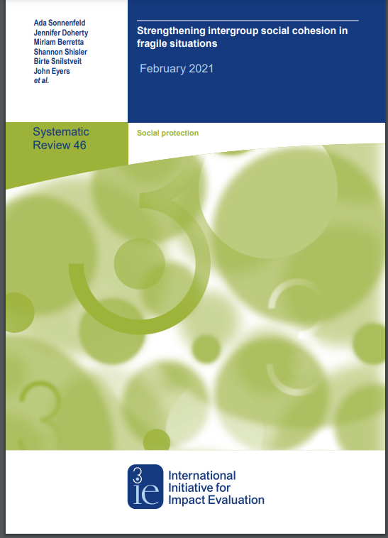
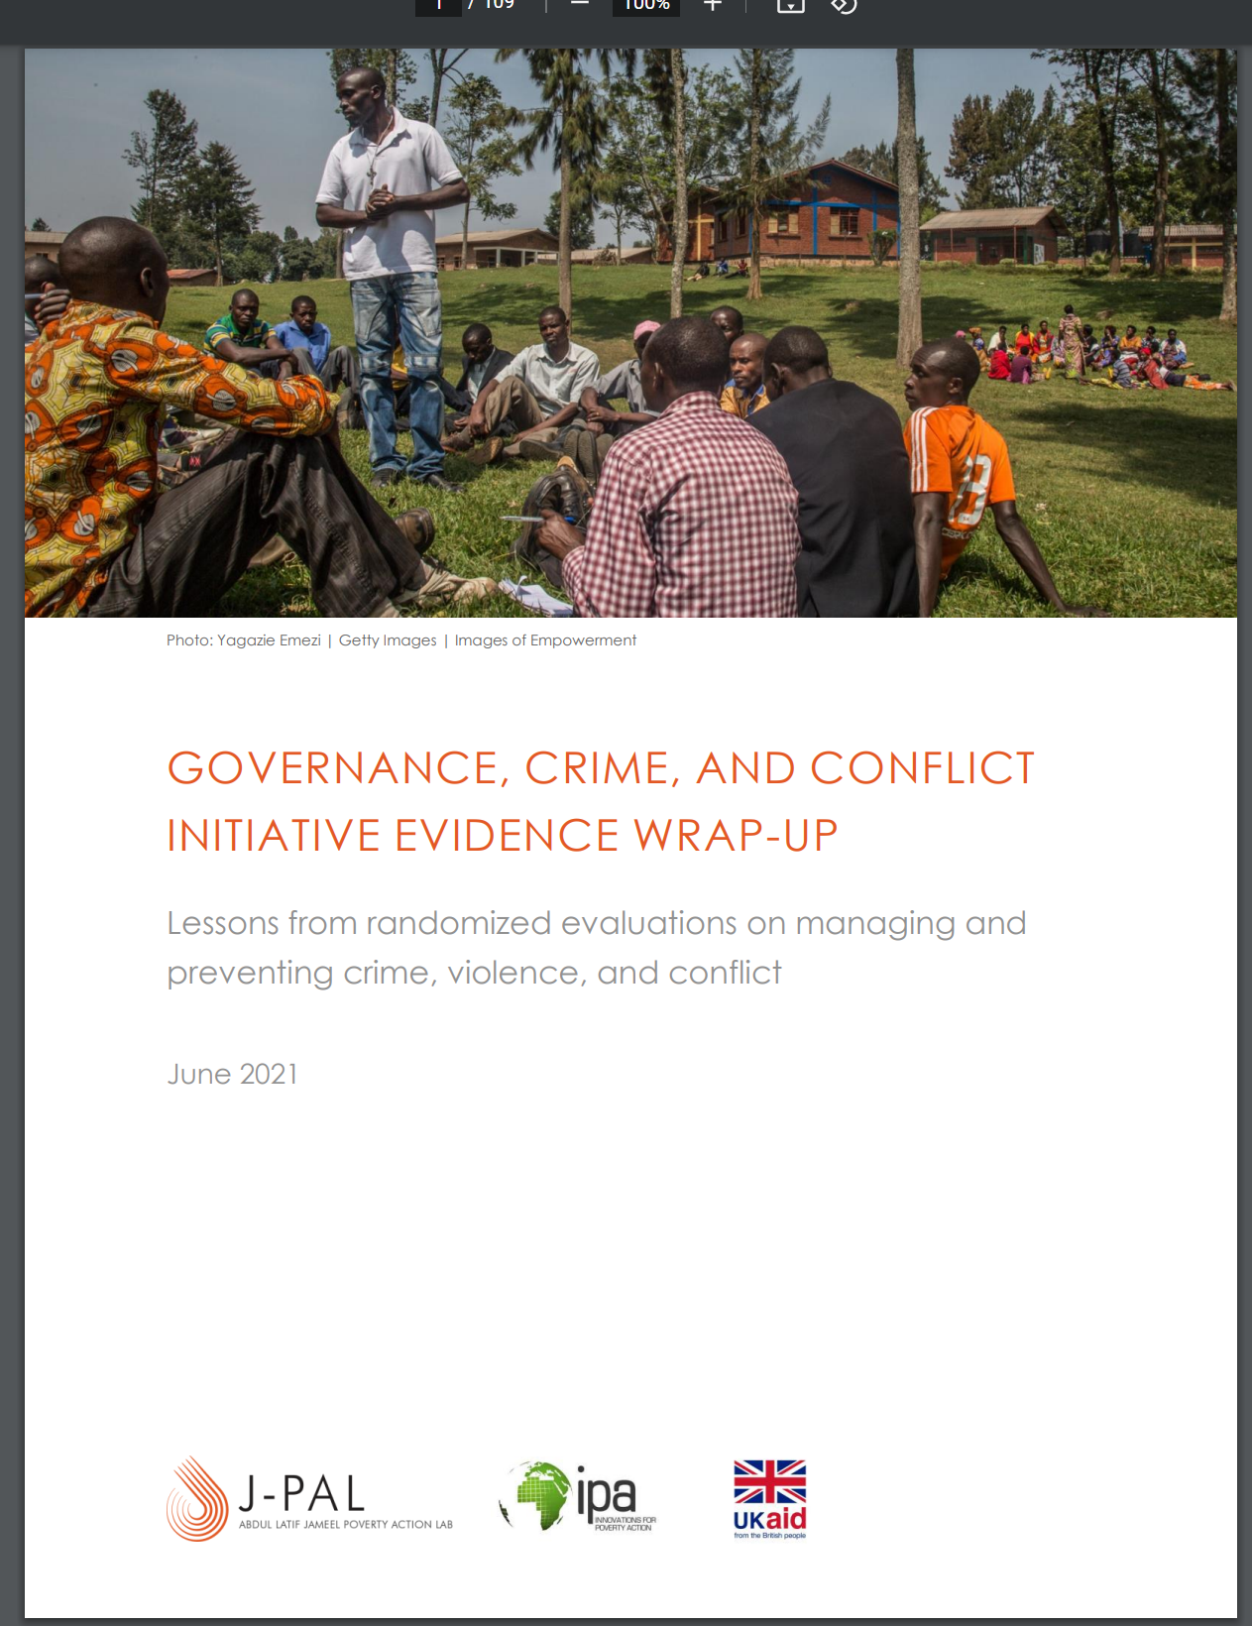
Growing evidence base on what works (and does not work) to repair or promote social cohesion
Participatory approaches & CDD
Mediation &
dispute resolution skills
World Bank – Leveraging Social Cohesion for Development Outcomes
Mercy Corps – Strengthening Social Cohesion for Violence Prevention
Intergroup collaboration & dialogue
Pedagogical/
perspective taking
3ie – Strengthening Intergroup Social Cohesion in Fragile Situations
IPA and J-PAL GCCI Evidence Wrap Up and numerous papers on social cohesion

Slide 8
Agenda
9.15 – 9.30 Expert presentation: social cohesion as a model
9.30 – 10.15 Panel discussion
Vertical social cohesion (Guinea)
Inter-community social cohesion (Benin)
Intra-community social cohesion (Senegal)
10.15 – 10.35 Q&A
10.35 – 10.40 Closing

Slide 9

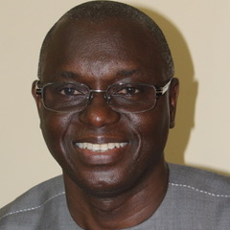
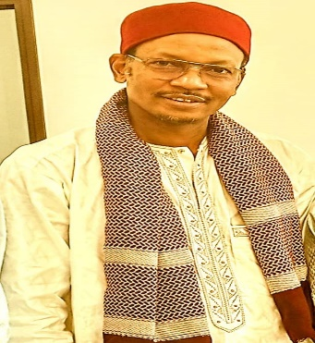
Panélistes
Ryan Sheely is Director of Research in Conflict and Governance at Mercy Corps, based in Washington, DC. His research is focused on using mixed methods to design and evaluate programs focused on strengthening civic engagement and social cohesion, preventing violent extremism, and building effective, accountable states. He has worked in and written about programs and projects in a wide variety of contexts, including Kenya, Sierra Leone, Nigeria, Myanmar, Niger, Mali, Jordan, Syria, Afghanistan, Colombia, and Liberia.
Sékou Mawa Touré is a Finance Specialist. Mr. Touré has more than 24 years of experience in the management of development projects and programs in Guinea. Mr. Touré has managed the finances for numerous World Bank and AFD projects through Public Private Partnership. He is currently the Managing Director of ANAFIC and the General Director of the ANAFIC (Agence Nationale de Financement des Collectivites Locales)
Adamou Mama Sambo is a Veterinarian and has more than 20 years of experience in the world of development and cooperation. Mr. Sambo is currently the High Commissioner for the settlement of pastoralists for the Republic of Benin and is social cohesion focal point for the Regional Social Cohesion Project for the Northern Régions of the Gulf of Guinea (COSO)
Youssouph Badji is an Agronomist, specialized in rural economy. Mr. Badji has more than 25 years of experience in the management of agricultural development projects for the State of Senegal. Youssouph Badji is currently the Coordinator of the "Casamance Development Pole Project" co-financed by IDA and the Government of Senegal

Slide 10
Social Cohesion at Mercy Corps
Overview and Examples from Niger
Ryan Sheely
Director of Research- Conflict and Governance
Notes:
I’m going to spend our time together speaking a bit about Mercy Corps’ conceptual model for measuring and strengthening social cohesion. I’ll then share a concrete application of our approach in action in the context of a program that we implemented in Niger from 2019-2021.

Slide 11
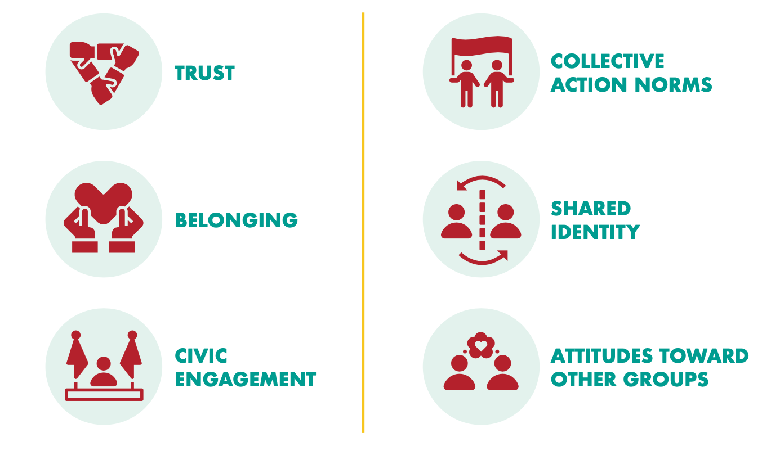
Social Cohesion at Mercy Corps
Social Cohesion: A sense of trust, shared purpose and willingness to engage and cooperate among different individuals, groups, and institutions in an area.
We measure and strengthen six dimensions of social cohesion:
Each dimension can be measured…
Within groups (Bonding)
Between groups (Bridging)
Between citizens & leaders (Linking)
Trust
Collective Action Norms
Shared Identity
Belonging
Civic Engagement
Attitudes Toward Other Groups
Notes:
We build our approach to measuring social cohesion on the understanding that the concept captures the ability of communities to collaborate with one another and with decision-makers for the common good. We operationalize this by focusing on six measurable dimensions: trust, belonging, shared identity, attitudes towards other groups, collective action norms, and civic engagement. Each of these dimensions can be measured horizontally- both within and between groups, and vertically- between citizens and the state.

Slide 12
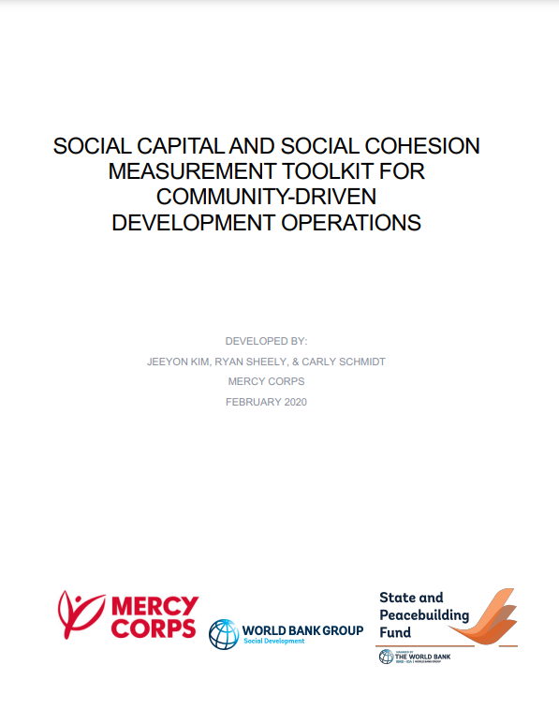
Measuring Social Cohesion
Toolkit published in 2020 provides a conceptual framework for social cohesion, a set of prioritized survey questions for measuring each dimension, and a qualitative guide
Emerging lessons:
Limits to Consolidation
Using Disaggregated Measures
Notes:
This list of dimensions comes from a social cohesion measurement toolkit for CDD operations that Mercy Corps developed with the World Bank in 2020. In developing that toolkit, we conducted a structured review of over 70 pieces of empirical research on social cohesion and classified and grouped the existing approaches, going from a set of 23 dimensions and over 2600 survey questions into this set of six dimensions and 18 questions that we recommend using to measure social cohesion.
In our recent programming and research, we’ve been learning two major things about using this type of disaggregated, multi-dimensional approach to measuring social cohesion:
One is that even though there have been advances in creating shared definitions and indicators, approaches to measuring social cohesion remain fragmented, and some of that is going to be unavoidable.
As an example from Mercy Corps… even with the measurement toolkit out in the world for three years, we’re still wrapping up the endlines for a number of program evaluations that started before we worked on the toolkit, meaning that the exact dimensions and measures in those studies are a bit misaligned with our newer thinking. This range is even greater in the broader field, with many implementers and evaluators using their own definitions and instruments…
How we recommend navigating this going forward is striving for consistency in the underlying concepts, but allowing the specific questions to evolve in response to a given program and context. This will mean using standardized questions like the one in the CDD measurement toolkit as the starting point for evaluat ions, but adding to and subtracting from that list in a transparent and intentional way, when adapting to the local context, programmatic theory of change, and logistical constraints in a given intervention or evaluation.
A second thing we’re learning about measurement is that the relative strength or weakness of these different dimensions can vary substantially within and across communities and societies, and that this variation militates against moving towards a single index that compresses all of these dimensions into a single measure.
This and similar findings from other studies has led us to be really wary of relying on aggregate indices of social cohesion and to focus instead on disaggregation at the level of these underlying dimensions for the purposes of diagnosis, program design, and evaluation.

Slide 13
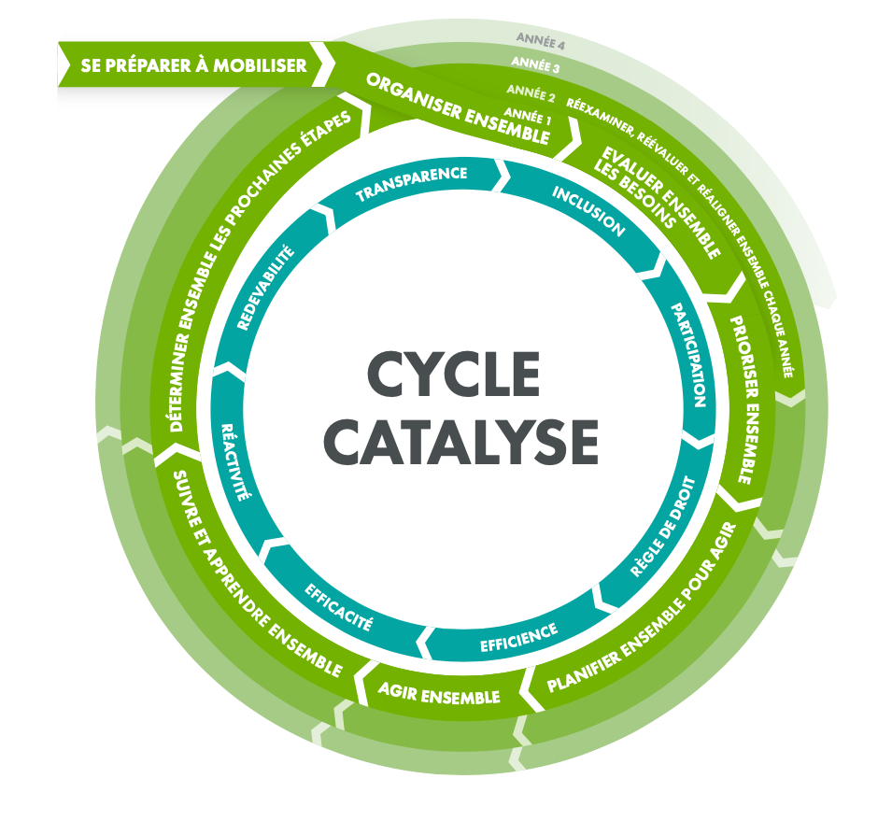
Social Cohesion in Action:
The Mercy Corps PEACE Program in Niger
Menu of Community Projects
Mediation and dialogue
Infrastructure rehabilitation
Access to shared natural resources
Livelihoods and economic inclusion
Cultural and sporting events
Notes:
I’m going to share a bit about what both of these lessons look like in the case of a USAID-funded peacebuilding program that Mercy Corps implemented in the Tillaberi region of Niger from 2019 to 2021.
The core idea behind the PEACE program’s theory of change is that if communities meaningfully participate in the design of joint projects across social divisions between, then this bridging aspect of social cohesion will be strengthened and community vulnerability to recruitment by violent extremist organizations will be reduced.
Within the set of 40 villages in our program area, the program team used Mercy Corps’ CATALYSE toolkit to facilitate an inclusive process to bring all groups within a community together to design, implement, and monitor community projects that were intended to build social cohesion.
The PEACE program’s adaptation of the CATALYSE toolkit contained a “menu” of community projects that strengthen different dimensions of social cohesion, along with an indicative theory of change and sample projects. The broad types of community projects included in this menu are on the right side of this slide. In the community planning sessions, the program team used the data from the baseline survey along with these project examples to work with communities to design a set activities that responded to that community’s specific needs
This mix of the CATALYSE participatory process plus targeted social cohesion projects is typical of Mercy Corps overall programming approach to social cohesion, and we’ll be publishing our programming guide that summarizes this approach later this year.
I’m going to spend the rest of my remarks illustrating how the PEACE program used its baseline data to adapt both of these aspects to Mercy Corps’ social cohesion approach in this particular context. To emphasize again, this is a program that started just before we had finalized our measurement toolkit in 2020, so some of the dimensions and measures that you’ll see on the next few slides are little different from the framework that we’re using now… but the overall structure of the measures and their underlying meaning is broadly similar.

Slide 14
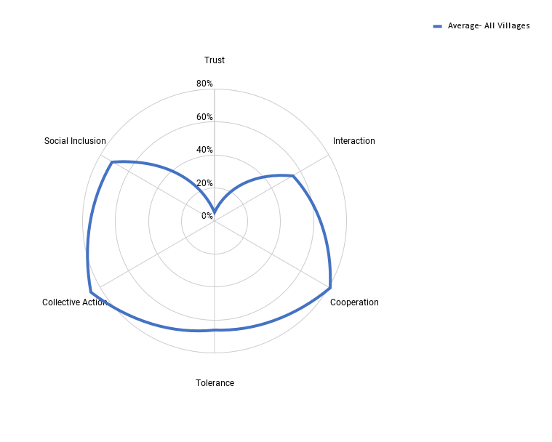
Social Cohesion in Action:
CATALYSE and Trust-Building
All Villages (Average):
Social Cohesion Index: 60.86%
Lowest Score: Trust (5.4%)
2nd Lowest Score: Interaction (54.86%)
Highest Score: Collective Action (86.44%)
Notes:
The core baseline finding that informed how the program team adapted the catalyse toolkit to the context was that horizontal trust between groups– this “bridging trust”-- was by far the weakest dimension of social cohesion across the sample.
You can see this pattern on this graph— each axis corresponds to one of the six aspects of social cohesion that this program measured, and the concentric circles correspond to the average percentage of respondents answering “yes” to that question across all 40 villages. So what really jumps out here is that trust is the overwhelming weak point.
In addition to mapping the general patterns across dimensions, we also used individual-level regression analyses to examine the relationships between these measures…While there is no clear link between cooperation, collective action, and trust, respondents who reported experiencing positive interactions with out-group members were more likely to be trusting and tolerant of these groups.
The PEACE program team drew on these baseline findings directly when adapting the CATALYSE toolkit. In particular, in training facilitators, they emphasized promoting positive interaction through careful management of initial meetings and by emphasizing inclusion, and meaningful participation in the design of initial interactions during the planning process. This was accomplished by meeting with a broad cross section of the community and allowing all groups an opportunity to speak and be heard. In addition, CATALYSE is an iterative planning process, meaning that it builds in multiple opportunities for planning and implementation of projects, which helps to sustain positive interactions and deepen trust over time.

Slide 15
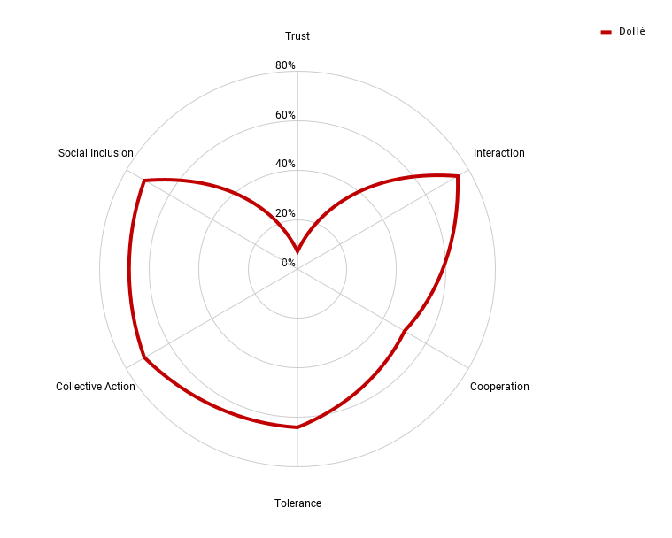
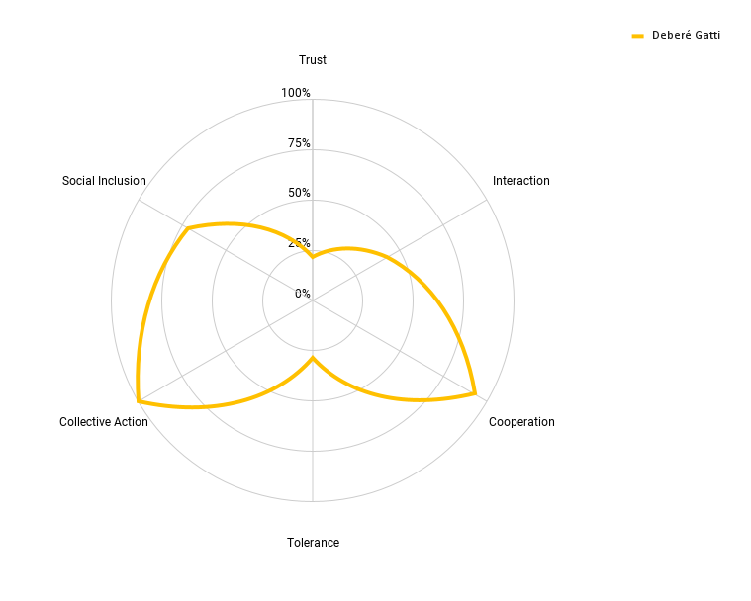
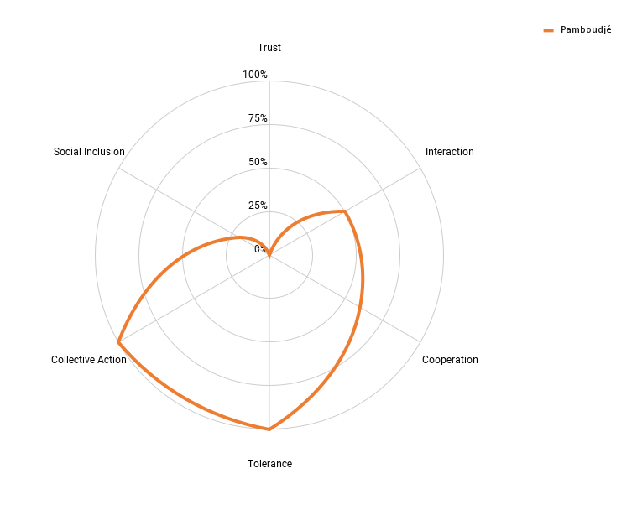
Social Cohesion in Action:
Targeted Mini-Projects
All Villages (Average):
Social Cohesion Index: 60.86%
Lowest Score: Trust (5.4%)
2nd Lowest Score: Interaction (54.86%)
Highest Score: Collective Action (86.44%)
Dollé:
Social Cohesion Index: 56.55%
Lowest Score: Trust (7.14%)
2nd Lowest Score: Cooperation (50.0%)
Highest Score: Interaction (75%)
Pamboudjé:
Social Cohesion Index: 55%
Lowest Score: Trust (0%)
2nd Lowest Score: Social Inclusion (20%)
Highest Score: Collective Action and Tolerance (100%)
Deberé Gatti:
Social Cohesion Index: 59.52%
Lowest Score: Trust (21.43%)
2nd Lowest Score: Tolerance (28.57%)
Highest Score: Collective Action (100%)
Notes:
While the catalyse process was the core active ingredient of the program across all communities, communities were able to select and implement a set of tailored mini-projects that addressed the other weak dimensions in social cohesion that they faced, which varied a lot from one community to another.
Again, it is helpful to look at these patterns graphically to help understand this finding from the baseline and how it shaped program design and implementation. So what you see here is the same graph from the last slide in the upper left hand corner, and the other three graphs show the scores for three different villages, which are all in the same administrative department within Tillberi.
When you drill into the patterns village-by-village, it indicates is that the “shape” of social cohesion dynamics can differ widely even within a relatively small geographic area. This matters because the body of evidence and practice on social cohesion and violent conflict is starting to indicate that different dimensions of social cohesion are connected to different types of conflict drivers.
For example contexts where a combination of trust, cooperation, and positive interactions are the weak point in local social cohesion are often characterized by disputes over access to natural resources such as land, water, and public services and are addressed by joint projects that focus on maintaining and rehabilitating infrastructure and resources. The community in Dolle (the village in the upper right hand corner) drew on this logic in the joint projects that it designed, implementing a grain mill and land forum alongside conflict management and mediation training to help improve cooperation over the use of natural resources and infrastructure.
In contrast, in contexts where social inclusion of youth and/or women are the weak dimension of social cohesion, conflicts are driven around frustration about lack of opportunities to meaningfully participate in economic, political, and social life. This weakness is addressed by projects that incorporate marginalized groups into community decision-making and into conflict resolution structures. The community in Pamboudje (the village in the lower right hand corner) drew on this logic in the joint projects that it designed, emphasizing training women in leadership and incorporating them into inter-group dialogues and mediation, alongside investments in local infrastructure.
The takeaway from this rapid snapshot of the PEACE program is that efforts to improve social cohesion need to target village-level patterns of social cohesion and conflict drivers. This means that programs designed to strengthen social cohesion need the ability to measure and identify how components of social cohesion differ across context, and the flexibility to design and target interventions accordingly.
Before I finish up, I want to briefly fast forward from the baseline to the program’s endline evaluation, to share some of the evidence about what this approach accomplished. This will be a very rapid review of key findings, but Maya will share the full report and executive with all of you afterwards.

Slide 16
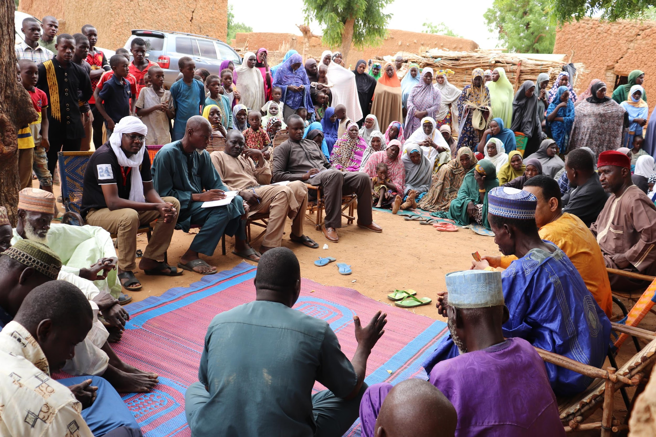
Social Cohesion in Action:
Impacts on Horizontal Social Cohesion
PEACE improved respondents’ willingness to participate and cooperate and strengthened trust within identity groups (Bonding)
Infrastructure projects and cultural activities improved trust and the quality of interactions between conflicting groups (Bridging)
Notes:
Our first finding is that we did find that the PEACE program had targeted effects on increasing social cohesion within and between groups.
-Specifically, The more PEACE activities implemented in a village - and the more respondents participated in them - the greater the increase in whether respondents said that everyone in a village helps out in community activities and the more individuals reported increases in trust in members of their own identity group.
-When it came to improving trust of the most relevant out-groups, we found that infrastructure projects and cultural activities had a positive and statistically significant effect, but other activity types did not…
Why? Interviews and observations by field monitors indicated that:
-Infrastructure/cultural activities engaged a greater number of people, required more coordination and collaboration between different groups and communities, and centered around addressing shared needs and participating in meaningful traditions.
-In contrast, other types of such as activities mediation and socio-economic activities were typically less communal in nature and targeted a smaller number of individuals within a village, which likely limited their impact on the key norms, behaviors, and attitudes that shape bridging social cohesion.

Slide 17
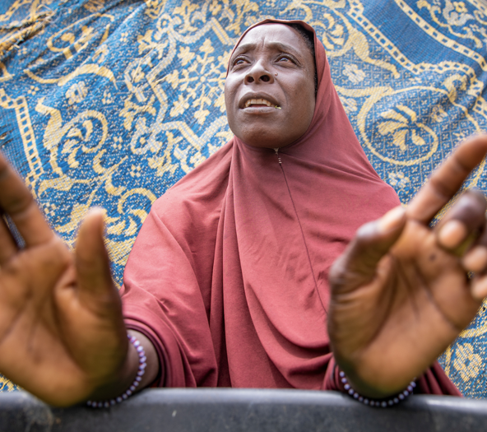
Social Cohesion in Action:
Impacts on Vertical Social Cohesion
PEACE led to modest improvements in relations between citizens and governing actors.
Increase in perceived availability of social services
Improved perceptions of leaders responsiveness and trustworthiness
Infrastructure projects had the strongest effect on improving state-society relations
Notes:
Our results also suggest that PEACE made a number of improvements in relations between citizens and governing actors
We found a small, positive effect of PEACE activities on the availability of social services reported by survey respondents. At midline, we found a 2.5 percent increase in people reporting improved services in communities where implementation had happened, and a 9.5 percent decrease in communities where the program had not yet been rolled out – a total difference of 14 percent.
More broadly, we also found that communities that received more activities under PEACE experienced an increase in respondents reporting that leaders keet their commitments to the community. We found that in particular, infrastructure projects appeared to have the strongest impact on state-society relations. This is likely because building or rehabilitating infrastructure required the active involvement of state and community authorities, and activities produced tangible, visible results – from grain mills to cereal banks – that provided a stark reminder of the presence of government at the local level. The qualitative observations also highlight that infrastructure projects also shaped community perceptions of governing authorities due shifts in how they were managed. For example, community members in two villages said that their grain mills “increased transparency in the management of food supplies, which has increased trust.”
I’ll stop there to leave space for the broader discussion, but if there’s interest in the Q&A, I’ll be happy to speak more about the PEACE program and our evaluation, including findings regarding both social inclusion and violence.
I’ll also be happy to dive into broader discussions about our conceptual model, measurement toolkit, and programming approach, and how we’ve applied them in other contexts. Thank you.

