Slide 1
Quick Guide to Collaboration for Development
.

Slide 2
Introduction
This guide is created as a resource to provide you with a simple overview of the Collaboration for Development (C4D) platform.
Collaboration for Development (C4D) is a secure social collaboration platform focused on development issues, that enables experts and practitioners to conduct online brainstorming, consultations, discussions, knowledge-sharing and learning, and much more.
You are encouraged to familiarize yourself with the platform by walking through the main features.
.
i

Slide 3
Table of Contents
Accessing and discovering C4D………………………………. | 1
Creating a Personal Profile ……………………………………… | 2
Participate in an existing Discussion or create a new one …………………………………………………………………… | 3
Create a Document …………………….…………………………… | 4
Managing versions in Documents ….………………………… | 5
Create Blogs ……………………………………………............ | 6
Using Tags ……………………………………………………………….. | 7
Connection Stream ……………………....................... | 8
Upload Photos ……………………………....................... | 9
Activity ……………………………………………………………………. | 10
Inbox & Actions ……………………………………… | 11
Status Update, Share, @Mention, Like and Direct Messages …………………………………………………………………. | 12
Create Content by Email ………………………………………… | 13
Access from Mobile ………………………………………………… | 14
Email Notification …………………………………………………… | 15
Search …………………………………………………………………….. | 16

Slide 4
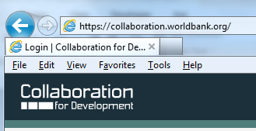
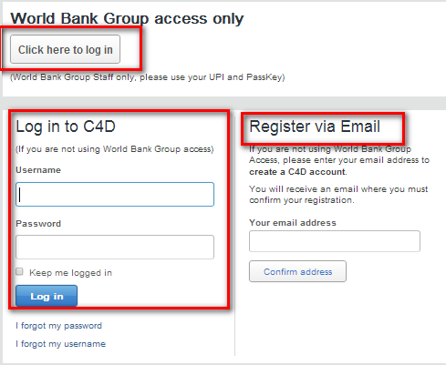
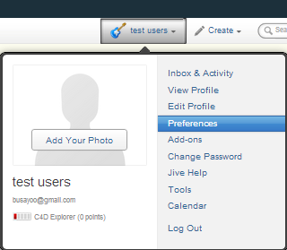
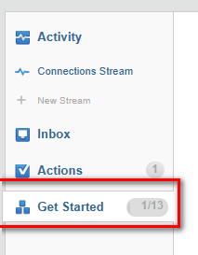
Accessing and discovering C4D
1. Access C4D
To access the platform type in your browser:
http://collaboration.worldbank.org
2. Log into C4D
World Bank Staff: On the upper white box on the log-in page click on the red log-in tab. Once on the log-in page enter your UPI and Passkey.
External Members: On the lower right corner of the log-in page, enter your email address and click on the Confirm Address button below. An email confirmation will be sent with a token. Click on the link provided in the email and create a log-in and password. Use the log-in and password to sign in under Log in to C4D for future visits.
3. Explore the Menu
Inbox & Activity: captures activity for people and groups you follow
View Profile: shows your profile as it will be seen by the community
Edit Profile: allows you to update your profile information avatar and privacy settings
Preferences: allows you to set your email preferences, pair your mobile device
Jive Help: takes you to Jive help manual
Calendar: shows events you are scheduled to attend
4. Discover C4D
In the Get Started section on the your Inbox & Activity page you will be able take a guided tour and learn functionality of the platform.
1

Slide 5
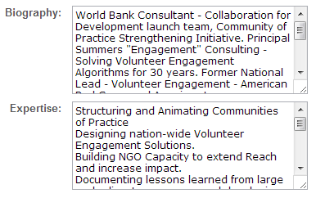
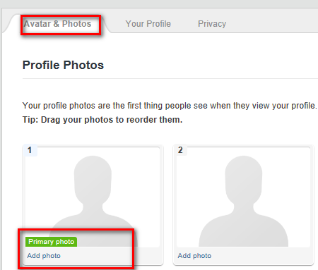
Create a Personal Profile
Your profile is a good way to share your interests and expertise with members of your group. On your profile page you can enter your biography, prior experience, languages, and expertise. You can also change your default picture to another image of your choice!
1. Access Your Profile
Once you have logged into C4D, click on your name on upper right hand corner of the screen.
2. Update Your Information
Click on the “Edit Profile” menu once you click on your name at the top right of the screen you can a) Update your photo and avatar b) Edit your profile and c) set your privacy preferences
3. Edit Your Profile
To edit your profile click on the “Your profile ” link. There you can update your biography and your expertise.
4. Update your photo
To update your profile image, click on “Avatar & photos” you will then be able to “Add photo”: select the one you are interested from your computer, upload it, crop it if needed, and finalize.
2

Slide 6
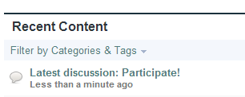
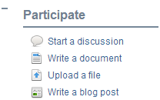
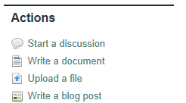
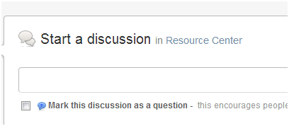
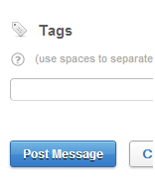
Participate in a Discussion or Create a new one
Discussions in C4D make it easy to reach out to your colleagues – wherever they are – to brainstorm, get
feedback or ask a question.
1. Browse for your Group
Discussions in C4D are anchored within specific
Communities/groups. To participate in a discussion or start a new one browse “My Groups” in the middle right of the page to find your community/group. You can also use the search bar on the upper right corner to find your Group.
2. Participate in an existing Discussion
Once you are on the homepage of your group you can participate in existing discussions by clicking on titles of discussions that are of interest to you.
2. Create your Discussion
Once you have selected the Group where you want to
create a discussion, go to the “Actions” submenu
and click under “ Start a discussion” link.
3. Your Discussion Post as a Question
If you choose to mark your discussion as a question,
you will be able to mark it as ‘answered’ later on. Once
you have posted your discussion it will be visible to other
members of your group and they will receive an e-mail
notification alerting them that a new discussion has been
started ( if their notification settings allow). You will also
receive e-mail notifications when comments are posted
to the discussion you started.
4. Add Tags
Tag your discussion using underscore “_” character to
concatenate multiphase keywords.
3

Slide 7
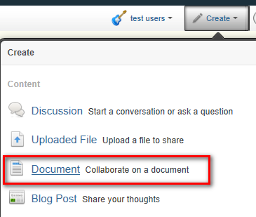
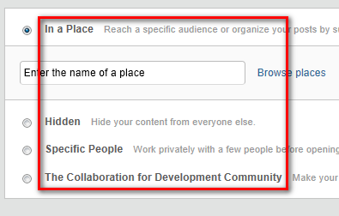
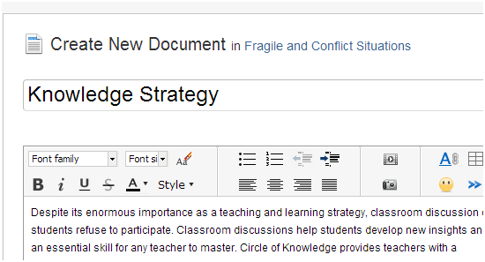
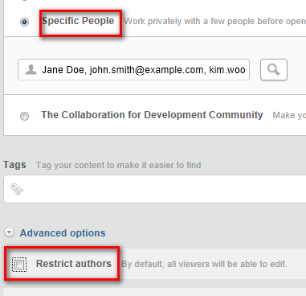
Create a Document
C4D allows users to create and edit online, wiki-type, documents that can be modified by a group of users collaboratively. This feature works well for documents such as team plans, meeting notes or things that need to be reviewed by your colleagues before release.
1. Select the Document feature
Documents on C4D can be created in your group or under your personal profile. Click on the “ Create” menu in the top menu of C4D.
2. Select the location for your document
On the drop down menu select the group where you want to create your document or choose “your documents”.
As an alternative you can also navigate to your group and select the “Write a document” option under the Actions menu.
3. Draft Your Document
Enter title and text, categories and tags and click “Publish” to save and post your document.
4. Other features
You have an option to choose users who will be allowed to edit your document by leaving “Restrict Authors” unchecked or selecting specific people to collaborate on your document.
4

Slide 8
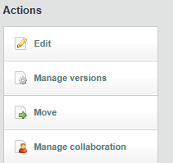
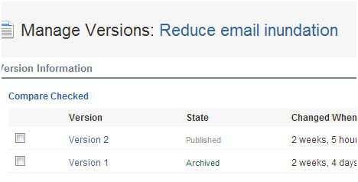
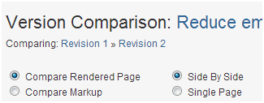
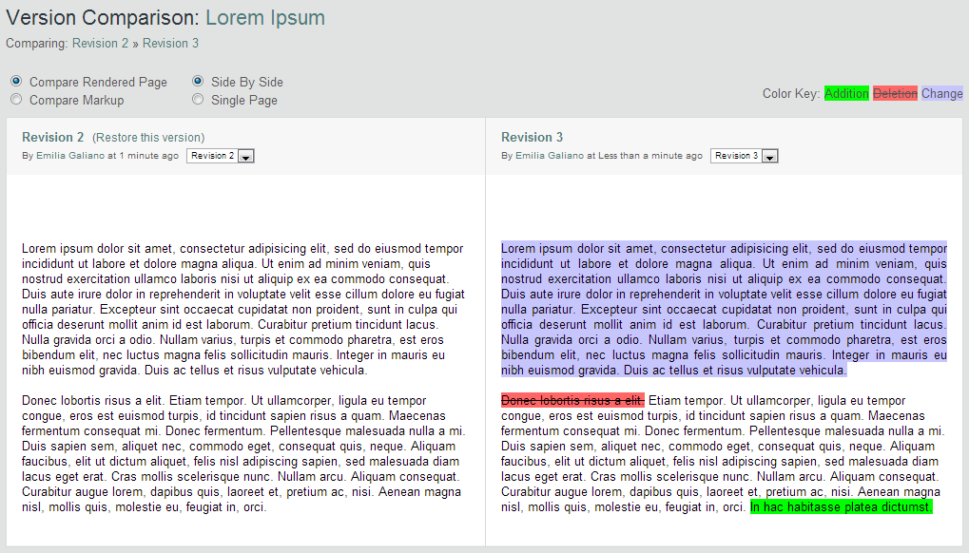
Managing Versions in Documents
One of the features of the platform is version control for documents: users have the ability to edit online documents, compare two versions of the same document side by side, and also restore previous versions of a document.
1. Access your document
To edit a document first navigate to that specific piece of content: it will normally be located under the content tab of your group.
2. Edit your Document
To edit a document go to the “Actions” sub-menu on the right hand side and click on “Edit” link. Once you have finished editing make sure to publish your changes.
3. Version Control
To see different versions of the same document click on
“ Manage Versions” .
a) To see the tracked changes
between the current and the previous version, click on
the magnifying glass icon.
b) To compare other versions click on “ Version
Comparison” link.
This feature applies only to documents created in C4D, not to uploaded files created in other applications (Word, Excel or Power Point).
5

Slide 9
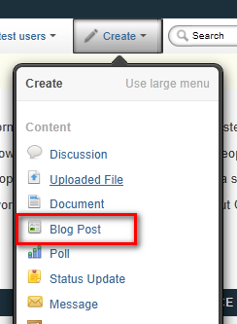
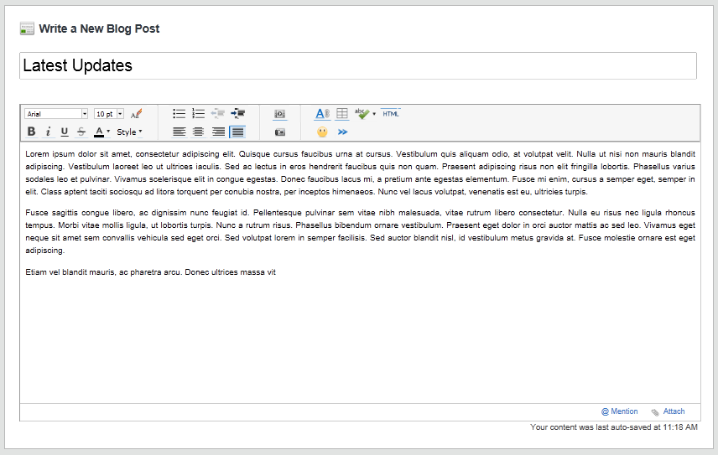
Create Blogs
Blogs can be used to broadcast individual messages to your group, post something noteworthy, or pitch a new idea or proposal. Blogs can be anchored to your personal profile or to a group. You can create your own blog or comment on blogs authored by your colleagues.
1. Select the Blog Feature
To create a blog click on the “ Create” submenu and
select” Blog Post”.
2. Draft your Blog
Create a title, enter your blog
3. Select the location for your document
You may choose to create a personal blog within your profile to focus on issues within your field of expertise, or start one within a group on a topic relevant to that community.
As an alternative you can also navigate to your group and select the “Create Blog Post” option under the Actions menu.
4. Other features
Click under “Advanced Options” to open your blog for
comments, to disable comments or to stop comments
that were previously enabled and to schedule when your blog gets published.
6

Slide 10
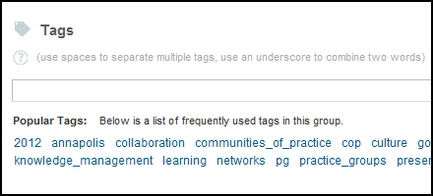
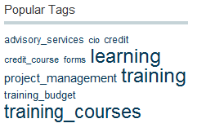
Using Tags
Tags are keywords that users can associate to a piece of content: they help to describe the content, but most importantly they help to make that piece of content more easily findable in searches.
1. Tags and Tagging
When you have content that you want to tag, scroll to the Tags field at the bottom of the page. Enter the tags that you wish to use.
Use an underscore (“_”) between words that you wish to keep together as one tag (e.g. East_Asia)
As you enter your tag(s), existing tags may show up as suggestions.
2. Other Features
You may see a “tag cloud” on group homepages on C4D. This is a box that shows tags that are used in that group: the size of the tag indicates how frequently that tag has been used associated to content.
7

Slide 11
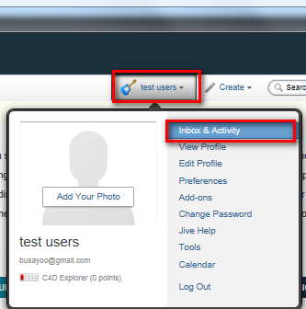
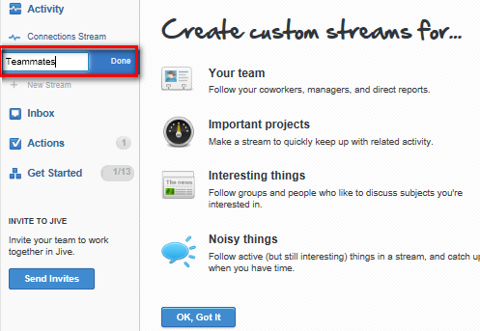
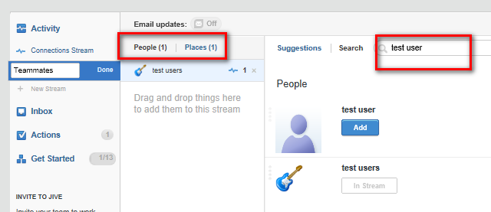
Streams
A stream shows you real-time updates of activity as people interact with content, people, and places in the community. You can see all public activity in the Activity Stream, or create your own custom streams that show only the people, places, and content items you select.
1. Create a Custom Stream
Click on your profile at the top of the screen and select “inbox and activity”
2. Create a Custom Stream
To create a new connection stream Click “ New Stream and provide a name to your stream.
3. Adding to your stream
You can add a combination of People, Content and places to your custom streams.
Use custom streams when there is so much activity, that you can’t follow it all
8

Slide 12
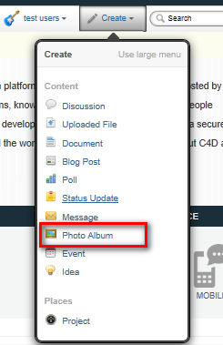
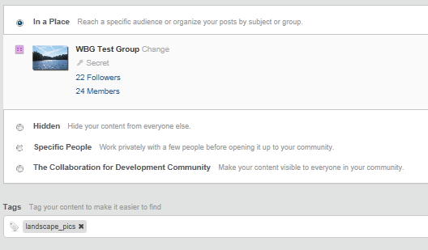
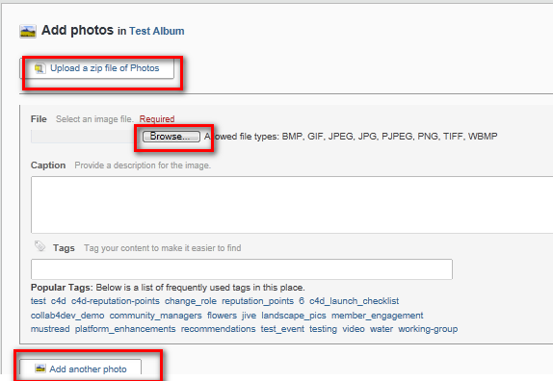
Photos
Photo albums are a way for you to share photos from your group conferences, workshops, study tours, and other events. This easy to use feature lets users store a large number of photos.
1. Create A Photo Album
Photo albums in C4D are anchored within specific
groups. To start one, navigate to the group where
you intend to start your album.
In the Actions box select “Create a photo
album” and fill out the required fields. Then, click
“Create photo album.”
2. Add Photos
Once you have completed this step, you will be able
to add photos. Enter your album and click “Add
photos.” You can add multiple photos at once
uploading a zip file containing all your photos.
3. Other Features
Note that you can also add more than one photo at a
time. To do so, click “add another photo” at the
bottom of the page before clicking the “Add” button
at the very bottom, which is at the end of the page.
Please note that this application supports the
following file types: BMP, GIF, JPEG, JPG, PJPEG,
PNG, WBMP, TIFF.
9

Slide 13
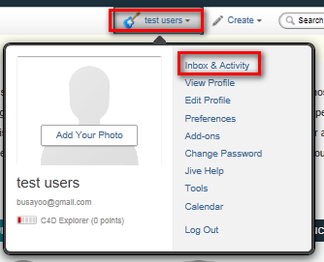
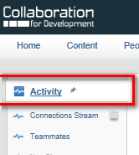
Activity
Under the “Activity” section you can either look at “All activity” or you can only see the activity stream for the people, groups, and content that you follow. The Activity section can be found in the top menu bar, and it will glow when new activity has appeared in the stream.
Go to Activity
Click on your profile at the top of the screen and select “Inbox & Activity”. Then Click “Activity”
Click on “expand” or “preview” to the right-hand side of
each activity to view the contents of that activity in the
activity stream. Within the preview, you can leave
comments, replies, likes, or you can share the item.
Update Your Status
Update your status by clicking in the text box at the very top
of the activity section on C4D. Include pictures or links
using the icons, and then click “Post” when you are ready
to finalize and post your status.
10

Slide 14
Inbox & Actions
The Communications stream shows what is relevant for you while the Actions stream shows items that you need to take action on. Both can be accessed in the top menu bar.
1. How to Use the Inbox Section
The “Inbox” section is you-centric and tracks activity on items related to you. This includes discussions that you are participating in, @ mentions, content that is shared with you, and direct messaging. You can also choose to track other things so that they show up in your Inbox section.
In this section, you will see unread alerts in the list on the left-hand side.
Click on an alert to view the details of this item in a window in the right-hand column.
In the preview on the right-hand side, you can easily reply to discussions, comment on documents, “like” an item, repost, or share.
Go to “Send Direct Message” in the upper right-hand corner to send a personal message directly to someone.
Use the “Filter” button above the alert feed to filter types of content that shows up in the alert list.
How to Use the Actions Section
The “Actions” section is focused on alerting you to things that you need to act on. These alerts include notifications, assigned tasks, to-dos, and required actions such as document revision or a group membership approval.
Once you are in the Actions section, there are three main tabs that contain “Actions Alerts,” “Notifications,” and “Tasks”. If there is content that requires your moderation, a fourth tab will also appear. Each tab will also have a number to alert you to the number of actions within that tab. In order to view actions in each tab, click on that tab.
a) Click on an alert to view details.
b) Click on a link to the right of an alert to take action on an alert and remove it from your alerts list. In order to remove an alert, you can click “Dismiss.”
c) To mark a task as completed, click on the checkbox to the left of a task.
Note: You need to create a Project first before using the Tasks feature.
11

Slide 15
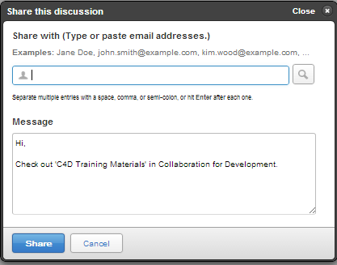
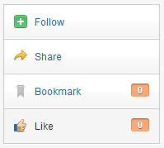
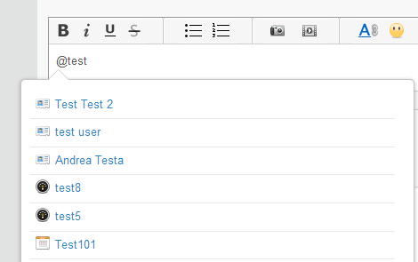
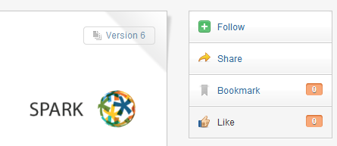
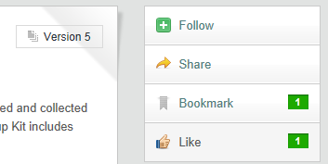
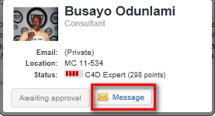
The Use of Status Update, Share, @mention, Like and Direct Messages
1. Status Update
Allows you to share with the community a brief thought, a link or your current location. Go to Create>Status Update.
2. Sharing
Access the content that you would like to share with another user. Click on Share to the right hand side of the content and select the user that you would like to share this content with. You can also add a message explaining why you think they should take a look at it.
3. @mention
Allows you to easily link to content, people or groups in C4D. Within any content or comment to a content you can @mention users, content or groups. Every time you type @ followed by the title of a content, the name of a user, or the title of a group you will see a drop down menu appear and you will be able to pick the link you were looking for (make sure to use underscore between words). If you @mention users they will get a notification in their Inbox: this is another easy way to share content with someone or to connect people.
4. Liking
You can also express appreciation for any type of content. This will be recorded as an activity and people who follow you will be able to see which documents, discussions or blogs that you like. You can find the Like option on the right hand side of any content.
5. Direct Messages
You can send a message to one person or a group of users in C4D. The message will appear in both your and their Inbox. You can send a Direct Message by either hovering over a person’s name when it appears as a hyperlink (and selecting the Direct Message option) or by going to your Inbox (you will find the Send Direct Message button in the top right corner).
12

Slide 16
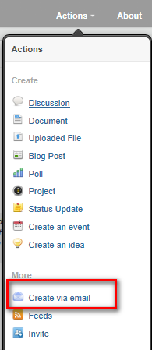
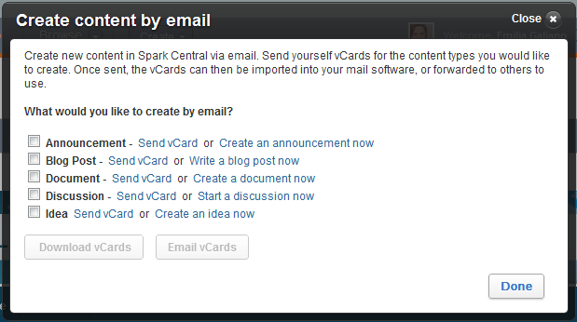
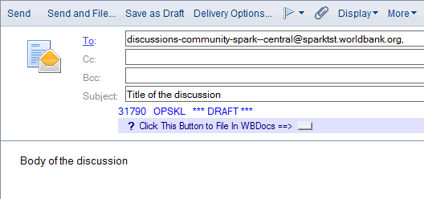
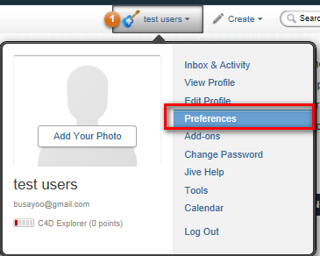
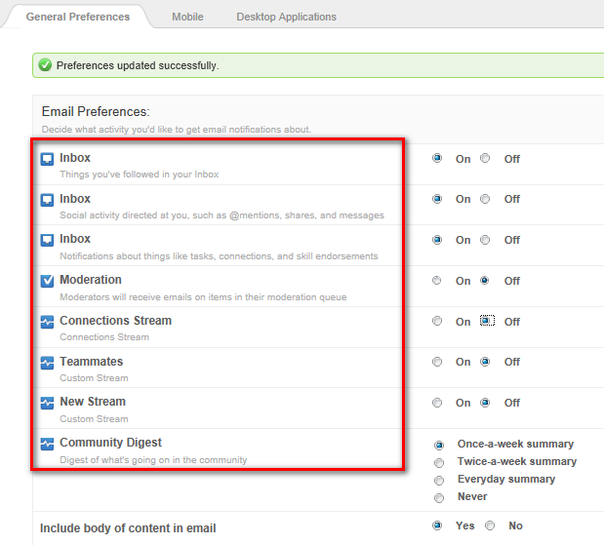
Create Content by Email With the advanced incoming email you can post documents, blogs, discussions, status updates, announcements and project tasks via email and also reply to discussions, comment on documents and blog posts, reply to direct messages and shares.
To create content in a group via email you need to first obtain specific content email addresses:
Access the group that you would like to be able to create content by email for.
Under the “Actions” menu on your group banner you will see the “Create by email" option under the “Actions” menu. If you select it a window will pop up allowing you to choose the type of content you would like to create by email.
Once you have selected the type of content, you can select to email the addresses for those types of content to your inbox. These will be the addresses that you will use to create content via email.
To create content via email, choose the email address related to the content type that you would like to create (from the email that you have received from the system): the subject of the email will become the title of your content, while the actual content of your email will become the body of the content.
To be able to comment on content via email please do the following:
Go to To your Profile and select “Preferences”
Under the Email preferences options on the top select items which you would like to receive email notifications on.
Now every time someone updates that specific group or content you will receive a notification: simply reply by email to that notification to comment on updates.
13

Slide 17
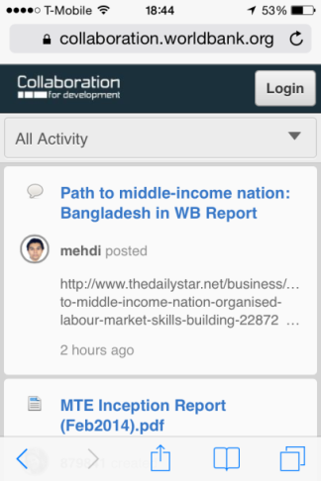
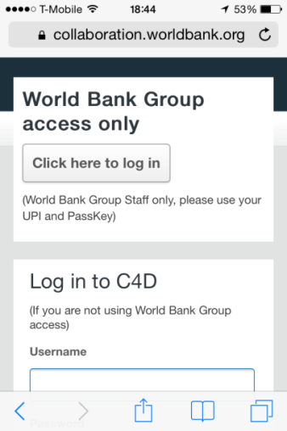
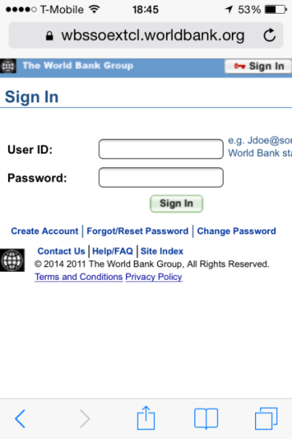
Access from Mobile
The search function in is a powerful tool that helps you to quickly and easily find content, people, and groups. You may do a quick search – also known as a spotlight search – from any screen in C4D or you may choose to do an advanced search
On your mobile device, open the internet browser (for example Safari on iPhone or iPad) and type collaboration.worldbank.org in the URL bar. You will land on the homepage shown in point 1.
Click on Login (top right corner on your screen). You will land on the page shown in point 2. Here please select the “Click Here to Login” if you are World Bank Group staff. If you are not World Bank Group staff, please enter your credentials (username and password) in the section below, titled Log in to C4D.
World Bank Group Staff only: after clicking on the “Click here to log in” you will be redirected to a page where you need to enter your UPI and Passkey. This is the last step, you have now successfully logged in to C4D using your mobile device.
14

Slide 18
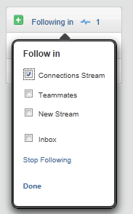
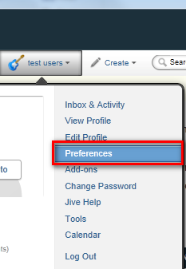
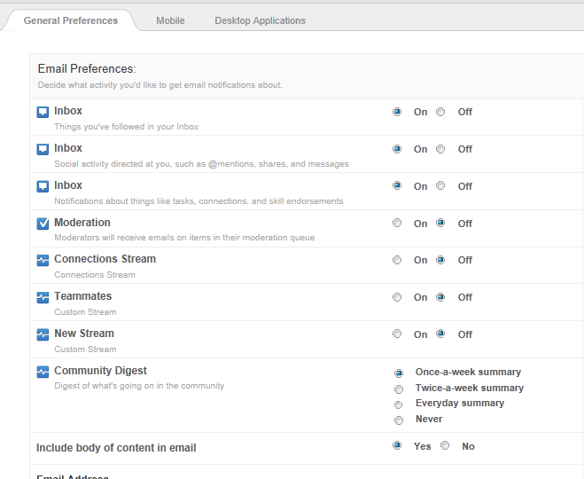
Following, Tracking in Communications and Email Notifications
C4D can create a high number of notifications, alerting you of new activity in the platform, either in your default connections streams, a newly created custom stream or by email. You have different options to receive email notifications depending on the type of activity.
Following
You can follow people, content or groups in Collaboration for Development: new activity related to the content, users or places that you follow will appear under the NEW connection streams, accessible through the top menu.
Change Your Preferences
By default the platform will send you notifications when certain activities occur. To change your default email notifications settings:
Click on your profile name then select the Preferences tab.
Here you can choose to set notification options from “On” to “Of” depending on your interests.
15

Slide 19
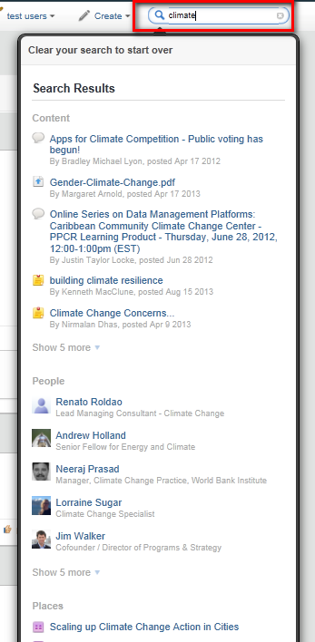
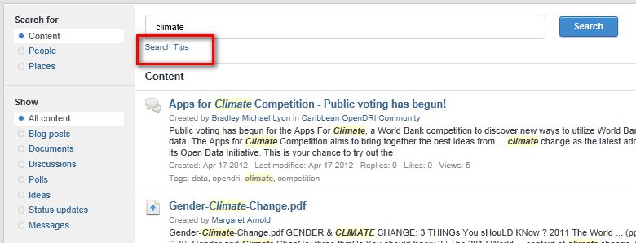
Search
The search function in is a powerful tool that helps you to quickly and easily find content, people, and groups. You may do a quick search – also known as a spotlight search – from any screen in C4D or you may choose to do an advanced search
Spotlight Search
Begin typing in your search terms – the auto suggest
box will show up beneath the search box as you type
slowly.
The other auto suggest box is divided in Content ( eg.
documents, discussions etc.), people ( profiles) and
groups (spaces and groups)
If you do not see the relevant results click on View all
Results or press Enter.
Advanced Search
Once you have pressed enter from a search in the
spotlight you will access an advanced Search menu,
there you will be able to browse all of the content,
people, and groups that are related to the search term or
terms that you entered by using the tabs. You can even
browse status updates and your direct messages in your
search. Use the filters to sort results by relevance and
other characteristics, by content type, or to limit your
search to a specific time period. You can also click on
the “Search Tips” link to get to Advanced Search
guidelines.
16

Slide 20
C4D Facilitation Team
To find more help or resources:
Access the Getting Started Page on C4D
Contact our team at collab4devadmin@worldbank.org
.

