Slide 1
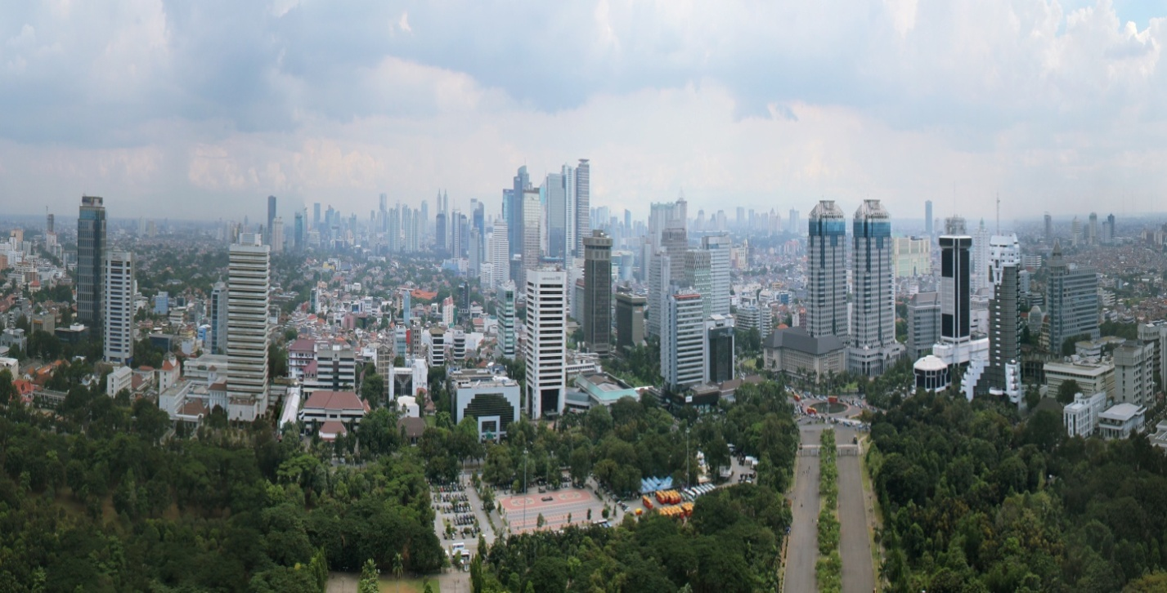
Directions for Affordable Housing Policy in Indonesia
Prepared by the Urban and Local Government Team
World Bank, Indonesia
October 3, 2012

Slide 2
Framing the Housing Opportunity in Indonesia
Indonesia has the potential to substantially increase its economic returns from urbanization– housing is an entry point
Indonesia is rapidly urbanizing with a young population that will demand housing
The majority of housing (~80%) in Indonesia is self-built
Affordability for housing is declining, especially for low income groups
Other constraints to the housing market relate to land, access to financing & targeting of subsidies
What can be done and where to go from here?

Slide 3
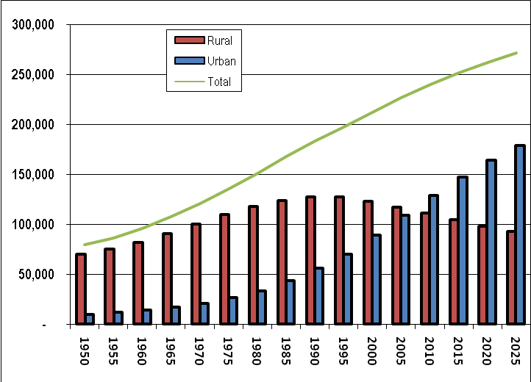
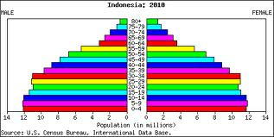
Rapid Urbanization and Demographic Trends
Forecasts by the UN suggest that Indonesia will add an average 2.2 million persons per year to cities between 2010 and 2025
Demographic trends show that Indonesia has a young population, also representing a large number of potential new households
Source: Indonesia Statistical Bureau (BPS) Proyeksi Penduduk, 2005
Source: http://www.nationmaster.com/country/id/Age_distribution
Notes:
Indonesia is one of the fastest urbanizing countries in East Asia
Level of urbanization has increased over the past 10 years to close to 50%

Slide 4
Population growth is primarily in the periphery of larger cities, while medium and smaller cities have more balanced growth.
Metro name | 2005 |  |  | CAGR 1995 - 2005
 | Core | Periphery | Metro | Core | Periphery | Metro
Jakarta | 8,820,603 | 12,799,559 | 21,620,162 | 0.44% | 2.47% | 1.56%
Surabaya | 2,611,506 | 5,974,090 | 8,585,596 | 0.33% | 1.46% | 1.10%
Bandung | 2,270,969 | 5,079,430 | 7,350,399 | 0.66% | 3.13% | 2.26%
Semarang | 1,446,533 | 4,335,017 | 5,781,550 | 0.97% | 1.15% | 1.10%
Medan | 2,029,797 | 1,812,196 | 3,841,993 | 1.07% | 0.10% | 0.59%
Palembang | 1,369,239 | 1,122,731 | 2,491,970 | 1.20% | -2.67% | -0.85%
Makassar | 1,194,583 | 1,106,362 | 2,300,945 | 1.58% | 1.58% | 1.58%
Denpasar | 574,610 | 1,208,004 | 1,782,614 | 3.97% | 1.07% | 1.87%
Source: Indonesia Bureau of Statistics (BPS)
Notes:
Metro areas consist of core city and periphery
The periphery is combination of small cities adjacent to the core (e.g Bogor to Jakarta) and rural areas farther from the core
For most metros, majority of the population live in periphery instead of the core city – due to cheaper price of housing in the suburbs
Many metro areas are gradually expanding their centers as they grow to periphery

Slide 5
Self-built houses are the most common acquisition method, especially in small to medium cities
Acquisition Method (Owner HH moving 2001-2007) | City Category
 | JMR | Large | Medium | Small | Towns
Bought from a developer (percent) | 15.0 | 7.8 | 9.8 | 3.5 | 3.4
Bought new other source (percent) | 11.7 | 9.7 | 7.4 | 6.9 | 5.7
Bought second hand (percent) | 19.5 | 15.5 | 12.6 | 16.1 | 11.2
Self-built (percent) | 40.2 | 52.2 | 55.4 | 60.1 | 63.2
Otherª (percent) | 13.7 | 14.7 | 14.9 | 13.4 | 16.4
Total | 100.0 | 100.0 | 100.0 | 100.0 | 100.0
Households (thousands) | 459.6 | 911.8 | 391.9 | 342.9 | 349.6
Source: Badan Pusak Statistik 2007.
Notes: a Includes inheritance, bequest, administrative allocation and official housing
Notes:
Given the population growth over the past ten years, this table shows how people who moved between 2001-2007 acquired their houses.
On average, a small share of movers bought new houses from developers or other builders, while the majority were self-built.
Jakarta Metropolitan Region is the outlier – larger market for houses bought from developers, purchased as existing houses, and a lower rate of self-built, incremental housing.

Slide 6
Housing demand is projected to grow in lower income groups (based on age/incomes)
Authors’ calculation with BPS 2007.
Notes:
Here we explore demand projections among different income levels. There is a clear variation in average ages in the different income groups.
The lower-income groups have a higher share of younger members (up to 18 years old) and a much lower share of older (mid-40s to mid-60s) members.
Of course many of the younger population in lower-income households will eventually earn higher-incomes.
These age distributions imply the demand for housing amongst people in lower income groups will grow relative to the demand from those in higher-income groups in the future.

Slide 7
Housing is becoming less affordable over time, especially for low income groups
Source: Badan Pusak Statistik 2001 and 2007.
Notes:
A simple measure of affordability – the share of household expenditure allocated to housing – showed an almost one quarter increase in the period from 2001 to 2007, from about 18 percent in 2001 to 22 percent in 2007.
The distribution of this variable also changed with many more households moving into an ‘unaffordable’ housing situation (more than 30 percent of expenditures on housing).

Slide 8
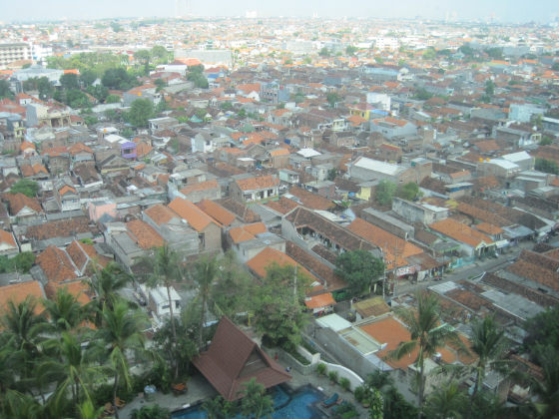
How can Indonesia move towards a more efficient, affordable housing system?

Slide 9
Different People Access Housing Differently
The Government needs a dynamic array of strategies that respond to various housing segments, including:
LAND | FINANCE | MATERIALS | LABOR
squat | savings | temporary | self-help
rent | pay as go | combined | barter
buy | loan | solid | contract
Notes:
Key elements for housing sector –
People access them differently, depending on many variables such a person’s location, income level, family characteristics, etc.

Slide 10
Policies must vary by Target Population Segment
Cornerstone of good housing policy: Create conditions that stimulate and enable market provision of various streams of housing supply to different segments.
Different segments of the population access and combine the basic inputs into housing (Land, Finance, Materials and Labor) using a range of different methods.
Analyzing how each different segment of the market accesses housing, and the bottlenecks in this system, is a crucial step in formulating Government programs.
This can indicate priority areas for Government programs and also greatly enhance the efficiency and outcomes of Government subsides and programs.

Slide 11
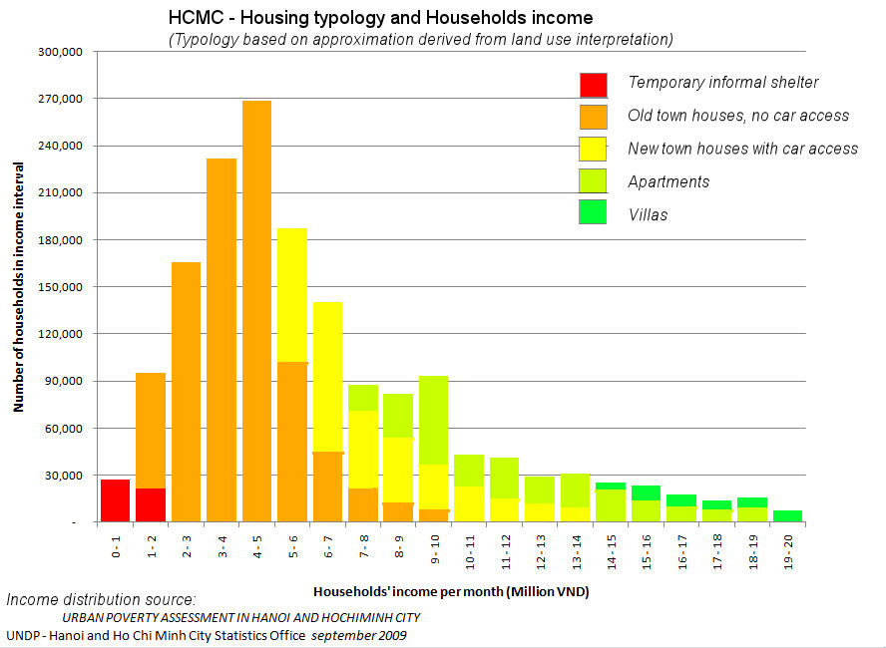
Different People Access Housing Differently
- Each City has Segments of Demand
Housing Market Segmentation done by the World Bank for Ho Chi Minh City (HCMC) in Vietnam
Graph by Alain Bertaud
Notes:
Vietnam Urbanization Review
In this example of, we can see:
each vertical bar represents the number of households within an income bracket (allowing us to estimate what they might be able to pay for housing)
each color represents a type of housing supply that satisfies to a different extent the different segments of the market
This graph reveals for us how to prioritize a housing policy to support the different housing segments in Ho Chi Minh City

Slide 12
Based on recent analysis, bottlenecks to increasing access to affordable housing can be reduced by:
Enable a deepening of the low-income and incremental housing microfinance market through product development, regulation and targeting
Improve targeting framework and efficiency of FLPP, Subsidized Housing Loan IR and down payment subsidies
Promote savings-based mortgage product development focused on low-income and informal households
Improve the provision, targeting and transparency of public housing development for the extreme poor
Articulate a national policy framework and program for slum upgrading
Notes:
The first three are related to access to finance to enhance demand for housing
Focus on lower income segments

Slide 13
Many broader and less understood challenges and opportunities exist…..
Increase flow of affordable land by strengthening urban and spatial planning, land policies and management and the streamlining housing development regulations
Address institutional coordination constraints
Enhance local government and community involvement in slum upgrading and low-income housing policy and delivery framework
Enabling secondary mortgage and construction finance markets
Develop practical and transparent framework for PPPs for low-income housing

Slide 14
How might the Bank support?
SAPOLA – Develop a national framework for slum upgrading
Support the development and piloting of an incremental housing microfinance product
Support improved design, management and targeting of Government self-help housing program, FLPP and SHL IR and down payment subsidies
Upstream thinking on land management, planning and a medium-term approach to increasing access to affordable land
Facilitate access to international experience on public housing, PPPs, housing finance, etc.
Deepen analytics on rental markets and the efficiency and effectiveness of subsidies

Slide 15
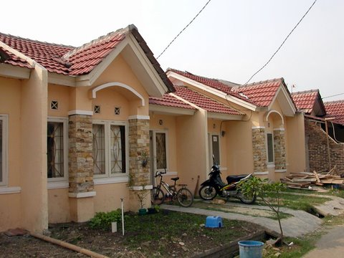
Thank you

