Slide 1
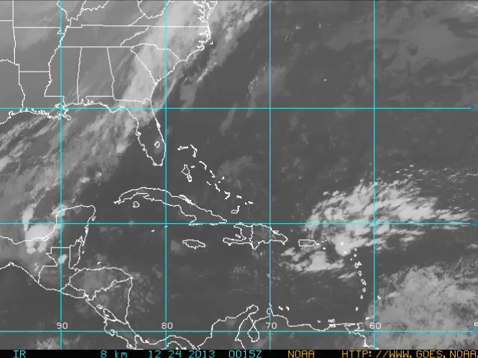
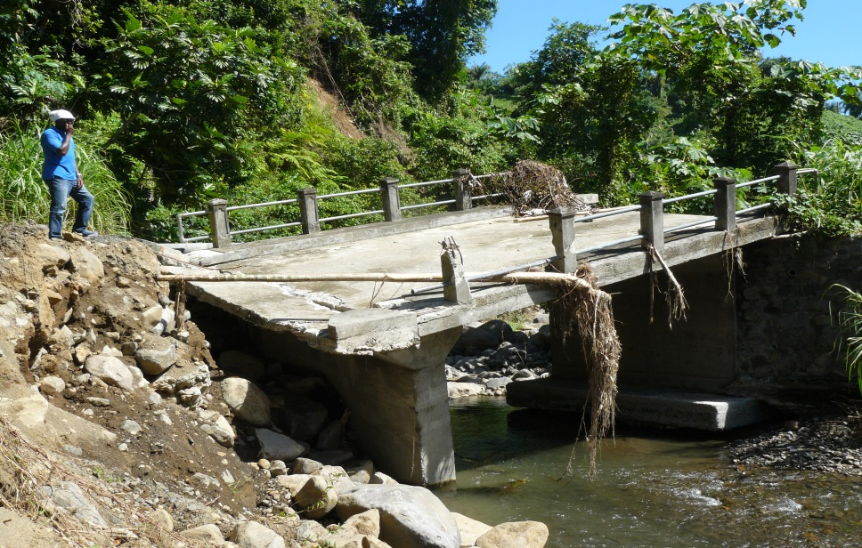
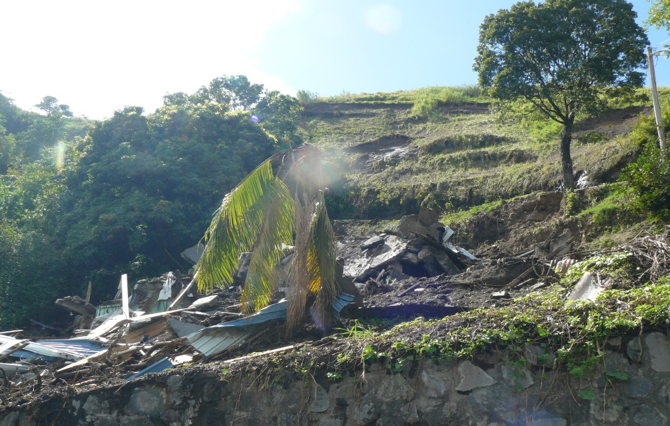
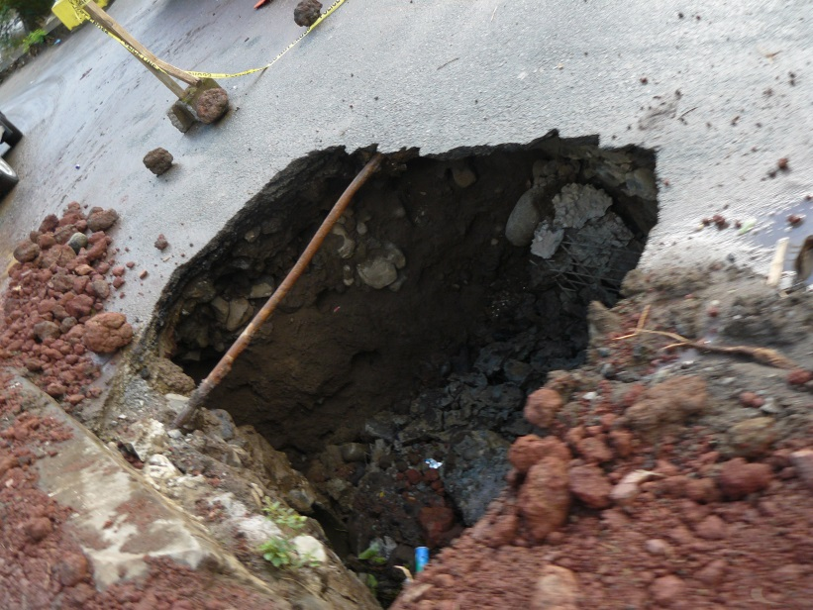
Rapid Damage and Loss Assessment December 24-25, 2013 in St. Vincent & the Grenadines (SVG) and St. Lucia (SLU)

Slide 2
Rapid Damage and Loss Assessment for Emergency Recovery from Flash Flooding Event December 24-25, 2013 in St. Vincent & the Grenadines (SVG) and St. Lucia (SLU)
DaLA

Slide 3
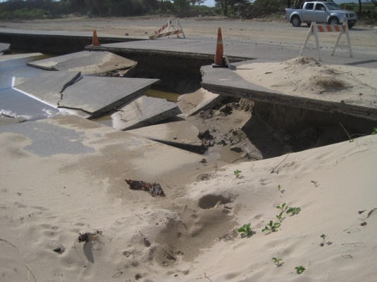
Overview
Caribbean Disaster Losses and trends
Country Profiles
Disaster Event
Impacts
Response to the Disaster

Slide 4
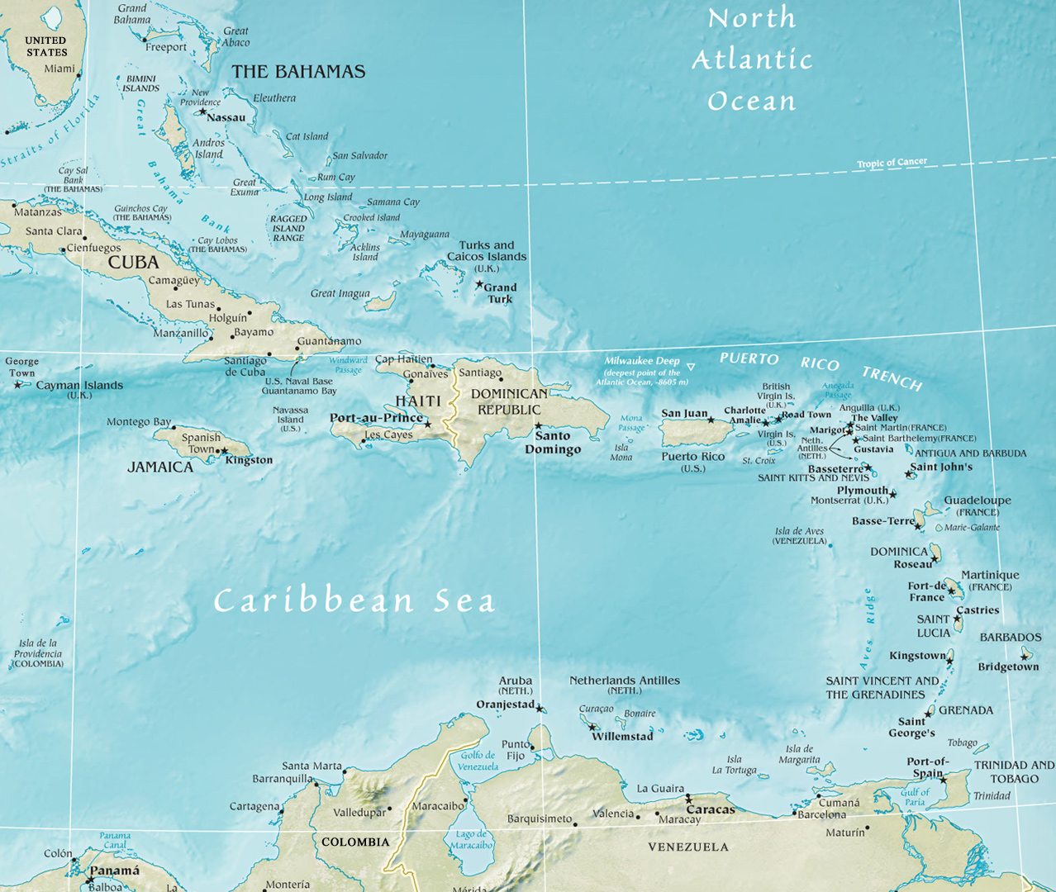
Map of the Caribbean

Slide 5
Damages from Disasters are Increasing in the Caribbean

Slide 6
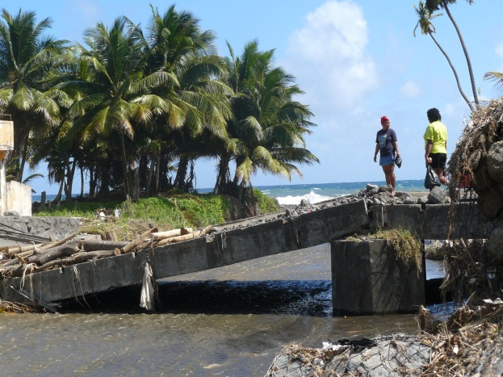
Profiles of SVG and SLU
 | SVG | SLU
Population | 109,373 | 180,870
Poverty Head Count, % | 30 | 28
GDP (US$ billion) | 0.71 | 1.24
GNI per capita (US$) | 6,400 | 6,890
Public Debt (% of GDP) | 70 | 78
Source: World Bank Development Indicators (2012)

Slide 7
Notes:
Dec 29 weather forecast. Based on 2-day TRMM aggregate, CCRIF Rainfall model

Slide 8
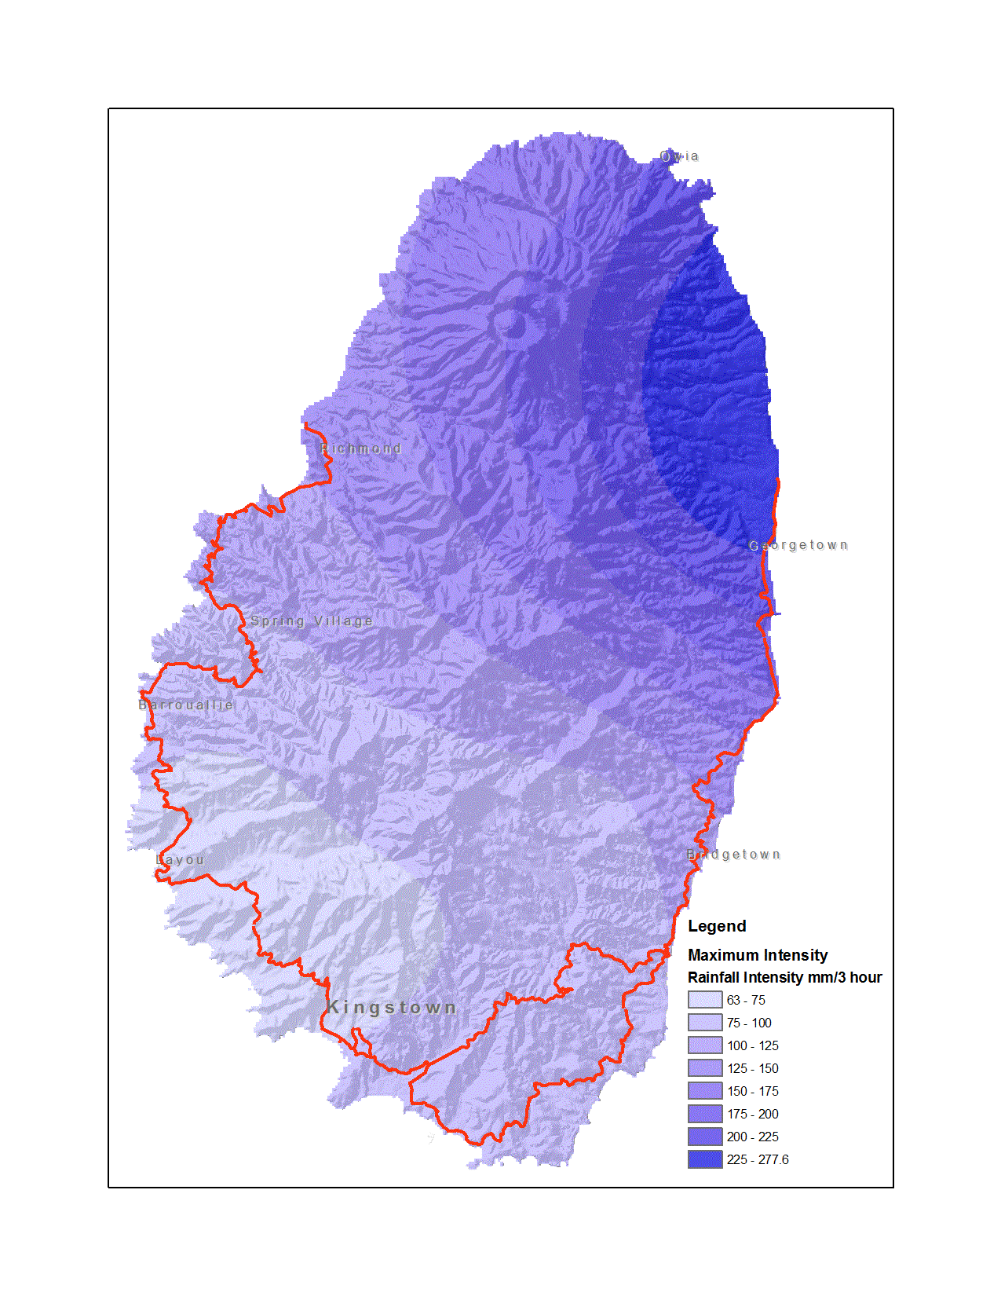
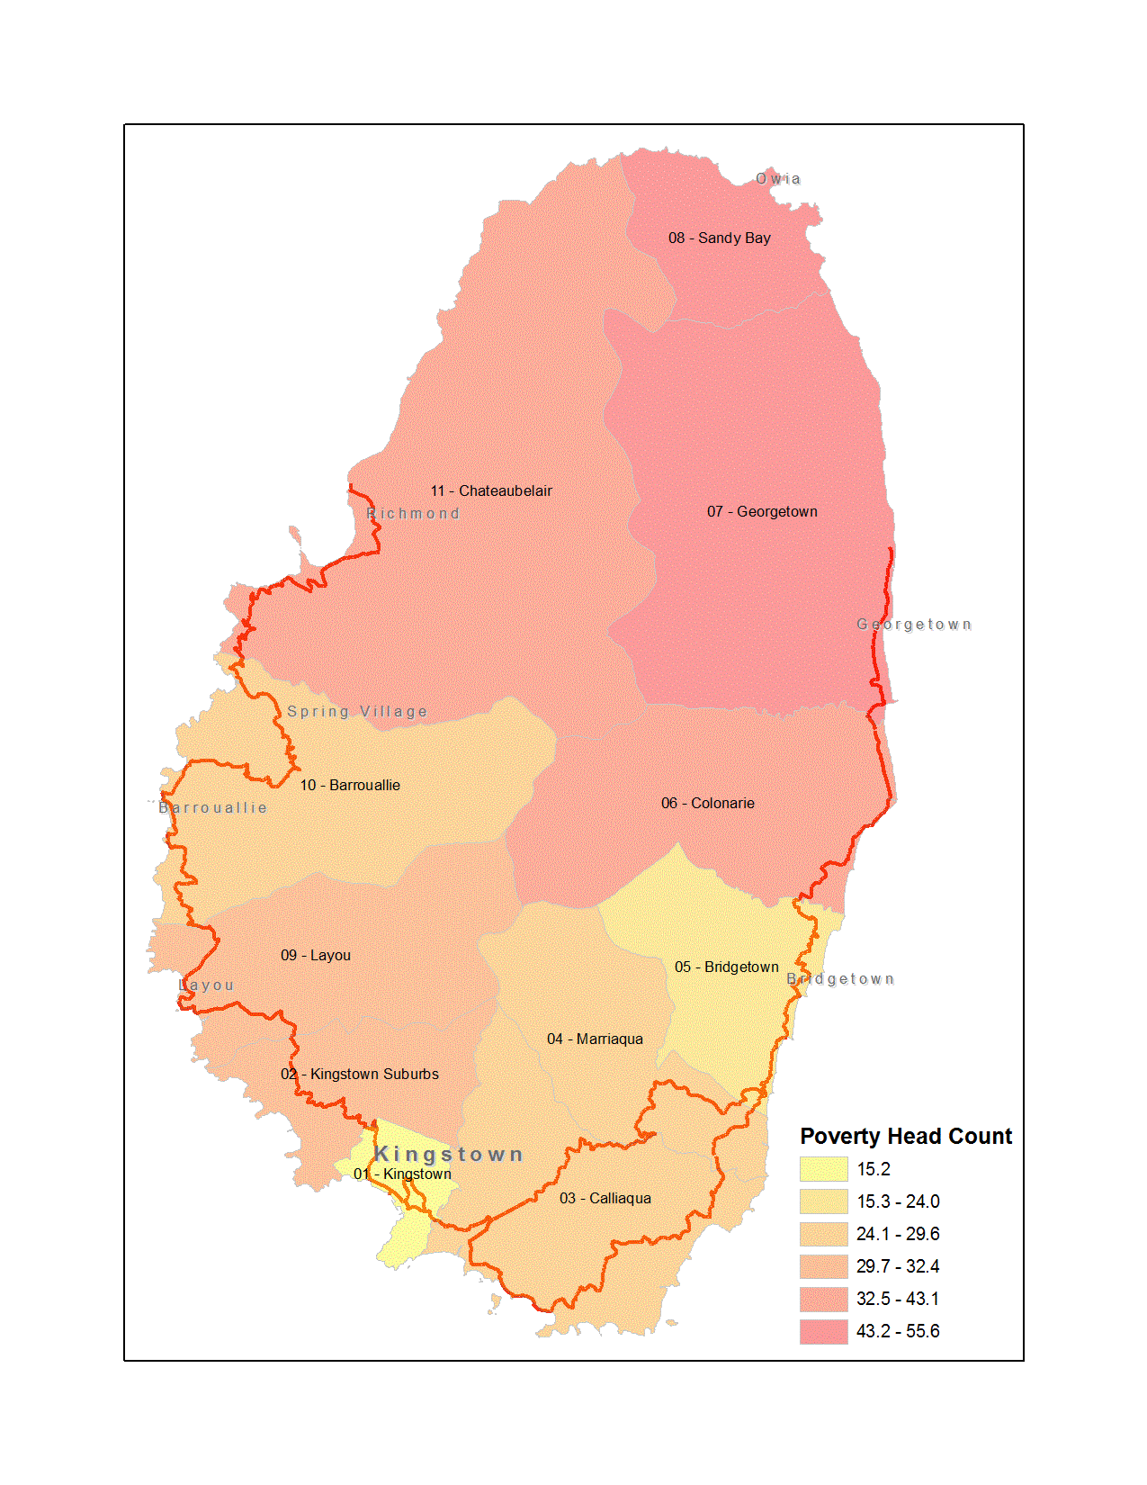
The poorest areas got the most rainfall: SVG
Maximum Rainfall Intensity in 3 Hours, Dec 24
Poverty Head Count, 2008
Max. 278 mm/3 hr
Min. 63 mm/3 hr

Slide 9
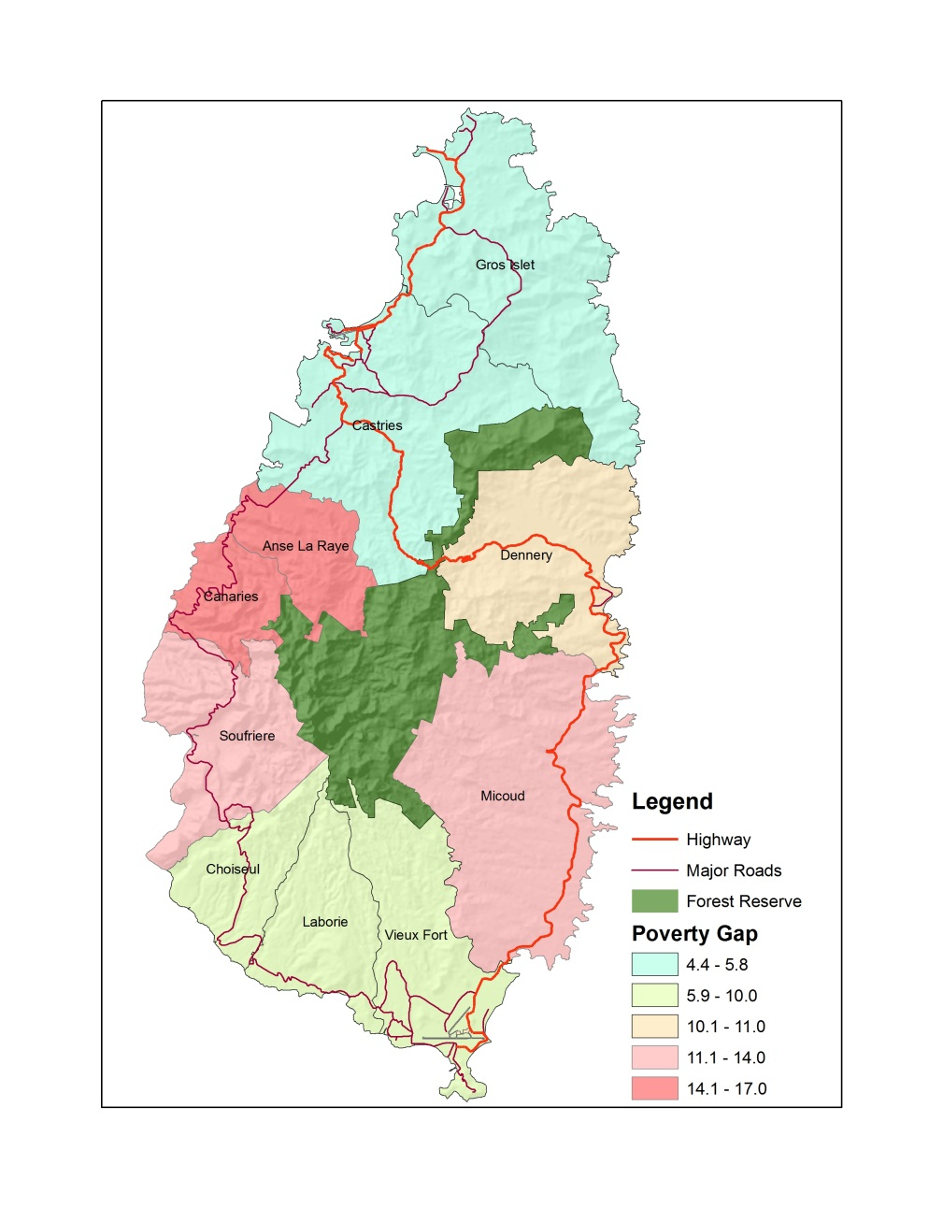
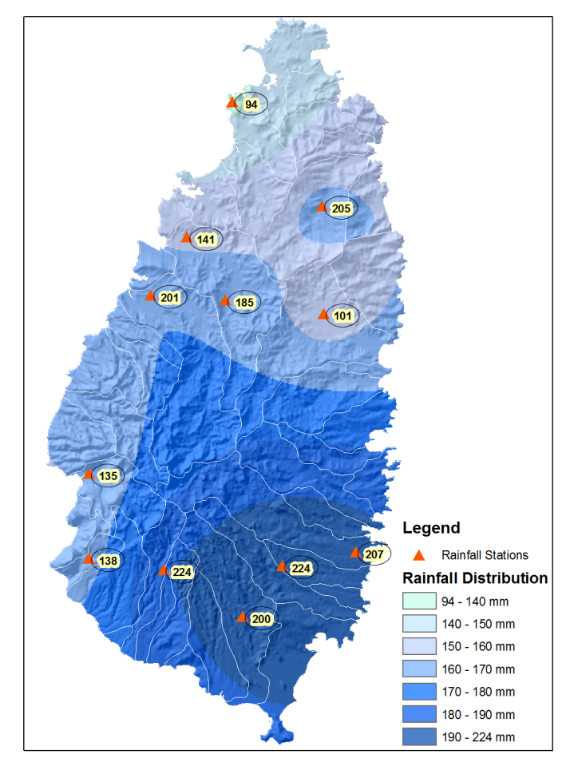
The poorest areas got the most rainfall: SLU
Maximum Rainfall Intensity in 3 Hours, Dec 24
Poverty Gap, 2005/06
Max. 224 mm/ 3 hr
Min. 94 mm/ 3 hr

Slide 10
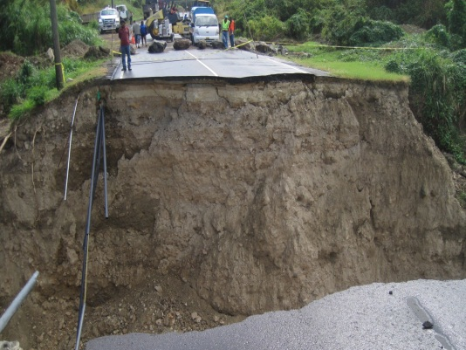
The Human Impact
33,000 people directly impacted
13,000 in SVG and 20,000 in SLU
15 killed
9 in SVG and 6 in SLU
775 persons displaced
225 in SVG and 550 in SLU
709 homes damaged or destroyed
662 in SVG and 47 in SLU

Slide 11
Damage and Losses: SVG
Sector |  | Damages (USD millions) |  | Losses (USD millions) | Total Damages and Losses (USD millions)
Infrastructure
 | Transport |  | $67.9 | $14.7 | $82.6
 | Water & Sanitation |  | $3.1 | $1.3 | $4.5
 | Electricity |  | $5.2 | $3.3 | $8.6
Social Sectors
 | Housing |  | $6.8 | $2.3 | $9.1
 | Health |  | $1.8 | $0.2 | $2.1
 | Education |  | NE | <$0.1 | <$0.1
Productive Sectors
 | Agriculture | $1.4 |  | NE | $1.4
 | Tourism | $0.1 |  | $0.1 | $0.2
 | Industry & Commerce | NE |  | <$0.1 | <$0.1
Total |  | $86.3 |  | $22.0 | $108.4
Infrastructure 88%
15% of GDP

Slide 12
Damage and Losses: SLU
Sector |  | Damages (USD millions) |  | Losses (USD millions) | Total Damages and Losses (USD millions)
Infrastructure
 | Transport |  | $68.8 | $3.1 | $71.9
 | Water & Sanitation |  | $2.3 | $4.1 | $6.4
 | Telecom |  | $0.1 | $0.4 | $0.5
Social Sectors
 | Housing |  | $2.15 | $1.6 | $3.7
 | Health |  | $0.2 | $0.1 | $0.3
 | Education |  | $0.8 | $0.1 | $0.9
Productive Sectors
 | Agriculture |  | $5.2 | $7.7 | $12.9
 | Tourism |  | NE | $2.1 | $2.1
 | Industry & Commerce |  | $0.4 | NE | $0.4
Total |  |  | $79.9 | $19.3 | $99.4
Productive
16%
Infrastructure 79%
8% of GDP

Slide 13
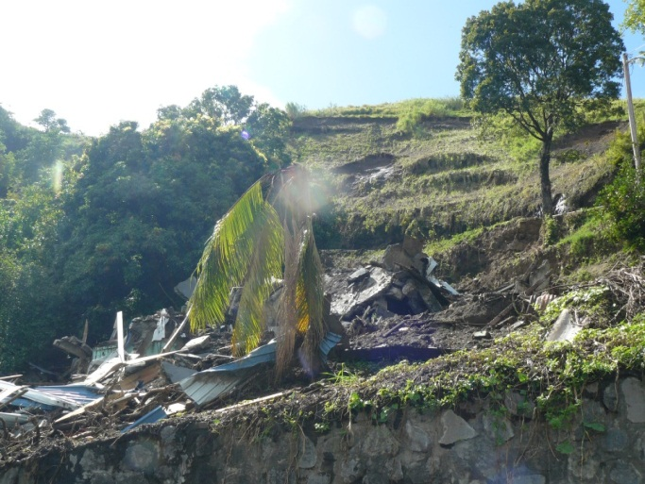
Overview
Caribbean Disaster Losses and trends
Country Profiles
Disaster Event
Impacts
Response to the Disaster
House that collapsed from slope failure where family of 5 died.

Slide 14
Response to the Disaster
SVG declared a state of emergency on December 26, 2013
SLU activated its National Disaster Plan on December 26, 2013
The National Emergency Management Organizations (NEMO) in SVG and SLU focused on immediate needs for relief
The Governments effected initial emergency response:
shelters were provided,
debris was cleared,
infrastructure repairs were initiated
The international community was quick to respond with humanitarian aid from the Red Cross, the Caribbean Development Bank, and other Caribbean countries
The Governments and World Bank coordinated a rapid Damage and Loss Assessment in January 2014

Slide 15
Financing Options
Reallocation within existing country portfolio:
SVG: <US$2 million available
SLU: <US$1 million available
Additional IDA 16 allocation:
SVG: <US$4 million available (IDA 16 fully committed)
SLU: <US$2 million available (IDA 16 fully committed)
Other Development Partners:
Humanitarian: SVG: US$3 million (CDB, PAHO); SLU: US$3 million (CDB)
Recovery/Reconstruction: SVG: US$5 million (Mexico); SLU: US$1 million (CDB)

Slide 16
Annex

Slide 17
Average losses due to extreme weather events for Caribbean countries from 1992-2011
Average Annual Losses per GDP (%)
() indicate Global Rank of 183 countries or territories evaluated.
Sorted by Losses per GDP (%)
Source: Harmeling, S. and Eckstein D. “Global Climate Risk Index 2013”. Germanwatch, November 2012. http://germanwatch.org/fr/download/7170.pdf

Slide 18
Barbados Doppler Radar
SVG
SLU
MAX SCALE 27mm/hr
Dec 24, 2013
9:00 – 10:00 PM
> 100 mm/hr
Dec 24, 2013
4:00 – 5:00 PM
> 75 mm/hr
278 mm in SVG and 224 mm in SLU over 3 hours represent a 1 in 100 year event for both islands
Notes:
An unseasonal tropical trough system produced heavy rains and high winds in SVG & SLU on December 24 and 25, 2013 between 9pm and 12am.
The extreme rainfalls of 278 mm in SVG and 224 mm in SLU over 3 hours represent a 1 in 100 year event for both islands.

Slide 19
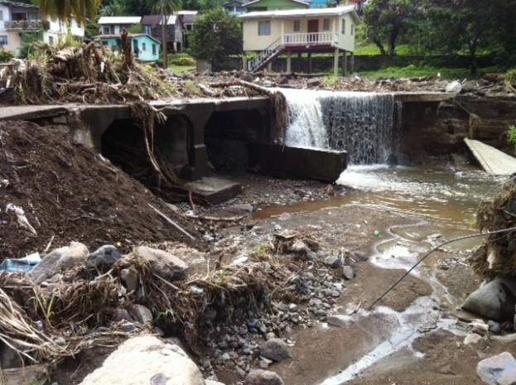
The Human Impact

Slide 20
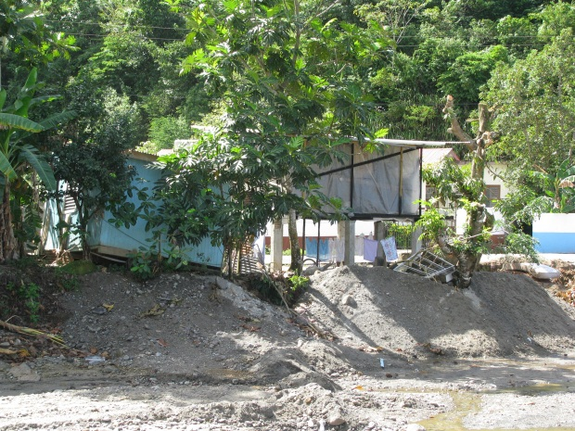
The Human Impact

Slide 21
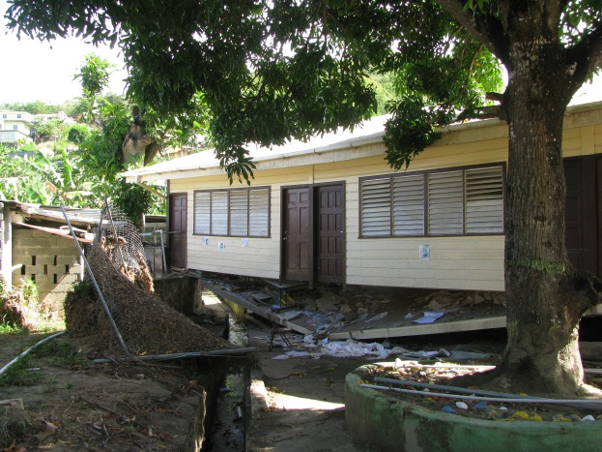
The Human Impact

