Slide 1
Hosted by the World Bank’s Social Sustainability and Inclusion (SSI) Global Practice; Agriculture and Food (AGF) Global Practice; Community and Local Development Global Solutions Group (CLD GSG); Rural Livelihoods and Jobs Global Solutions Group; and Local Economic Development Knowledge Silo-Breaker (LED-KSB)
Ethiopia Local Economic Development Webinar
May 17, 2023 4:00 pm - 5:30 pm (Ethiopia time) | 9:00 am -10:30 am (EST)

Slide 2
Welcome and webinar Overview by Chair & Moderator
Parmesh Shah, Global Lead, Rural Livelihoods and Jobs Global Solutions Group

Slide 3
Webinar Agenda
Chair & Moderator
Parmesh Shah, Global Lead, Rural Livelihoods and Jobs Global Solutions Group
Opening Remarks
Doina Petrescu, Manager Operations, World Bank
Nigatu Bogale, DRDIP National Coordinator, Ministry of Agriculture, Government of Ethiopia
Speakers
Matthew Stephens, Senior Social Development Specialist, TTL Ethiopia LED Pilot
Ashutosh Raina, Social Development Specialist, Co-TTL, Ethiopia LED Pilot
Fireside Chat
Mohamed Adulahi Farah, DRDIP Coordinator, Somali Region
Teresa Ongaro, Former Senior Inter-Agency Coordination Officer, UNHCR
Neway Alemayehu, Managing Director, INKOMOKO Ethiopia
Paul Joicey, Team Leader, SHARPE - Strengthening Host and Refugee Populations in Ethiopia
Rediet Abiy Kassaye, Program Manager, IKEA Foundation

Slide 4
Opening Remarks
Doina Petrescu, Manager Operations, World Bank
Nigatu Bogale, DRDIP National Coordinator, Ministry of Agriculture, Government of Ethiopia

Slide 5
Speakers:
Matthew Stephens, Senior Social Development Specialist, TTL Ethiopia LED Pilot
Ashutosh Raina, Social Development Specialist, Co-TTL, Ethiopia LED Pilot

Slide 6
LED Paper
The paper examines approaches to supporting rural livelihood in refugee-hosting areas across Ethiopia, building on the experience of the long-standing Development Response to Displacement Impacts Project or DRDIP, and other programs.
Here is a link to access the paper

Slide 7
Key findings
Limited information about LED actors
There is limited information about who is doing what, what we can learn from each other’s projects and experiences, and how we can leverage each other’s strengths and weaknesses to amplify impact.
Lack of common vision for LED, limited coordination and planning among LED actors
Multiple programs/initiatives to support livelihoods are going on in an ad hoc manner in refugee-hosting districts.
Implemented by a mix of government, non-government, development, and humanitarian actors, each project tends to operate in isolation.
Despite heavy investment in livelihood and employment generation programs, results have not been achieved at the scale and impact necessary to move beyond subsistence.
Limited last-mile delivery of quality and comprehensive LED support services (financial services, customized extension services, markets, business development services) to communities
Communities need intensive and comprehensive LED support at the doorstep including financial services, customized extension services, markets, business development services
This would mean an emphasis on greater interface with markets, private sector, and financial institutions
The paper concludes that the multiple, ad hoc and often poorly coordinated approaches to supporting livelihood for host community members and refugees have not been able to generate the desired impacts.

Slide 8
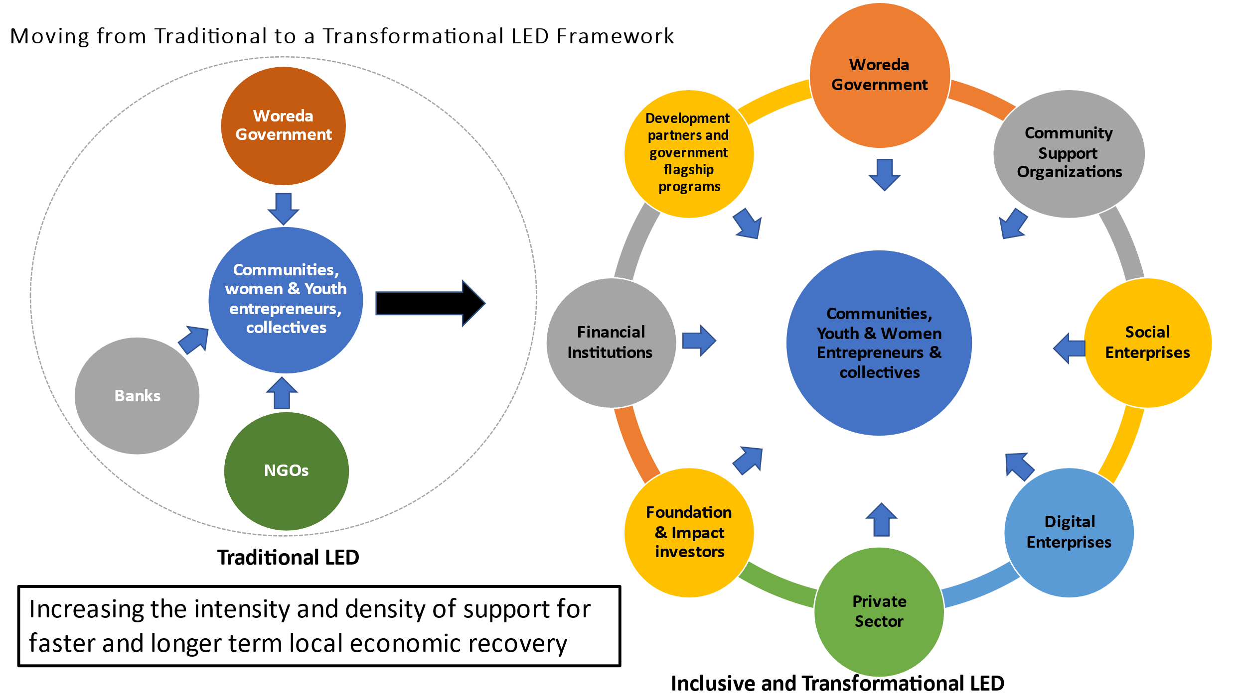
LED Paper Recommendation
The paper calls for a new way of working to scale up the impact of the interventions by moving away from a project-based approach toward a platform-based one that creates synergies and leverages the potential of community support organizations, social enterprises, digital enterprises, and the private sector.
Moving away from a project-based approach toward a platform-based

Slide 9
Local Economic Development (LED) pilot overview
Objective: To build the capacity of the Woreda government to pilot a local economic development (LED) approach in one refugee-hosting woreda to improve coordination among LED actors to provide more comprehensive livelihood support to communities.
Pilot Duration: February 2023 to December 2024
Pilot Woreda: Kebribeyah
The team that prepared the paper is starting the implementation of a LED pilot to operationalize its key findings in one Woreda in the Somali region to develop a proof of concept.
LED is a territorial approach and is defined as a process by which public, business, and non-governmental sector partners work collectively to create better conditions for economic growth and employment generation

Slide 10
LED Pilot Focus Areas
a) Create an enabling environment for coordination of an inclusive LED ecosystem approach at the Woreda Level
•Carry out LED stakeholder mapping and analysis
b) Strengthen Woreda LED implementation architecture and last-mile service
delivery capacity through a partnership approach (Leveraging on DRDIP and other similar existing programs)
• Support aggregation of existing cooperatives/community/livelihoods groups
• Greater emphasis on financial empowerment and linkages to financial institutions
• Strengthen linkages with markets and private sector
c) Monitoring, Knowledge Management and Learning at the Woreda level
• Monitor the performance and impacts of LED pilot activities
• Document operational learning and processes throughout the pilot and develop an LED operational toolkit.
• Organize knowledge sharing events and support peer to peer learning
•Build LED public-private partnership platform and strengthen LED coordination
•Strengthen the capacities at the Woreda for effective LED governance, public-private partnerships, and integrated LED planning
•Develop Woreda LED strategy and action plan and incorporate in Woreda Development Plans
• Support linkages with social enterprises and digital service providers
•Promote linkages with complementary economic infrastructure.

Slide 11
Expected outputs
Training material on LED approach for Woreda governments
Note on Woreda LED stakeholder mapping and analysis
Note on Woreda LED strategy
LED operational toolkit to help replicate and scale up the approach in other Woreda
Lessons learned note

Slide 12
Expected Results:
The anticipated impact after the pilot period:
Improved coordination among LED partners and initiatives
Increase in the number of public-private partnerships linking communities to market, private sector, financial institutions, and digital services in target areas
Improvements in last-mile LED service delivery in target areas
Increase in access to finance through financial institutions in target communities
Increase in the density of nano or microenterprises in target areas
Increase in job opportunities in target areas
Increase in participation of women in economic activities in target areas

Slide 13
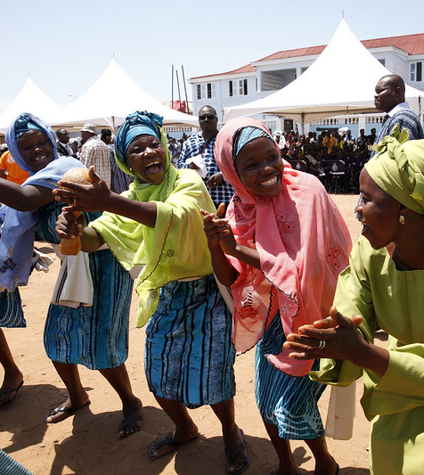
Fireside Chat:
Mohamed Adulahi Farah, DRDIP Coordinator, Somali Region
Teresa Ongaro, Former Senior Inter-Agency Coordination Officer, UNHCR
Neway Alemayehu, Managing Director, INKOMOKO Ethiopia
Paul Joicey, Team Leader, SHARPE - Strengthening Host and Refugee Populations in Ethiopia
Rediet Abiy Kassaye, Program Manager, IKEA Foundation

Slide 14
Audience Questions

Slide 15
THANK YOU
THANK
YOU

