Slide 1
Co-hosted by the World Bank’s Community-Driven Development Global Solutions Group Data-driven and Digital Agriculture Community of Practice; Local Economic Development Knowledge Silo Breaker (LED KSB)

Slide 2
Today’s Structure
Ignite Talks
Fireside Chat
Audience Q&A (15 mins)
Conclusion

Slide 3
Blockchain Innovations at the World Food Programme
Bernhard Kowatsch Head of WFP Innovation Accelerator
UN World Food Food Programme Twitter: @BKowatsch
#disrupthunger
@WFPInnovation
WFP Innovation Accelerator

Slide 4
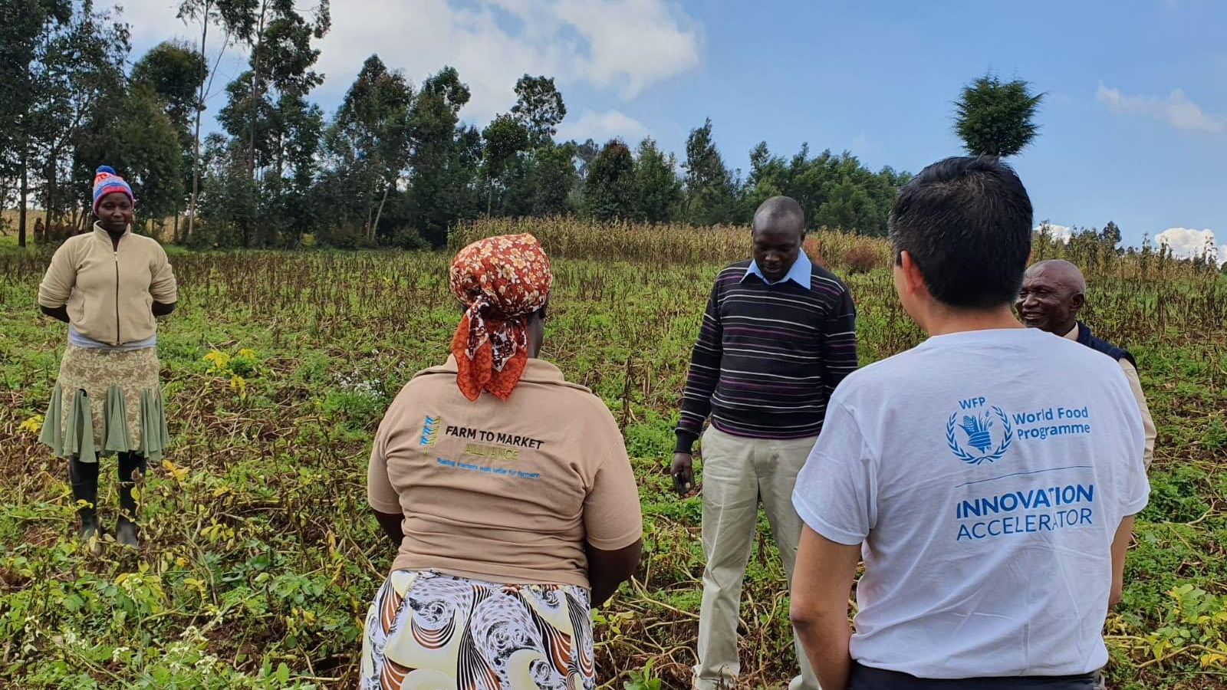
The WFP
Innovation Accelerator
sources, supports and scales high-impact innovations to disrupt hunger.
Notes:
Now that I’ve given you an introduction to the World Food Programme, I’d like to introduce you to the WFP Innovation Accelerator. Established in 2015, the WFP Innovation Accelerator sources, supports and scales high-impact innovations to disrupt hunger. Based in Munich, we provide WFP employees, entrepreneurs and startups with funding, support and access to WFP’s global operations.

Slide 5
WFP Innovation Accelerator’s path to scale
Scale-up Enablement
14
PROJECTS
Sprint Programme
90+
PROJECTS
Innovation Bootcamps
34
COHORTS
335
TEAMS
Innovation Sourcing
6100+
APPLICATIONS
Frontier Innovation
Field innovation hubs in Tanzania, Jordan, South Sudan
First Regional Innovation Hub: Nairobi
Full programme virtual
Notes:
This is our path to scale.
At its base is our Frontier Innovation programme: our research and development wing. We actively explore new trends, game-changing technologies and long-term project strategies that can help move us towards Zero Hunger.
We take those learnings to proactively source innovative ideas to disrupt hunger and have processed more than 5,000 innovative applications since launching in 2015. Every year, we host multiple Innovation Challenge campaigns, but also accept applications at any time. We have a rolling application process and review applications multiple times a year.
Successful applicants are selected for our Innovation Bootcamps: five-day, high-intensity workshops to help teams dive deep into challenges, ideate solutions and refine project plans. Twice a year, we source up to 10 teams based on a competitive application process with a one percent acceptance rate, offering a life-changing experience with expert mentors and facilitators. Over 50 percent of participating teams go on to receive funding and support.
The best teams are selected for our Sprint Programme, an intense six-month acceleration programme that matches innovators and startups with exceptional support to sprint from idea to impact. Successful applicants to our Sprint Programme receive access to US$100,000 in funding, world-class mentors, results-driven programming, and WFP’s vast field operations. On average, our Sprint projects hit 69 percent of their targets within six months.
We scale-up high-impact innovations through our Scale-Up Enablement Programme, featuring tailored strategic planning, fundraising, communications, knowledge management and mentorship support. We scale-up innovations that have the potential to significantly disrupt hunger by improving the livelihoods of over 100,000 people, increasing efficiency and effectiveness across multiple countries. On average, our scale-up projects raised $2 million in funding in 2019 alone.

Slide 6
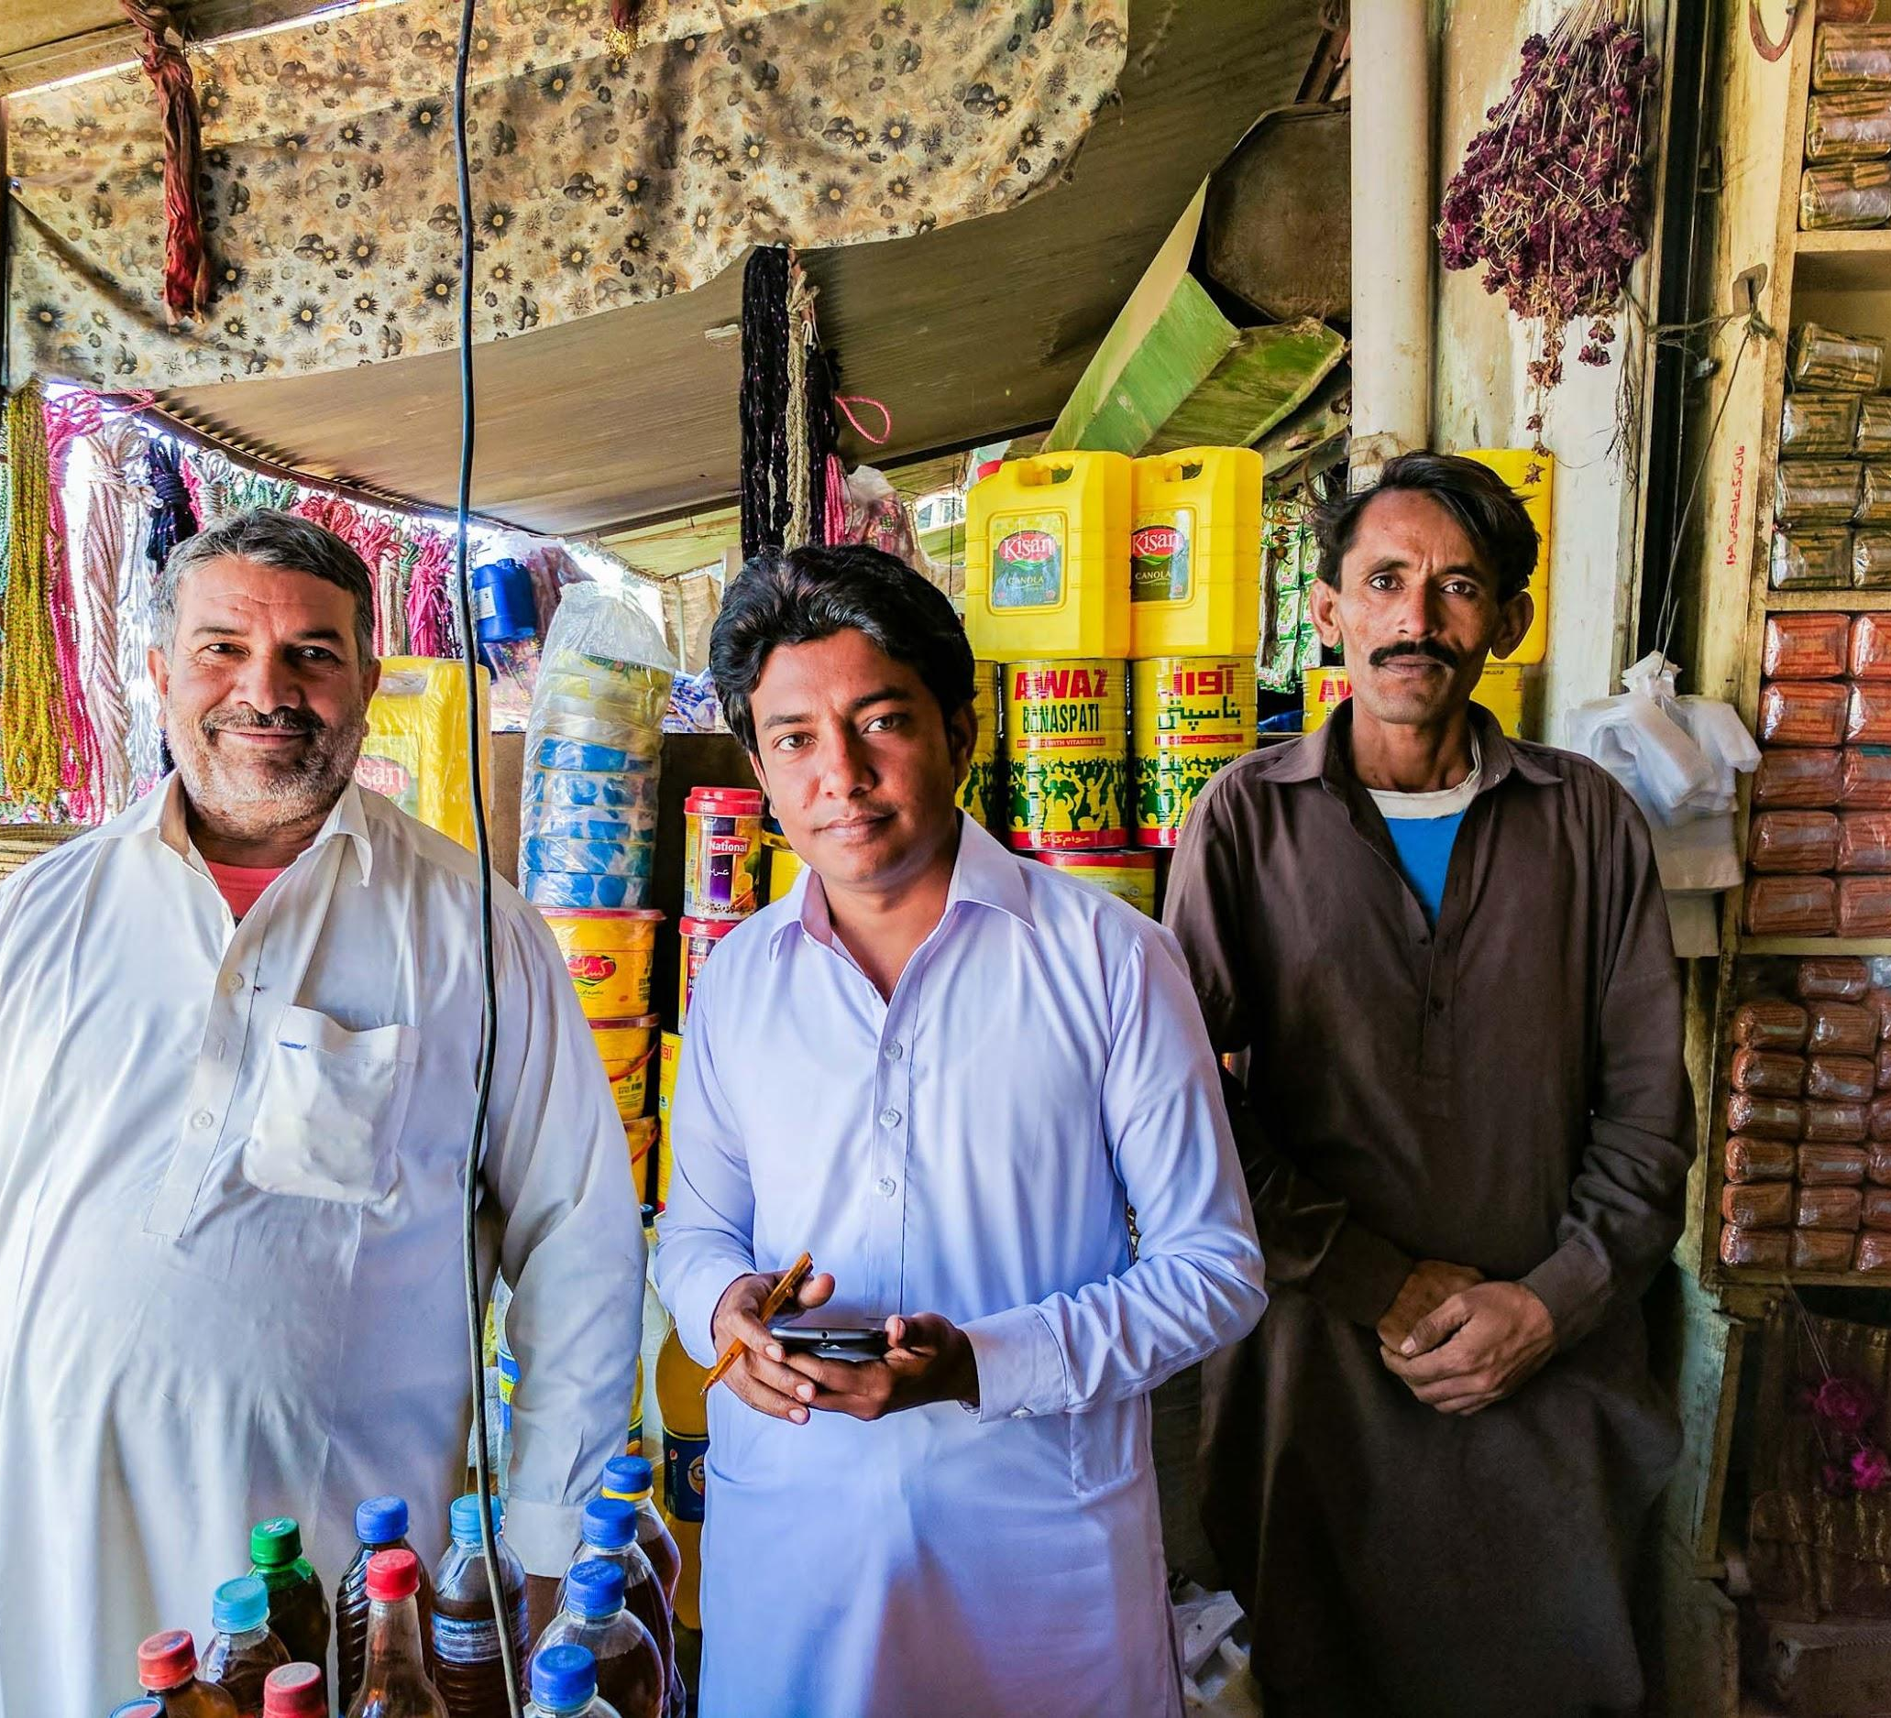
Building Blocks Bangladesh | Jordan
WFP’s Building Blocks project is the humanitarian sector’s largest blockchain-based cash distribution system, leveraging blockchain to coordinate with other humanitarian agencies and transfer cash assistance to refugees securely and efficiently.
over
910,000
Refugees reached to date
98%
saved in financial
transaction fees
Notes:
WFP’s Building Blocks uses blockchain technology to distribute US $104 million over 6.3 million cash-based assistance transactions to over 400,000 Rohingya refugees in Cox’s Bazaar, Bangladesh, and Syrian refugees in Jordan.

Slide 7
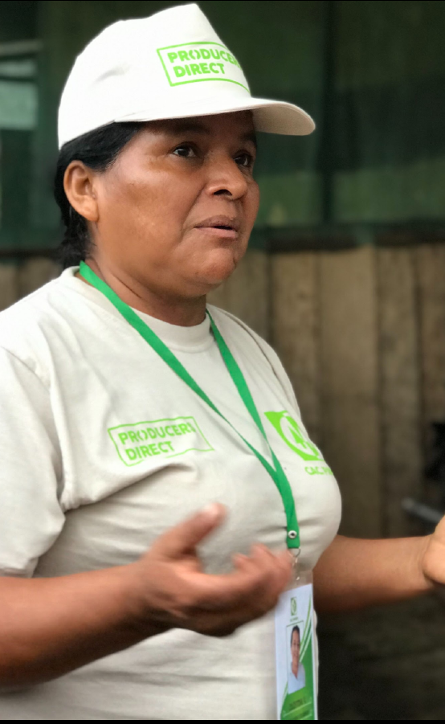
Producers Direct
Peru CO
Smallholder Farmers
Increased inclusion in food value chains for Peruvian female farmers will increase financial
independence, food security, and incomes.
Active Sprint: Producers Direct is currently working with female smallholder farmers and several local youth members in Peru. The team is providing training ih in several topics such as cooperatives, biosecurity and access to markets. The team will be working on creating a digital system to aggregate the farmers produce and connect the farmers to markets, increasing the community’s income.
Female smallholders are disproportionately marginalised from global food production systems. Although women make up 50% of the agricultural labor force, women do not have equal access to structured food value chains, and are forced to sell their crops for less than it costs to produce them, furthering the cycle of poverty, food insecurity and women’s disempowerment in rural smallholder communities.
Producers Direct - Digital Cooperatives is a tool powered by blockchain technology to create dynamic digital cooperatives specifically for the most marginalised groups - female smallholders and youth - who have limited profiles in global food value chains. The team will then empower them to scale-up their on-farm diversification products and facilitate market access, payments and digital records utilising blockchain.
http://producersdirect.org/| @ProducersDirect

Slide 8
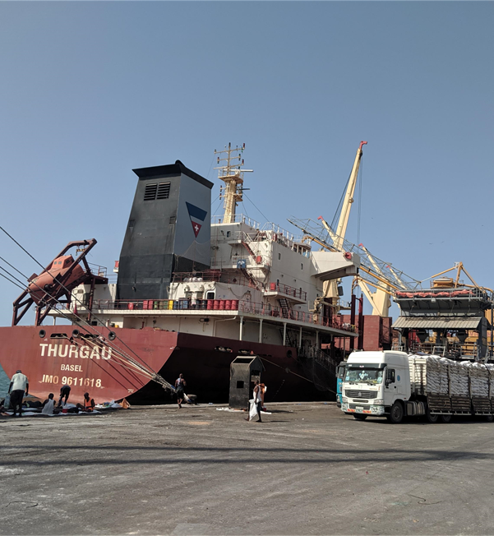
Blocks for Transport
Blocks for Transport
Ethiopia and Djibouti CO
Supply Chain
Aim to streamline the logistics process and reduce delays in the Djibouti-Ethiopia corridor
Lack of timely availability of over 15 documents along the supply chain and 40+ interactions between stakeholders results in delays along the Supply chain process in Djibouti and Ethiopia Corridor.
A digital platform to have a single source of truth, enabling access to original documentation for relevant stakeholders, could shorten the time delay for the movement of goods across the corridor
First POC tested in Ethiopia and Djibouti in June 2019. The second iteration of the product was completed in Feb 2020. Due to the travel restrictions, we are unable to test the second iteration. Currently, we are exploring OCR technology to digitize shipping documents that will be shared on the platform.

Slide 9
It’s time to #disrupthunger.
innovation.wfp.org
global.innovation@wfp.org
@WFPInnovation
WFP Innovation Accelerator

Slide 11
Vision
Billions of people are excluded from or underserved by the financial system, limiting their ability to build assets and leaving them caught in a poverty trap from which it’s almost impossible to escape.
FinX aims to accelerate global financial inclusion by advancing innovative, responsible distributed ledgers, digital assets, cryptocurrencies and other digital financial solutions that help people join the global economy and lift themselves out of poverty. We will fund and support a portfolio of solutions that leverage emerging technologies and business models — launching them on a path to reach 10 million people in the next decade and creating a roadmap for an inclusive financial system for the world’s most vulnerable populations.

Slide 12
Provide Capital
to High-impact Enterprises
FinX
Co-design and Pilot
New Solutions for the Underserved
has four operational pillars to generate real world use cases and build the evidence base of emerging fintech solutions
Build Capacity
to Leverage Transformative Fintech
Research and Learning
to Measure Impact and Share Insights

Slide 13
FinX Approach to Pilots
Piloting is hard and expensive.
Ventures often do it poorly and come out the other side without actionable insights.
We invest in & partner with emerging ventures leveraging technology to create access to and use of financial services. Our team works with ventures to rigorously pilot new products and prototypes to increase loan-to-value and deepen impact.
Tools & Experts
Catalytic Partnerships
Blockchain / Crypto Expertise
We bring the frameworks, and value-add experts needed to get from concept to product, de-risking the product development process and helping ventures to achieve their vision for impact.
We leverage our growing ecosystem of ventures and partners in frontier markets to strengthen the potential to scale up.
Our team understands the blockchain and crypto ecosystem and knows how to navigate and understand users in frontier markets.

Slide 14
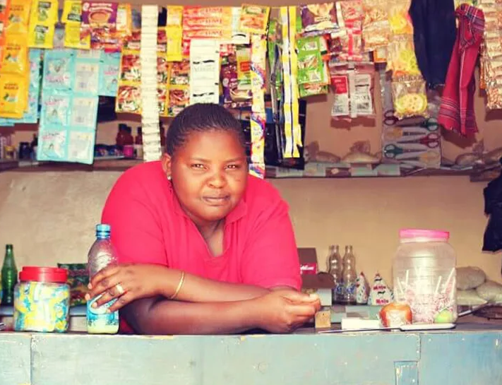
USE CASE 1
DIGITIZING MSME SAVINGS & INCENTIVES
MARKET NEED
Informal, unbanked retail microentrepreneurs perform >90% of business transactions in cash and struggle to separate business cash and personal cash, often spending working capital on non-income-earning items.
FINX HYPOTHESIS
Digital wallets and DeFi integration can incentivize digitization and strengthen financial resilience by improving access to secure savings mechanisms and contributing to building a credit history based on past transactions.
Currently piloting with 200 informal, unbanked SMEs in Rwanda with Sokowatch

Slide 15
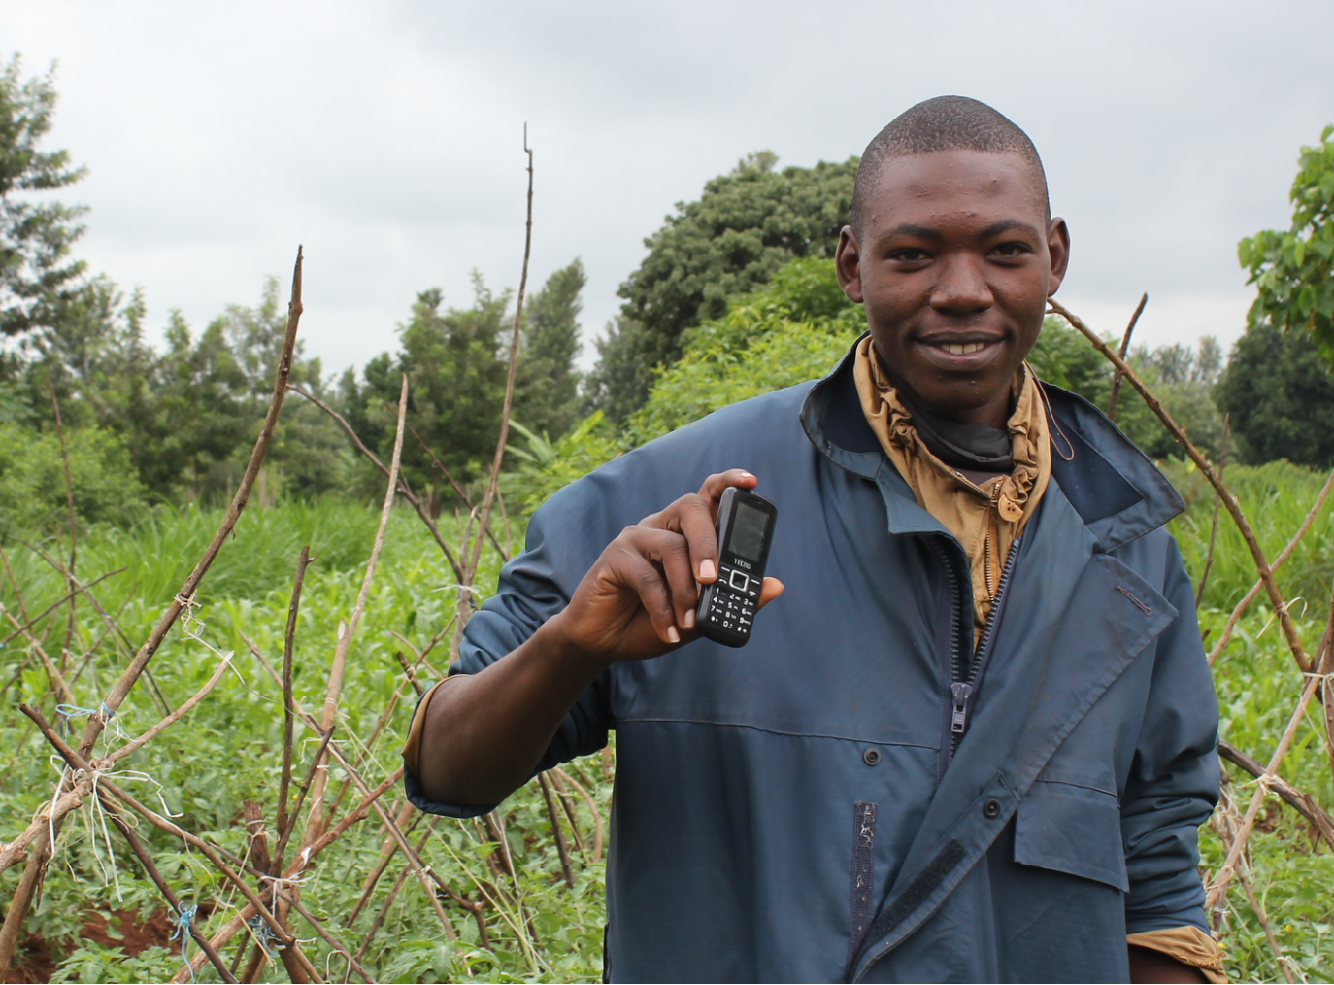
USE CASE 2
SMALLHOLDER RESILIENCE & INSURANCE
MARKET NEED
Low awareness of insurance products and their benefits, the high cost of premiums, and long, complex and multi-step claim settlement processes have restricted farmer trust and uptake of crop insurance services.
FINX HYPOTHESIS
Integrating blockchain-based smart contract automation into agricultural insurance products will lower premiums, reduce payout times, and increase transparency for smallholder farmers at scale.
Currently piloting with 10K smallholder farmers
in Kenya with Acre Africa

Slide 16
USE CASE 3
X-BORDER MICROPAYMENTS & REMITTANCES
MARKET NEED
Unbanked populations pay exorbitant fees often via black market services in order to access basic remittances and micropayments. Such services are highly valued for refugee populations fleeing fragile contexts as well as the unemployed youth seeking flexible online work opportunities..
FINX HYPOTHESIS
Integrating stablecoins and digital wallets for refugee populations and unemployed youth can improve access to secure, low/no-cost remittances and micropayments at scale even in fragile contexts..
Currently piloting with 10K smallholder farmers
in Kenya with Acre Africa

Slide 17
USE CASE 4
SUPPLY CHAIN TRACEABILITY FOR SMALL-SCALE PRODUCERS & ARTISANS
MARKET NEED
Despite billions of dollars invested, most companies struggle with visibility throughout their supply chain. Traceability processes are particularly slow and manual beyond tier-one suppliers.
FINX HYPOTHESIS
Low-cost, first-mile blockchain integration solutions will reduce transaction speeds and increase transparency for global supply chains, while improving agency for small-scale producers and artisans.
Planning pilot for late 2021

Slide 18
Join Us
We are welcoming partners under this initiative to strengthen and scale our work. UC Berkeley, IDEO CoLab and the Gates Foundation have signed on to learn with us. We are building a coalition of partners to create a roadmap for a more inclusive financial system, with the needs of the world’s most vulnerable people at the center of its design.
For more, check out the FinX blog!

Slide 19
Co-hosted by the World Bank’s Community-Driven Development Global Solutions Group Data-driven and Digital Agriculture Community of Practice; Local Economic Development Knowledge Silo Breaker (LED KSB)

Slide 20
WBG Information Technology Solutions
ITS Technology & Innovation Lab
April 1st 2021

Slide 21
WBG Information Technology Solutions Vice Presidency/CIO
FY21
ITS Technology & Innovation Lab/Unit
Exploration Sandbox & Technology Advisory on Emerging Technologies Operationalization
Explore, Prototype & Experiment
Blockchain for Transparent Tracking of Singh/Pakistan Agriculture Equipment
AI for Post Procurement Reviews (PPR)
AI for IBRD Treasury Green Bonds and Project Stories Reporting
Blockchain for WB Trust Funds’ Disbursement & Traceability
AI & ML for South Africa Job Matching
Bangladesh Land Resettlement
AI for Legislation Screening (Romania Procurement Agency)
AI for HR e-Performance
Blockchain for Pharma Supply Chain
Ethiopia Fintech for SMEs Growth
Redesigning Social Service Delivery in Tunisia
IFC Building Resilience Index
AI for IFC Integrity Due Diligence
AI to Safeguard IFC Investments
Gaming technologies for Climate Resilience
South Africa Psychometric Gaming Tool
Emerging Tech for Decentralized Climate Markets (Paris Agreement Article 6.2)
Sierra Leone Transit Fare
Verifiable claims for Labor Mobility in Tonga
ITSTI Lab’s Emerging Tech Exploration Sandbox provides a safe environment to design, do agile and rapid prototyping and test the viability and feasibility of emerging technologies’ potential to solve development and operational problems, identify adoption risks and challenges, to be considered by the WBG and client countries.
Methodologies & Toolkits
Foresight & Scenario Planning
Systems Design
Design Thinking
Emerging Tech Exploration Sandbox
Technology Expertise & Hands-on Skills
Infrastructure & Software Components & Capabilities
Technology Advisory for Operationalization
AI for IFC ESG
Blockchain for Health Results Based Financing in Cote d’Ivoire
Blockchain for Haiti Agri Value-chain
Blockchain for Micro-pension & Retail Bonds in Kenya
Iraq FCV Project Monitoring Digital Platform
Blockchain for India Irrigation Performance Measurement
AI & ML
xAI
Blockchain & DLT
5G, IoT, Edge Computing, Cybersecurity
3D & Robotics
Technology Foresight & Scenario Planning
Technology Foresight for Bangladesh Disruptive Technology Assessment
Foresight & Scenario Planning for Accelerating Human Capital Development in SAR

Slide 22
ITS Technology & Innovation Lab Focus Areas
FY21
Expand & Deepen knowledge about emerging technologies’ potential through Sandbox Exploration & Hands-on Experimentation.
Support WBG operations (external and internal)
to operationalize emerging
technologies (incubation, scaling, knowledge sharing, tech advisory).
Support WBG teams to explore innovation & tech for Sectoral & Systems’ Transformation (through Human-centric Design, Foresight, Systems’ Design).
Knowledge & Partnership Hub innovation & tech for Development.
1
2
3
4
Sensemaking* Foresight & Future Thinking | Human Centric Design* Systems’ Design | Operationalizing Innovation & Tech*
ITSTI Foresight & Scenario Planning Playbook Capture, sense-make, translate trends, drivers & signals of change; create future ready interventions (Societal, Technological, Normative, Operational). | ITSTI Innovation & Systems’ Design Playbooks Explore, experiment & design innovative tech-enabled solutions at the project & systems’ levels by applying a human-centred multi-disciplinary approach. | ITSTI Operationalization Playbook & AI Playbook 1.0 Technology advisory on operationalizing (scaling) innovative-tech enabled projects in WBG operations.
*Since 2017, the Lab has been applying innovative methodologies & playbooks to explore and build knowledge around emerging technologies, innovative business models and operationalization frameworks with WBG teams in over 40 use cases/projects across 17 Global Practices/Sectors.

Slide 23
ITSTI Contribution to Explore & Operationalize Emerging Technologies for Development Impact
FY21
Explore
Exploration Phase
10-12 Week Journey
Incubate
Scale
Your
Challenge
Innovative Tech-Enabled Project
Value we Provide:
Tech Advisory and/or the use of a human-centric and systems design approach to do hands-on experimentation and prototyping to co-create innovative service delivery models enabled with emerging technologies.
How to Engage with us:
Bring your challenge/problem and provide us some context and we will work with you using out sandboxing approach to see if there is an innovative tech-enabled project to help solve it!
Outputs:
Lab Prototype*, Viability Report and other supporting artefacts including, Learnings, Insights, Key Findings
Operationalization Phase
3-6 Month Journey
Value we Provide:
Tech Advisory and/or our support to “Translate” key findings, innovative insights and learnings from the exploration prototypes into operationalization approaches and frameworks to support the scaling of innovative tech-enabled projects.
How to Engage with us:
Following Exploration, we can work with you to ​design an innovative service delivery business model​, define the incubation & scaling approach & framework, and help to develop out the technical requirements & future solution architecture designs and supporting artefacts.
Outputs:
Operationalization Artefacts, such as Business Model Canvas, Feature Map, Blueprint & Roadmap; Operating Model; Feature Tech Matrix, Technical Requirements, & Solution Architecture Designs
*Technical Prototypes designed and developed in the ITSTI Sandbox during the Explore stage, are meant for learning purposes only, to support WBG teams learn and better understand the emerging technologies’ capabilities and how best to define and operationalize innovative tech-enabled solutions in WBG internal & external operations. The prototype code is not meant for and shall not be utilized for developing production-level systems.

Slide 24
Financial Inclusion - Micro-Pensions in Kenya
The Challenge :
The MBAO Pension Scheme is a pension plan designed for informal sector workers in Kenya, It leverages the M-Pesa mobile money platform and has been in operation for over 7 years with 76 thousand members to date. It has fallen short of its goal to reach the 14 million informal sector workers in Kenya who are excluded from the current pension system.
A WBG study identified the root cause as the current administrative platform was not sufficiently robust enough to acquiring the scale needed to secure the scheme viability in the long run. Thus produced the recommendation to improve the existing scheme by focusing on developing the pension administration functions with a using technology, with the vision to create a “New Administrator “ entity that can be leveraged as a template for other micro-pension schemes as a public good.
The Request :
Explore the use of distributed ledger technology ( DTL, blockchain) to design a specialized administrative platform that can better support enrollment ;retention services of prospects/ members and management micro-level contributions efficiently this includes record keeping , registration, easy access to information on products and services. Understanding the scale needed to secure the scheme viability in a cost-effective manner.
.
Expected business outcome :
A Proof of concept ( lab prototype) that can inform a successful pilot that can be spun off toward further development of a platform that could:
Reduced barriers of entry and Increase financial inclusion.
Encourage the creation of a market for Micro-Pension Schemes that can flourish in Kenya.
Drive increased demand for the goods and services for Pension Scheme products and intrinsic long-term savings.
Spark innovation and demand for bundled products and services that Micro-Pension Schemes could include as part of their product offering.
Stakeholders:
Sponsor /Client– Fiona Elizabeth Stewart (GFCLT )

Slide 25
Blockchain for Transparent Tracking of Agricultural Equipment Singh/Pakistan
Background Information:
Development Objective (PDO) of this project is to improve the productivity and market access of small and medium producers in important commodity value chains.​
The Challenge:
Currently in the eco system of SAG project, there is no real-time data of beneficiaries (farmers) and the purchased agricultural equipment. The whole cycle of issuing the purchase order to supplier, receiving the equipment from supplier, then delivering this equipment to farmers and finally getting feedback is scattered in manual and paper-based forms. The absence of linkage in the full cycle increases the level of errors and causes incorrect reporting which eventually reduces the trust on data. The ISTTI Lab worked closely with Governance and Agriculture Global Practices to explore blockchain to solve this challenge. Based on the learnings from the exploration stage, the Pakistan government has operationalized the project in partnership with external technology partners.
The Objective:
The objective of this use case was to produce a working prototype that records the transactions on the blockchain to further streamline the procurement process of equipment financing for farmers in Sindh, Pakistan. From the time a contract is created, and a purchase order (PO) made, the details of a specific contract and PO should be captured using blockchain.
The Benefit:
By storing transaction details made by purchaser and supplier on blockchain, we create an independent, transparent system where beneficiary and equipment distribution information cannot be manipulated, and all stakeholders can have access to comprehensive view of agriculture data instantly.
Notes:
There is a sense that the equipment may have gone to the wrong people. It is hard to ensure today that the equipment is going to the real beneficiaries.​
There is no comprehensive view of agricultural data (including farm equipment distribution) across all provinces in Pakistan. The last time the team sought a list of agricultural items (threshers, etc) and beneficiaries, the effort took two years.​

Slide 26
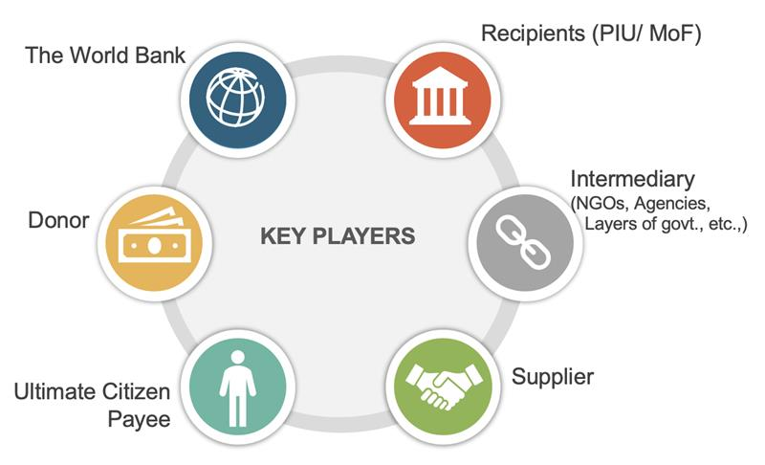
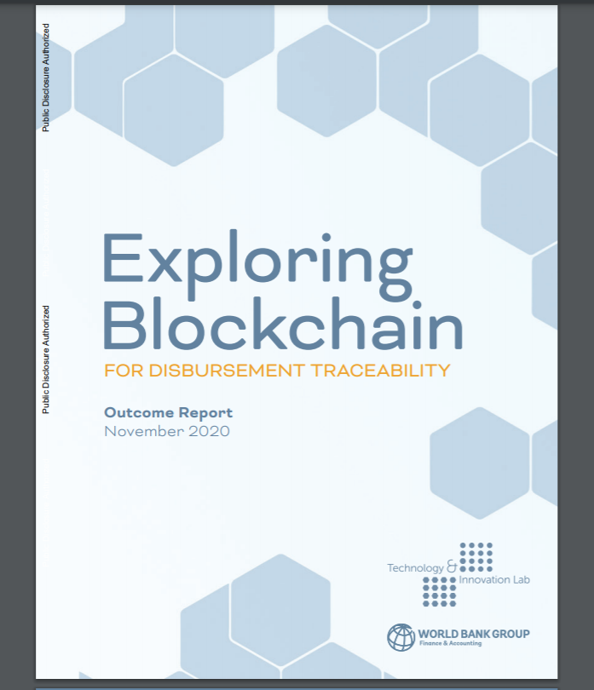
Blockchain for Funds Disbursement Traceability
The Challenge:
The effective monitoring and evaluation of the WB funded projects is challenging due to:
Inaccessible records due to disparage storage and when only hard copies are available
Difficulty to obtain records if PIU closes after project completion
Labor-intensive coordination efforts to retrieve documents from all stakeholders
The Objective:
Explore how blockchain technology for automating traceability of disbursements and capture documents evidencing work performed and payments related to WB projects
Ensure the seven types of disbursement payment scenarios are addressed
Protect the privacy and confidentially of records
The Benefit:
Provide World Bank, Donors and Auditors visibility into disbursements beyond Borrower
Improve efficiency through business process engineering and tracking flow of funds
Ensure and verify that project funds are delivered to intended beneficiaries
The Client:
World Bank Finance and Accounting (WFA)

Slide 27
Let’s Work Together
FY21
Want more information? Contact us at TechnologyInnovation@worldbankgroup.org
Visit our website http://ITSInnovation
Read our Publications :
Join our Yammer Groups:
ITS Technology & Innovation
Blockchain - Legal & Policy Community
Blockchain - Technology Community
Blockchain - Security Community
Artificial Intelligence
5G & IoT Lab
Collaborate2Innovate
Learn2Innovate
Exploring-blockchain-for-disbursement-traceability-outcome-report
Blockchain-interoperability Report
Communicate2Innovate

Slide 28
Co-hosted by the World Bank’s Community-Driven Development Global Solutions Group Data-driven and Digital Agriculture Community of Practice; Local Economic Development Knowledge Silo Breaker (LED KSB)

Slide 29
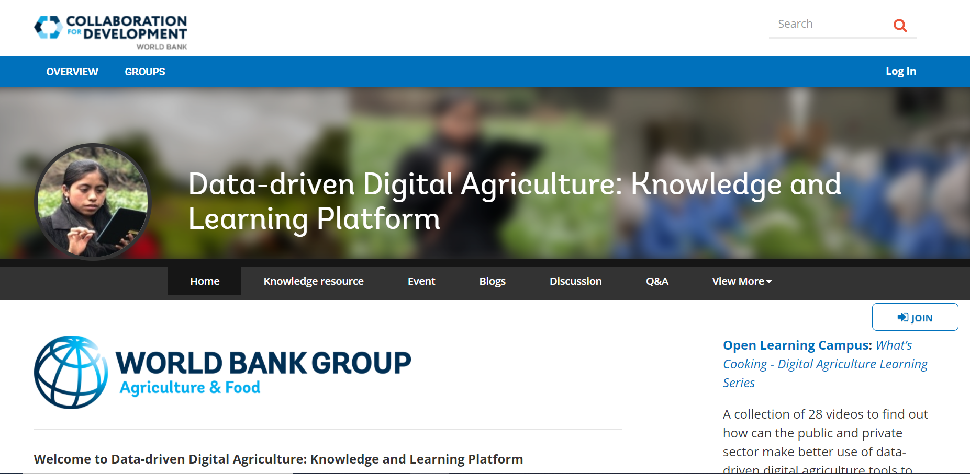
www.worldbank.org/digitalagriculture

Slide 30
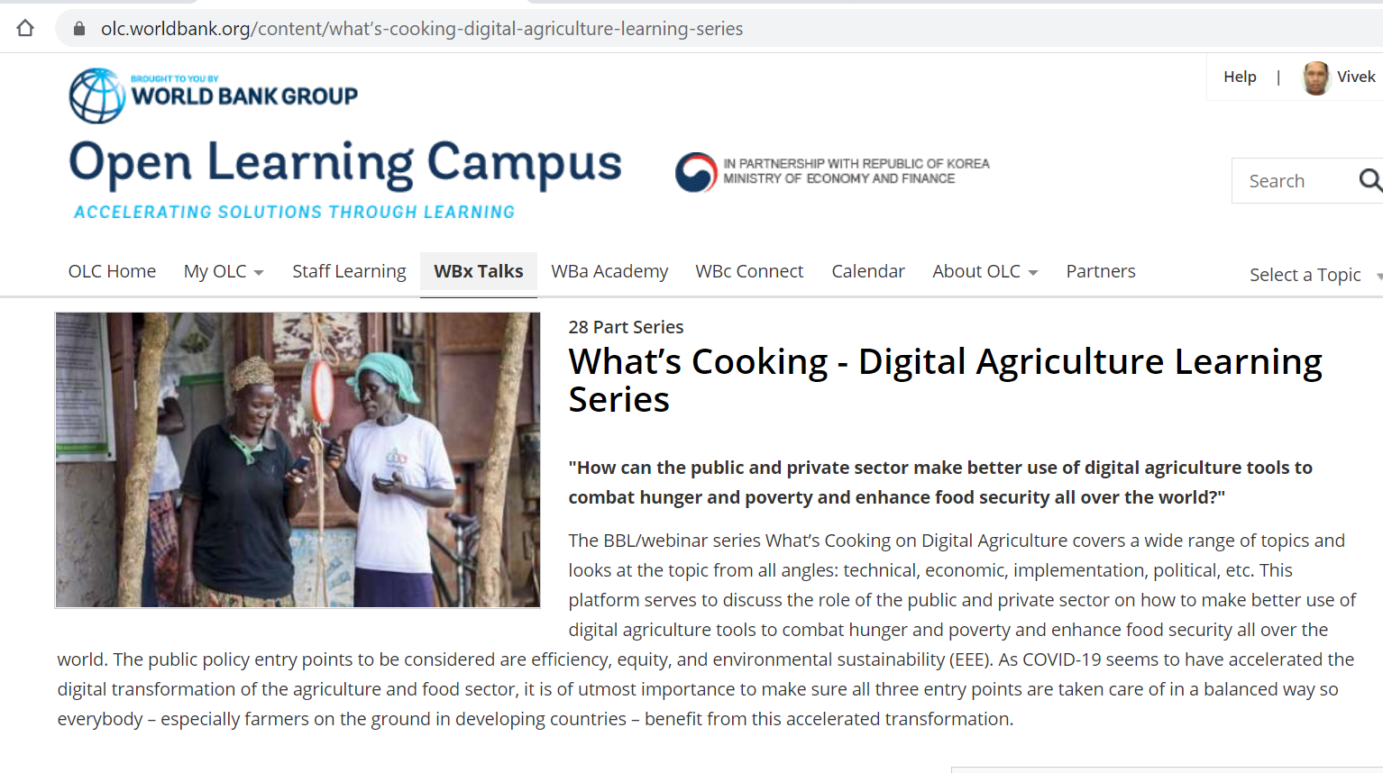

Slide 31
Visit the LED Resource Page for Useful Materials
https://tinyurl.com/WBLED

Slide 32
Upcoming Events
Webinar #6
Tuesday, April 20, 2021: Inclusive Recovery for Local Economic Development with the Center for Mediterranean Integration
8:00am ET | 12:00pm GMT | 5:30pm IST

