Slide 1
Productive alliance projects
David Tuchschneider
Agriculture, World Bank

Slide 2
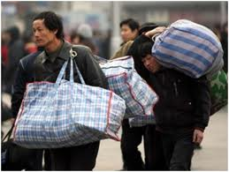
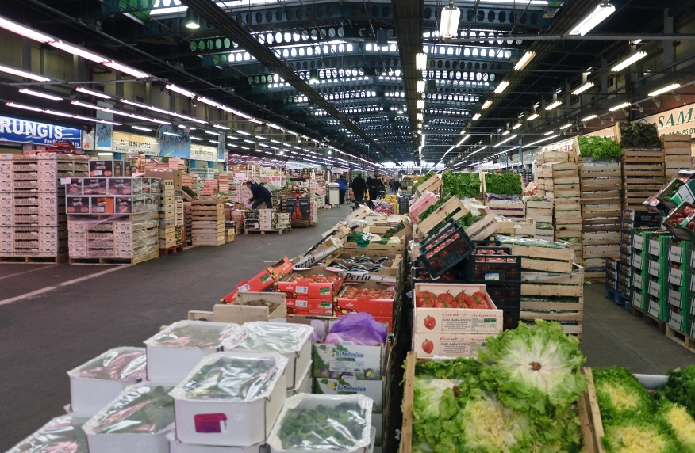
Rural poverty reduction
Migration
Transfers
Inclusion in higher-value markets

Slide 3
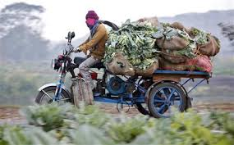
From Informal, low value, low quality segments of value chains

Slide 4
To Formal, standardized, high quality segments

Slide 5
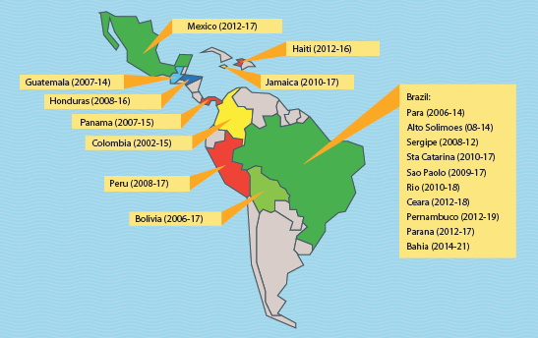
Experience in Latin America
Plus 3 new: Argentina, Brazil and Honduras
Notes:
18 in 12, of which 12 vertical + 3 = 15 in 13
New projects in Viet Nam, Zambia, Malawi, Philippines, New Guinea….

Slide 6
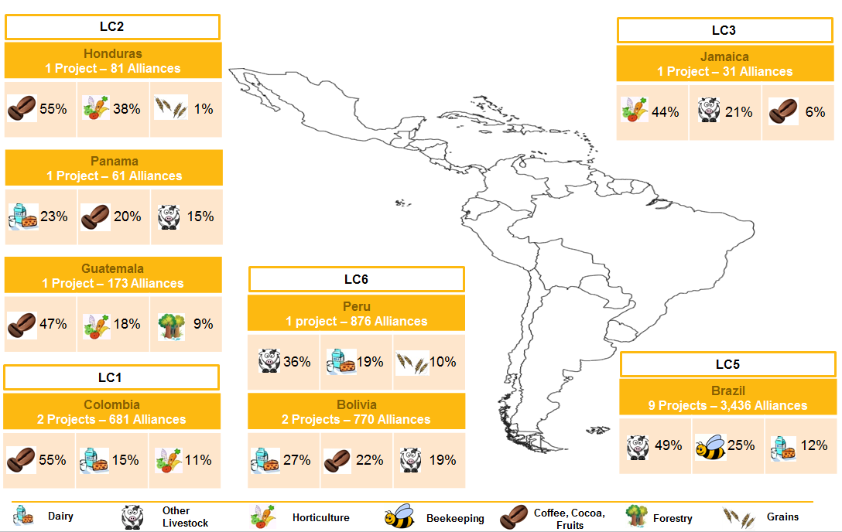
Products supported
Notes:
By 2014,
6140 partnerships
more than 300,000 households

Slide 7
Constraints for inclusion
Buyer point of view
Scale and dispersion
Assessing, agreeing, enforcing
Strategy
Vertical integration
Links with large producers
Outgrower schemes
Small producer point of view
High unit costs for services and inputs
Small production volume
Poor profitability
Strategy
Increase farm size
Collective action
High TCs
High risk

Slide 8
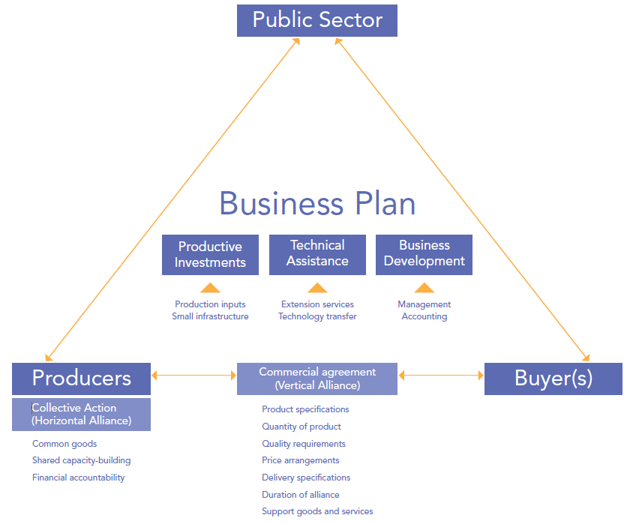
Building blocks of alliance model

Slide 9
Key design features
Support producer opportunities, not needs
Selection by competitive mechanism, not participatory planning
Buyers bring information, not consultants doing market studies
POs manage tailored subprojects focused on market demand
Alliances must prove feasible and sustainable
Counterpart crucial: At least 30% of PO subproject cost covered by beneficiaries in cash and upfront in every tranche.

Slide 10
Bolivia Rural alliances project Impact evaluation

Slide 11
Bolivia Rural Alliances Impact Evaluation: Income change and difference ($B)
Impact
42% higher
Impact
63% higher

Slide 12
Impact by income quintiles
Poorest ←→Richest

Slide 13
Bolivia Rural Alliances Impact Evaluation: Average impact on poverty
 | Poverty |  | Extreme poverty
 | Level (%) | Gap (%) | Level (%) | Gap (%)
Bolivia rural | 57.6 | 30.5 | 36.1 | 17.9
Total sample | 53.1 | 30.2 | 36.0 | 19.1
Control group | 61.3 | 36.6 | 43.1 | 24.5
Beneficiaries | 49.6 | 27.5 | 33.0 | 16.8
Difference (%) | -19.1 | -24.9 | -23.4 | -31.4

