Slide 1
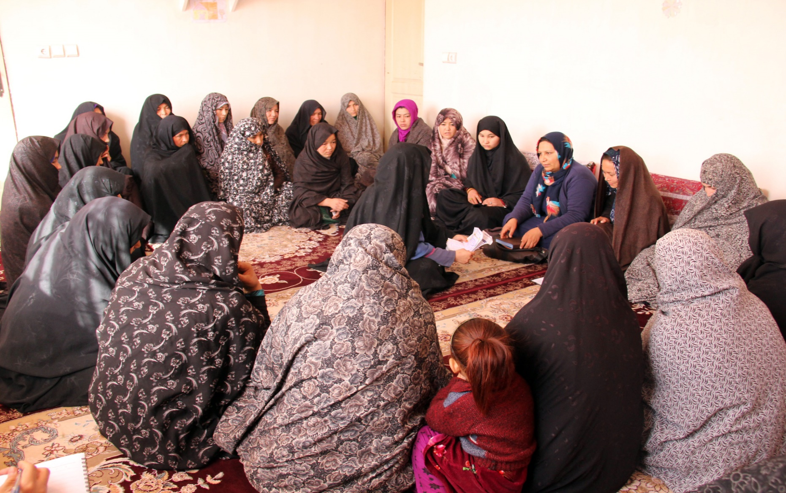
Ministry Of Rural Rehabilitation And Development
(MRRD)
Women’s Economic Empowerment – Rural Development Program (WEE-RDP)
26 March 2018

Slide 2
Overview of the Afghanistan Context
Afghanistan faces tremendous development challenges:
GDP per-capita is among the lowest in the world,
poverty is deep and widespread, and social indicators are still at very low levels.
Afghanistan also has substantial vulnerability to poverty with very high prevalence of economic shocks and nearly half of the population falling twice the poverty line.
Declining foreign aid, weak private sector growth, low human capital,
And (in the case of women) social constraints renders high shares of the adult population unemployed, vulnerably employed, and (in the case of women) out of the labor force.
Afghan women suffer discrimination that is multi-faceted, inter-related and self-reinforcing
Lack of conducive environment for women entrepreneurship, despite huge potential within Afghan women.

Slide 3
Route to WEE-RDP: AREDP in Brief
Afghanistan Rural Enterprise Development Program (AREDP), is one of the National Programs in Ministry of Rural Rehabilitation and Development (MRRD) to improve employment opportunities and income of rural men and women; and sustainability of targeted local enterprises.
AREDP started in 2010 to achieve the above objective by strengthening the private sector through integrated, value chain and community based enterprise development and by addressing credit and capital needs on all levels.
Only in 5 provinces, rural communities saved US$ over 5 million (54% by women) that helped to create 140,000 sustainable job opportunities.
Over 1,200 Enterprise Groups (micro SMEs) were established with US$ 11 million sales (65% women).
As whole, the program has changed communities attitude from being dependent to independent, particularly, it has socially and economically empowered women.

Slide 4
Route to WEE-RDP: AREDP in Brief
According to Afghanistan Micro Finance Association MicroWiew Report:
AREDP has 94% market share in microfinance sector (based on GLP), the leading share in the market.
AREDP is the 2nd most leading institution in CSPIs category; Number of Active borrowers, Gross loan portfolio and number of clients.
Out of the 12 institutions, AREDP is on 2nd position regarding amount of savings, 4th position regarding women borrowers percentage and 4th position regarding women savers percentage.
It shows that AREDP has a big stake in boosting the growth rate of loan portfolio and active borrowers.
AREDP has worked purely in Rural Areas and there is a significant increase in the number of active borrowers in rural areas after it started its operations, clearly boosting rural economy and entrepreneurship.

Slide 5
How AREDP is being Implemented
Robust community mobilization in view of the religious and cultural values to inject the new idea of saving and gaining, not taking and gaining. Never challenged religious values and community norms.
Trust building with key community and influential members and mobilizing women through mobilizing men first, who later on serve as change agent. Never conducted gender awareness training for community, but inspired them through live examples.
Community is at the driving seat from day one and has the ownership of the whole process. AREDP never made the decision on their behalf.
Village facilitators from the same community.
Business Service Providers, payment to field staff against deliverables, not time-based contracts.
On capacity building for community and entrepreneurs, heavily depended on business know-how, exposure visits and practical trainings.
Strong M&E, MIS, continues data analysis and reviews of the performance. Shared mistakes and learned from others.
Converted limited qualified human resources in difficult bureaucratic procedures into strengths for enterprise development.
With roots in the communities, it has helped to reach out to different target groups, improved employment opportunities, increased and generated incomes leading towards self reliance.
Micro Enterprise Development well suits current Afghanistan context towards jobs creation, stability, peace and for returnees/IDP

Slide 6
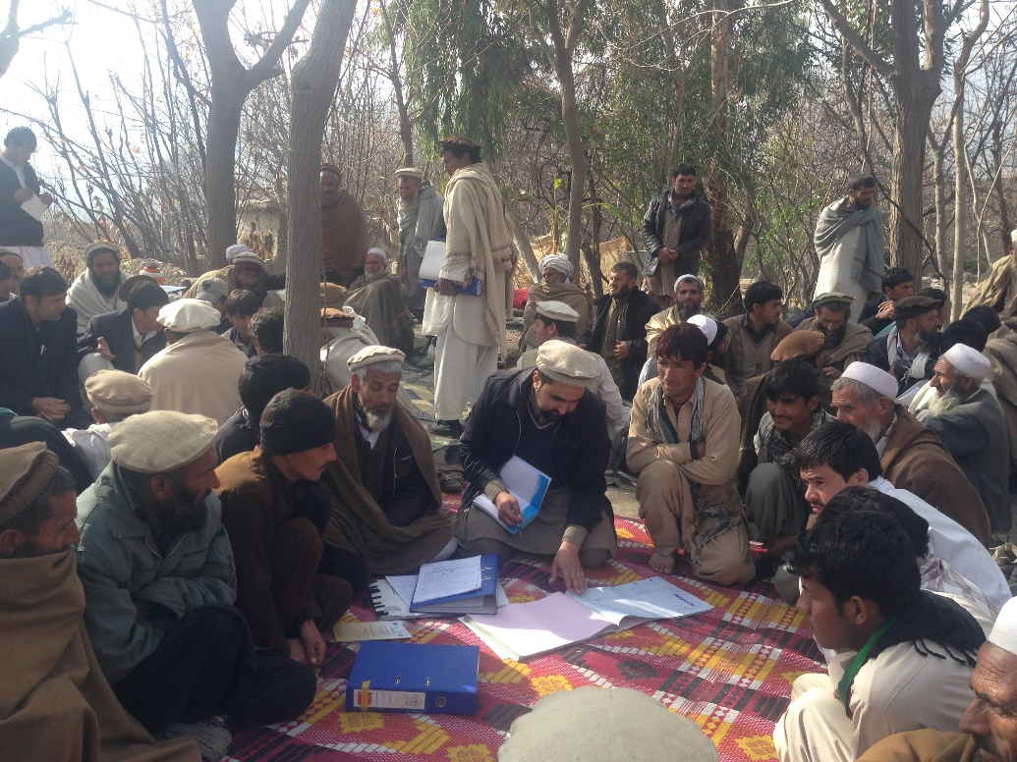
AREDP: View from the Bridge:
Program Budget: USD 43.9 Million Total Community contribution in form of Saving: USD 5 Million (12%)
P.S: Community’s contribution in AREDP is very high, through very poor communities and it is very sustainable, without considering their own investment for their enterprises.
Cost Per beneficiary: Total Program Budget: USD 43.9 Million Total Employment Generated: 140,000 (over 50% Female) Cost Per Beneficiary as of Dec 2017: USD 314 (USD 40 per year/beneficiary)

Slide 7
Route to WEE-RDP: General Picture
From:
Afghanistan Rural Enterprise Development Program (AREDP)
To:
Women Economic Empowerment Rural Development Program
(WEE-RDP)
To support:
Women Economic Empowerment National Priority Program
WEE-NPP

Slide 8
Route to WEE-RDP: WEE-NPP
To respond to emerging needs of women in Afghanistan, government launched Women Economic Empowerment National Priority Program (WEE-NPP).
Objective: To advance women’s agency, autonomy, and well-being by expanding their access to economic resources and training.
Facilitating Activities
Component 1: Increasing the Availability and Analysis of Gender Statistics
Availability of gender statistics impacting WEE increased
Component 2: Removing Legal Barriers
Legal barriers to economic participation are removed, and women are better able to participate in economic and social activities.
Component 3: Ensuring Inclusive Access to Finance
Women’s access to finance will be improved through informal and formal channels
Capacity to track, analyze, and use data is strengthened
Component 5: Improving Access to Agricultural Inputs, Extension Services, and Markets
Component 4: Capacity Building
Women’s knowledge and skills to operate more effectively at home and in the marketplace increased.
Women’s capacity to engage in agricultural markets increased, enabling a transition from subsistence farming to surplus production, to improve food security and increase household incomes.
Component 6: Promoting Access to Creative Economy Markets (“Made by Afghan Women”)
Women’s access to quality inputs, designs and markets improved, facilitating export and income generation for women undertaking creative activities.
MRRD/WEE-RDP are responsible for delivering on most of the key targets in these pillars through WEE-RDP
Productive Components

Slide 9
Route to WEE-RDP: Introduction
Women empowerment is not easy in Afghanistan almost in all sectors and it requires contextualized strategies and program models to address women issues.
The Government and donors, to roll out WEE-NPP pillars, are going to build on the successful model of AREDP with some modifications and more complementation.
WEE-RDP a five years program is set to start in July 2018 In-Shah Allah.
Program Period: 5 Years
US$ amount : 100 million
Implementing agency: MRRD/ WEE-RDP
Geographical coverage & scope: 15 Provinces, 50 Districts and 5,000 villages in Afghanistan
Beneficiaries: Approximately 500,000 rural women.

Slide 10
WEE-RDP Core Elements
Development Objective: To increase social and economic empowerment of poor rural women in selected communities.
Social Mobilization (Community Institutions)
$ 25m
Aggregation to Village Saving and Loan Associations (VSLA)
SOCIAL INCLUSION
Participatory identification of poor and social mobilization
Development of Saving Groups (SGs) and Provision of Seed Capital
FINANCIAL INCLUSION
Financial Planning, Literacy and Counselling
Linkages to formal/informal financial institutions
Access to Finance
$ 40m
Provision of seed capital
ECONOMICINCLUSION
Creation of Community Enterprises
Aggregation to Producer Associations
Market/Value Chain linkages
Development and Market Linkages
$ 20m
Program Support
$ 15m
M&E/MIS
Knowledge Management
Link to other NPPs
Focus is on Rural Poor Women – ideally to ‘saturate’ all women in savings groups and target those who are capable for enterprise development

Slide 11
Building on AREDP Successes and Leveraging on other programs while bringing in global lessons
Combining savings track with enterprise development
Recognizing the power and challenge of building institutions
Using the social mobilization of MRRD Programs
Ensuring that the poorest are not left out
Complementation and Efficiency

Slide 12
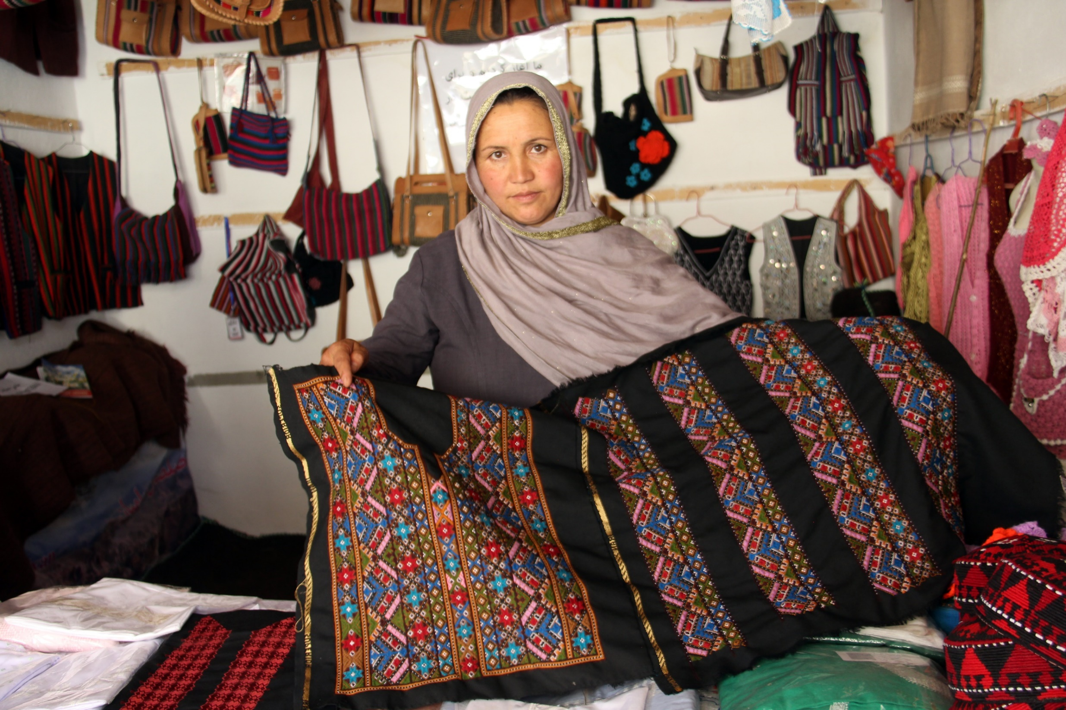
Thank You!
“Together Towards A Competitive Afghanistan”

