Slide 1
CDD in Indonesia – Development of a long journey
Pungky Sumadi, Samsul Widodo, Lulu Wardhani, Bambang Soetono
and Dan Vadnjal.

Slide 2
A Brief History….
BAPPENAS: Planning, Implementing and Supervising…..
We started with:
Integrated Area Development (PKT): 1989 – 1992.
Presidential Instruction on Disadvantage Village (IDT): 1992 – 1993.
Infrastructure Development Program for Disadvantage Village (P3DT): 1993 – 1996.
Kecamatan Development Program (1996) and Urban Poverty Project (1998).
National Program on Community Empowerment (2007-2014).
Village Fund Program (2015 – date).

Slide 3
LED in Indonesia –
Evolution of new initiatives

Slide 4
I. Market systems development program - PRISMA
PRISMA is a Market Systems Development program
Background analysis are conducted to design its interventions
Sector analysis – to understand how the sector works, why is it not performing optimally.
high numbers of poor people
opportunity for the poor to improve their position in society
reasonable feasibility of bringing about change in the sub-sector.
Stakeholder analysis
Supply – demand of the market
Private Sector, Public Sector, Civil Society
Supporting functions
Rules
Competitiveness analysis – analysis of market players, market potential, market failures.

Slide 5
Results
 | KPI tracking | Actual cumulative Y17S2 | Actual Y17S2
1 | # Outreach (all farm HH) | 144,063 | 66,367
1b | # Outreach (<$2.50 PPP) | 100,240 | 45,630
2 | Net Income Impact in IDR (all farm HH) | 688,105,546,926 | 477,938,447,377
2b | Net Income Impact in IDR (<$2.50 PPP) | 480,396,958,096 | 320,024,564,196
3 | # ISPs | 1,355 | 224
4 | Increased Turnover ISPs in IDR | 175,165,232,658 | 85,317,226,934
5 | # Innovations/Interventions | 115 | 26
6 | # Initiatives by Government to improve BEE | 21 | 11
7 | # Intervention Partners (public & private sectors) | 107 | 30
8 | Private Partner co-investment in IDR | 37,115,328,704 | 11,269,750,472
9 | Value of additional investment by farmers | 125,874,189,197 | 61,456,957,473

Slide 6
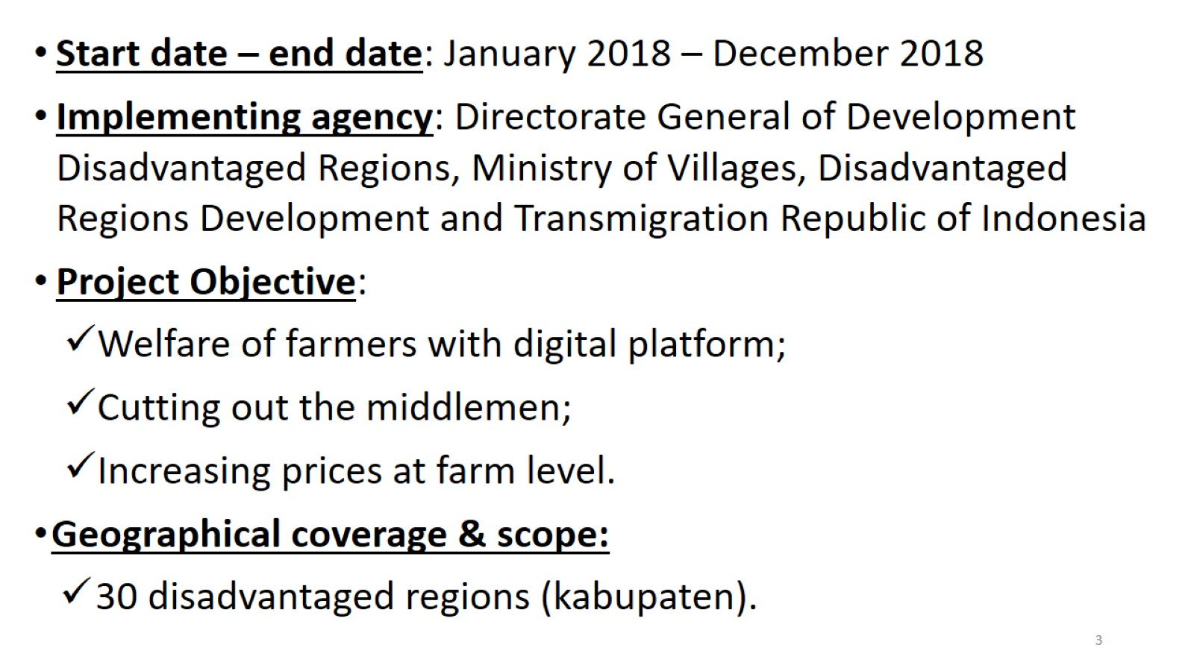
II. Leveraging the digital economy for local economic development
.

Slide 7
.

Slide 8
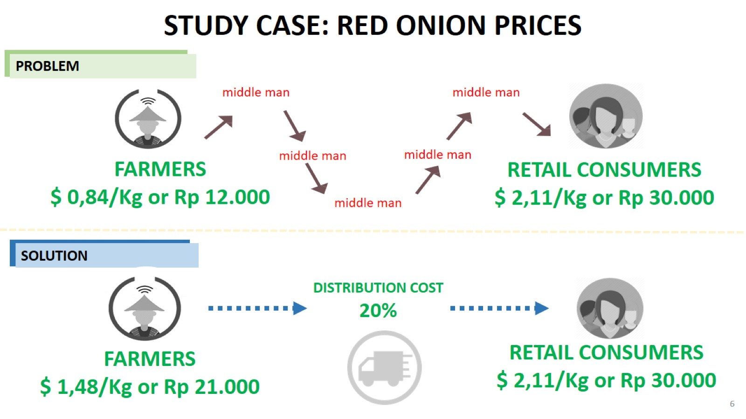
.

Slide 9
.

Slide 13
III. Local economic development pilot
Village law implementation and Village Innovation Program
Pilot, January 2018 – December 2018, implementation not yet commenced
US$ 12 million
Ministry of Villages, Disadvantaged Regions and Transmigration
Project Objective: To design and test a scalable model of local economic development that aims to increase incomes of aggregated village producers and economically marginalized groups in pilot locations
East Java and East Nusa Tenggara (10 districts)
Domestic (small and medium sized) enterprises operating in local markets, all sectors

Slide 14
Proposed Design
What problems are the project trying to solve – under-developed alliances between domestic enterprises and villages
Background analysis – rapid desk top analysis of value chains and sectoral analyses
Types of interventions/project component – Village Economic Partnerships (i.e. alliance of Business Partners/Village Partners/BumDesa) and grants
Measures to ensure profitability and commercial viability of the project – incorporation of enterprises as Business Partners, vetted during partnership appraisal process, into the Village Economic Partnerships
Number of beneficiaries, women, specific groups – 500 villages, minimum 20% of Village Partners below poverty line, 20% of Village Partners are women and 10 of partnerships are women-led
No (initial) link to other sources of public funds

Slide 15
Questions to be answered
. What are some of the design options you are currently considering?
Out-source or in-house the partnership proposal appraisal?
Disburse funds to a single entity within the partnership or to the partnership as a single entity
Cost share on a 20% partnership in kind or in cash contribution and a 80% pilot contribution or 100% grant
What questions do you wish to ask the audience for which you seek guidance?
How do we best appraise partnership proposals?
How do we best manage our fund flows?
How do we structure our grant arrangements?
What sort of technical support to assist the formation (e.g. partnership networking) and implementation of partnerships?
What and how do we capture learnings from the pilot?

