Slide 1
What is PRISMA?
Pungky Sumadi
Deputy Minister for Population and Labor Affairs
3 April 2018
CDD Conference, Colombo Sri Lanka

Slide 2
Project Background
28 October 2013 – 31 December 2018
AUD77 million = US$59 million
Implementing Agency
Government of Indonesia : Bappenas
Government of Australia : Department of Foreign Affairs and Trade
Objective :
To increase by 30% the net incomes of 300,000 smallholder farming households
Project Location
Eastern Indonesia : East Java, West Nusa Tenggara, East Nusa Tenggara, Papua, West Papua

Slide 3
Who We Are
PRISMA offers win-win agricultural solutions that provide profitable opportunities for co-investors while benefiting farmers at the same time
PRISMA helps spur growth along the value chain by reducing constraints and barriers to farmer productivity, performance and market access.

Slide 4
What PRISMA Offers
Innovative & durable
business solutions
Risk sharing in
implementing
these solutions
Mediation between
market players
To foster more
profitable & effective working relationships
Assessments
On growth-constraining
factors in the
agriculture sector
Helping to
improve market
efficiency

Slide 5
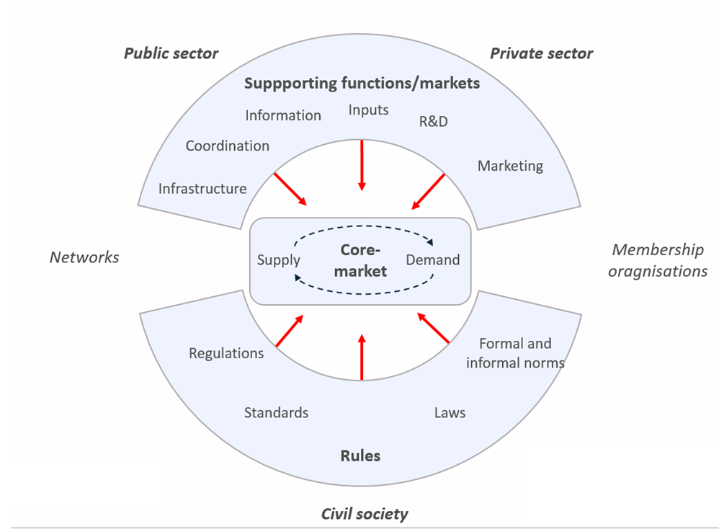
Design of Local Economic Development/ Livelihoods Component
PRISMA is a Market Systems Development program
Background analysis are conducted to design its interventions
Sector analysis – to understand how the sector works, why is it not performing optimally.
high numbers of poor people
opportunity for the poor to improve their position in society
reasonable feasibility of bringing about change in the sub-sector.
Stakeholder analysis
Supply – demand of the market
Private Sector, Public Sector, Civil Society
Supporting functions
Rules
Competitiveness analysis – analysis of market players, market potential, market failures

Slide 6
Design of Local Economic Development/ Livelihoods Component (2)
Types of interventions – With the private sector, PRISMA develops new or improved business models focusing on particular markets (different to value chain interventions).
Methods include : Demonstration plots, social marketing, market storms, good agriculture practice training, marketing
Access to finance (value chain financing) to support the development of farmers’ businesses
Linkages to buyers and suppliers
Measures to ensure profitability and commercial viability of the project
Embedding MSD in core business not CSR!
Providing business services such as market analysis, business plans/strategies,
Planning and tracking of the profitability
Scale and sustainability
Sustained take up of innovations by initial partners
Crowding in of more market actors expand coverage of innovation to benefit more people in the sector (and beyond)
Wider systemic change locks in innovations , supporting and promoting further expansion and strengthening resilience and longevity of sector
Embedding market systems development thinking and practices across Indonesia to ensure institutionalisation of more sustainability and scale oriented approaches.

Slide 7
Results
 | KPI tracking | Actual cumulative Y17S2 | Actual Y17S2
1 | # Outreach (all farm HH) | 144,063 | 66,367
1b | # Outreach (<$2.50 PPP) | 100,240 | 45,630
2 | Net Income Impact in IDR (all farm HH) | 688,105,546,926 | 477,938,447,377
2b | Net Income Impact in IDR (<$2.50 PPP) | 480,396,958,096 | 320,024,564,196
3 | # ISPs | 1,355 | 224
4 | Increased Turnover ISPs in IDR | 175,165,232,658 | 85,317,226,934
5 | # Innovations/Interventions | 115 | 26
6 | # Initiatives by Government to improve BEE | 21 | 11
7 | # Intervention Partners (public & private sectors) | 107 | 30
8 | Private Partner co-investment in IDR | 37,115,328,704 | 11,269,750,472
9 | Value of additional investment by farmers | 125,874,189,197 | 61,456,957,473

Slide 8
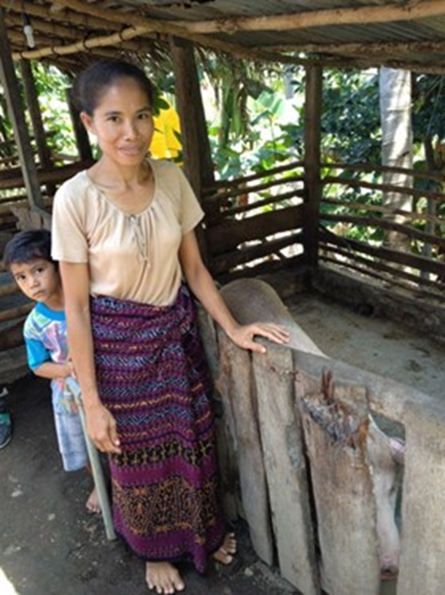
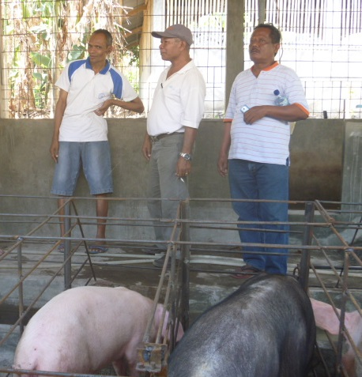
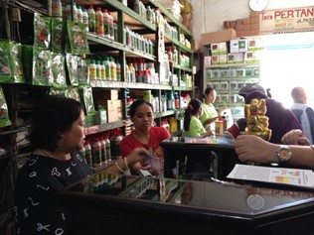
Case study – How MSD works in practice – pig pen to pork industry
SMALLHOLDERS (BEFORE)
Ibu Maria owned 1-2 few pigs since 2011
Spent 4-5 hours/day collecting and preparing local feed
2 years to fatten piglets to adult size (70-100kg), sold at IDR2m
SMALLHOLDERS (AFTER)
Shaded, watered pen, cleaned twice a day
Spends less than 90 min/day feeding and cleaning pigs
3-4 months for piglets to fatten to marketable size, sells at IDR3-4m
BREEDERS
Bruder Luci introduced new water supply, high quality feed, improved breeding practices, regular cleaning
Sell piglets and provides husbandry advice to 1,100+ famers
RETAILERS
Ibu Regina sells pig feed and provides husbandry info
Sales increased from 250-500kg to 5-20 tonnes/month in 2 years
INTERVENTION
Breeders and farmers to invest in improved breeds and husbandry practices, supported by local vets
Provision of info about healthier pens and fatten using high-quality commercial feed
Feed companies to supply quality feed mixes and info, through breeders, credit union and retailers
Hog Cholera outbreak – Support from Livestock Agency from District to National level

Slide 9
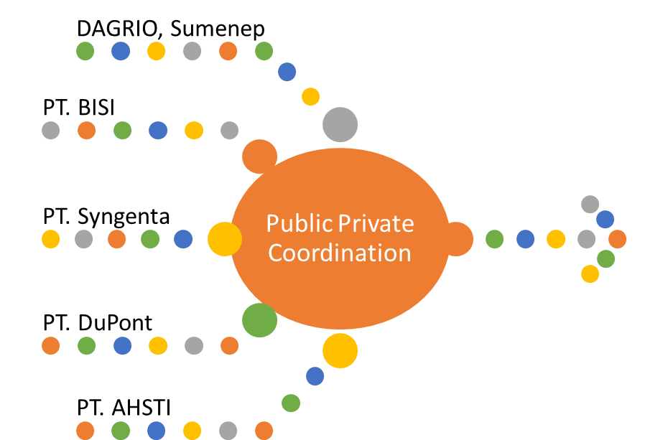
Case Study : Public Private Coordination for better UPSUS (Govt Subsidy) planning
Private companies shared data base on their existing customers and operating areas
Private companies shared data base on their existing customers and operating areas
Subsidy program plan 2017
GAP training plan for subsidy recipients
Free market expansion plan

Slide 10
Challenges and Lessons Learned
Challenges
Needs in-depth analysis to understand the root problems
Needs high quality people – people with business backgrounds rather than CDD.
Failures in MSD interventions especially in the agriculture sector are common. Private sector pulls out, crop failure, etc. Embrace the failure - PRISMA tolerates a failure rate of 30% of its interventions.
Results/outcome oriented.
Rules/regulations that hinders market systems development – subsidies, trade restrictions
Finding a partner that is interested and committed to work together with PRISMA.
Lessons learned
The market systems approach is proving to be effective in Indonesia
Facilitation requires time and patience
Use rigorous evidence and results based portfolio management
Retain as much flexibility as possible
Understand stakeholder requirements and tailor communications
Supporting public policy where opportunities arise
Support leadership and culture
Human resources talent is the vital ingredient

Slide 11
Thank you!

