Slide 1
Myanmar National Community Driven Development Project (NCDDP)
Mr. Kyaw Swa Aung, Director
Department of Rural Development
Ministry of Agriculture, Livestock and Irrigation
Government of the Union of Myanmar

Slide 2
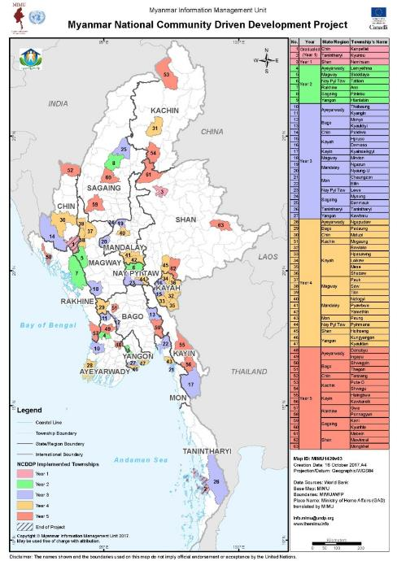
Overall Project Status
Objective:
Enable poor rural communities to benefit from improved access to and use of basic infrastructure and services through a people-centered approach.
Scope:
9 years (Jan 2013-Oct 2021)
$564 million ($480m IDA)
Current Coverage:
63 townships, 12,000 villages, ~7 million people
Key results to date:
6,300 kms of roads constructed/repaired
2,500 schools repaired
3.6 million paid labor-days created
94% satisfaction rate
92% subprojects meet or exceed government standards
Other results:
>15,700 subprojects completed
>12,500 comments received through GHM
$225m IDA disbursed (on target with projections),
effectively operating in 20 conflict-affected townships
realtime MIS of subprojects at: ncddmis.com
Notes:
What is the graph for?

Slide 3
Proposed Design of Local Economic Development Component
Since beginning of NCDDP, communities have asked for livelihood support. Rural poverty rates are high, employment opportunities limited.
DRD now looking to test local economic development approaches in select pilot areas
Trust fund resources have been mobilized for initial 1-2 year pilot period, potential partners identified
Focus on linking communities to value chains, with focus on inclusion of the poor
Work through service providers to create “menu of services” for communities
Strengthen economic analysis during planning process, integrate with livelihoods component where possible

Slide 4
Questions to be answered regarding design and implementation
Design and targeting:
How to ensure that value chain approaches are inclusive of poor community members, not just better off farmers?
How to support livelihood opportunities for landless community members?
How to ensure that communities can sustain livelihood gains?
Monitoring and implementation:
How to measure impact and assess context conditions needed for pilot to succeed?
How to scale up in cost-effective manner, limiting amount of TA and additional staff needed?
What’s the potential for linking infrastructure and livelihood interventions?

Slide 5
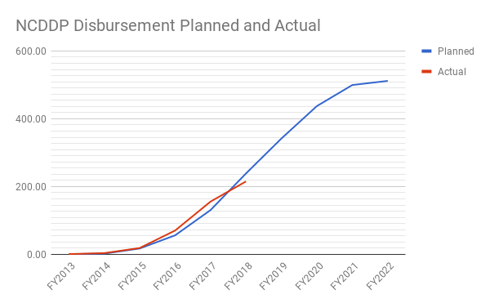
Overall Project Status (cont.)

Slide 6
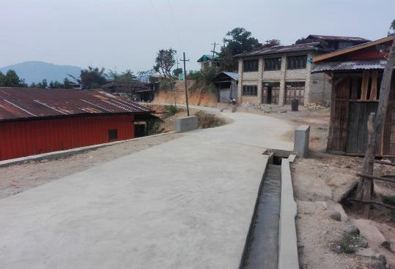
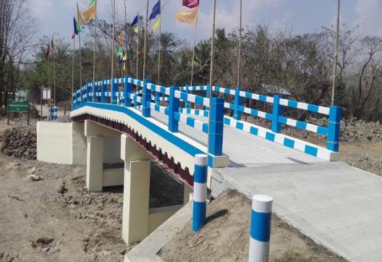
Infrastructure Completion (Cycle1-Cycle5)
Namhsan Township, Road Sub-project
Htantabin Township, Bridge Sub-project

Slide 7
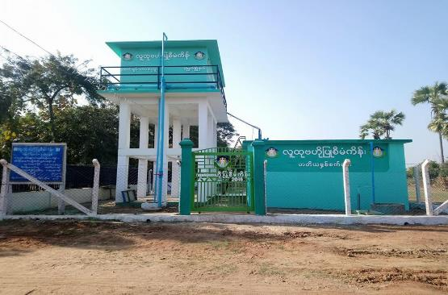
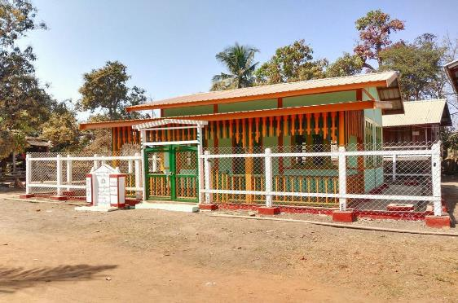
Infrastructure Completion (Cycle1-Cycle5)
Myaung Township, Water Supply Sub-project
Pinlelbu Township, Library Sub-project

Slide 8
MIS
Knowledge & Learning (information)

Slide 9
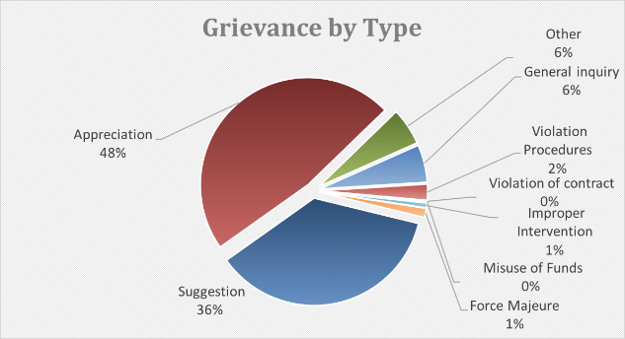
Knowledge & Learning (feedback)

Slide 10
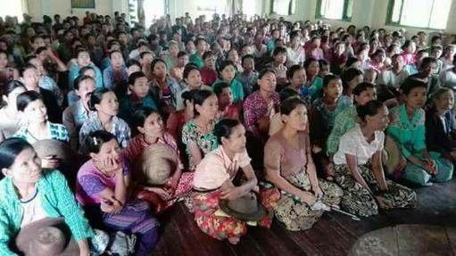
Inclusion (gender and ethnicity)
50-50 requirement for Village Project Support Committee
At least one member of each sub-committee members are women
At least one-sub-project per village tract is suggested by women’s group
Head of VPSC and VTPSC should be one woman and man
Equal pay for equal work
Integrating gender aspects in project cycle
ကော်မတီဝင် ၅၀%သည် အမျိုးသမီးများ ဖြစ်ရမည်
ဆပ်ကော်မတီတိုင်းတွင် အနည်းဆုံး အမျိုးသမီး ၁ ဦး ပါဝင်ရမည်။
ကျေးရွာအုပ်စုနှင့် ကျေးရွာစီမံကိန်း အထောက်အကူပြု ကော်မတီတွင် အမျိုးသမီး(၁)ဦးသည် ခေါင်းဆောင်အဖြစ် ပါဝင်စေရမည်။
နှစ်စဉ် ကျေးရွာအုပ်စုတိုင်းတွင် အမျိုးသမီးများ ရွေးချယ်သော စီမံကိန်းလုပ်ငန်းခွဲ အနည်းဆုံး(၁)ခုကို အကောင်အထည်ဖော် ဆောင်ရွက်ရမည်။
တူညီသော အလုပ်အတွက် တူညီသော လုပ်အားခ ပေးချေရမည်။
စီမံကိန်း လုပ်ငန်းစဉ်တိုင်း ကျား-မတန်းတူညီမျှရေးကို ထည့်သွင်း စဉ်းစားရမည်။

Slide 11
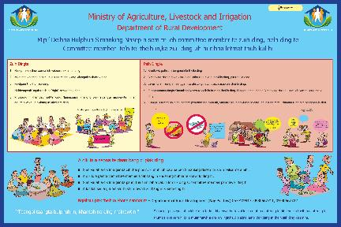
Inclusion…
Kayah
Kayan
Sagaw
East Poe
Paoh
Shan
Matu
Dai
Zome

Slide 12
Thank You!!

