Slide 1
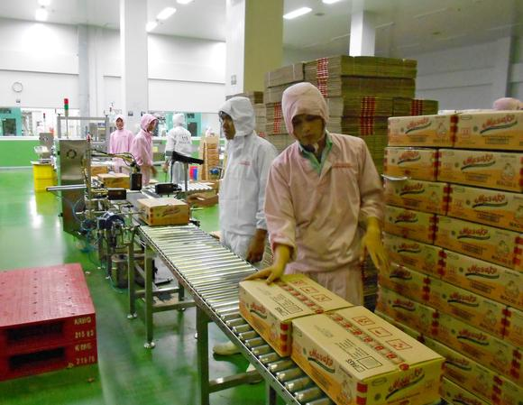
Parmesh Shah, Global Lead, Rural Livelihoods and Agriculture Employment, Agriculture Global Practice The World Bank Email: pshah@worldbank.org Twitter: @ShahParmesh
Linking Villages, Communities, Farmers, and Entrepreneurs to Markets

Slide 2
Sri Lanka: Globally Competitive Agriculture
Largest Tea producer
Largest producer and exporter of Cinnamon
Leading producer of spices
Nutmeg
Arecanuts
Pepper

Slide 3
Indonesia: Globally Competitive Agriculture
Largest oil palm producer
Third largest Rice producer
Third largest Cassava producer
Largest coconut producer
Third largest Coffee producer
Eighth largest peanut producer
Largest beef producer in EAP
Third largest Cocoa producer
Largest fruit crop in the country

Slide 4
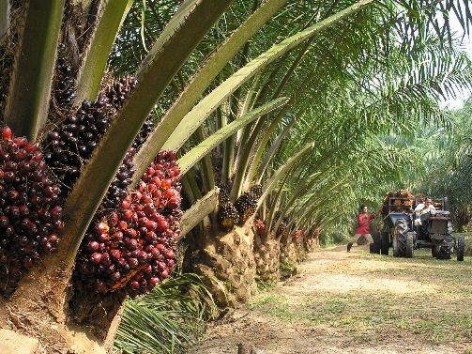
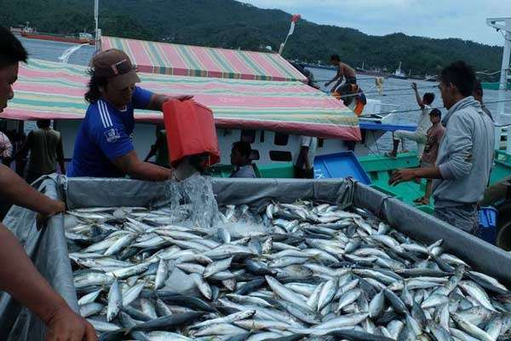
Opportunities: Diversification in Agricultural Production
Notes:
FAO STATISTICAL YEARBOOK 2014 Africa FAO

Slide 5
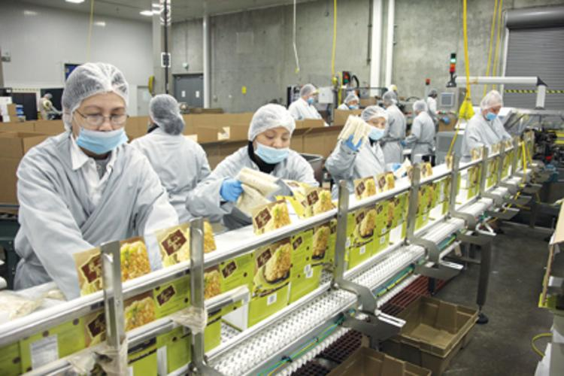
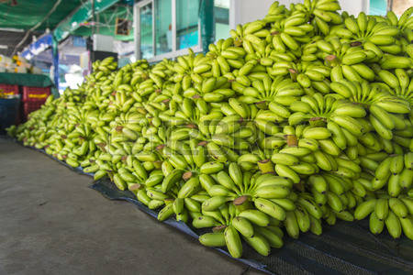
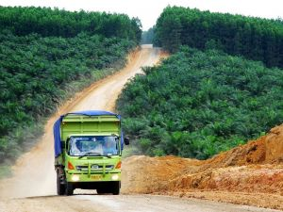
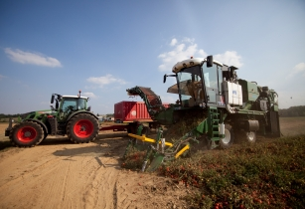
Opportunities: Diversification in Agriculture Value Chain
Packagers of produce for
National and international markets
Commercial millers
and food processors
Wholesalers, aggregating produce from a number of small-scale farmers
Transport providers
Farm equipment and fuel suppliers

Slide 6
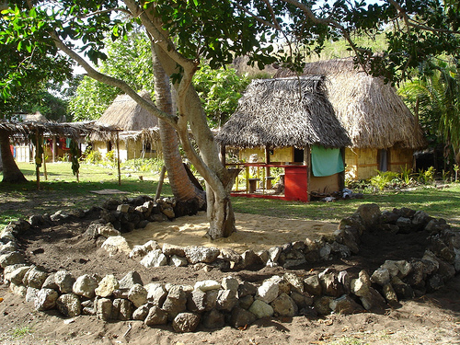
Rural Non-Farm sector
Food & Beverages
Tourism
Textile & Garment
Footwear

Slide 7
Lessons from Global Experiences: Five Models for Linking Villages, Communities, Farmers, and Entrepreneurs to Markets

Slide 8
5 models for Linking Villages, Communities, Farmers, and Entrepreneurs to Markets
Model 1: Producer Organization to Producer Company
Model 2: Producer Organization to Productive Alliance
Model 3: Rural Livelihoods Enhancement
Model 4: Rural entrepreneurship
Model 5: Village e-commerce model

Slide 9
Model 1: Producer Organization to Producer Companies
Producer Organization: Producers aggregated into their institutions
Producer Owned and managed Companies: Producer Organization with Business Orientation.

Slide 10
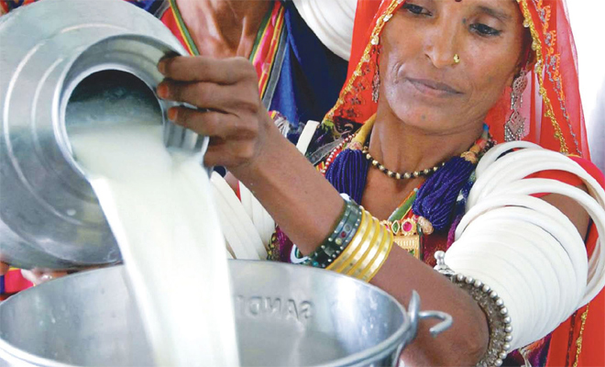
Case 1 : Producer Organization to Producer Companies
India- Amul:
World’s largest farmers’ own dairy cooperative
Annual turnover US$ 4.23 billion (2016-17)
3.37 million
milk producer members

Slide 11
Case : Farmers Producer Company, India

Slide 12
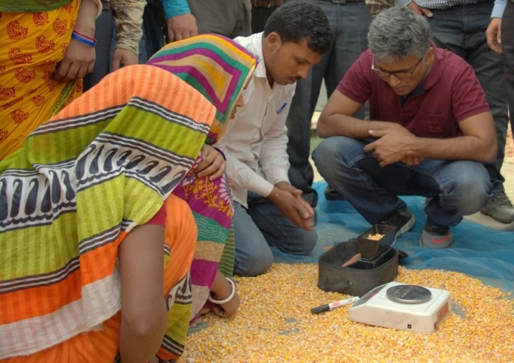
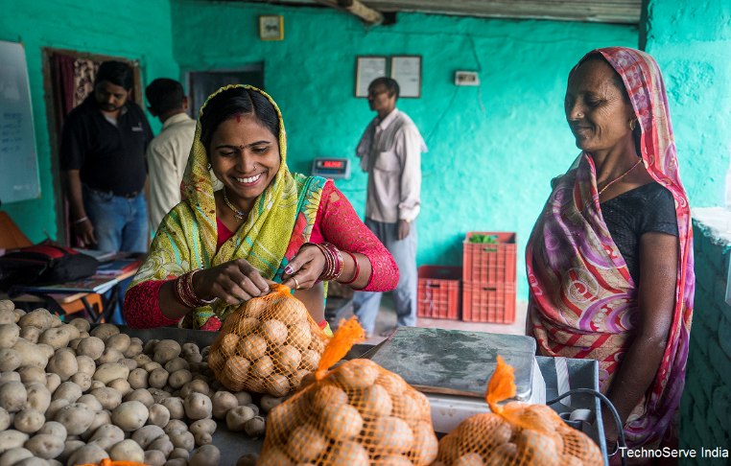
Agriculture Collective: A women owned USD 2 million enterprise
Aaranyak Farmer Producer Company Ltd – Purnea (10,000 farmers)
$ 2 million turnover in 2017
Trading on online commodity exchanges; first to introduce Digital Weighing Scales and Moisture meters at village level
Expected to develop into a $ 10 million producer cluster around Maize
Working with renowned technical partners like TechnoServe, NCML and many others

Slide 13
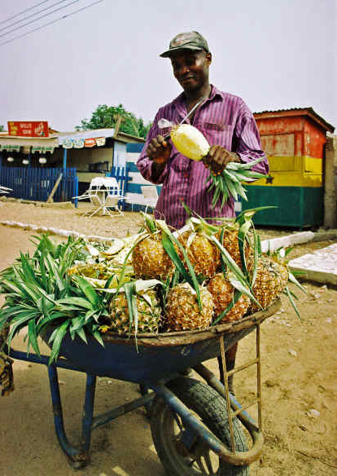
Ghana Pineapple Cooperative: Farmapine GH Ltd
Five pineapple cooperatives comprising 450 farmers
Members are able to consistently achieve exportable yields of 65% or more from their fields, which guaranteed profits of about $1,000 per acre.
80% of the shares of the company were acquired by five smallholder cooperatives
Notes:
http://www.fao.org/3/a-ar708e.pdf
http://www.fao.org/3/a-ar708e.pdf
http://www.choicesmagazine.org/2005-1/grabbag/2005-1-16.htm
http://citeseerx.ist.psu.edu/viewdoc/download?doi=10.1.1.604.909&rep=rep1&type=pdf

Slide 14
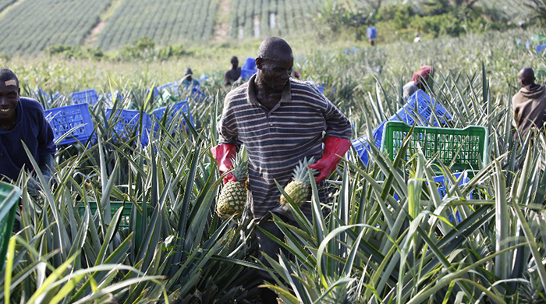
Ghana Pineapple Cooperative: Farmapine GH Ltd

Slide 15
Model 2: Producer Organization to Productive Alliance
Public Sector
Productive
Investments
Technical
Assistance
Business
Development
Producers
Commercial Agreement
Buyer(s)
Common goods,
Shared capacity-building
Product specifications,
Quantity of products

Slide 16
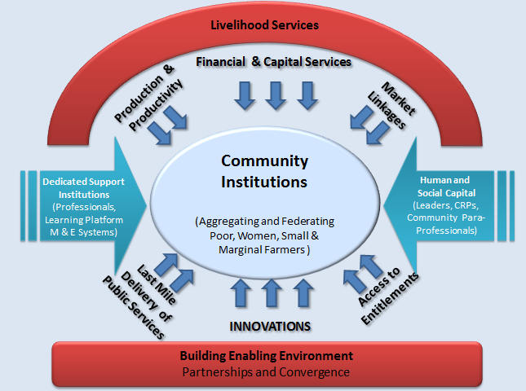
Investment framework in community institutions
Model 3: Rural Livelihoods through Financial Inclusion and Livelihoods development

Slide 17
Case: Rural Livelihoods through Financial Inclusion and Livelihoods development, India
250 million poor women mobilized
US$ 1.5 billion saving
US$ 25 billion credit flow from commercial bank
US $ 5 billion Annual Turnover of Enterprise

Slide 18
Model 4: Rural Entrepreneurship Development
Microenterprises and SMEs
Rural Entrepreneurship Development
Incubation
Technical and Vocational Education and Training (TVET)
Agropreneurs

Slide 19
India: Approach to Enterprise Promotion : 2 stage process
Stage 1 :
Access to finances along with enterprise counselling leading to creation of Nano/Micro enterprises
Guestimate of nearly 4 to 5 million such Nano enterprises from among the 45 million women organized.
Stage 2 :
This cohort of 4 to 5 million enterprises would now graduate to a higher level of small and medium enterprises
In order to aid this process, the following set of bundled services are being delivered
Large scale Access to Financial Services
Skill building including access to New Technologies
Specific Business Advisory services
Access to Markets
Facilitate Partnerships with the Private Sector
A number of the above enterprises are in the manufacturing, retail and services sector and are home based and are contributing to enhancing women’s labor force participation

Slide 20
ENTERPRISE JOURNEY: ‘The two-stage process’
Building Strong Institutions
45 million women part of network
Platform for peer learning and Sharing
USD 20 Billion of formal credit delivered
Capacity for regular financial intermediation developed
Nano & Micro-Enterprises
- First Generation entrepreneurs
- Nearly 5 million enterprises directly impacted
- Simplest form of enterprises; employing mostly family labour
- Serves local village or nearby market
Small & Medium Enterprises
- 1 out of 4 graduates to a higher level
- Nearly 1 million SME ecosystem
- Complex and more institutional, industrial characteristics
- Specialized skills and division of labour
- New Jobs beyond family labour
- Use of technology-processing/manufacturing
STAGE 2
STAGE 1

Slide 21
ENTERPRISE JOURNEY: ‘The two-stage process’
Customized Package of Services
Access to Financial Services
Access to new technology
Business Advisory Services
Access to markets
Private sector linkages
Core
Building Strong Institutions
- 45 million women part of network
- Platform for peer learning and Sharing
- USD 20 Billion of formal credit delivered
- Capacity for regular financial intermediation developed
Stage1
Nano & Micro-Enterprises
- First Generation entrepreneurs
- Nearly 9 million enterprises directly impacted
- Simplest form of enterprises; employing mostly family labour
- Serves local village or nearby market
Stage2
Small & Medium Enterprises
- 1 out of 4 graduates
- Nearly 2 million SME ecosystem
- Complex and more institutional
- Specialized skills and division of labour
- New Jobs beyond family labour
- Use of technology-processing/manufacturing
Enterprise Support Services
Access to Credit
Enterprise Counselling
Better Quality Inputs

Slide 22
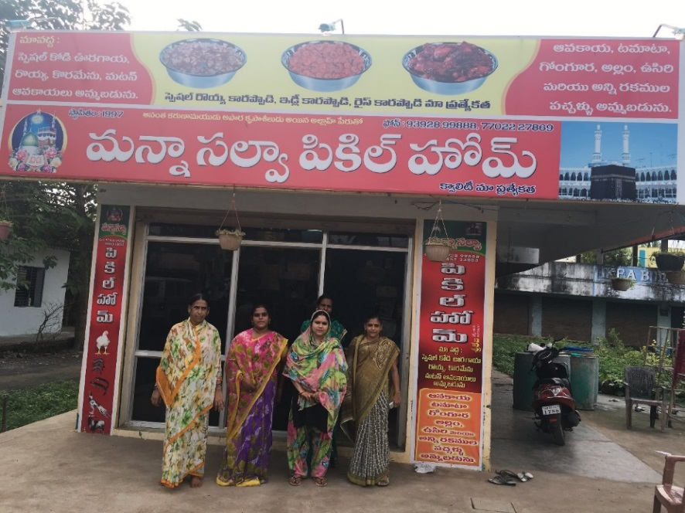
Processed Food Collective: $ 1 million enterprise creating 500 jobs
Total HHs involved: 550
Number of Jobs created: 480 + 70 (self)
Business Size: USD 1 million; $ 30,000 per household
Preparing pickles of several varieties; linking with institutional markets like nearby residential school campuses; branding efforts underway

Slide 23
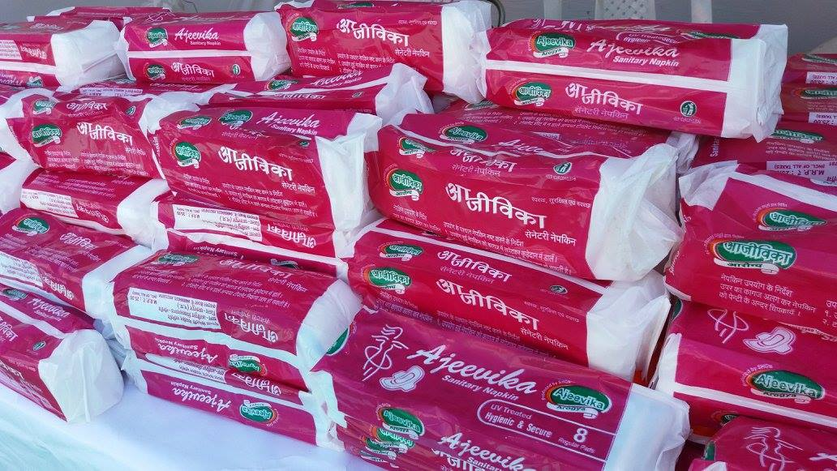
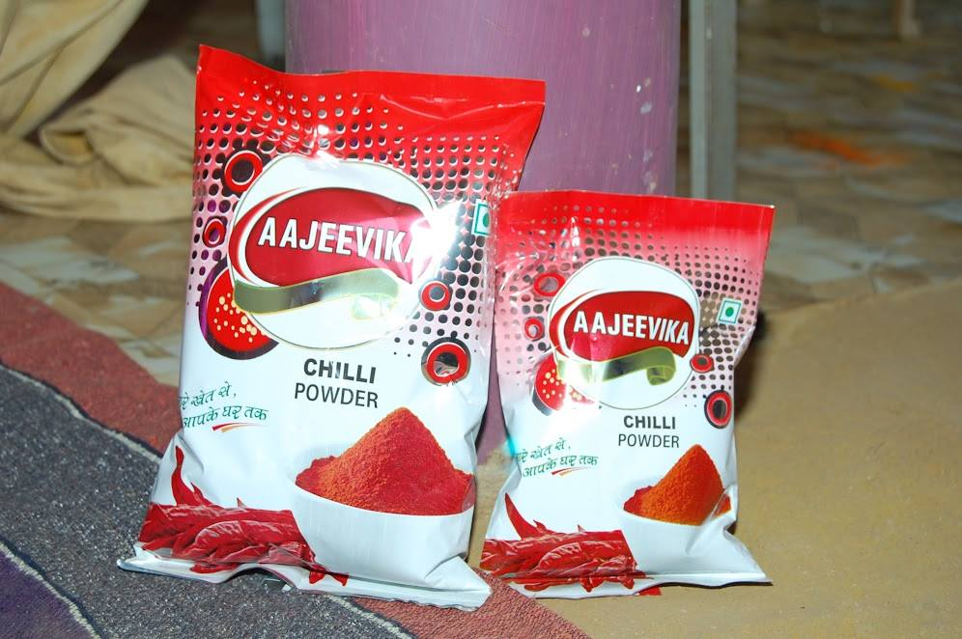
Retail: Product Aggregation & Branding: Aajeevika Fresh- A USD 4 million brand
More than 200 stores across the state of Madhya Pradesh
Procuring primarily from Women Farmer Producer Companies promoted under NRLM and MPDPIP
Annual Business Turnover: USD 4 million
Multicommodity Trading: Fresh Products, Spices as well as specialized items like Sanitary Pads, all sourced from small manufacturing units run by rural women

Slide 24
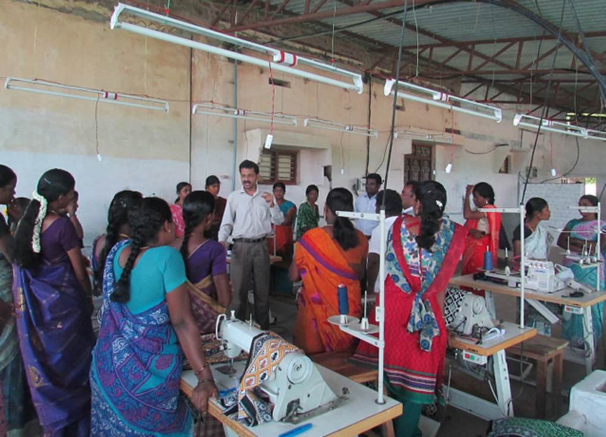
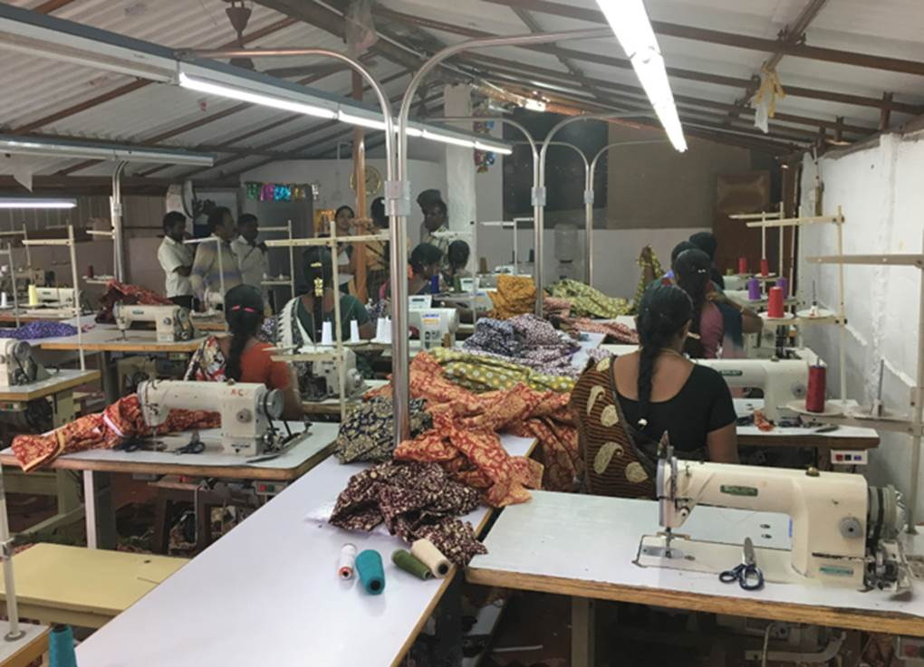
Individual Garment Units: An emerging cluster supplying to big brands
20 new garment manufacturing units; employing 200 women
Supplying clothes to several leading brands
Focus on improving work performance through better technology and initial working capital support

Slide 25
Results: The Non-farm Pathway
1.8 million women entrepreneurs engaged in NTFP, food, manufacturing and service sectors
Café Kudumbshree in Kerala, Rural Retail Mart chain in AP, Bee Keeping Cluster and Cluster of Art and Craft enterprises in Bihar, Lac enterprises in Jharkhand; with an overall estimated turnover of Rs. 85 crores.
Partnerships
Start up Village Enterprise Fund (SVEP) - MoRD
Skills Training and Linkages to Self-Employment & Entrepreneurship
Strengthening implementation of Rural Self Employment Training Institutes (RSETIs)
Private Sector: ITC; Dabur
Technical Agency: Enterprise Development Institute, ORMAS, Jaipur Rugs, AHF;
Public Sector: IRCTC NGOs: Udyogini
Notes:
Through NRLP and other state projects (BTDP, APRIGP, JOHAR, TNRTP, RRLP)
RSETIs provide self-employment and enterprise related skills training through training centers run by lead commercial banks in each district of the country.

Slide 26
Impact
Impact analysis shows that in the areas with the SHG platforms of NRLM, there are 80% more enterprises compared to the control areas, 75% increase in number of workers employed by non-farm and agri-business enterprises

Slide 27
Case : Agribusiness incubator in Africa, 2SCALE
Works with over 353,000 farmers
in eight countries (Sub-Saharan Countries) Nearly 30 percent of these farmers are women
Partners include more than 1,200 firms
from multinationals to small community-based enterprises.
Build Networks
that connect farmers, buyers and intermediaries, enabling them to create and grow new businesses.
Private Co-investment 24 million USD (2015)
representing cash investments, staff time.
Notes:
http://2scale.org/the-program
https://ifdcorg.files.wordpress.com/2016/06/2scale_highlights-2015.pdf

Slide 28
Agri-Incubator Functions
Incubator solutions
Entrepreneurs needs
Seed Funds
Incubation Fund
Investment opportunities for private companies to invest in incubate companies
Startup finance for incubatees
Infrastructure
Common infrastructure
Technology /product-Development and commercialization protocols.
Technology and products
Government /Policy support
Liasoning/ Involving government agencies
Ecosystem Support services and promotion
Evaluation tools for promoting agencies
Technical competency of entrepreneurs
Mentorship and coaching programs

Slide 29
NRETP: Non-farm Enterprise Development
Incubator and Accelerator approach for investment support and skills training to learn how to manage an asset and run a business
Across viable and promising sectors (high value agriculture, manufacturing and services)
Differentiated support strategy based on the age, size and potential of enterprise
Deliver all requisite products and services (finance, technology, mentoring) through a single source
Leverage technology and private sector in program delivery
Match making with social investors

Slide 30
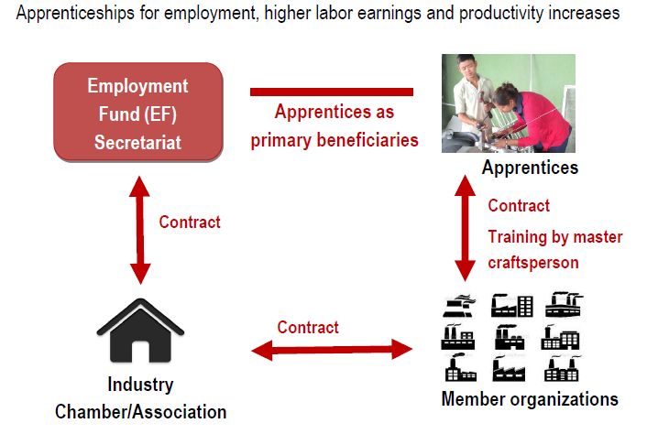
Example EF Nepal: Apprenticeship model

Slide 31
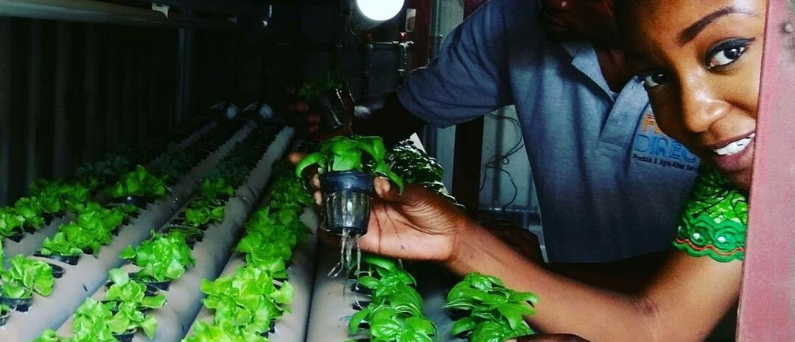
Case: Agropreneurs- Fresh Direct Nigeria
Winner of World Economic Forum Africa’s female innovators of 2017
Notes:
http://amp.weforum.org/agenda/2017/05/world-economic-forum-awards-africas-breakthrough-female-tech-entrepreneurs
http://www.freshdirect.ng/

Slide 32
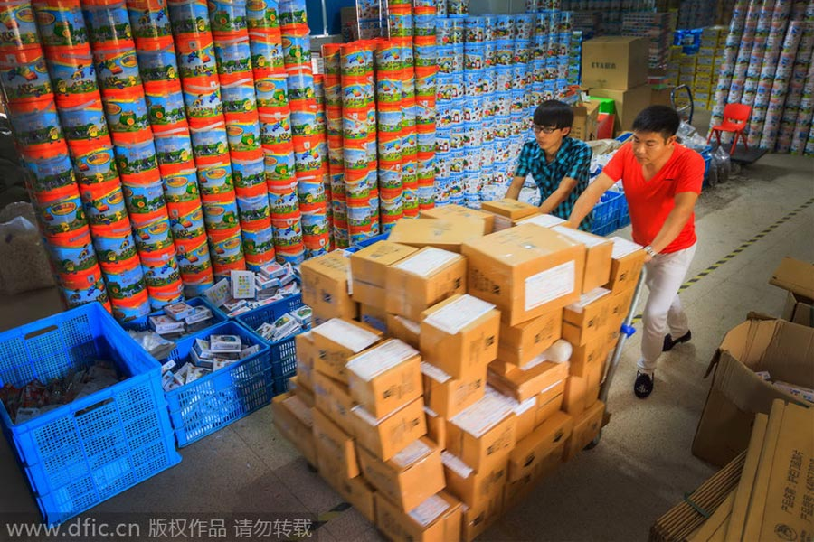
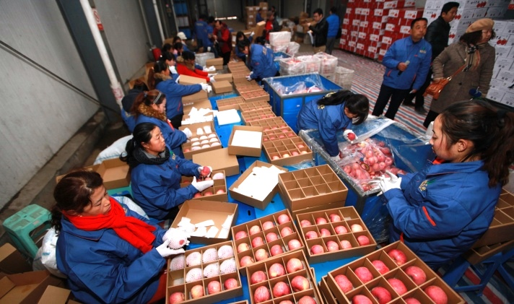
Model 5: Village E-commerce
Taobao Villages in China
1,311 Taobao Villages
200,000+ active online sellers
25 Taobao Village Clusters
71 Taobao Towns
Notes:
http://www.alizila.com/an-introduction-to-taobao-villages/ 840,000 job opportunities

Slide 33
Taobao Village is a cluster of rural e-tailers where:
at least 10% of village households engage in e-commerce
at least 100 online shops have been opened by villagers
at least $1.6 million total annual turnover
Notes:
https://sampi.co/taobao-villages-china-rural-ecommerce/

Slide 34
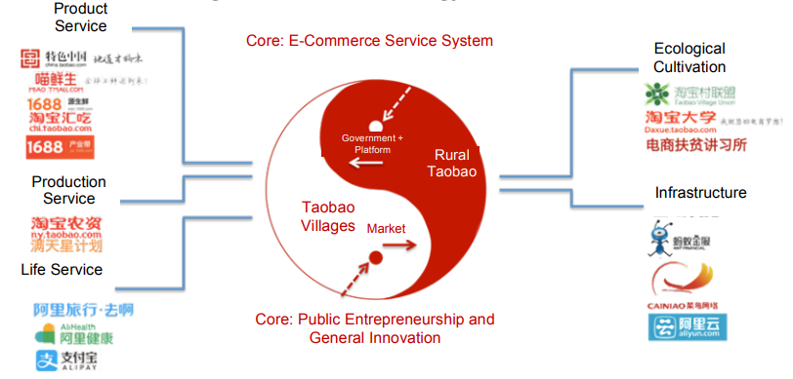
Alibaba’s Strategy on Rural Areas

Slide 35
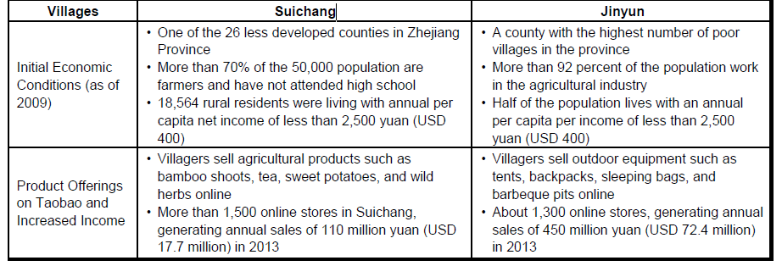
Impact study:
Suichang and Jinyun Villages
Leong, C. M. L., Pan, S.-L., Newell, S., & Cui, L. (2016).
The Emergence of Self-Organizing E-Commerce Ecosystems in Remote Villages of China:
A Tale of Digital Empowerment for Rural Development. MIS Quarterly, 40(2), 475-484.

Slide 36
Key elements of mobilization:
Mobilization through Digital Interaction
Combining Entrepreneurial and Organizational Aspect
Connected Network Approach
Key elements of mobilization:
Regular interaction,
Intensity,
Iteration
Self- Renewal
Economic capital
Financial capital
Expansion
Social capital
Birth
Community mobilization using face-to-face interaction
Community mobilization using digital stimuli

Slide 37
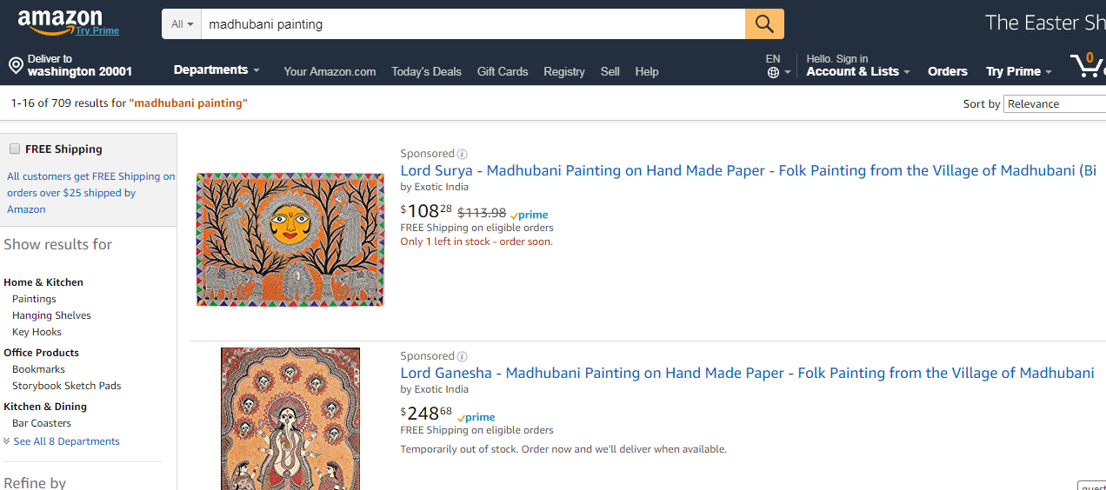
From subsistence laborer to Amazon seller: A story from Bihar, India
Blog Link: http://blogs.worldbank.org/endpovertyinsouthasia/subsistence-laborer-amazon-seller-story-bihar-india

Slide 38
Lessons from Global Experiences - 10 key principles for Successes in Linking Villages, Communities, Farmers and Entrepreneurs to Markets

Slide 39
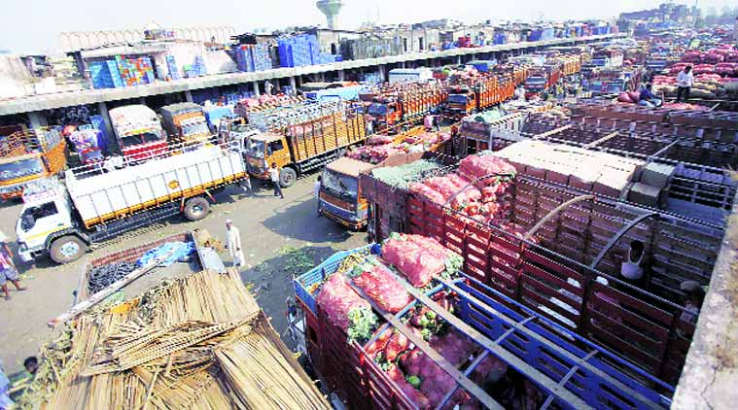
10 Key Principles for successful programs
Aggregation
Strong economic mobilization as basis
Social and Economic Differentiation
Digital mobilization

Slide 40
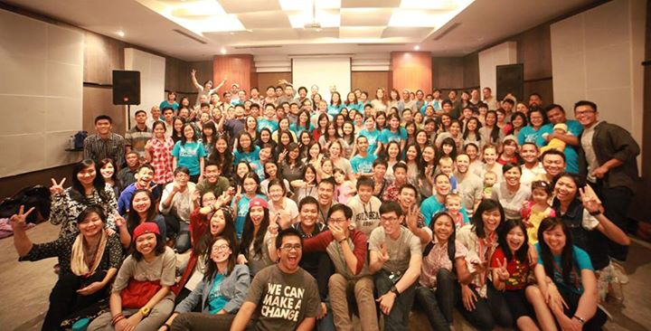
10 Key Principles for successful programs
4. Economic clusters as unit of intervention (not necessarily village)
5. Market Driven
6. Investments in Public and Private Goods in Complementary Manner

Slide 41
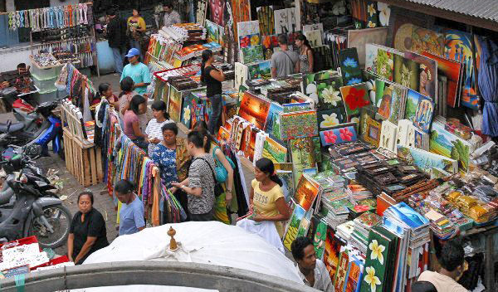
10 Key Principles for successful programs
7. Public-Private Partnerships
8. Brokerage
9. Producer/Entrepreneur Owned and Managed Businesses and Enterprises
10. Leverage Financial Sector/Rural Financial Services

Slide 42
Investment in local economic development-Moving forward
Invest in aggregation. Build on existing farmer and producer groups
Work on economic clusters. These can be across villages
Find market opportunities in agriculture and non-farm sector
Link buyers and producers and facilitate productive alliances
Support business plans

Slide 43
Investment in local economic development-Moving forward
Invest in complementary productive infrastructure through village funds
Develop a public private partnership platform
Measure economic and business performance of the local economic development projects and scale up approaches which have worked.

