Slide 1
Community Development and Livelihood Improvement “Gemidiriya” Project Sri Lanka
Speaker
Gamini Batuwatige

Slide 2
Project Background
Start date – end date : 2004 - 2014
US$ amount: 126 million (Phase I, 51 m. grant Phase II 75 m. loan)
Implementing agency : Gemidiriya Foundation of the Ministry of Nation Building and subsequently Ministry of Economic Development under the name “Gama Neguma” project in Phase II
Project Objective: Enhance incomes and quality of life of the poor households in the poorest divisions in the country while building capacity of government agencies, local governments and community organizations for service delivery and overall project implementation.

Slide 3
Scope
(i) empowering the poor and developing and strengthening
institutions of the poor;
(ii) improving access of the poor to basic infrastructure and social
services and providing support for productive activities; and,
(iii) developing policies, rules, systems, procedures and institutional
arrangements to enable the government to transfer funds directly
to communities and local governments.

Slide 4
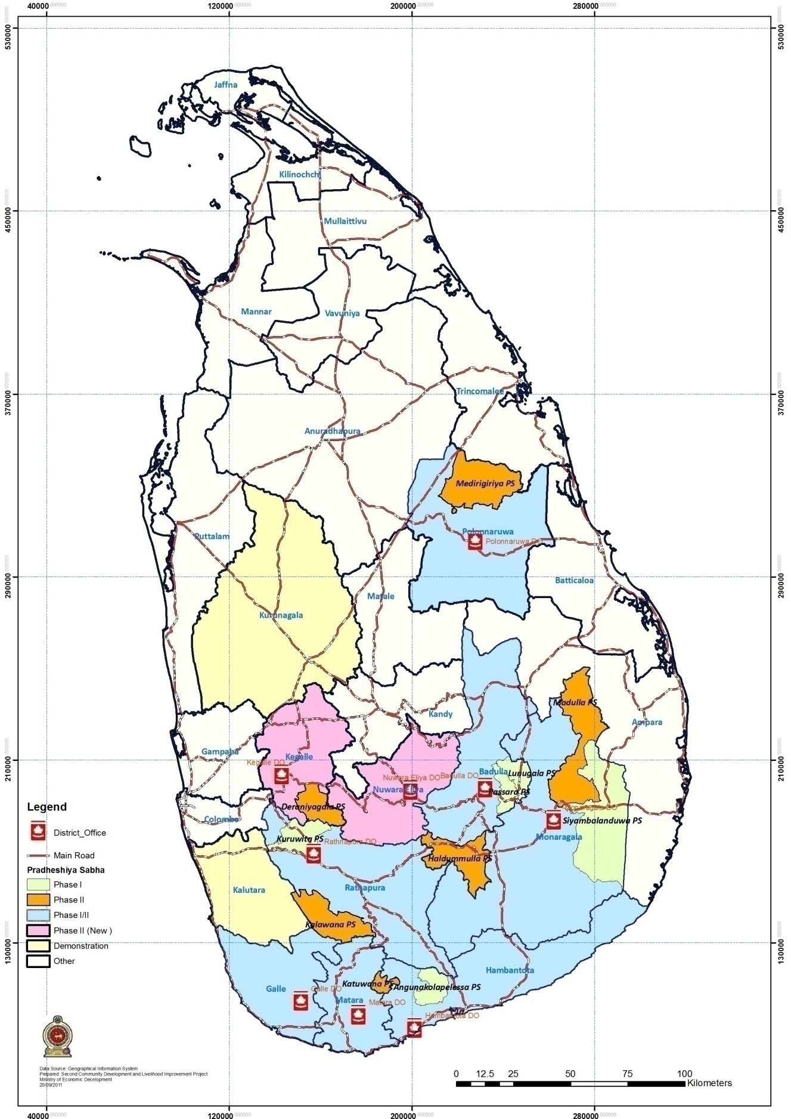
Geographical Coverage and Beneficiaries
The project was implemented in 2,044 remote and poor areas of 11 districts out of 25 leaving 5 districts in the North and East and 9 relatively better off districts reaching 2.2 million beneficiaries

Slide 5
Design of Local Economic Development/ Livelihoods Component
Problems the project was trying to solve
Poor access to capital for households for investment
Low productivity of production processes
Poor access to skills/technologies/gainful income generation
Poor access to markets
Background analysis to design program
Local economic development was an expected long term outcome from increased investments and household income through incremental productivity increases and marketing.
Situation analysis was built in to the planning process for IG opportunities, technology, instruments and skill development for growth oriented production identified through PRA and supported by economic analysis of products
Geographical spread of activities depended on the type of production with growth potential identified. (e.g. Maize, tea, rubber, seed paddy, potatoes, milk, rice, lime)
Economic analysis of key products were done and used for planning inputs

Slide 6
Design of Local Economic Development/ Livelihoods Component
Types of interventions/project component (Technical assistance, credit, linkages with buyers)
Technical assistance provided to the project staff to undertake participatory situation analysis, planning of livelihood investments and facilitating skills
Technical assistance direct to producer groups on production and marketing
Credit through community savings and credit organization of the village organizations initially registered under the companies act to attract private sector
Financial support on equipment to selected producers for production and marketing
(distribution of poly tunnels, agricultural machinery and equipment)

Slide 7
Measures to ensure profitability and commercial viability of the project.
The main project inputs (information, decision making power and resource support) continued stimulating risk taking
Investment capital was not free so that investments were made on profitable ventures by the community
Economic analysis of key products were done and used as inputs for planning.
Trade exhibitions were organized to increase market opportunities
Production on contract was encouraged
Number of beneficiaries, women, specific groups
2.2 million people benefitted from the project where 50% of minimum
female participation was ensured. In each village savings and credit
organizations (VSCO) are of 100% female leadership. 67% of decision making positions
were held of all community organizations by women. Tamil community in Estate
plantations where Gemidiriya CDD was introduced were specific groups to benefit
$ Amount for Local Economic Development/Livelihoods
Approximately USD 21.2 million (30% of 57.6 +3.6 for partnerships)

Slide 8
Challenges and Lessons Learned
Difficulties encountered
Changing policies on political interests with changed regimes and controls affecting CDD elements of the original project approach (Control vs Facilitation)
Absence of macro level policies to support the micro economy affecting production processes (e.g import and trade policy, production subsidies, Lack of private sector expansion for innovative partnerships
High opportunity cost of business propositions to local producers
institutional support policy)
How they were addressed
Community institutions were allowed to continue partnerships with private sector
Restructuring was introduced but resulting in project closure without the third phase.
The new government decided to continue CDD with focus on inclusive growth scaling it up countrywide aiming at the vision 2030 target of poverty free Sri Lanka

Slide 9
Results
End line assessment concluded that participating households had 41% increased income compared to controlled villages.
Out of 67% of the poor of the constituency 60-65% of all households had access to savings and credit
70% 0f consenting households participated in village organizations (highly socially inclusive)
77% of households expressed that their life had improved due to the assets from the project;
93% of the households expressed that they were informed about the financial transactions (transparency)
68% of the members of savings and credit organizations were women. Leadrship 100%
ICR recorded 30.5% economic rate of return
IED rated outcome a sastisfactory, risk to development outcome was significant, Bank performance was satisfactory and borrowers performance was moderately satisfactory (2015/03/13 IEG)
The present Government decided to implement CDD countrywide under the name Gramashakthi (website – Gramashakthi.gov.lk) following same principles of Gemidiriya adding more focus on economic growth
Gvernment approved budget by Cabinet decision to launch Gramashakthi country wide

Slide 10
Lessons Learned
Suggestions in terms of design and implementation
Building and strengthening accountable community institutions is the key for effective CDD.
The three pillars, information, decision making power and resources, need to be made in the design and implementation for the communities to better manage their resources through CDD
Give more emphasis on collaboration as mechanism of joint decision making and conflict resolution to address political economy effects
The management of the implementing agency should be supported by an accountable strong steering committee for policy and strategic guidance
Strengthening large number of dispersed accountable community organizations to practice CDD following an ethical framework would (a) increase healthy citizen engagement and strengthening political and economic stability instead of weakening and (b) promote resource use efficiency and effectiveness through community managed processes
Link supportive action through mechanisms such as social business to poverty alleviation country goals encouraging the private sector to create space for the poor communities to engage in productive partnerships
Make government functionaries to shift response from control to vigilance and facilitation in a decentralized framework through iterative capacity building.

Slide 11
Lessons Learned - IEG 2014
Multi stage lending requires iterative analysis of national priorities which can be interpreted through political economy analyses.
A relatively autonomous implementing agency would allow greater flexibility over a line agency but folding back into a government institution needs a roadmap prepared well in advance.
Continuity of community support up to a defined point of graduation is needed to sustainability of the poor and vulnerable groups
Synergies between financial services and complementary infrastructure investments, carefully designed, can offer compounded community welfare benefits.

Slide 12
Impediments in scaling up the project to reach more beneficiaries
The restructuring resulted in scaling down due to delinking, loss of opportunities and loss of community control over the resources
The community institutions restructured lost the legal acceptance loosing registration although they are still functioning on their own with lower capacity
Community professionals service and federations could not continue under the non acceptance of the institutional model (one federation still continues with highly demanded seed paddy production withstanding competition)
The non utilization of the trained community professional with training and practice with grading that could have been a low cost input for scaling up

Slide 13
Village Institution
Board of Directors
Sub committees
Sub project committee (infrastructure)
Procurement committee
Social Audit Committee
VSCO
Village Savings and Credit Organization
Clusters of small groups
Small Groups

Slide 14
Local Government Institutional Arrangement
Pradeshiya Sabha Council
Provincial Council
Steering Committee
Pradeshiya Sabha Sub Committee
30% PS members
70% Community members
Social Audit
Committee
Financial
Committee
Procurement
Committee
Development
Committee
Zonal committee
Zonal Sabha
Zonal committee
Zonal Sabha
Zonal committee
Zonal Sabha
VO
VO
VO
VO
VO
VO
1 BOD member and 1 VSCO member from each village

Slide 15
Gramashakthi for Future Collaboration
A process to bring about desired change to people and places with effective collaboration and partnerships with the government, private and peoples sectors through inclusive growth.
Component 1 will expand CDD to the areas where CDD was not practiced to scale up the program country wide
Component 2 will facilitate 2,044 CDD villages to be linked with Gramashakthi to continue as inclusive accountable and legally accepted community institutions effectively managing their resources providing a credible platform to partner with the government and the private sector.
Component 3 will promote public private and peoples sector to partner in developing the micro economy promoting supply/value chains with products and services of growth potential with shared values beyond CSR with technology for growth that is inclusive.

