Slide 1
CDD & Local Economic Development (LED) March 2018

Slide 2
Outline of presentation
1. What is LED?
2. Practical project examples
3. Lessons learnt & practical tips

Slide 3
1. What is LED?

Slide 4
Defining LED
“It is a process by which public, business and non-governmental sector partners work collectively to create better conditions for economic growth and employment generation”
World Bank (2006)

Slide 5
LED vs. Sectoral Development
LED
Territorial approach to development
Bottom-up promotion of development in every territory
Decentralized, cooperation between local public and private bodies
Focus on maximizing local economic potential
Traditional Sectoral Approaches
Sectoral approach to development
Top-down approach; center decides where and how to intervene
Managed by the central administration
Focus on large projects e.g. infrastructure or investment attraction, etc.

Slide 6
LED vs. Community Development Approaches
LED
Main focus is income generation & job creation
Requires market based economic analysis of sectors and value chains with potential for the locality
Requires dialogue with private sector to identify 1) constraints experienced, and 2) actions that could promote local value chains
Community Development
Often includes focus on social sectors e.g. education, health or small-scale infrastructure alone.
Relies on community prioritization and needs based analyses
Seeks to primarily involve excluded groups and the poor to identify needs

Slide 7
LED is a type of territorial development
Applying a spatial lens to identify local level actions to spur economic development and job creation
Offers tools to help subnational clients plan and implement investments based on local economic potential and key constraints
Results in implementation of a coordinated strategy, including infrastructure investments; institutional reforms and other interventions (World Bank WDR 2009)

Slide 8
Main interventions
Infrastructure
Institutions
Interventions
Which coordinated infrastructure investments can be made to improve the potential of local value chains?
Which institutions need to be strengthened or reformed to improve coordinated planning, implementation & participation
Which interventions with social aims are needed to improve livelihoods & job creation among the poor e.g. skills devt, entrepreneurship promotion, etc.
Framework from World Bank WDR 2009. Reshaping Economic Geography

Slide 9
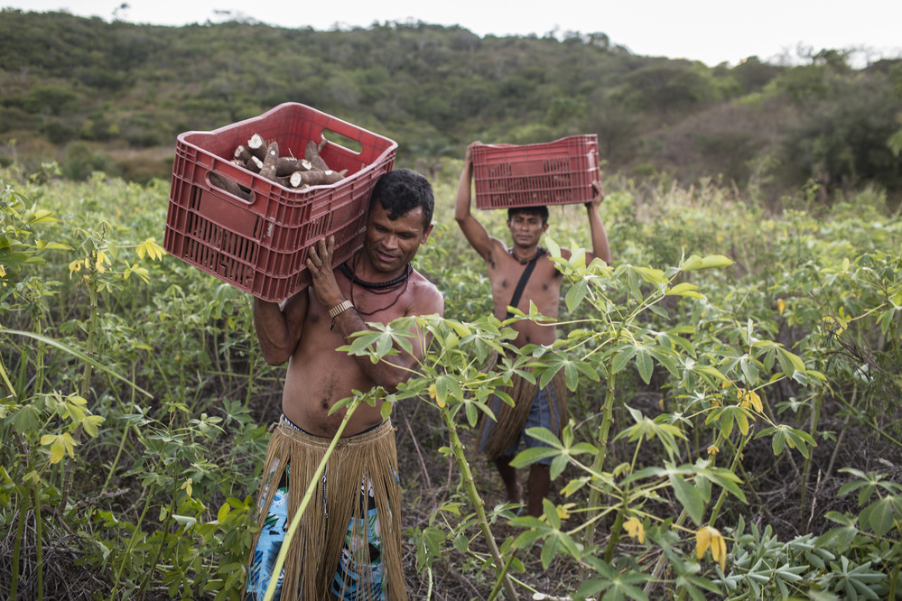
2. Practical Project Examples

Slide 10
Criteria for selection of examples
Territorial focus on particular geographical area(s)
Infrastructure component
Livelihood activities focused on particular value chains or market-based economic potentials – and linking poor people to economic opportunities

Slide 11
Bahia Sustainable Rural Development Project, Brazil (2014-2020)
Territorial focus
Focus on Bahia state – highest percentage of poor people in Brazil
Builds on several generations of CDD projects
Contributes to Bahia State Territorial Development Plan
Component for strengthening 27 territorial councils and developing territorial plans

Slide 12
Bahia Sustainable Rural Development Project, Brazil (2014-2020)
Livelihoods & pro-poor focus
Targeting 56,000 families
Component on value chain analysis and research to analyze viable market opportunities (e.g. apiculture, fruit farming, goat and sheep farming)
Market based sub-projects: Linking Producer Organizations (POs) and Community Associations (CAs) to commercial opportunities and contracts - Technical assistance & matching grants to help POs and CAs implement business plans and investment plans, respectively
Social and environmental sub-projects: focused on food security, income generation and natural resource management
Notes:
Specific consideration given to consistency with Territorial Sustainable Development Plans in selection of sub-projects

Slide 13
Bahia Sustainable Rural Development Project, Brazil (2014-2020)
Infrastructure component
Warehouses and other logistics infrastructure to support market access by POs and CAs.
Equipment for value-added processing; packing and storage facilities; etc.

Slide 14
Tanzania - Resilient Natural Resource Management for Tourism and Growth Project (2018 – 2022)
Territorial Focus
Focus on Southern Tanzania
Improving management of natural resources and tourism assets in priority areas and to increase access to alternative livelihoods for targeted communities

Slide 15
Tanzania - Resilient Natural Resource Management for Tourism and Growth Project (2018 – 2022)
Livelihoods & pro-poor focus
Strengthening alternative livelihoods for 34,000 households in proximity to Protected Areas
Conservation-related community-based initiatives; alternative community livelihoods linked to conservation of wildlife and landscapes; and skills development for local access to jobs in tourism and conservation.
Tourism related livelihoods, such as services and agricultural products to tourism operators, and cultural tourism products; and natural resources-based livelihoods, such as conservation based crop and livestock production, human-wildlife conflict reduction, and participatory forest management

Slide 16
Tanzania - Resilient Natural Resource Management for Tourism and Growth Project (2018 – 2022)
Infrastructure component
Infrastructure in priority Protected Areas e.g. investing in new roads and upgrading the existing network, bridges, airstrips, entry gates, ranger posts, visitor’s centers, etc.
Landscape management and infrastructure investments to augment dry season flows; irrigation systems; catchment conservation; land and water management and climate change adaptation

Slide 17
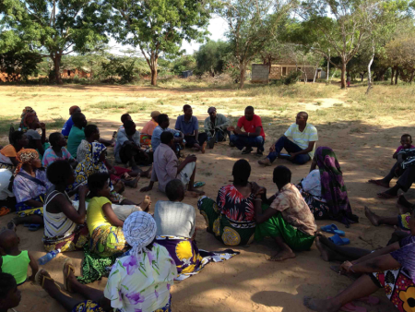
3. Lessons learnt & practical tips

Slide 18
Institutional mechanisms
Various institutional options for flow of funds from national or regional government to communities e.g. through:
Matching funds for Producer Organizations
Linking Village Saving and Lending Associations (VSLAs) to credit via Micro-Finance Institutions (MFIs)
Grants & matching funds to Community Associations
Risk capital fund, managed by private sector (for middle of the value chain e.g. agro-processors)

Slide 19
Partnering with NGOs and private sector
Government agencies most often do not have strong capacity in the following areas, which would benefit from partnering with others:
Value chain research
Facilitation of multi-stakeholder platforms for value chain development
Coaching of Producer Associations on access to markets

Slide 20
Sustainability
Often, institutions established stop operating at the end of the project, when donor support ceases. More attention could be given to:
Linking project activities to local government regular development plans
Linking value chain development activities to government extension system or entrepreneurship development programs
Linking VLSAs / community associations to sustainable sources of finance e.g. MFIs

Slide 21
Summary
The LED approach focuses on income generation and job creation through promoting the economic potential of territories.
Projects adopting an LED approach in the rural context can have three focus areas:
a territorial focus
linking poor people to value chains with potential
infrastructure investments that promote local value chains
Lessons learnt include the need for establishing strong institutions, partnering with NGOs & the private sector and thinking about sustainability early on

