Slide 1

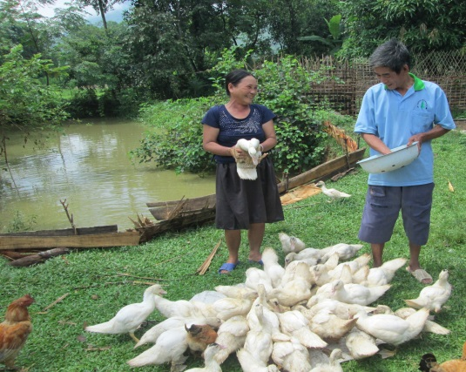
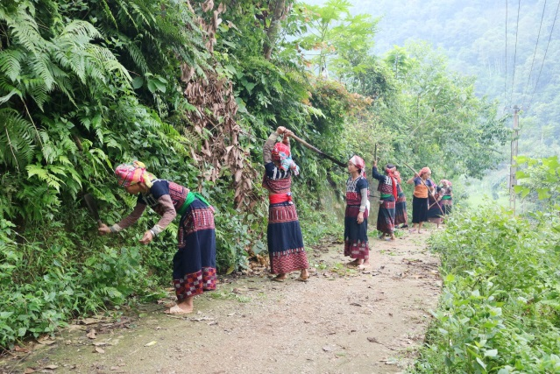
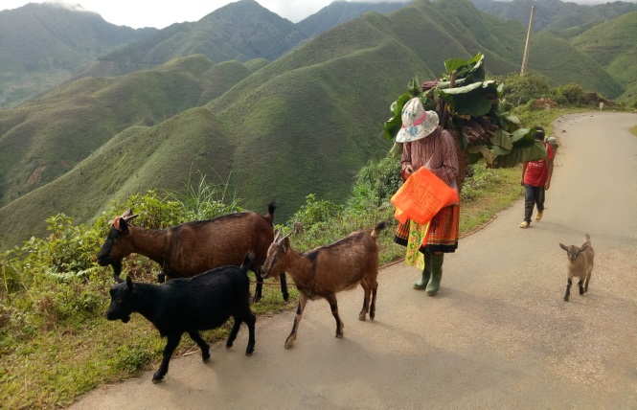
VIETNAM – SECOND NORTHERN MOUNTAINS POVERTY REDUCTION PROJECT
Nguyen Thi Minh Nghia – Project Deputy Director
April 2018

Slide 2
NMPRP2 - Background
Timeline: May 2010 – June 2018
Budget: US$275 million (WB funds: US$250 – GoV funds: US$25)
Implementing agency:
  Overall Coordination: Ministry of Planning& Investment
  Implementing by: People’s Committee at province, district &commune level
Project Objective: To enhance the living standards of the project beneficiaries by improving: (i) their access to productive infrastructure; (ii) the productive and institutional capacities of local governments and communities; (iii) commune integrated investment planning; (iv) market linkages and business innovations
Geographical coverage & scope: 6 poorest provinces in the Northwest region of Vietnam, including 29 poor districts, 259 poor communes and 2,716 villages

Slide 3
NMPRP-2 - Design of Livelihoods Component
NM region: (i) highest overall poverty rate in the country; (ii) about 30 different EM groups; (iii) very remote area
Project aims to improve employment and income-earning opportunities for rural poor households
Undertake twin approaches as: “resource based” and “market led”
Provide grants and/or matching grants to CIGs (for breeding/seeds and services as veterinary, agri. extension, technical training via learning by doing model)
Support to both farmers’ production capacity and group operation
Each group has prepared their business plan (to present implementation arrangements and cost-benefit analysis) that is reviewed and commented by agri. agencies and approved by authorities
About US$75 million are financed to Livelihoods components

Slide 4
NMPRP2 - Challenges and Lessons Learned
Challenges:
  Northern Mountains region: heavily affected by natural disasters (flood, rime, landslide); severe weather; difficult terrain;
  EM groups: most vulnerable to risks and shock; poor access to market, credit, new technology; and barriers of language, illiteracy
Lesson Learned:
  Selecting livelihood activities based on: (i) situation assessment study; (ii) participatory process linking with sectoral master plan for that area
  CIG needs a combination of poor households and better off ones to support each other

Slide 5
NMPRP2 – Livelihood Support Results
Establishing and supporting: more than 10,000 Common Interest Groups (CIG) with more than 93,000 members, of which 75% are the poor and about 90% are ethnic minority people, about 42% are women-led CIGs
More than 100 Productive Partnerships setup between private sectors and CIGs
60% of supported CIGs have maintained their activities over more than 4 production cycles
80% of CIGs have expanded their production scale as compared to the first cycle that project supported with grant
More than 90% of CIGs have group’s funds that be used as revolving funds for groups’ members

Slide 6
NMPRP2 - Lessons Learned
Integrated development program (including infrastructure and livelihood) could creates sustainable results and impacts
More matching funds (less subsidies) – More Ownership of group members
Role of group leader is extremely important for group success and sustainability
The enthusiasm and attention of authorities create more motivation for communities

Slide 7
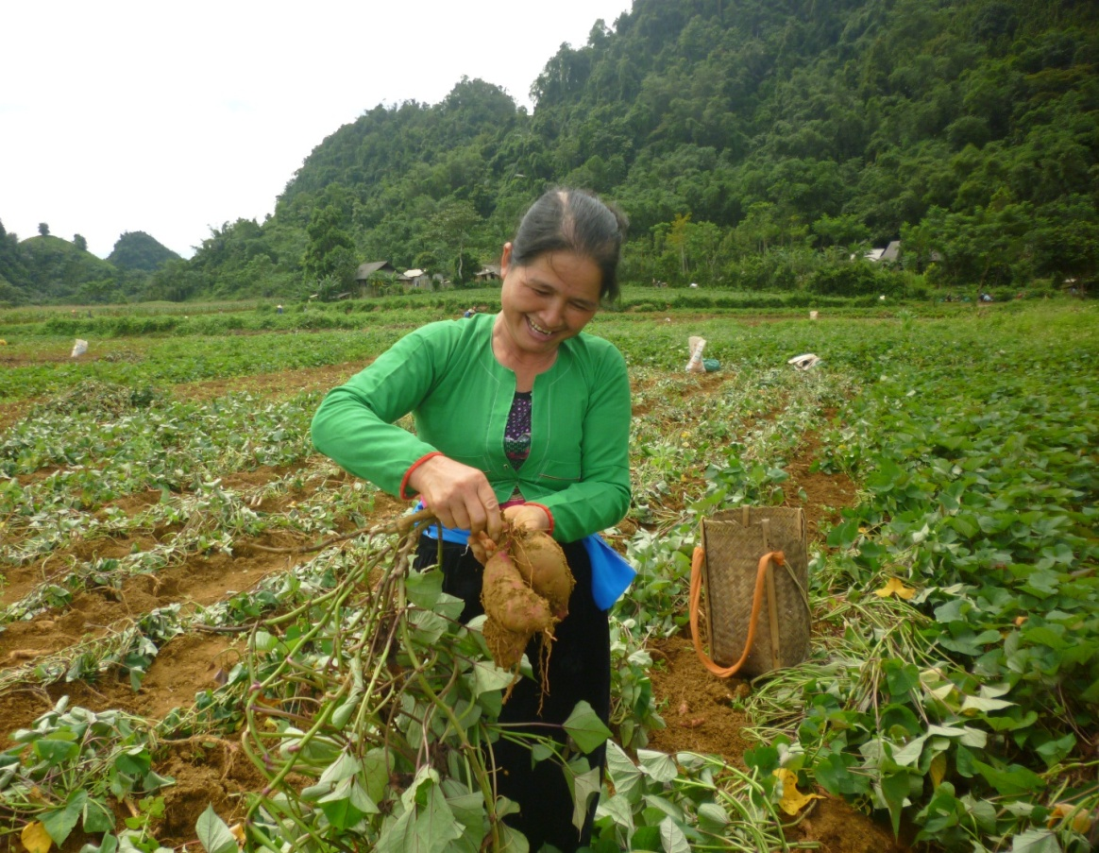
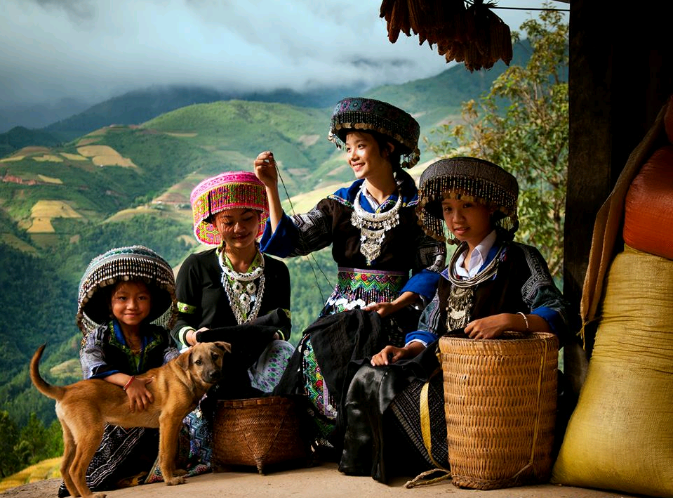
NMPRP2 – Some project photos

Slide 8
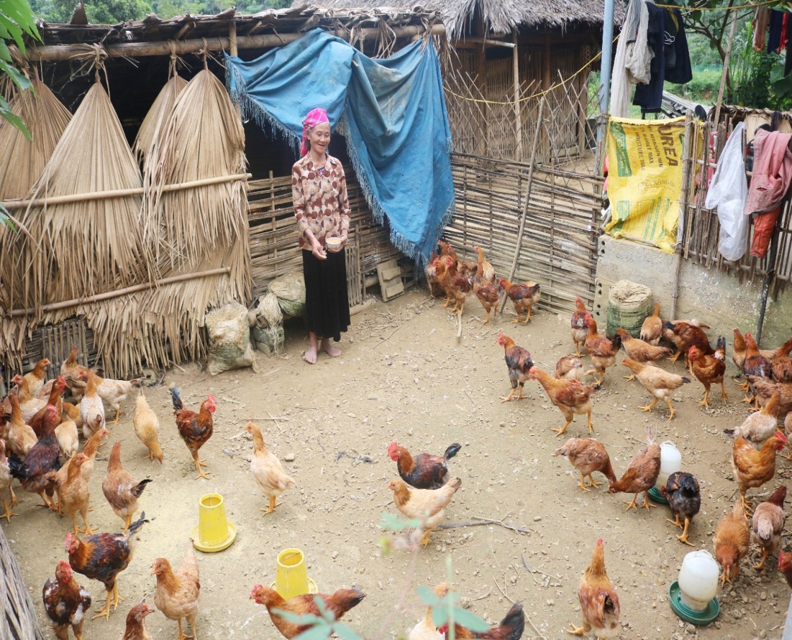
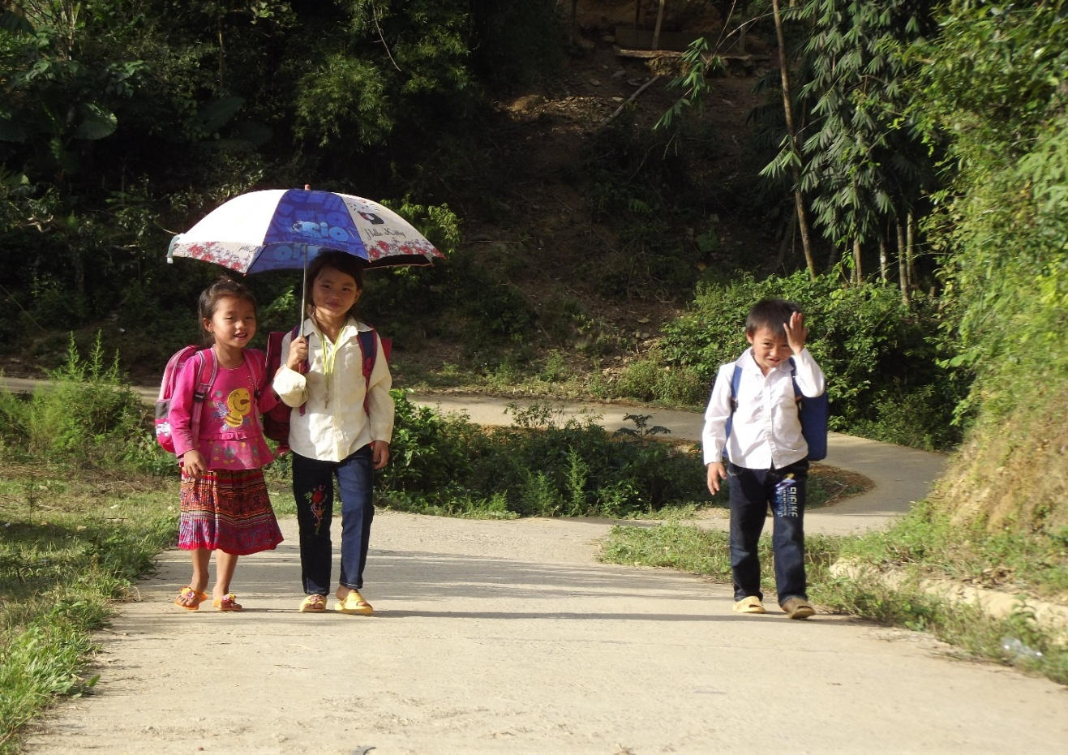
NMPRP2 – Some project photos

