Slide 1
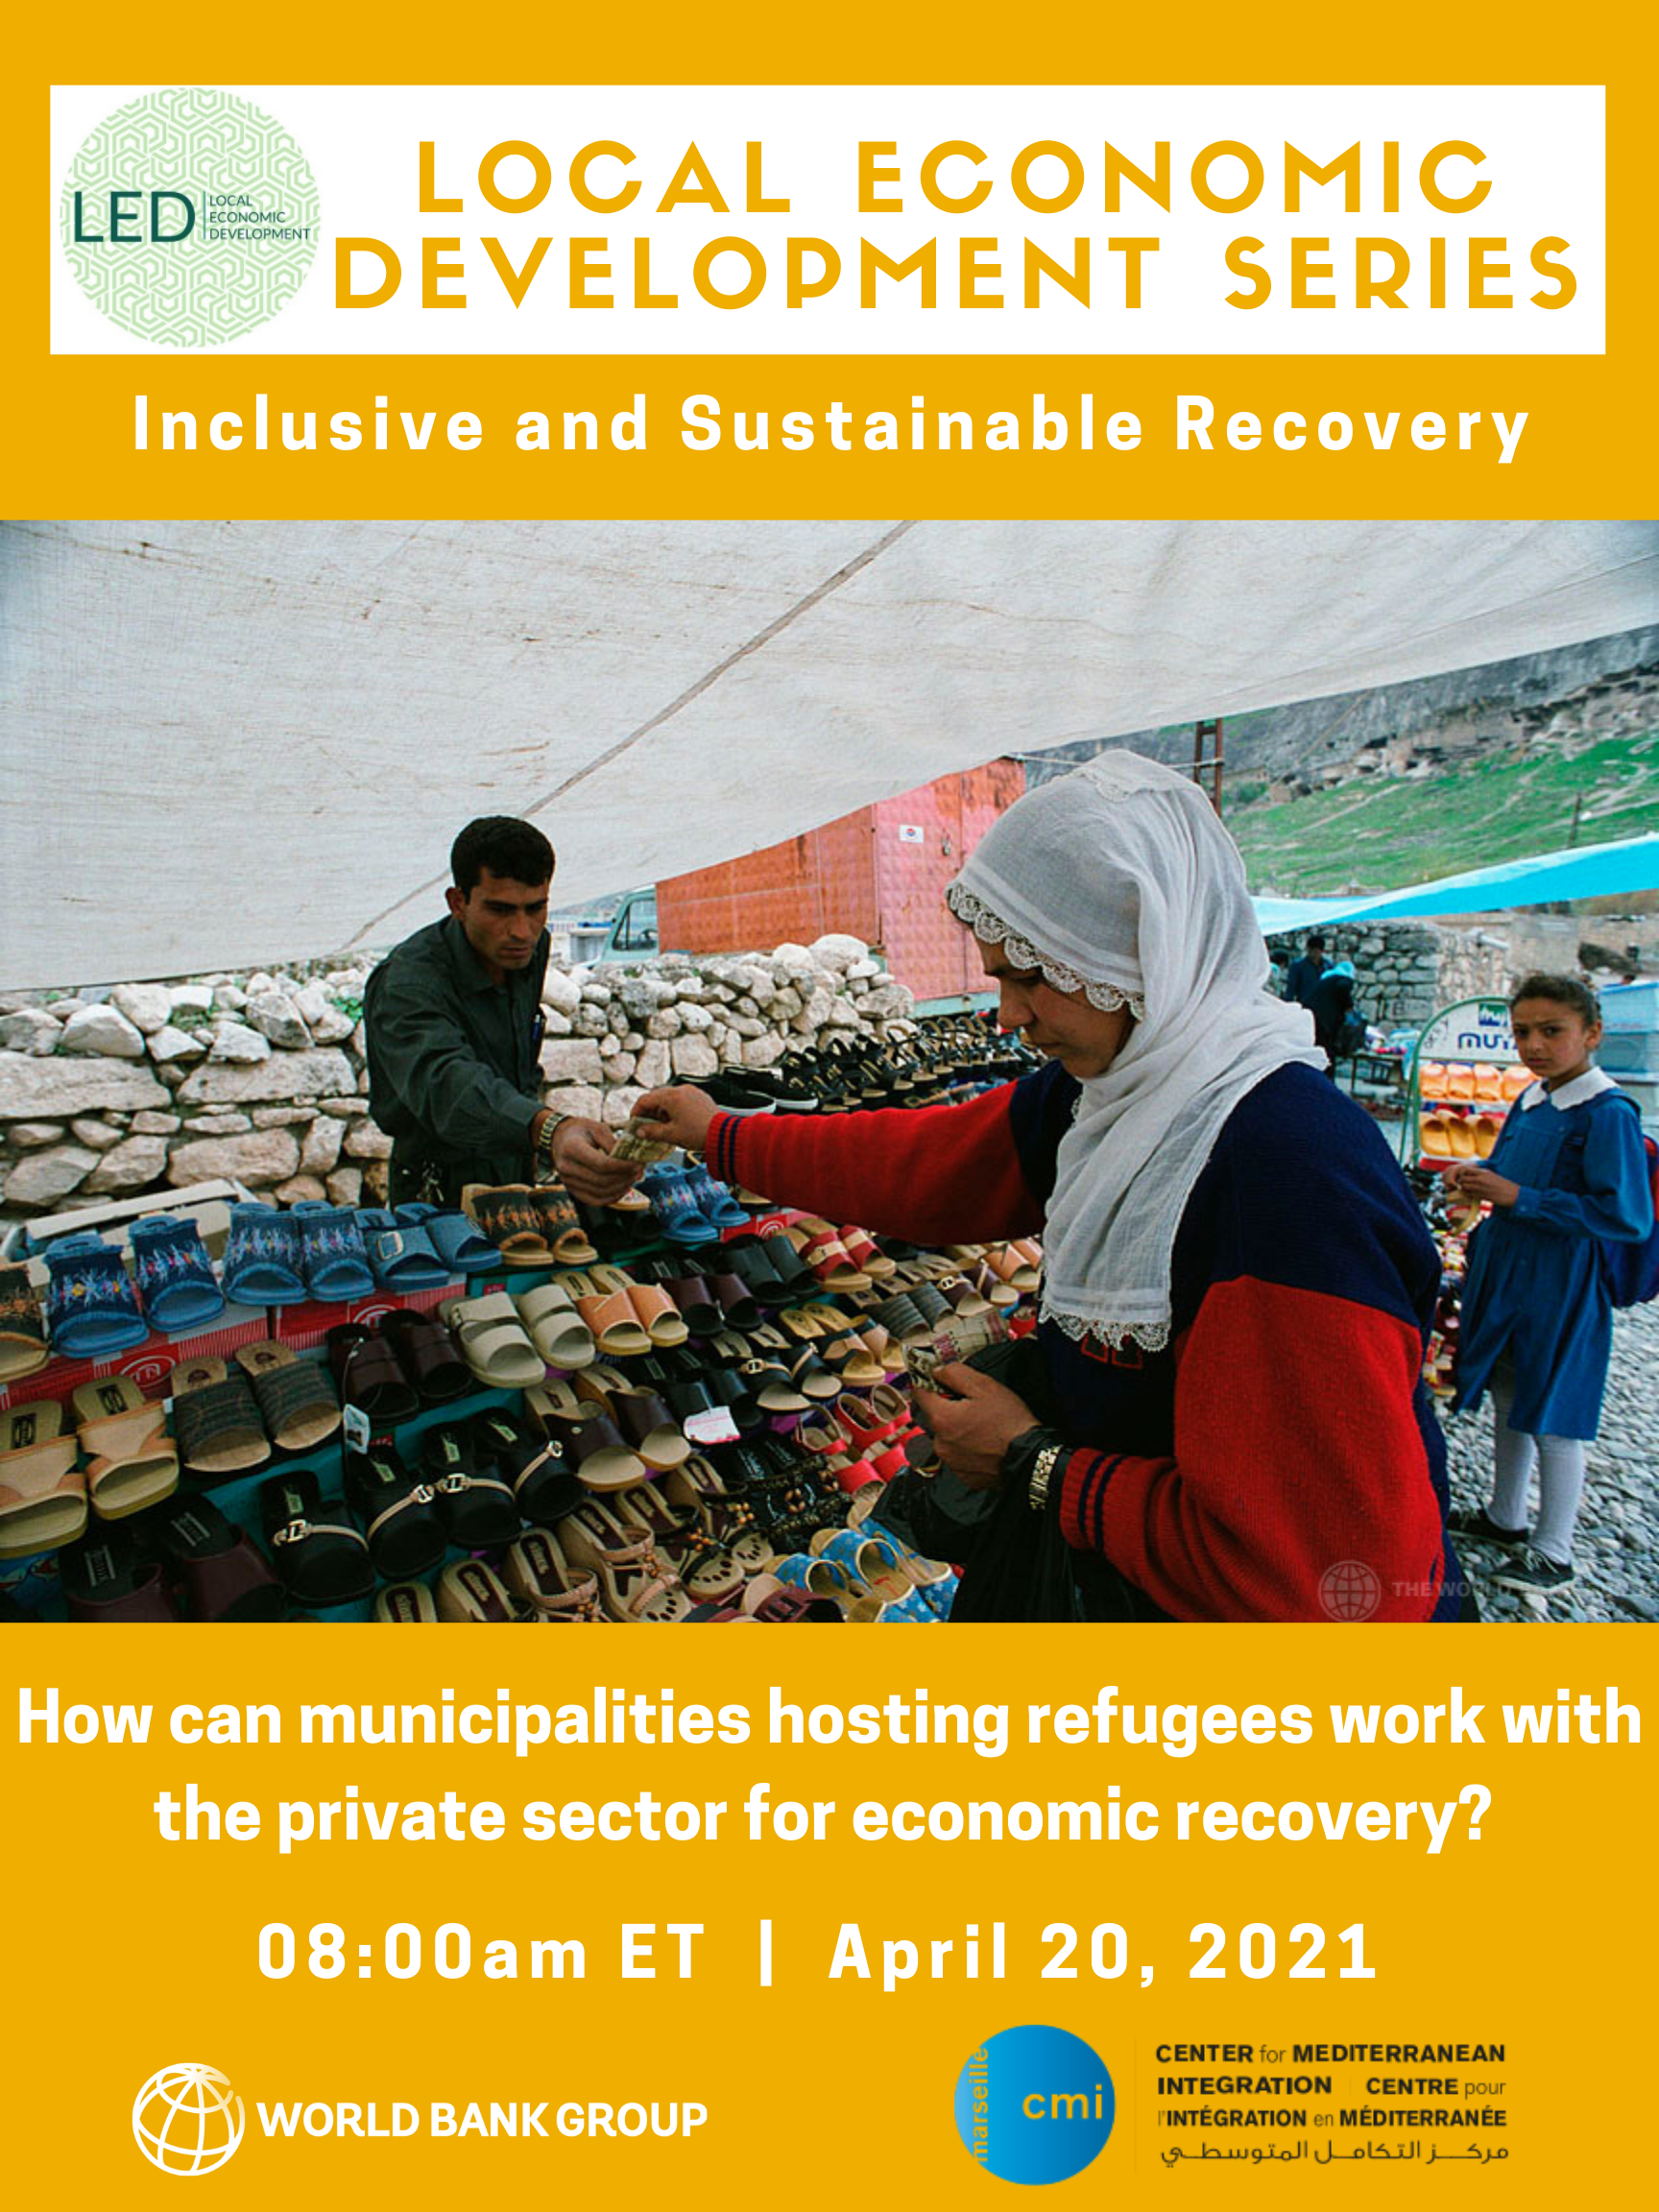
Hosted by the World Bank’s Community-Driven Development Global Solutions Group (CDD GSG), Rural Livelihoods and Agriculture Employment GSG, Local Economic Development Knowledge Silo Breaker (LED KSB) in collaboration with the Center for Mediterranean Integration (CMI)

Slide 2
Today’s Structure
Opening remarks:
Blanca Moreno-Dodson, Manager, CMI
Moderator:
Sara Boughedir, Consultant, CMI
Speakers:
Giulia Marchesini, Senior Partnership Specialist, CMI
Fuat Ozharat, Gaziantep Metropolitan Municipality, Turkey
Nadine Burbar, Head of Local Economic Development and Deputy Chief Resilience Officer, Ramallah Municipality, Palestine
Reham Jammal, Director of Planning Department & Director of International Projects and Programs Unit, Greater Irbid Municipality, Jordan
Closing remarks:
Vara Vemuru, Practice Manager, Social Sustainability and Inclusion, World Bank

Slide 3
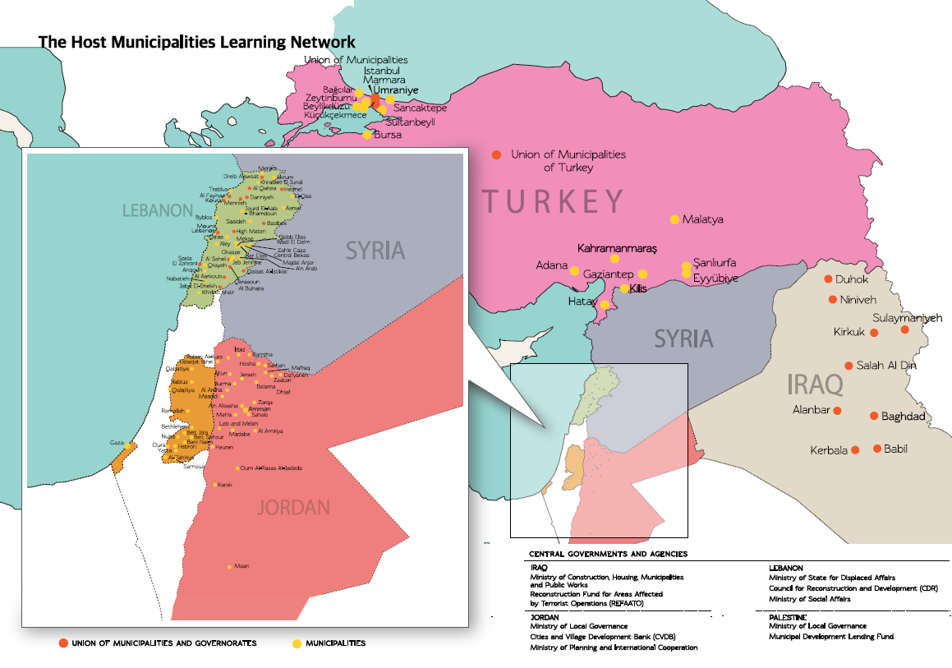

Slide 4
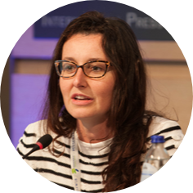
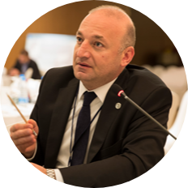
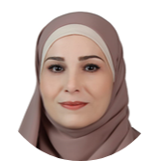
Giulia Marchesini, CMI
Fuat Ozharat, Turkey
Nadine Burbar, Palestine
Reham Jammal, Jordan

Slide 5
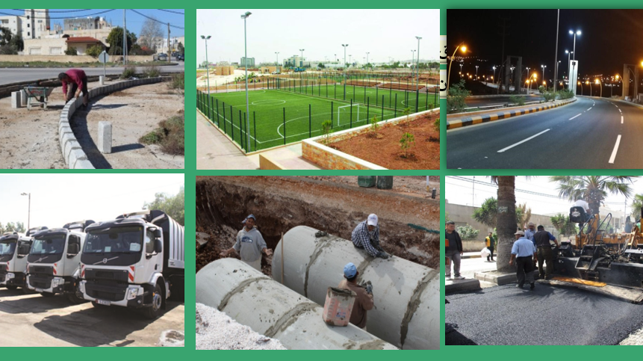

Slide 6
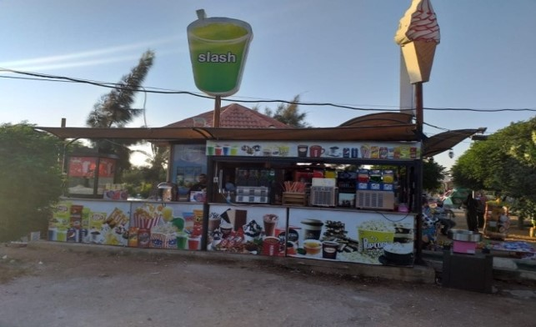

Slide 7
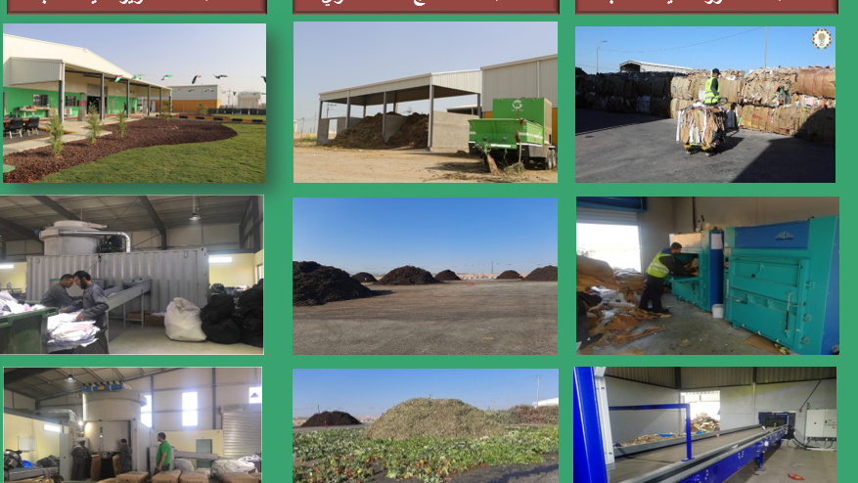

Slide 8
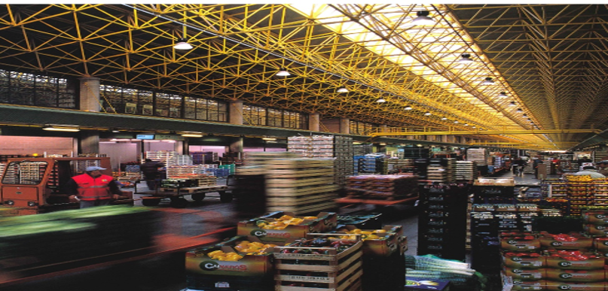

Slide 9
Giulia Marchesini, CMI
Fuat Ozharat, Turkey
Nadine Burbar, Palestine
Reham Jammal, Jordan

Slide 10
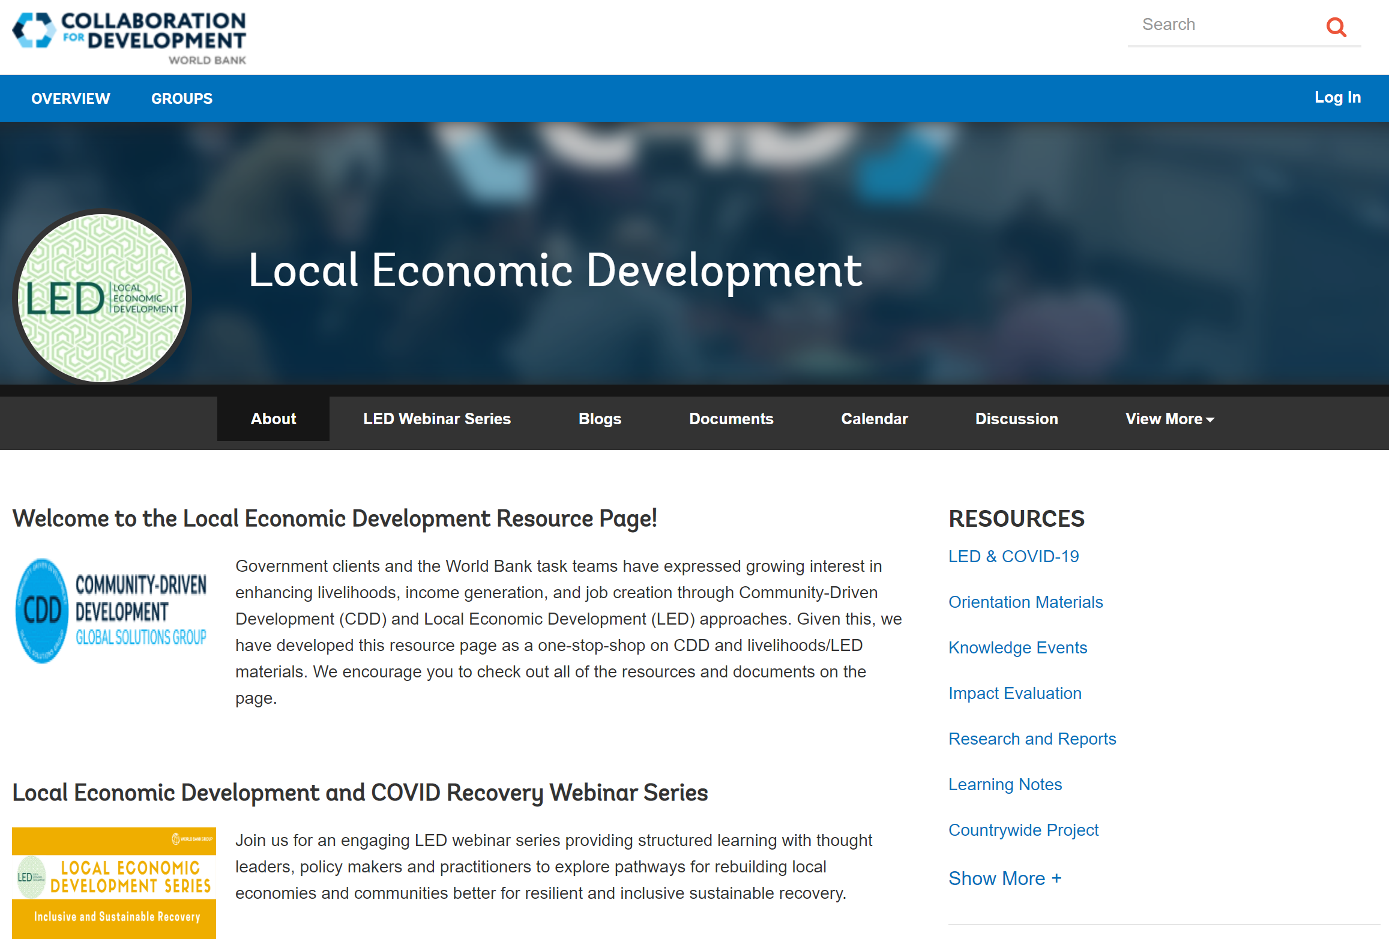
LED Resource Page
https://collaboration.worldbank.org/content/sites/collaboration-for-development/en/groups/cdd-and-local-economic-development.html

