Slide 1
LIVELIHOOD ENHANCEMENT AND ASSOCIATION OF THE POOR PROJECT (LEAP)
(P153591,IDA-Credit No. 59600-KH)
Community Driven Development Approach
For
Small-Scale Infrastructure Sub-projects
Date:
Prepared by: Project Coordination Office

Slide 2
Project Perspectives
- Build Social Capital and
- Giving the voice and opportunities to the poor in planning and managing their own destiny.
Principle of Project Preparation
Does not provide fish to eat, but helps to make the ability to make their own fishing tools.

Slide 3
Implementation of Community-Driven Development
1. Training on Procurement and Finance Manuals
7 Key Steps in the Implementation Process
Conduct training for SMT’s related staff
2. Mobilization and Dissemination
Conduct dissemination meetings with community and local authority.
3. Establishment of Community Committees
Conduct meeting with interested people to elect the Community Committees (Procurement and Finance Committees)
Contract between SMT and the Community. (Threshold Value $25,000 for Civil Works & Goods.)
4. Capacity Building and Training
Prepare and submit CPP to PCO through the SMTs for WB NOL.
Procurement, finance and technical training programs for Community Committees.
5. Community Procurement Plan (CPP) Preparation
6. Contract for Financing Sub-project
7. Sub-project Implementation

Slide 4
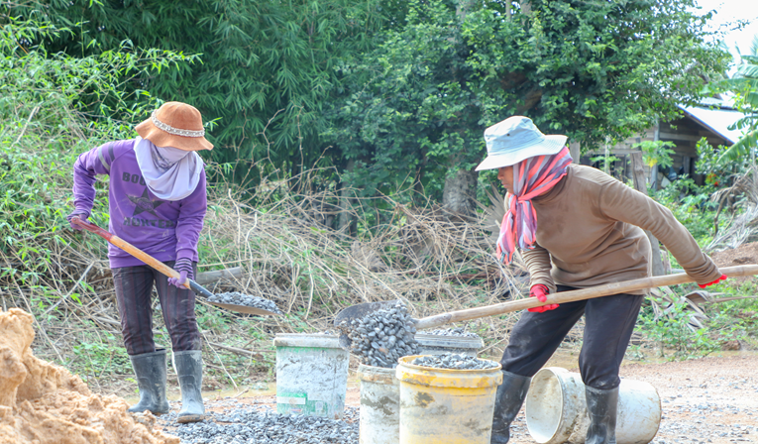
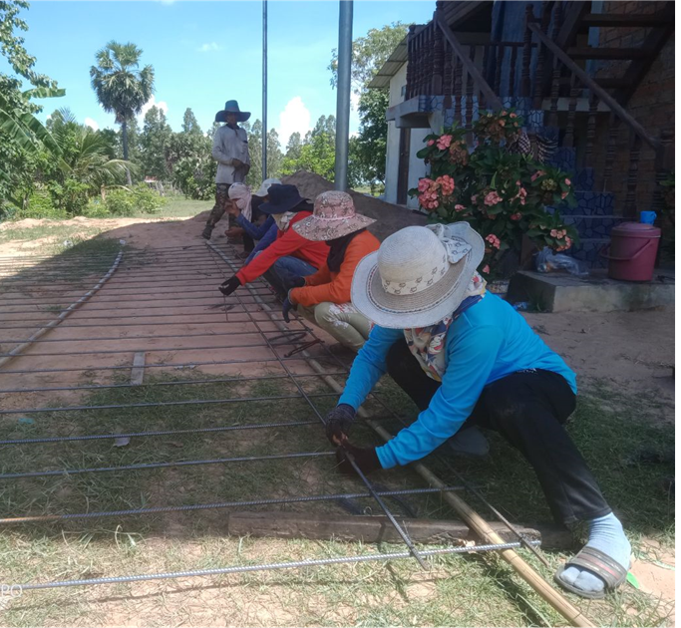
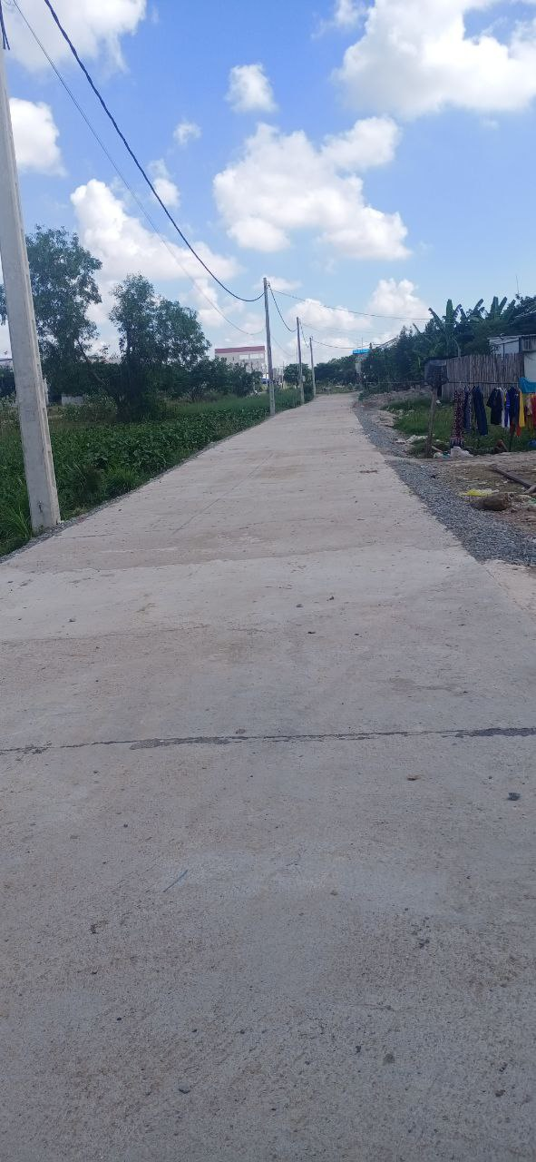
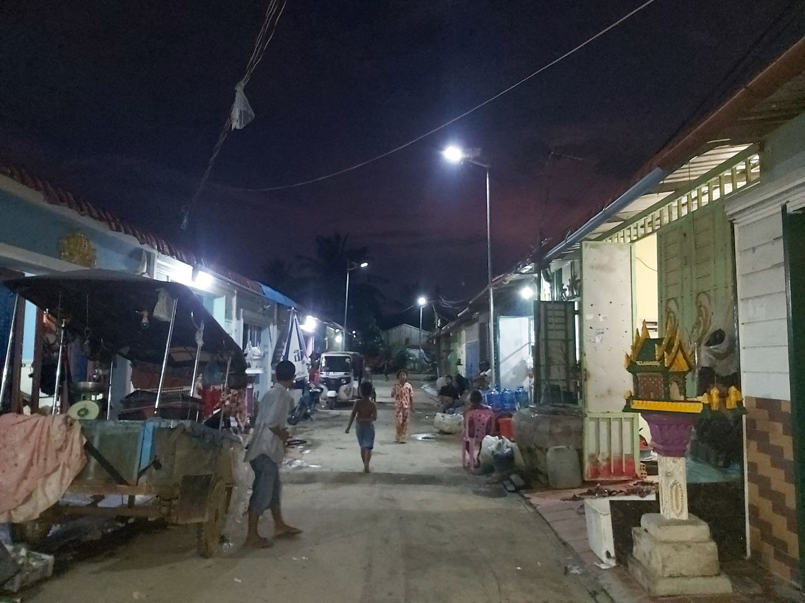
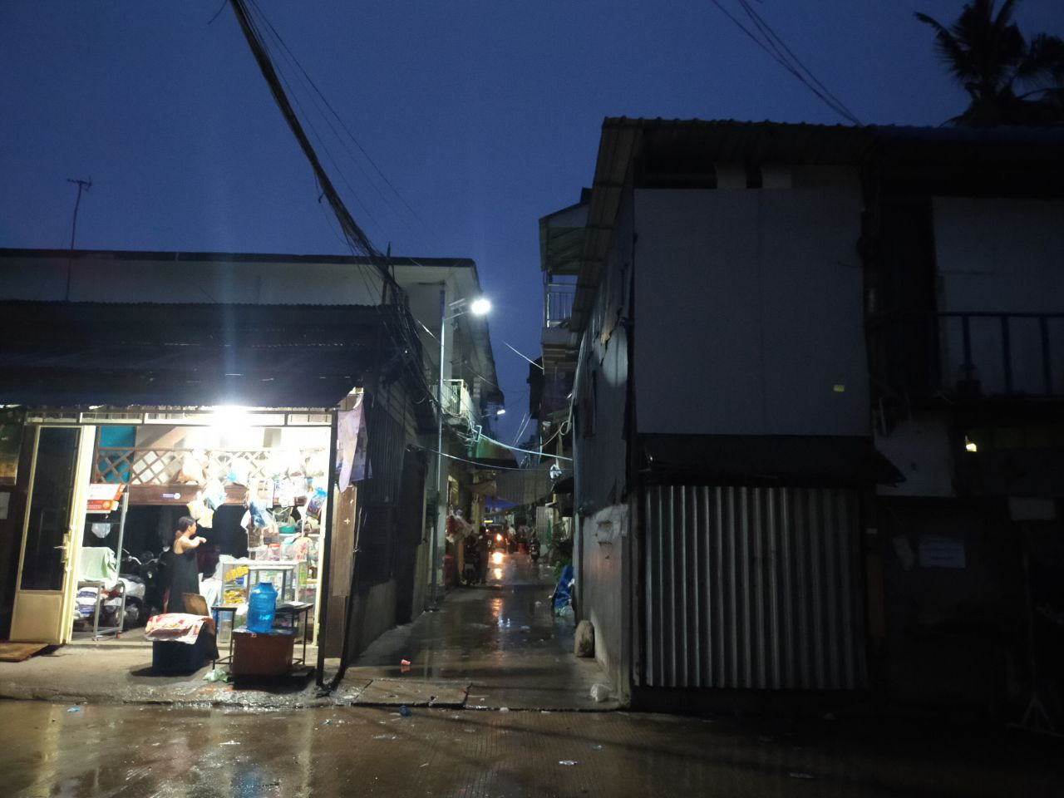
Concrete Road in Siem Reap Province and Solar Street Lighting in Phnom Penh

Slide 5
Key Results, Challenges & way forward
Constructions carried out by local communities are of better quality compared to the ones by contractors and provide more jobs and incomes to community members
Improved ownership, participation and the feeling of care and maintenance of construction outputs
There is a need to increase budget for Personal Protective Equipment (PPE)
Procurement guidelines remain complex and strong coaching and backstopping support is required
Fund flows for disbursement for labor cost need to be well managed
Exchange learning visits among community committee should be promoted
Need to clearly define and adapt the design of subprojects that are suitable for communities – when it involves high technical solution and heavy-duty machine it may not be possible.
Need a fair labor recruitment to avoid any conflicts in the community
Ministry of interior is considering the possibility to apply and include the Procurement Procedures for Community Participation into the Commune/Sangkat Project Implementation Manual (PIM) and it will be used nationwide.

