Slide 1
“Poverty Reduction Fund Project, Lao PDR” Community Driven Development (CDD)
PRF introduced CDD approach to be a rural development tool that can be for nationwide policy by encouraging high level of participation (women, and ethnic groups).
Community participation in planning(decision making based on eligible list),
Implementation (CFA),
Operation & maintenance, and ensure sustainability by community themselves and local institution.
Achievement: 1) Improve basic infrastructure over 5000 sub-projects in over 2500villages, including Rural road improvement, irrigation, dispensary, water, school(Applying CFA), 2)Capacity building for community& local authority, and 3)Livelihood through SHGs and producer group; and Nutrition through behavior change through project activities. Due to positive outcome on rural development, PRF is an outstanding project that received an ASEAN Award in 2015.
PRF future vision
Continue supporting the basic infrastructure (using CFA) that supports the livelihood with links nutrition activities, encourages women and ethnic group participation, together with strengthen local government .
CDD will be anchored within existing contextual systems of The Lao Government), frameworks, and processes;
Increasing the role of Government in taking lead in fund raising and technical supporting that would ensure the sustainability of community development.

Slide 2
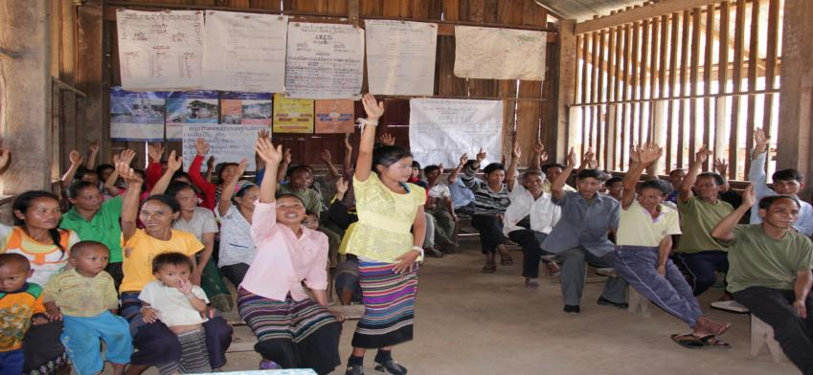
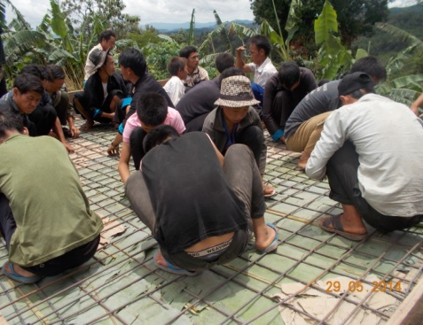
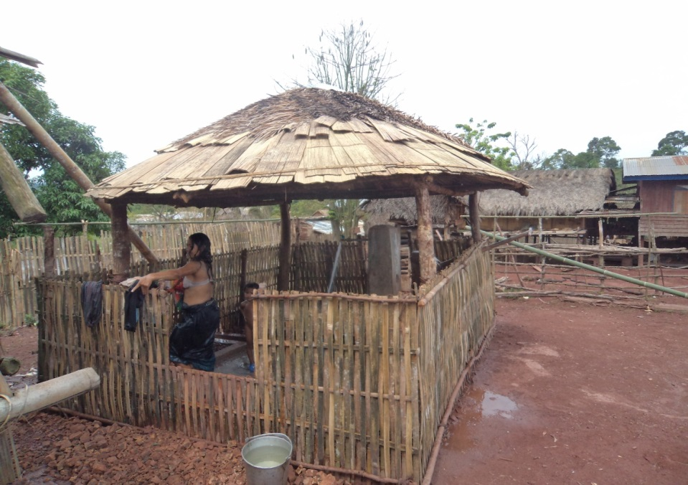
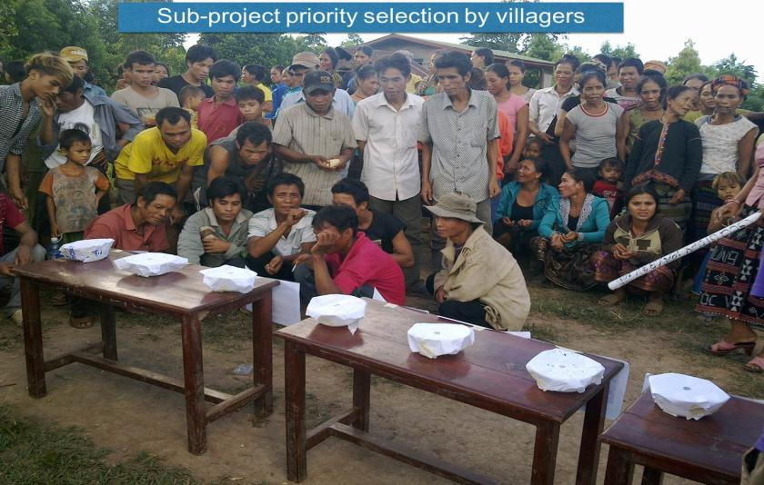
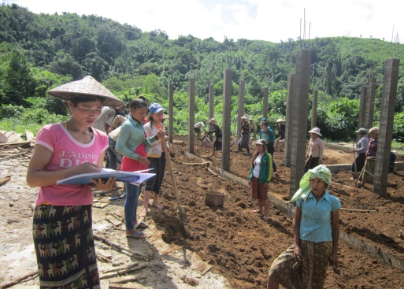
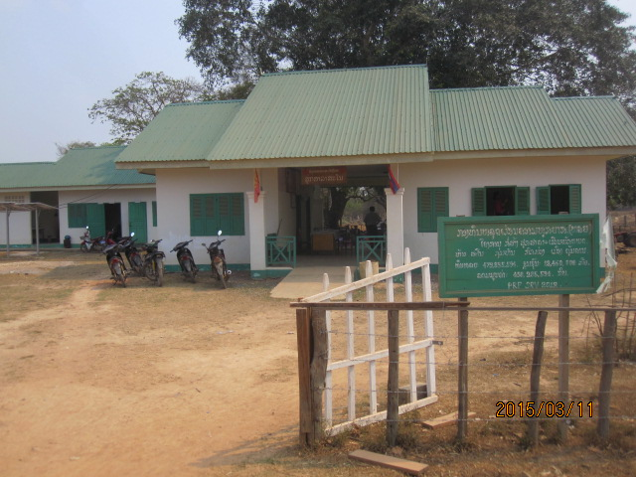
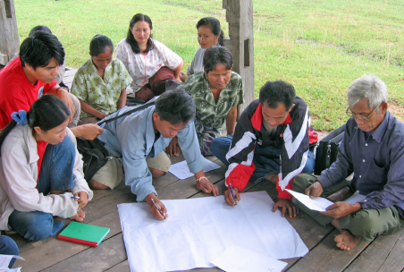
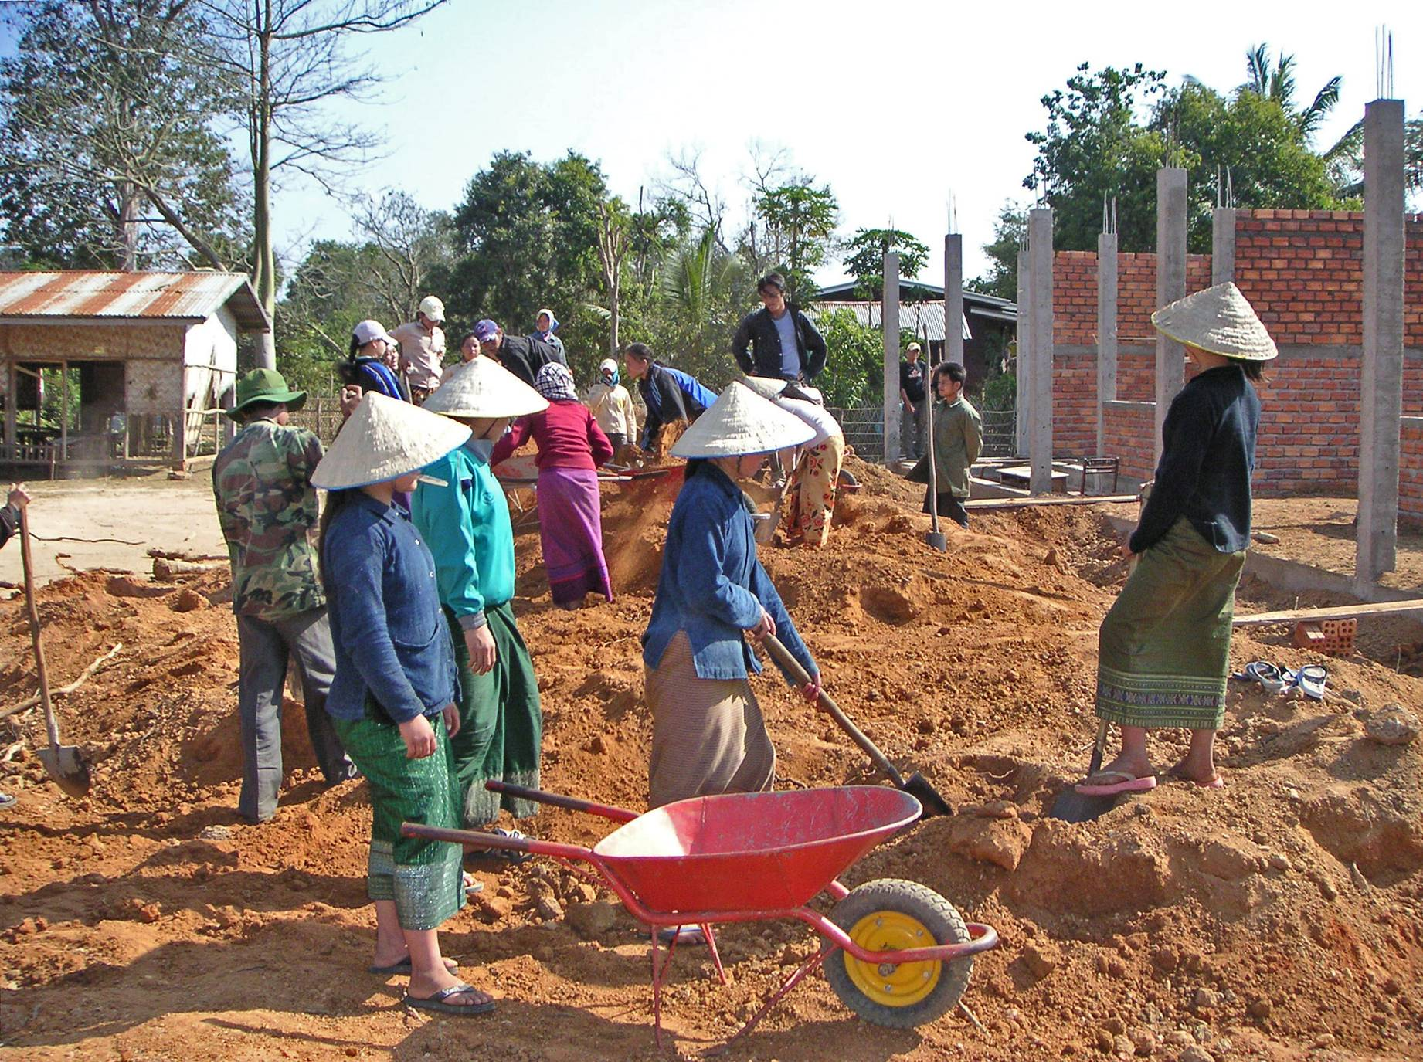
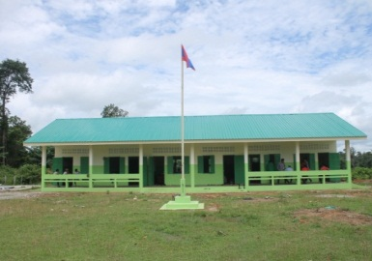
Sustainability
Village Planning
Implementation by CFA
Operation and Maintenance

Slide 3
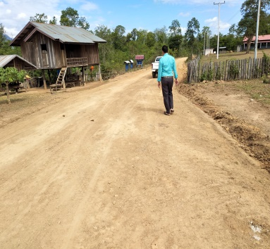
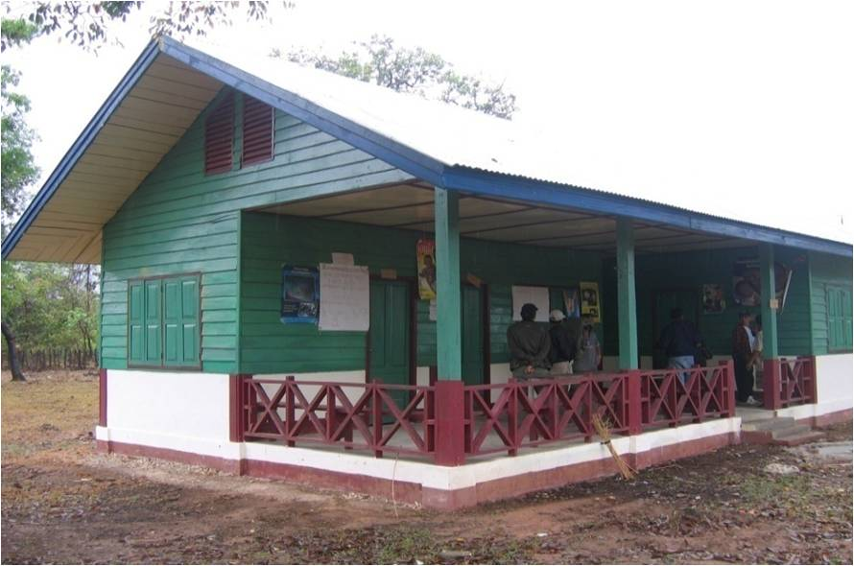
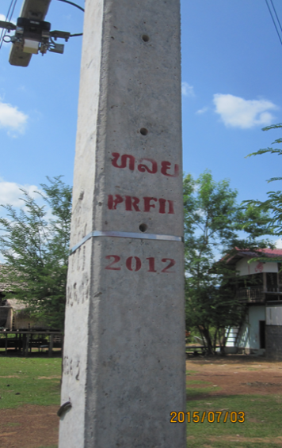
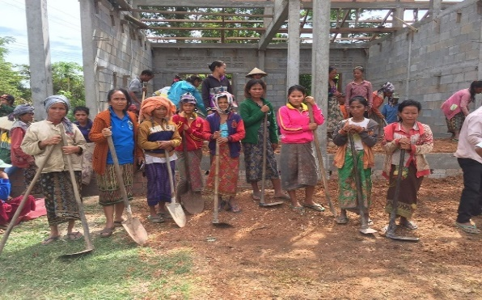
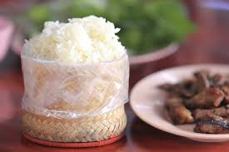
PRF’s Support to National Growth and Poverty Eradication Strategy
Village poverty Criteria: 1) Sufficient food, 2) School access, 3) Health service, 4) Safe and sufficient water, 5) Road access, and 6) Electricity
(under PRF supporting activities)
Safe and sufficient water
PRF I (2003-2011): Total 2,461 SPs
PRFII:(2012-2016): Total 1,930 SPs
PRFII: (2017-2021): Total 1458 SPs
Road access
Health service
Village planning
School access
CFA: Implementation
Electricity
Sufficient food,

