Slide 1
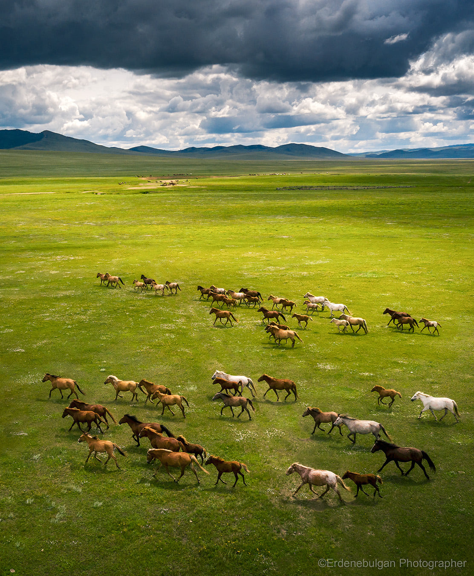
BRIEF INTRO
Performance Based Grant
ENKHBAT MANGAL, Senior technical advisor
JIGJID BANZRAGCH, Procurement specialist
THIRD SUSTAINABLE DEVELOPMENT PROJECT
Ulaanbaatar, Mongolia
2022

Slide 2
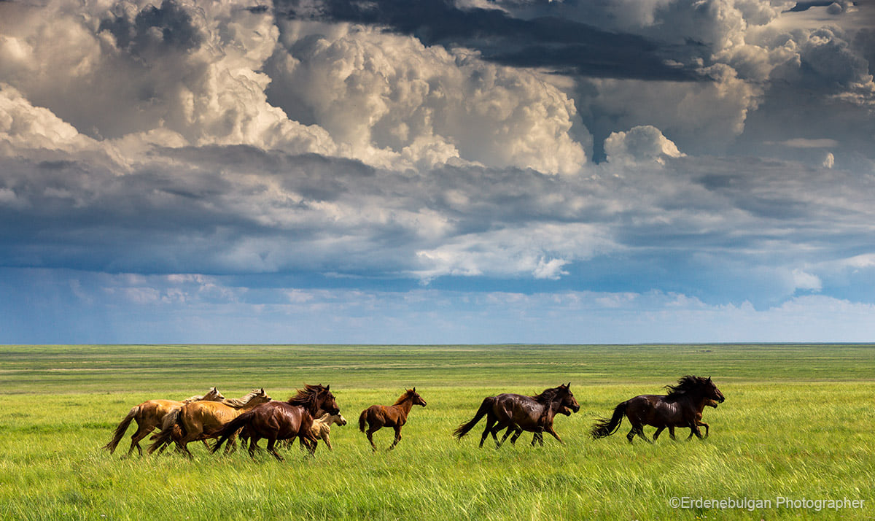

Slide 3
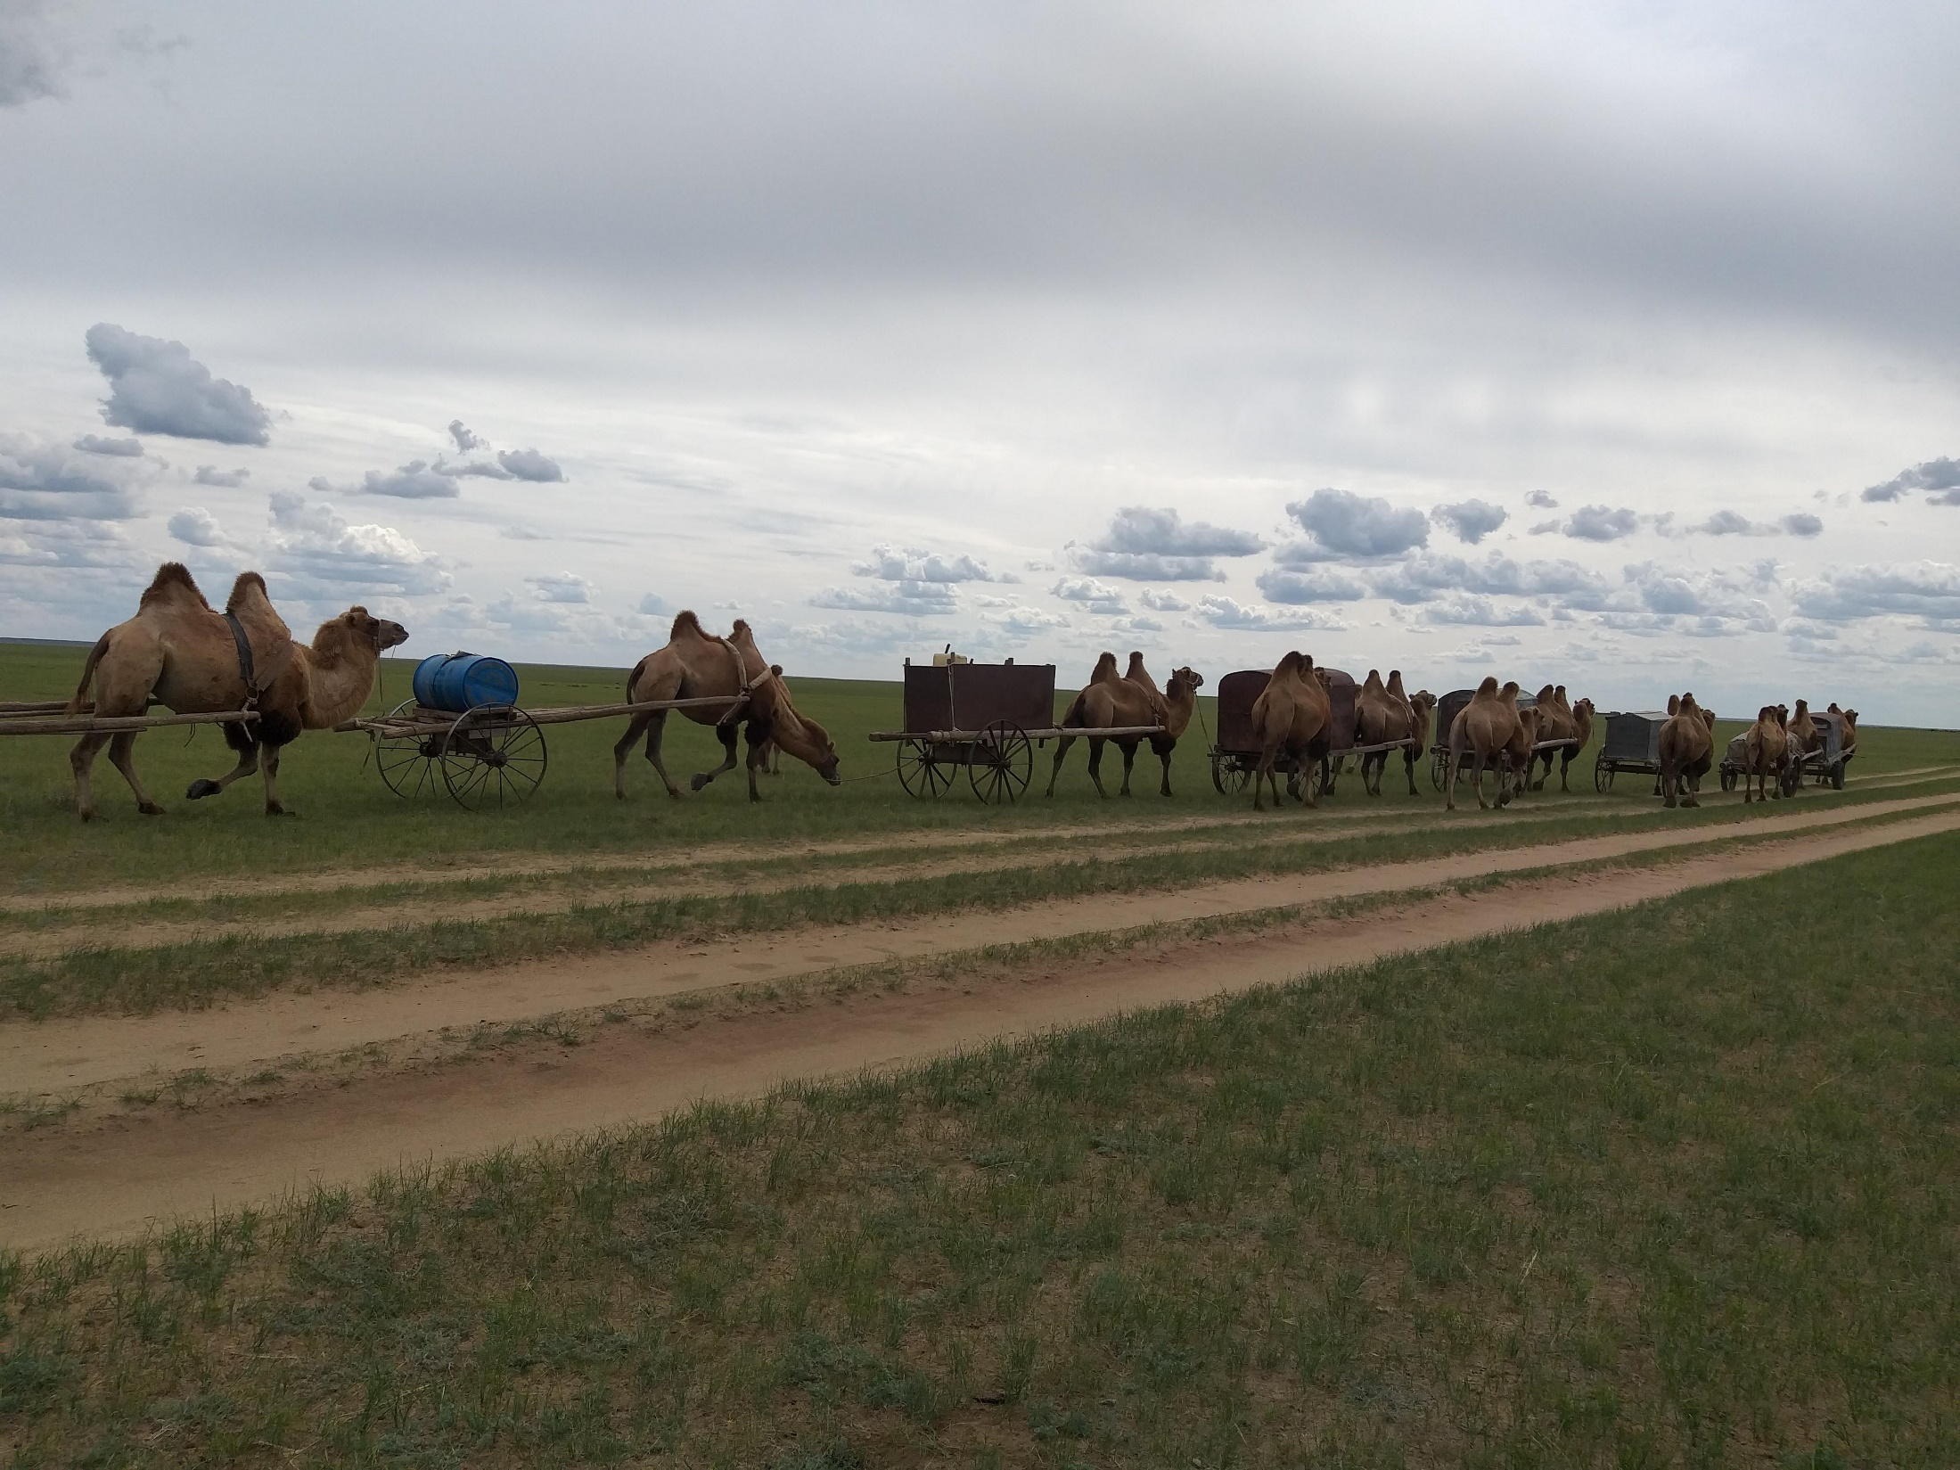
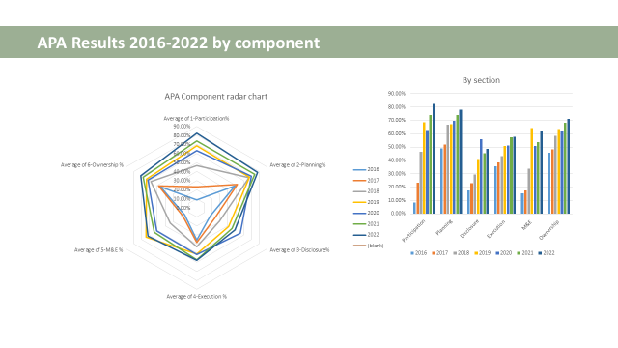

Slide 4
KHERLEN | LDF, PBG and Top -Up
Year | 2017 | 2018 | 2019 | 2020 | 2021 | 2022 | Total
PBG | - | 10,275,000.00 | - | 47,934,266.45 | 58,487,603.24 | 52,207.36 | 116,749,077.06
Top-Up | - | 90,231,800.00 | 59,797,792.00 | 29,625,123.75 | 15,339,160.15 | - | 194,993,875.90
Total | - | 100,506,800.00 | 59,797,792.00 | 77,559,390.20 | 73,826,763.40 | 52,207.36 | 311,742,952.96

