Slide 1
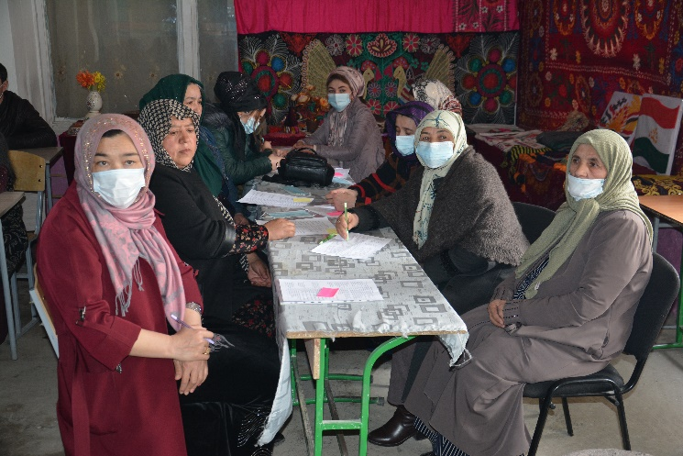
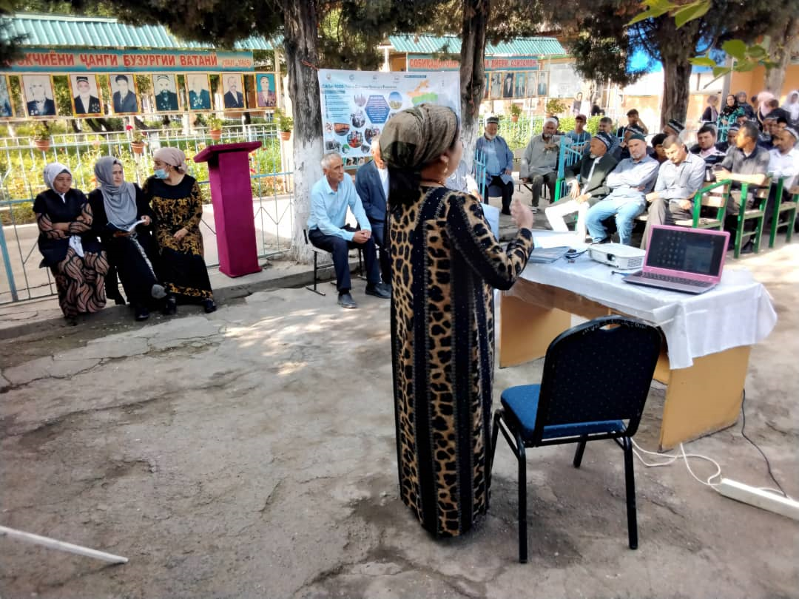
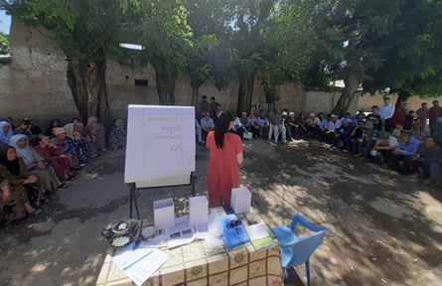
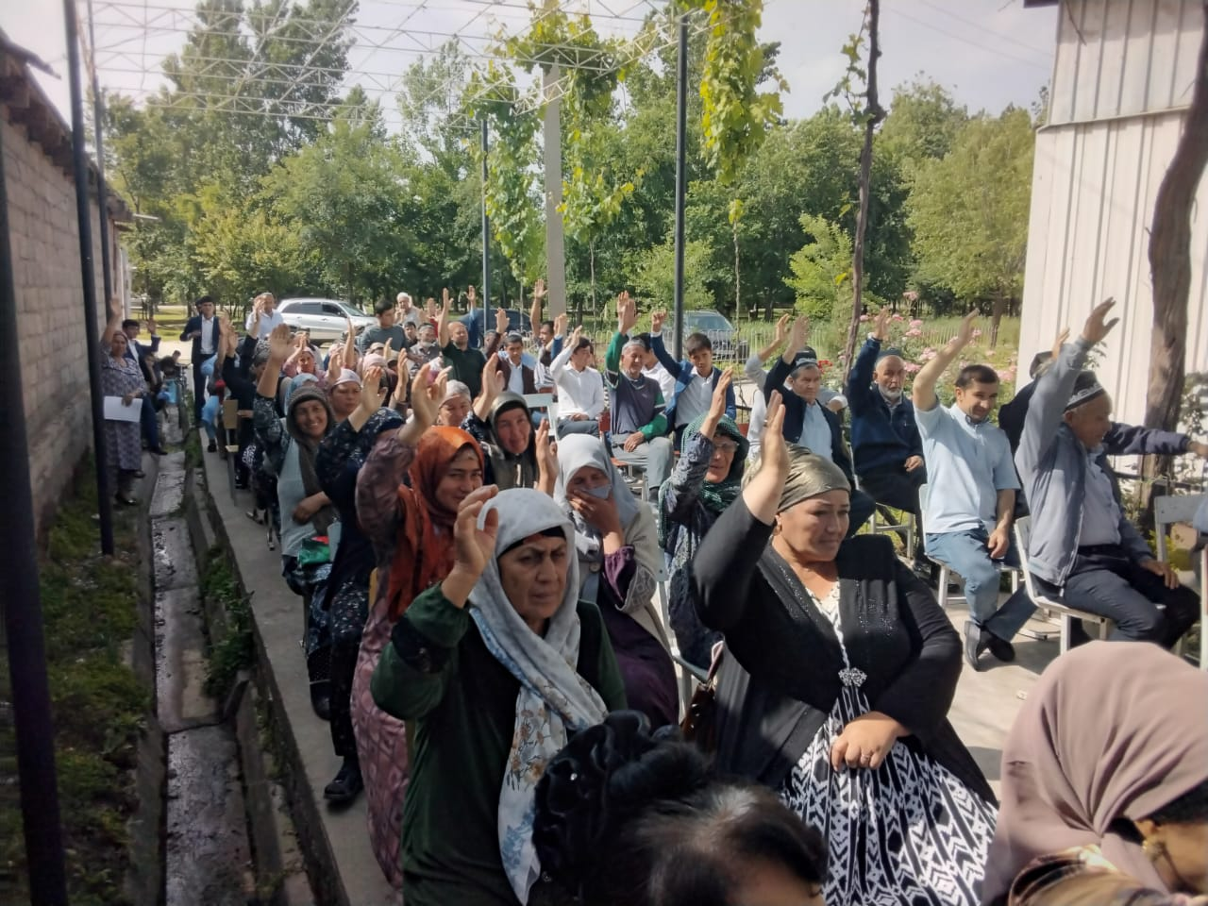
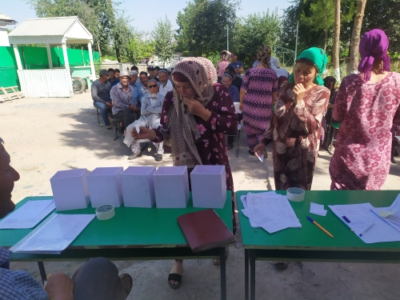
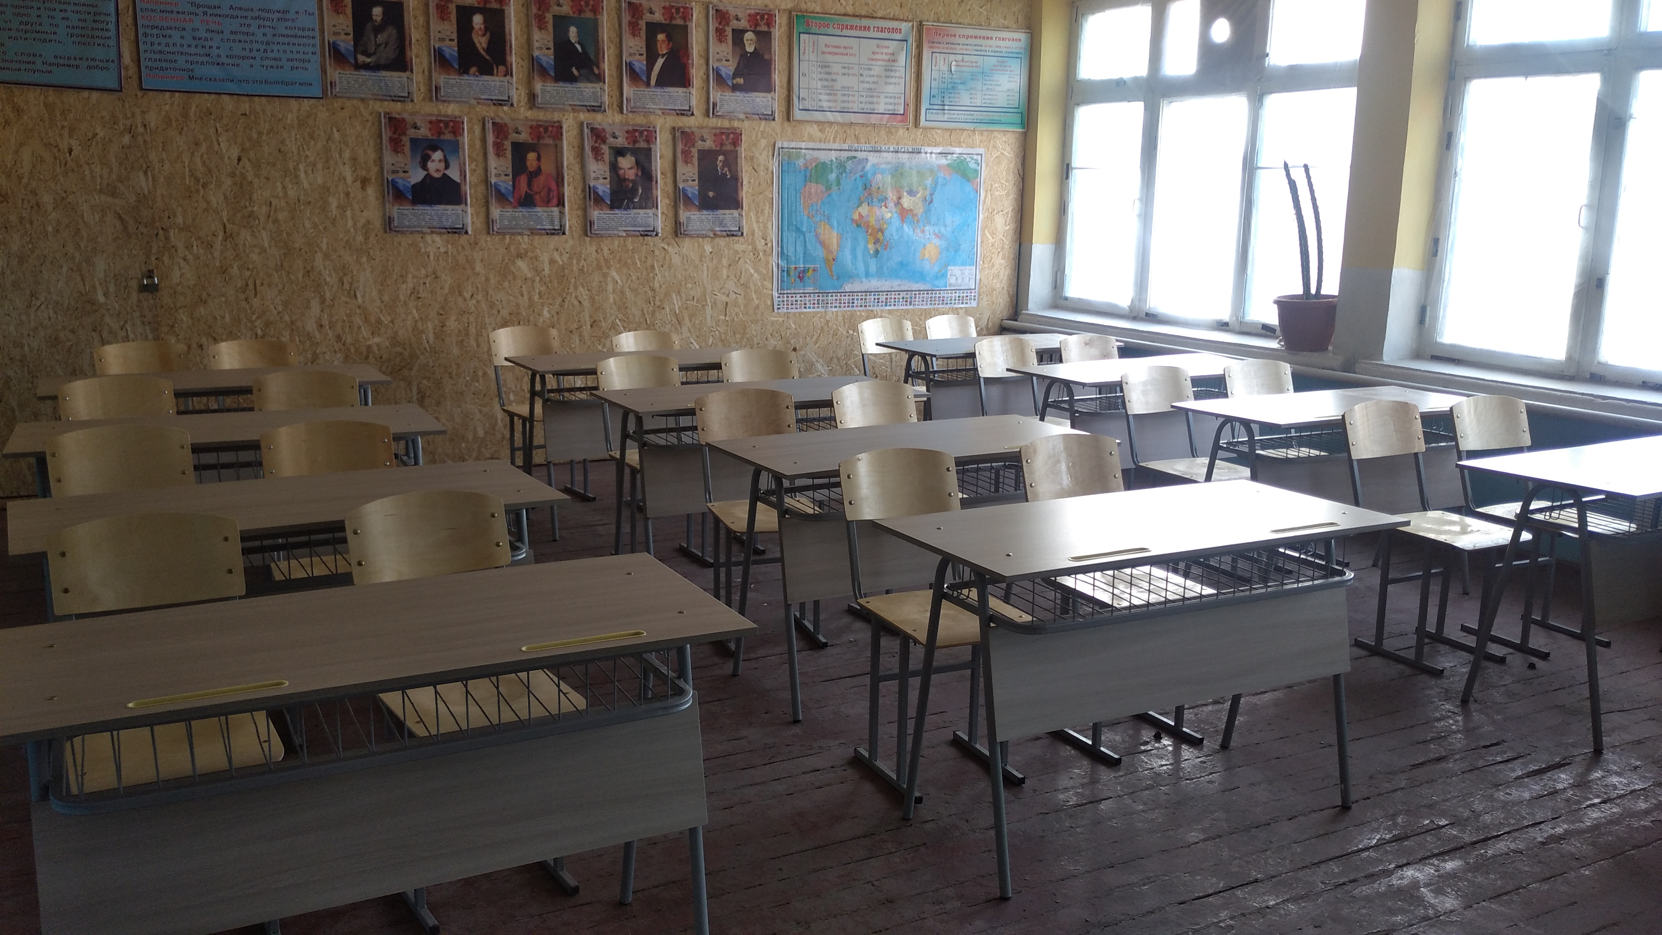
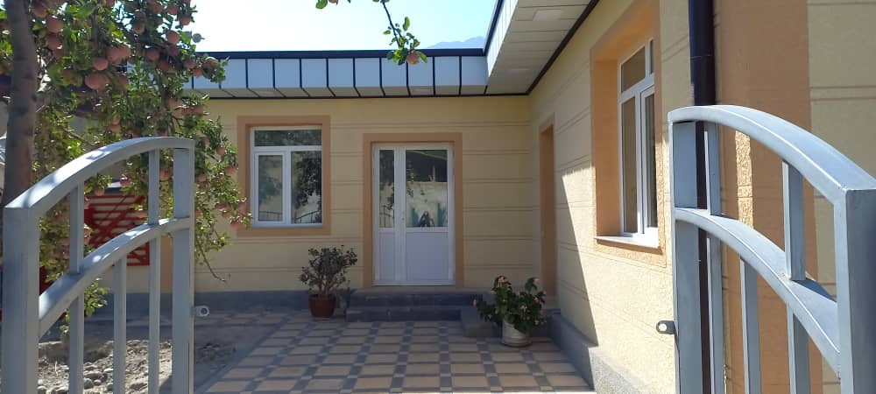
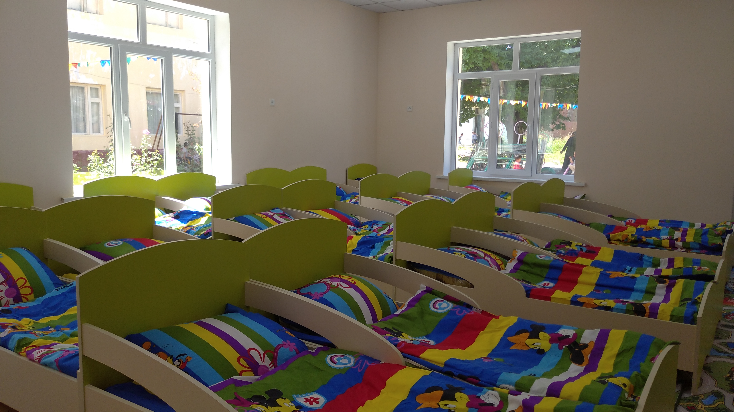
NATIONAL SOCIAL INVESTMENT FUND OF TAJIKISTAN
«CASA-1000 COMMUNITY SUPPORT PROJECT»
Information about project beneficiaries
Project event | Total
The total number of participants in all activities within the CSP | 38659
General information on social audit | 9396
CSP
Subprojects within the project implementation

