Slide 1
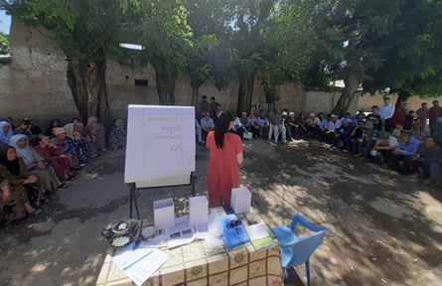
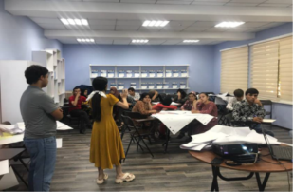
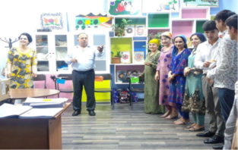
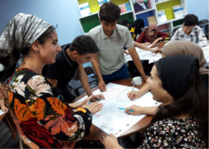
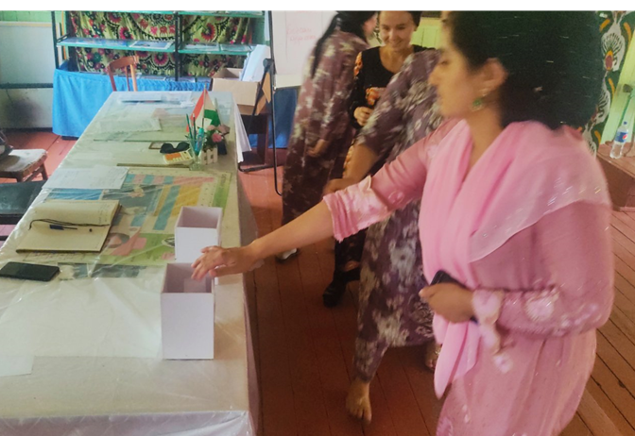
SOCIO-ECONOMIC RESILIENCE STRENGTHENING PROJECT IN TAJIKISTAN
Building resilient communities in districts bordering Afghanistan through community participatory approach and selection of socio-economic infrastructure.
Giving more support to the SPs prioritized by youth and women
Creating village profiles that in turn drives local development
Creating livelihood opportunities for youth
Creating extra-curricular opportunities for youth

