Slide 1
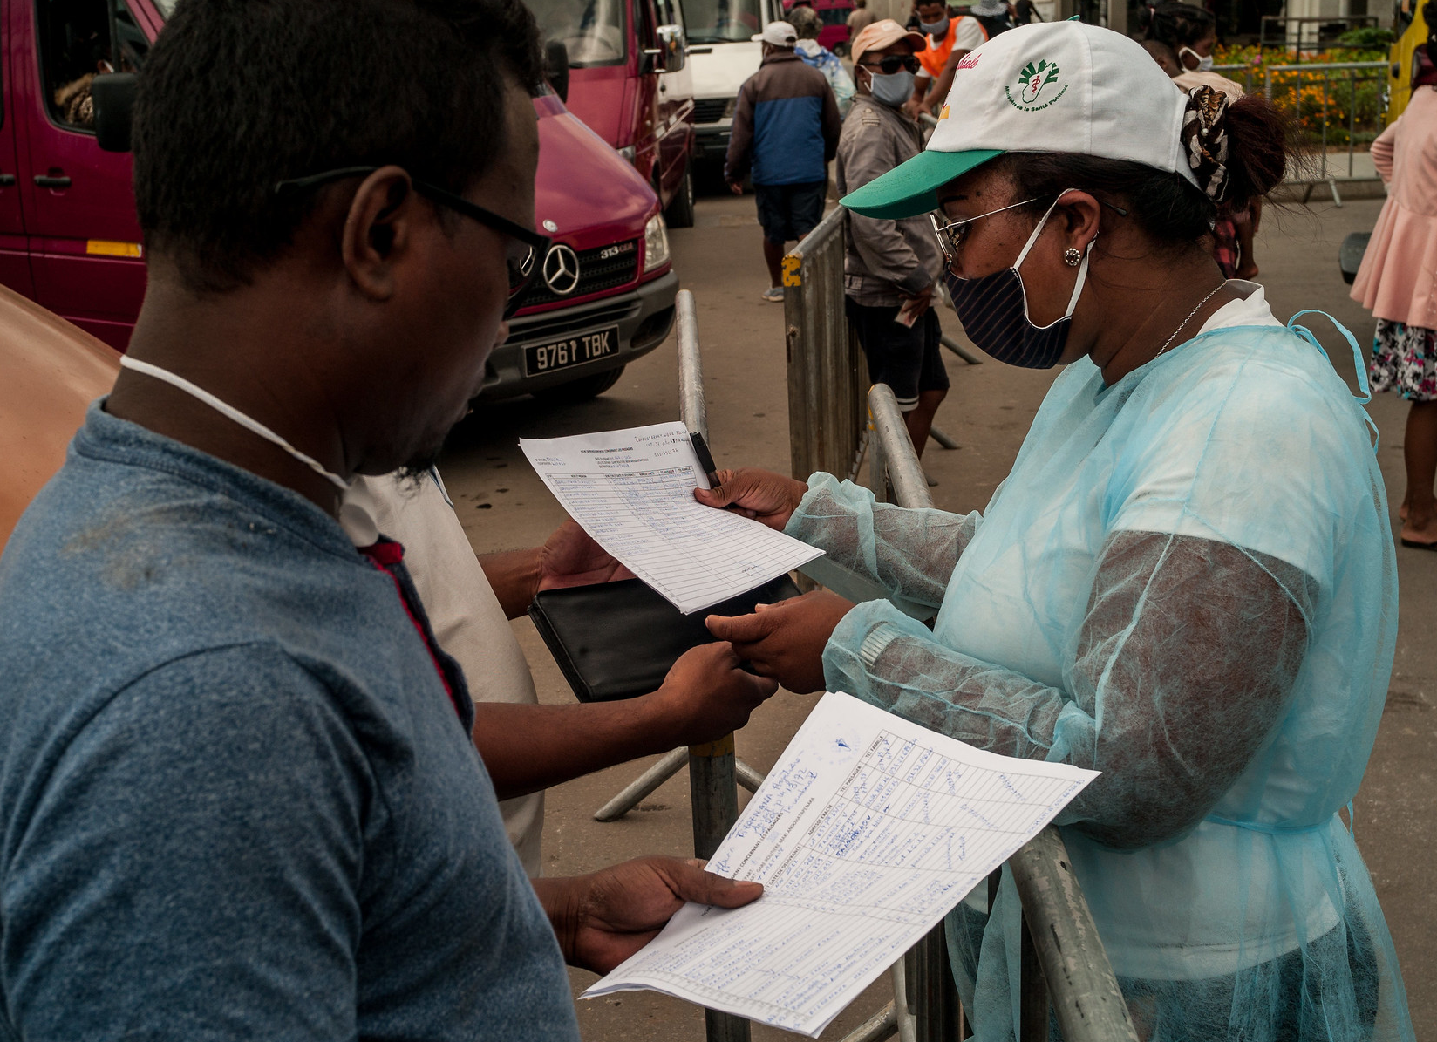
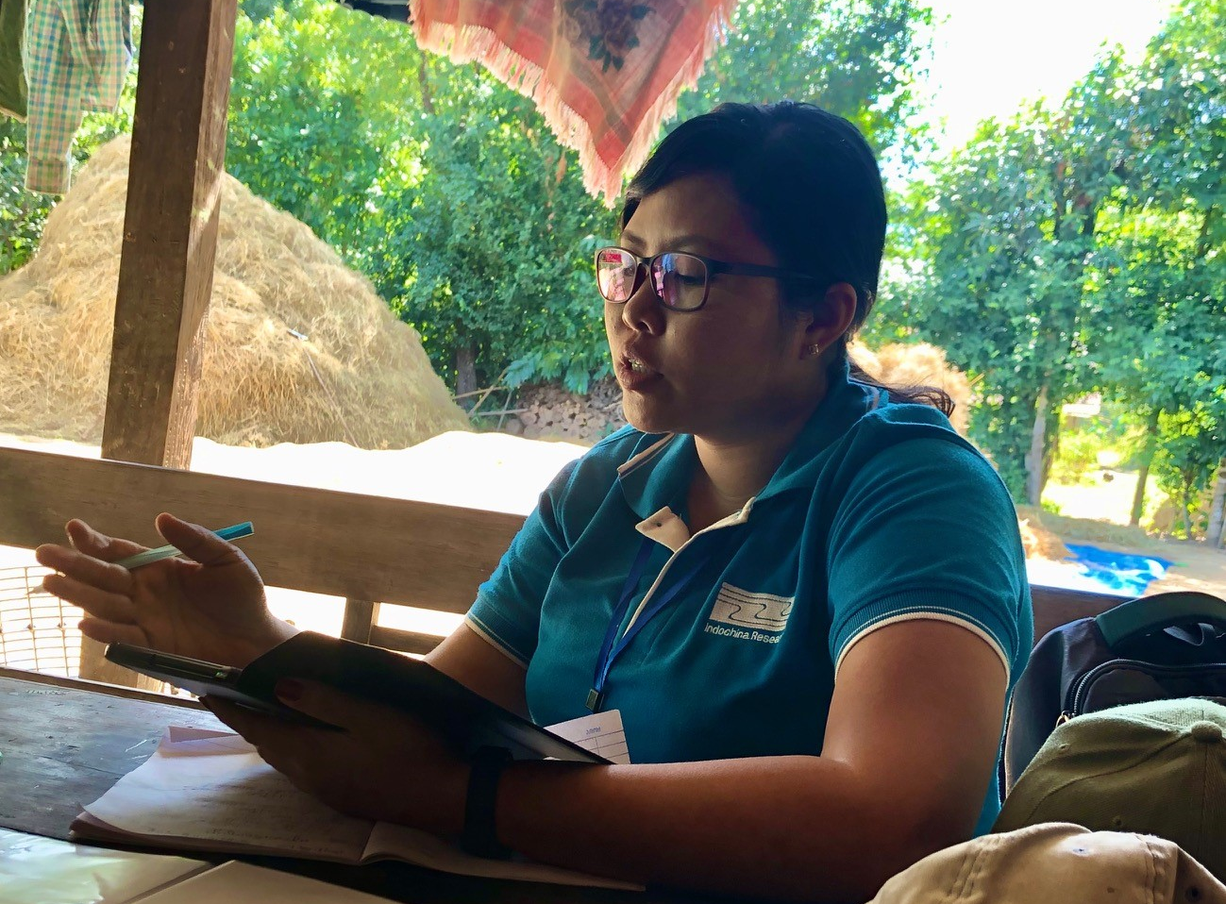
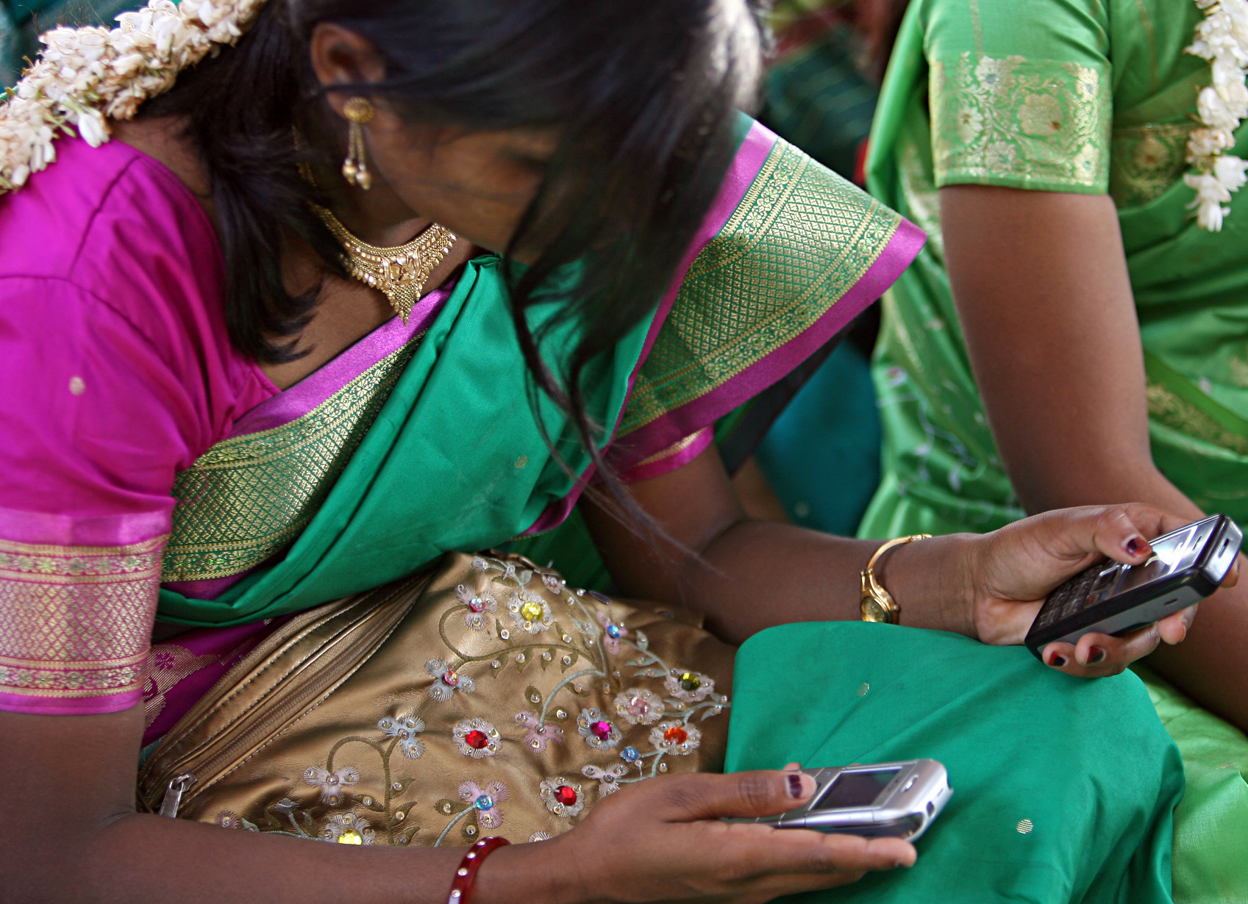
CDD IMPACTS
An overview of the latest evidence
Stephen Winkler, Social Development Specialist
December 2022

Slide 2
Measuring CDD impacts is challenging but important
Diversity and Scale of CDD programs
Can cover 1000s of communities
Participant communities may not be known in advance
Subprojects are multi-sectoral and not predetermined
Multiple objectives related to local governance, social cohesion, livelihoods, infra
Different types of evaluation approaches:
Impact and Program Evaluations
Thematic Evaluations
Evaluation Methodologies
Experimental, quasi-experimental
Baseline – endline
One-time program evaluation
Pilot to test new element
Conflict & fragility
Gender
Technical audits: technical quality, cost effectiveness, rates of return
Quantitative
Qualitative
Mixed-method

Slide 3


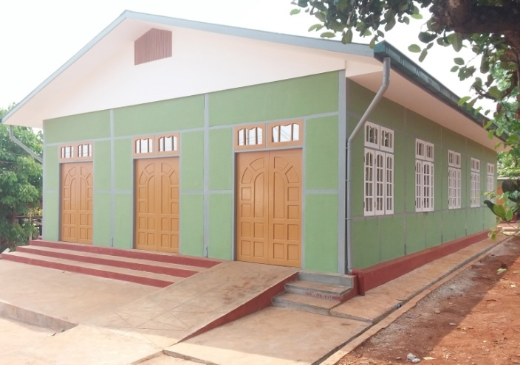
Service Delivery
Evaluations regularly find strong positive effects on access, utilization, and quality of services and infrastructure.
  Improved infrastructure quality for schools, health facilities, and roads (Laos, Philippines).
In some cases, CDD projects also improve individual health and education outcomes.
  10% decrease in childhood malnutrition (Indonesia) and increased school enrollment among 6- to 15-year-olds (Nepal).
These effects often vary based on the type of sub-project investments.

Slide 4

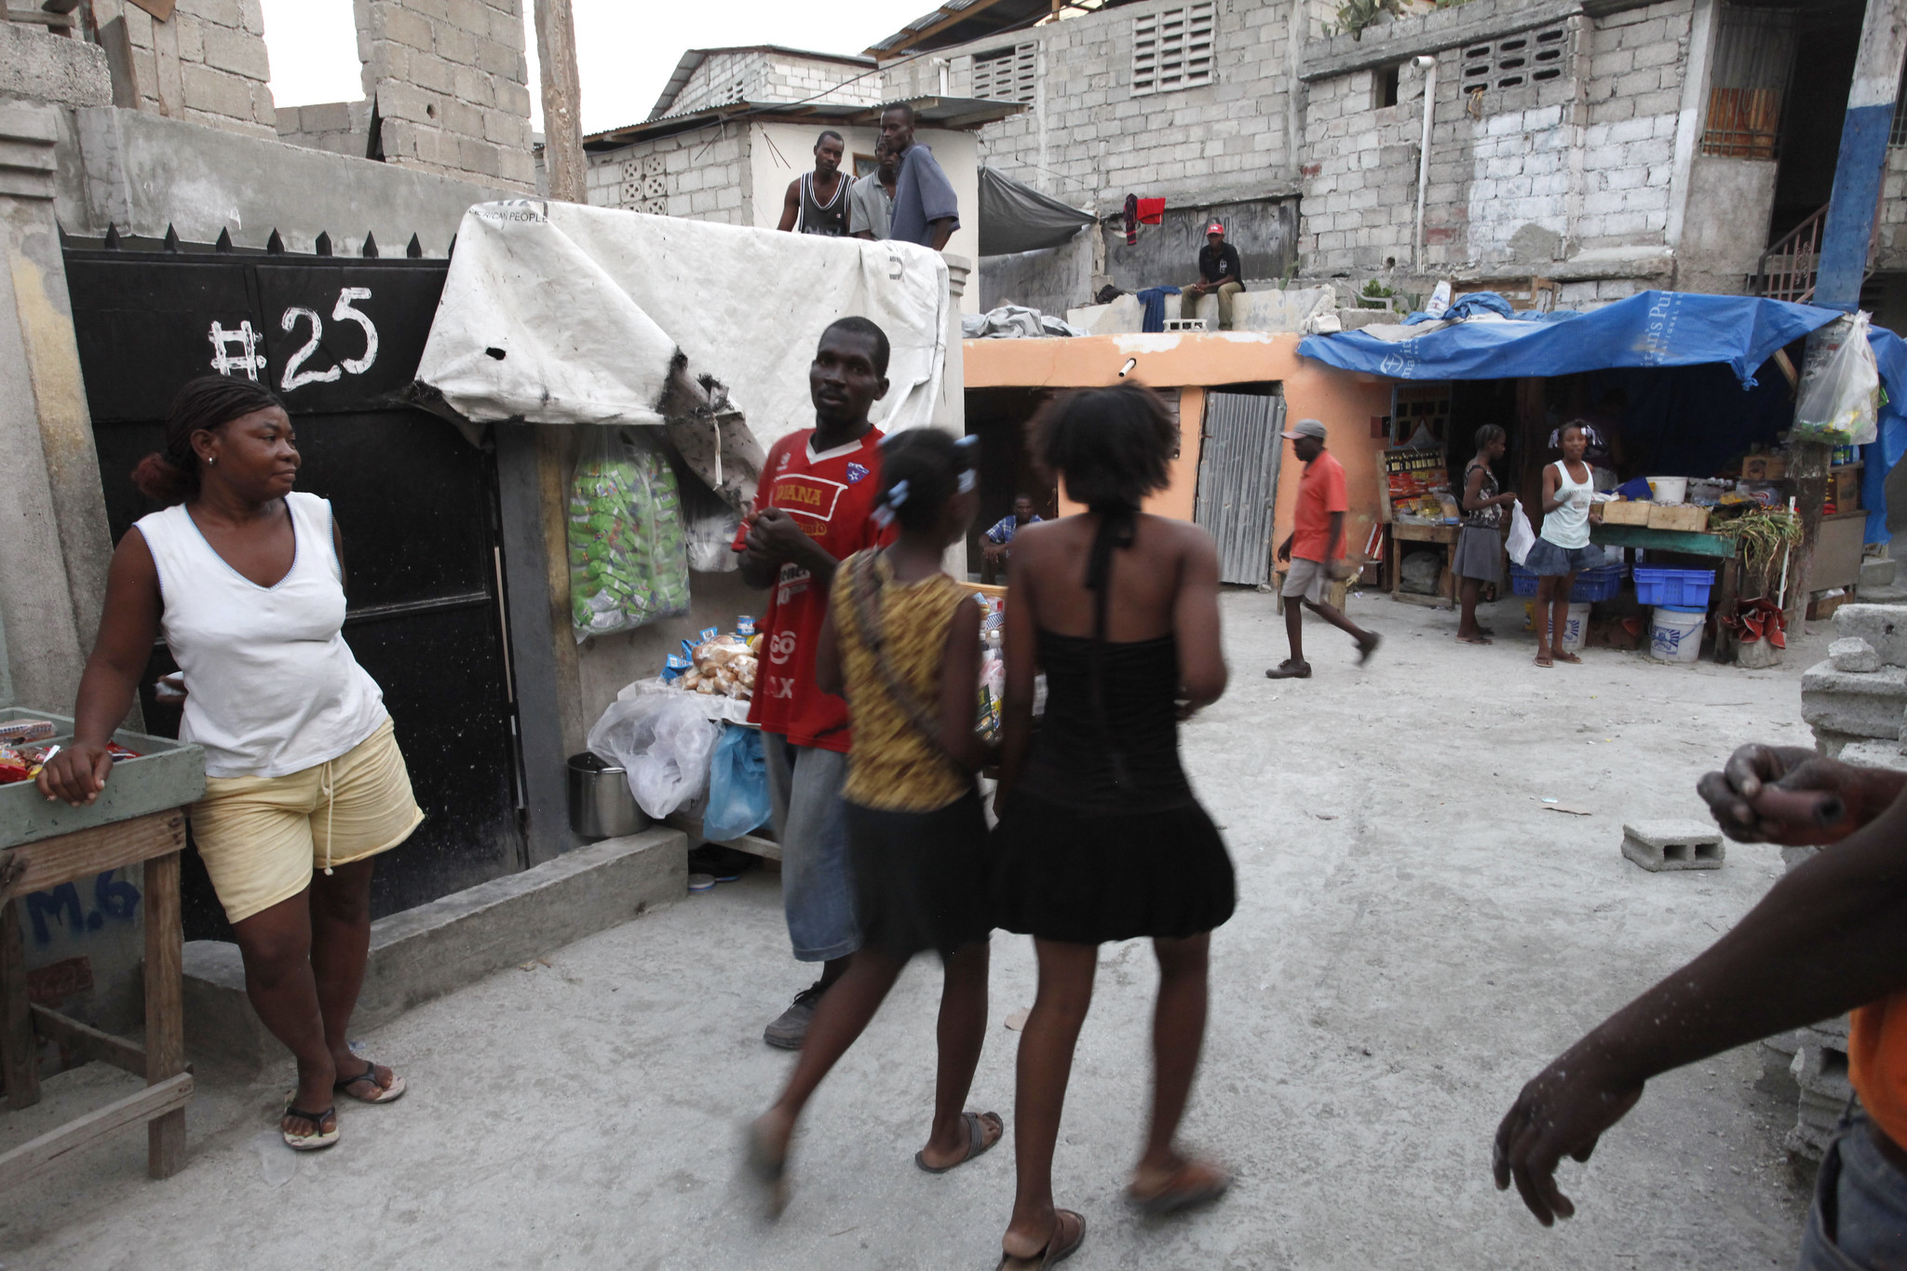
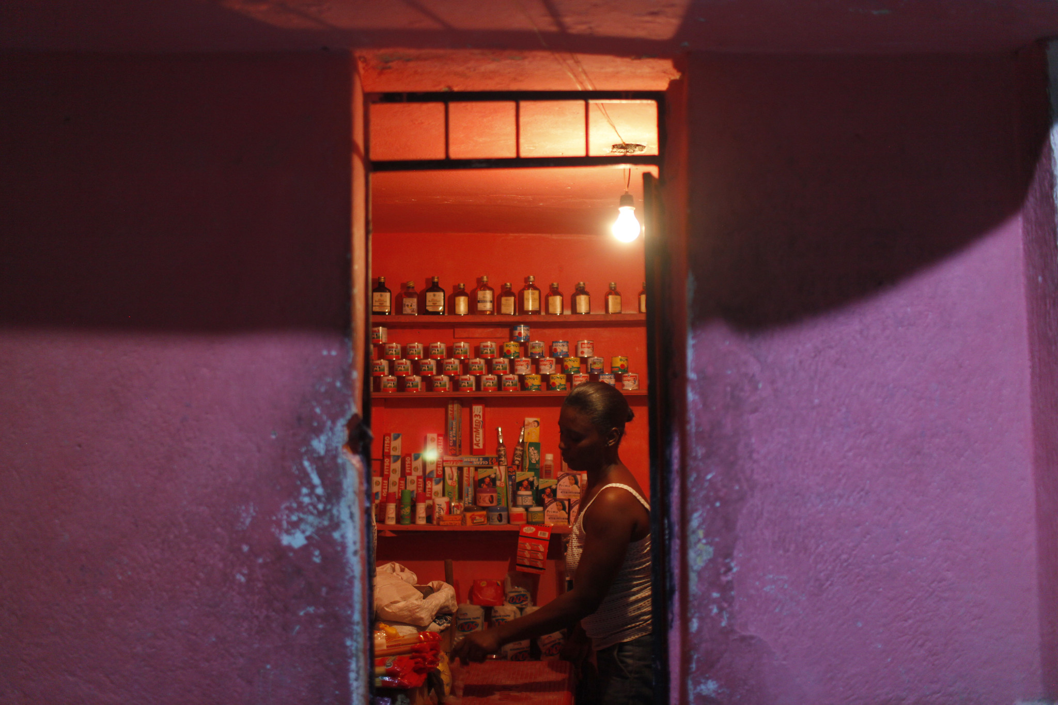
Poverty Reduction
Several rigorous evaluations find that CDD projects improved economic welfare measures such as household income, consumption, and village-level economic activity.
  7% increase in household consumption and 13% increase in spending (Cambodia).
  30% increase in petty traders and 13% increase in goods available for local sale within treatment villages (Sierra Leone).
Effects vary based on overall project objectives, subproject types, and per capita allocation of funds.
  Increases in per capita household expenditure in Senegal were limited to villages with agriculture and education subprojects, not water or health.
  In Cambodia, rural transport projects were the main driver of increased economic development.

Slide 5


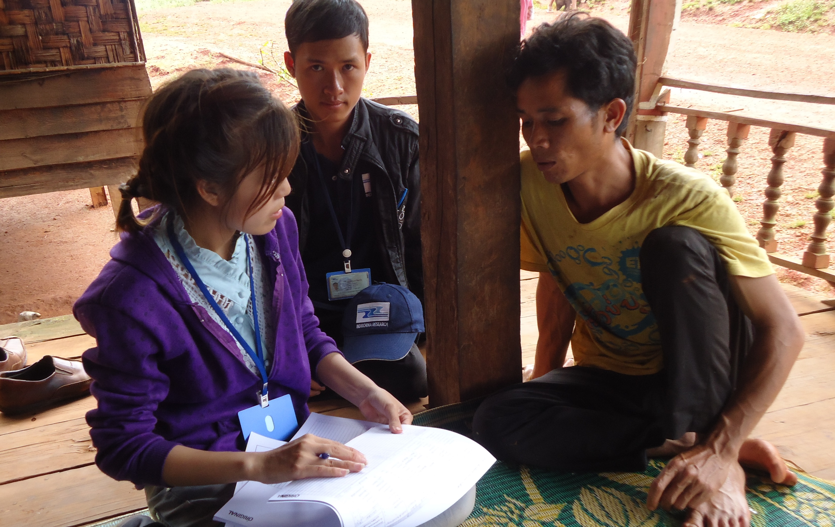
Poverty Targeting
CDD projects invest in public goods and service delivery that benefit both the poor and non-poor, yet they effectively target vulnerable areas of a country.
  Households in the poorest sub-districts experienced the most positive impacts on per capita consumption and movement out of poverty (Indonesia).
They also effectively target poor and vulnerable community members.
  Poorest households experienced the largest household consumption gains (Indonesia, Philippines, Nigeria).

Slide 6

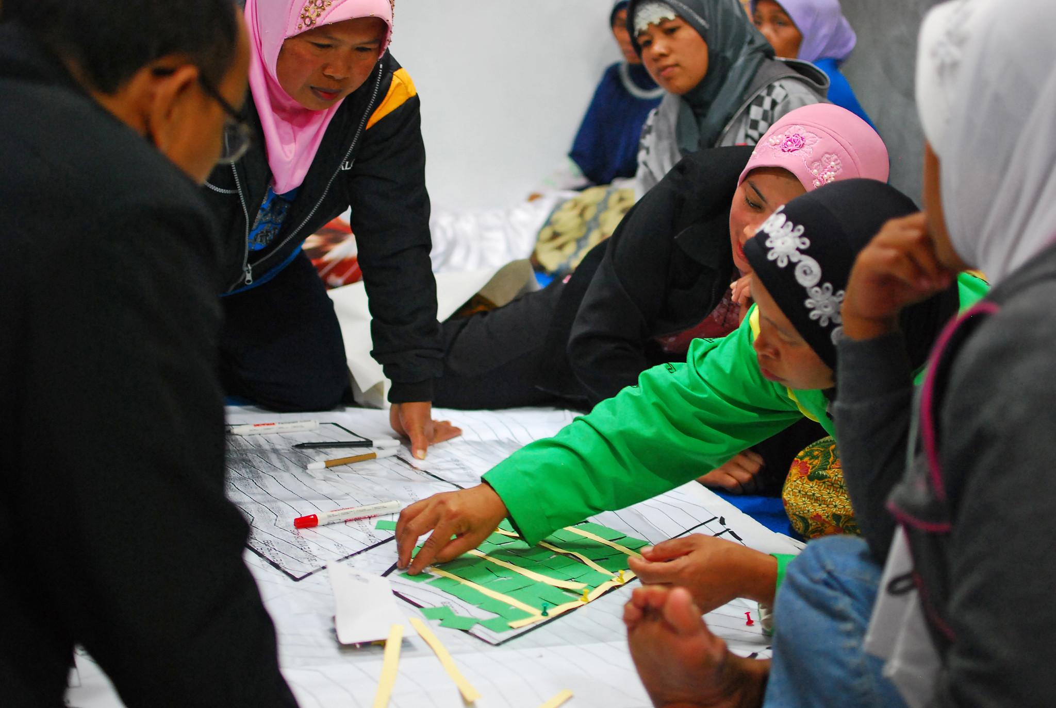
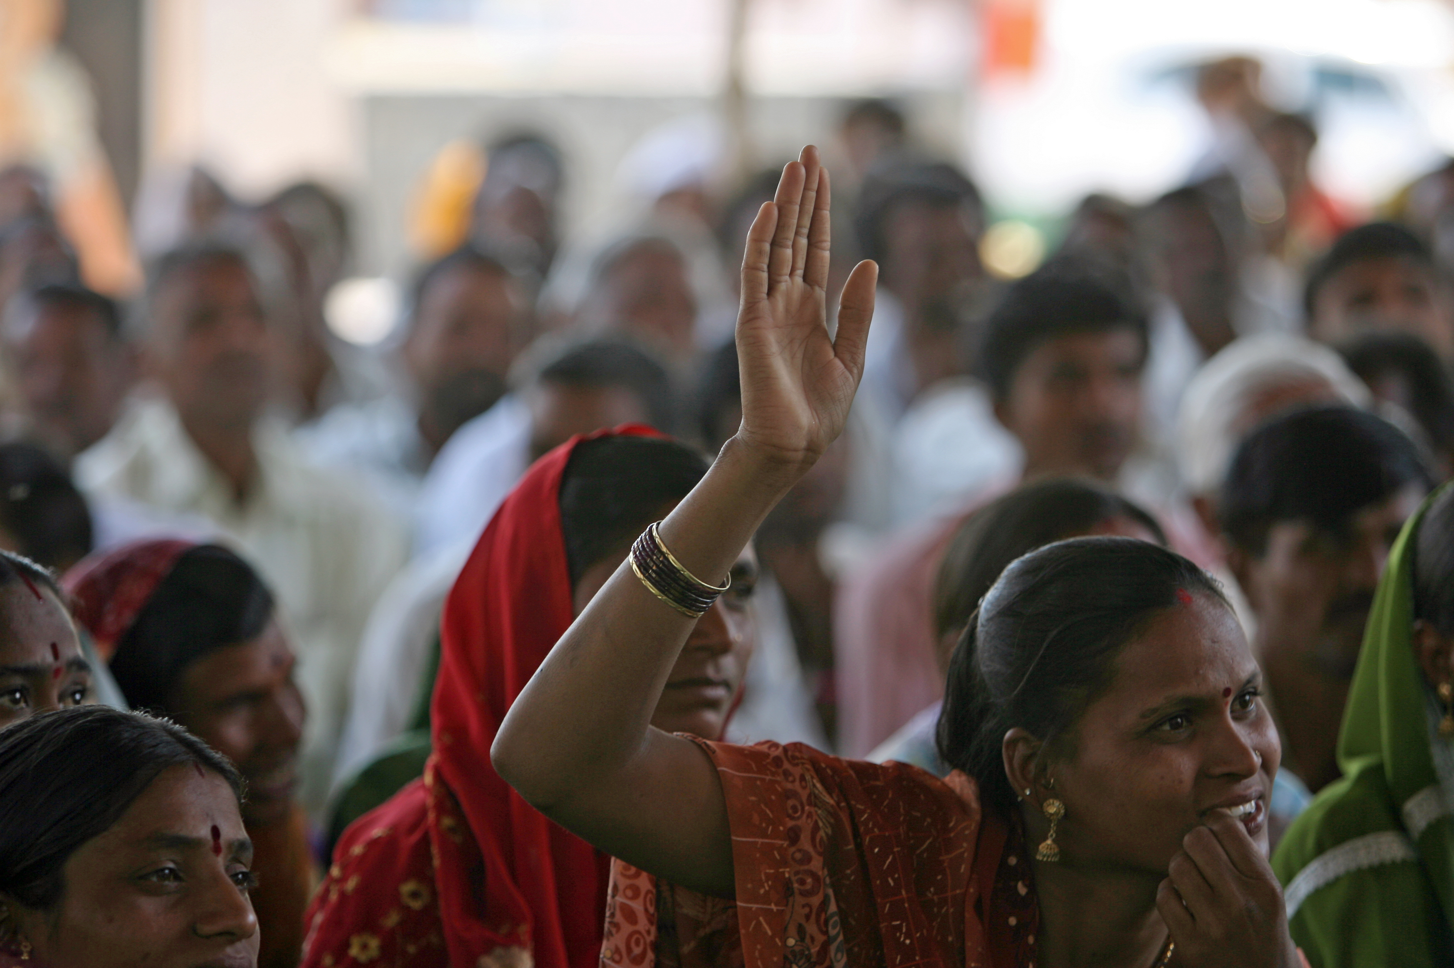
Inclusive Participation
CDD projects contribute to increased participation in community development, including among women and vulnerable groups.
  82% of women and ethnic minorities participate in planning and decision-making (Vietnam) and women’s priorities are reflected in 90% of selected projects (Afghanistan).
  Household participation in village meetings increased by 20 percentage points (Philippines) and women participation in village meetings doubled (India).
In some cases, CDD projects also improve agency, voice, and accountability in community development decision-making.
  Individuals in CDD communities are more likely to say their community had influence of community decision-making (Laos, Afghanistan).
Legacies of exclusion can make it difficult for vulnerable groups to feel empowered to actively participate in some activities.

Slide 7

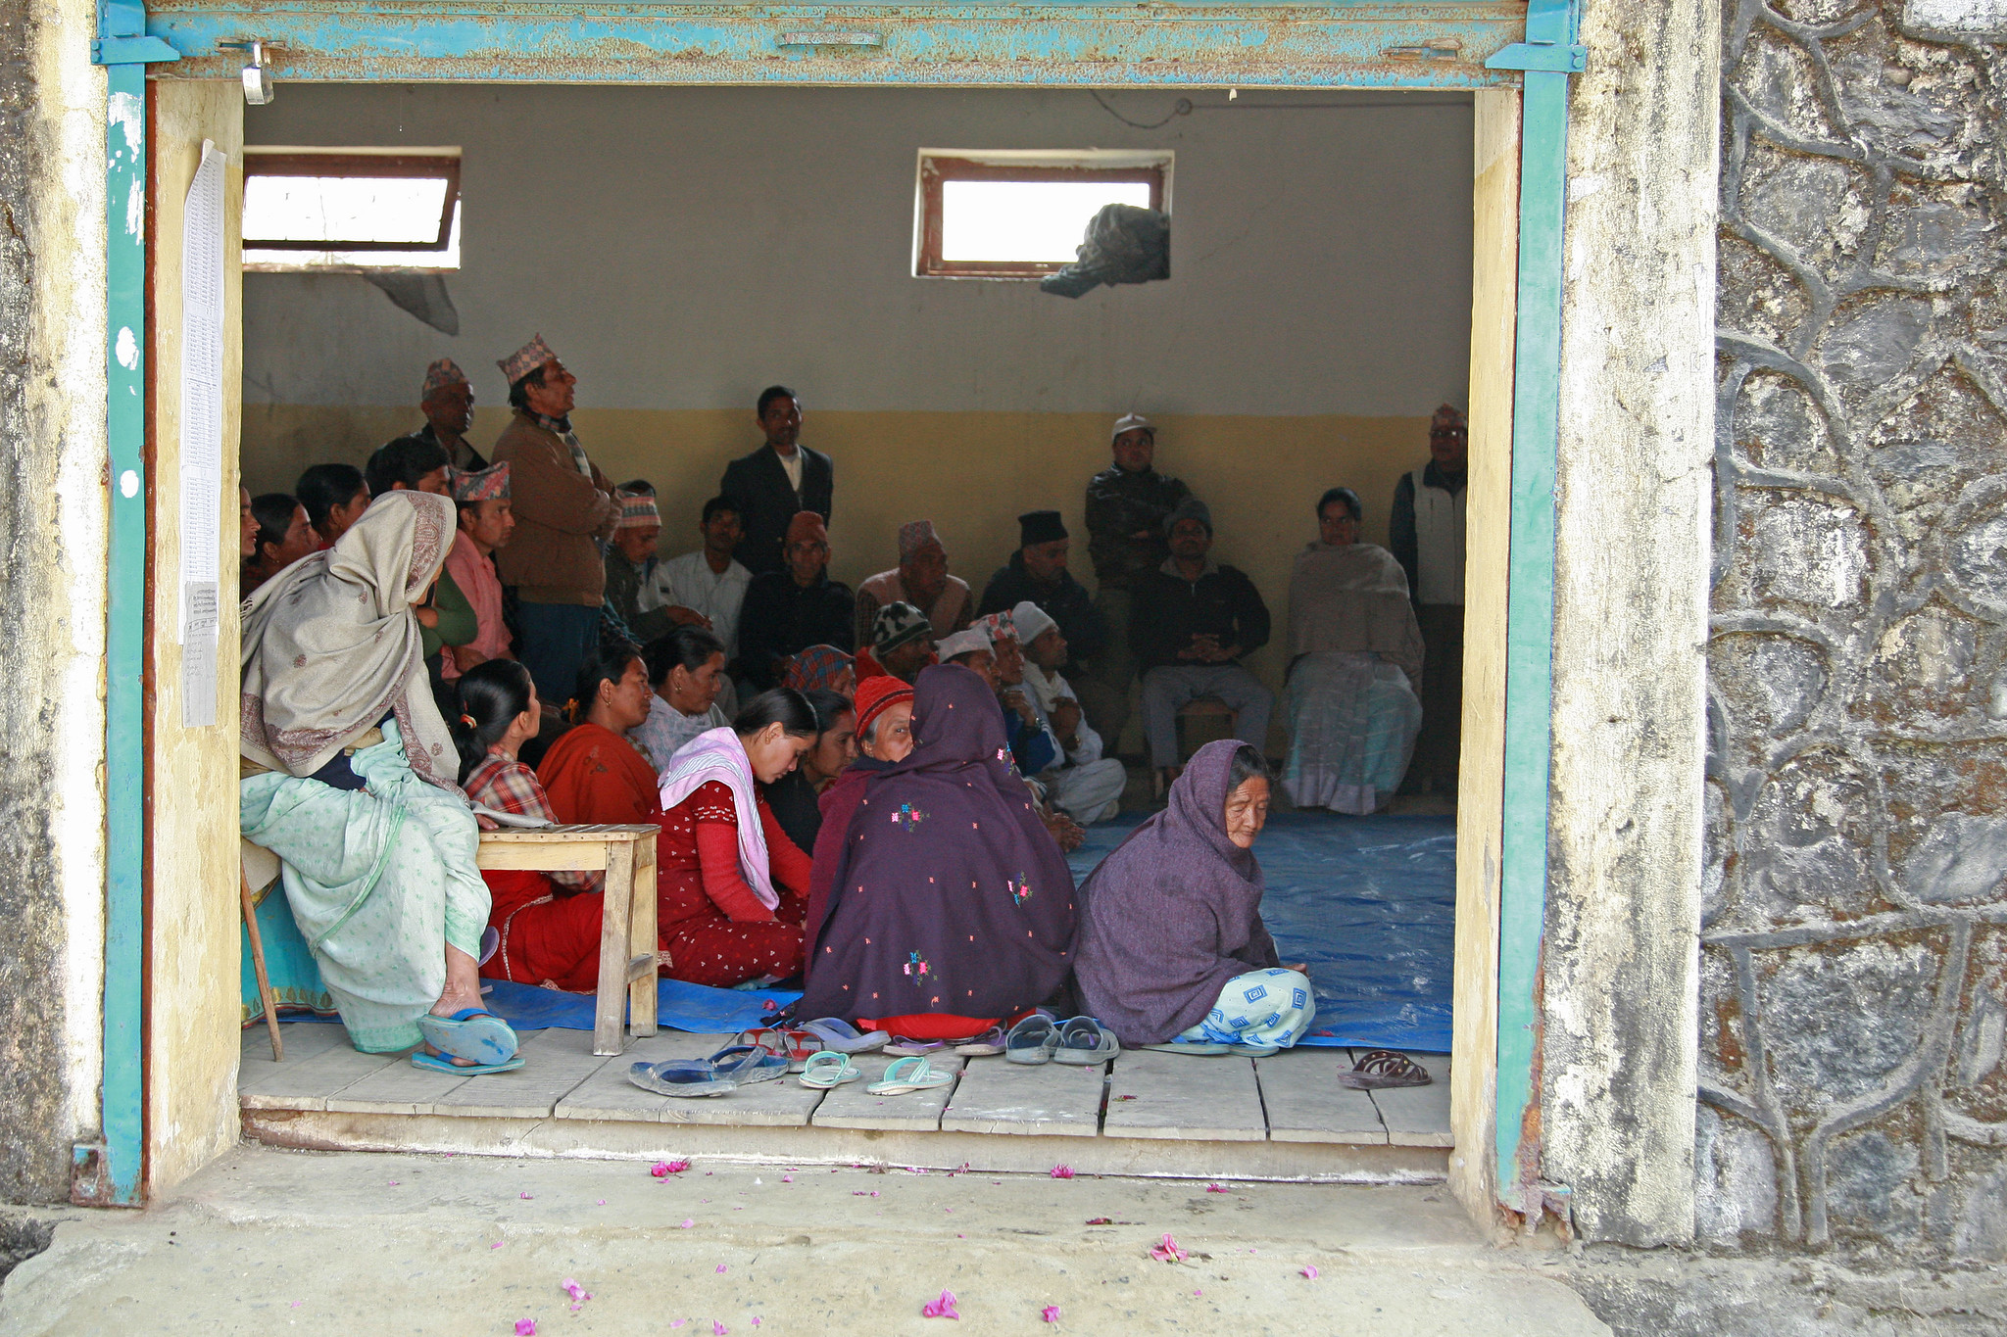
Social Cohesion
Existing evaluations provide mixed evidence on CDD’s effects on social cohesion outcomes.
5 explanations for the mixed results:
  Most CDD programs are not designed with explicit purpose to improve social cohesion.
  CDD communities are often homogenous and have high baseline levels of trust, cohesion, etc.
  Evaluators use varying definitions of social cohesion and do not have tools to measure these concepts.
  In FCV contexts where CDD works, communities are more concerned about immediate service delivery needs.
  It takes time to change social norms and project evaluation periods (3-5 years) cannot detect these changes.

Slide 8


Key Takeaways & Future Research
Consistent evidence showing that CDD projects:
  Effectively improve access, utilization, and quality of basic services
  Reach lagging regions, conflict-affected areas, and vulnerable households
  Increase participation and voice in the village development process, including among vulnerable groups.
  Many CDD projects also contribute to positive impacts on economic welfare and health and education outcomes
Ongoing research will build evidence on additional CDD focus areas, including:
  Social cohesion
  Refugees and IDPs
  Climate resilience
  Women’s empowerment
  Local governance

Slide 9
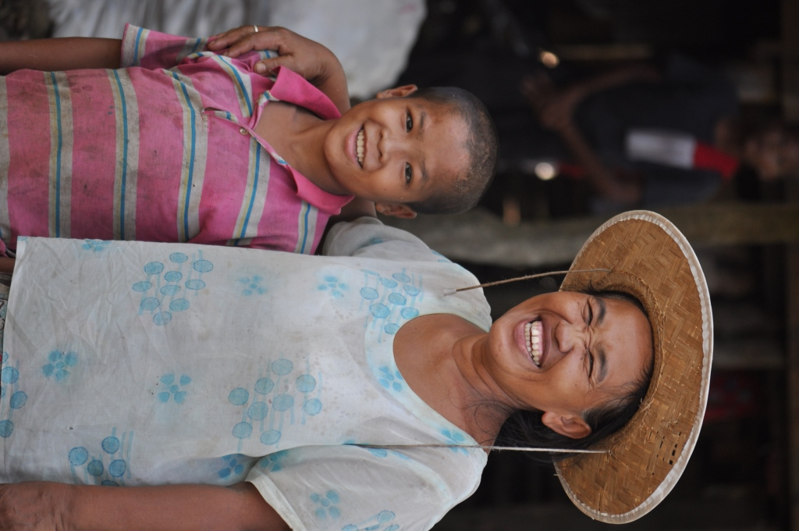
Thank you!
Questions or Comments? swinkler2@worldbank.org

