Slide 1
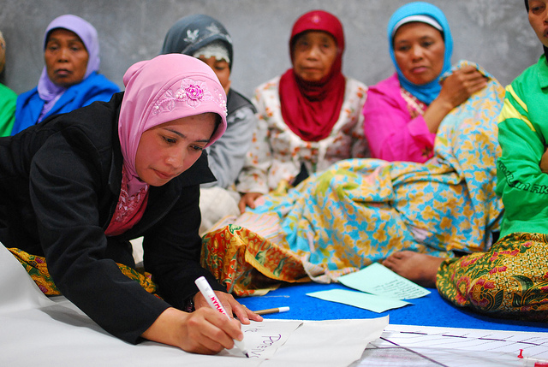
Community and Local Development
Partnering with Communities and their institutions to Deliver Change
East Asia Pacific Conference
December 2022
Nicolas Perrin
WB Lead Social Specialist
December 2022
Notes:
Good morning to all. First of all my apologies for not being present with you to this important conference this week. I am currently in Senegal working on one our CLD program and could not join you this week for this conference. I am NP, GL on CLD based in Washington. I was asked to provide you with an global overview of the CDD approaches globally for this coming week of exchange on CDD. Including Global context for CDD: areas of growth, new evidence and areas of debate and innovation. Let me start by reminding everyone what are the building block of this approach.

Slide 2
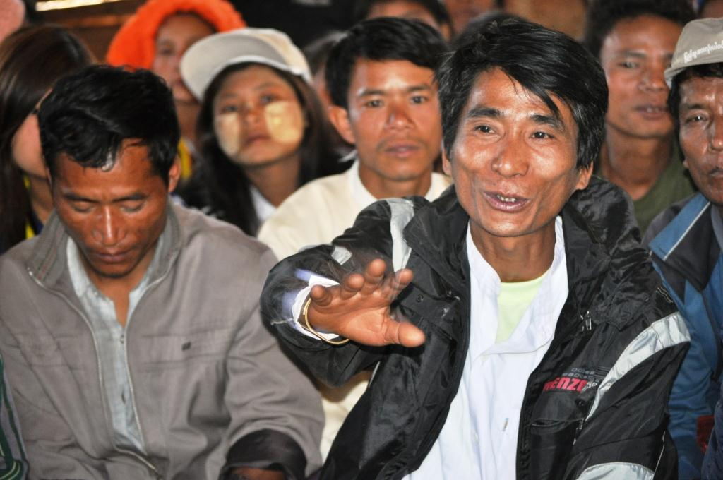
Community and Local Development
is an approach to development that emphasizes community control over planning decisions and investment resources.
Planning decisions
Investment
resources
Project implementation
Notes:
Community Local development (CLD) is an approach to local development that emphasizes community control over planning decisions and investment resources. CLD programs prioritize community participation and voice in the planning, implementation, and decision-making processes of development. This approach enables communities to work in partnership with national and local governments to identify and manage community-level investments. CLD builds upon the idea that local communities have greater knowledge than central planners about their circumstances and needs and therefore can help set priorities for local development.

Slide 3
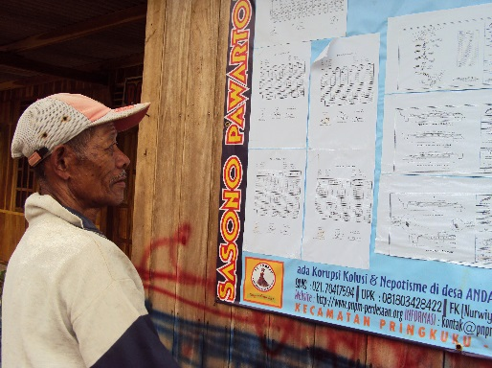
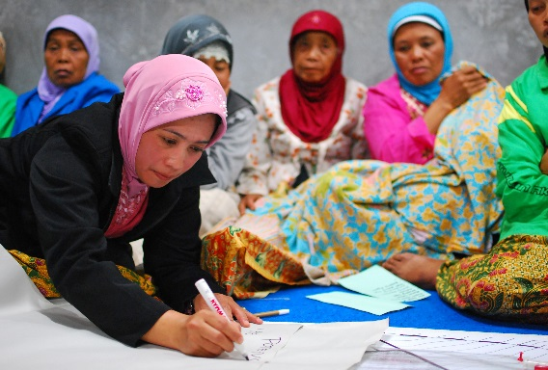
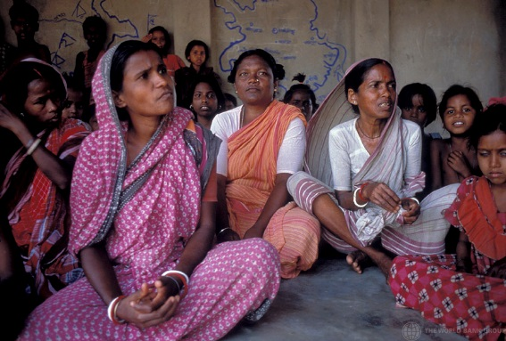
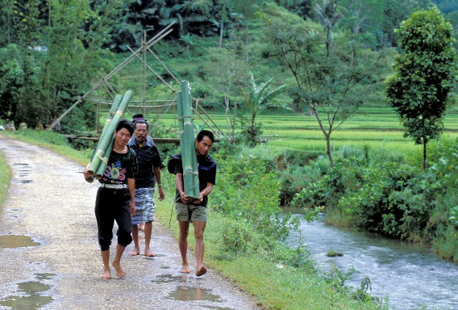
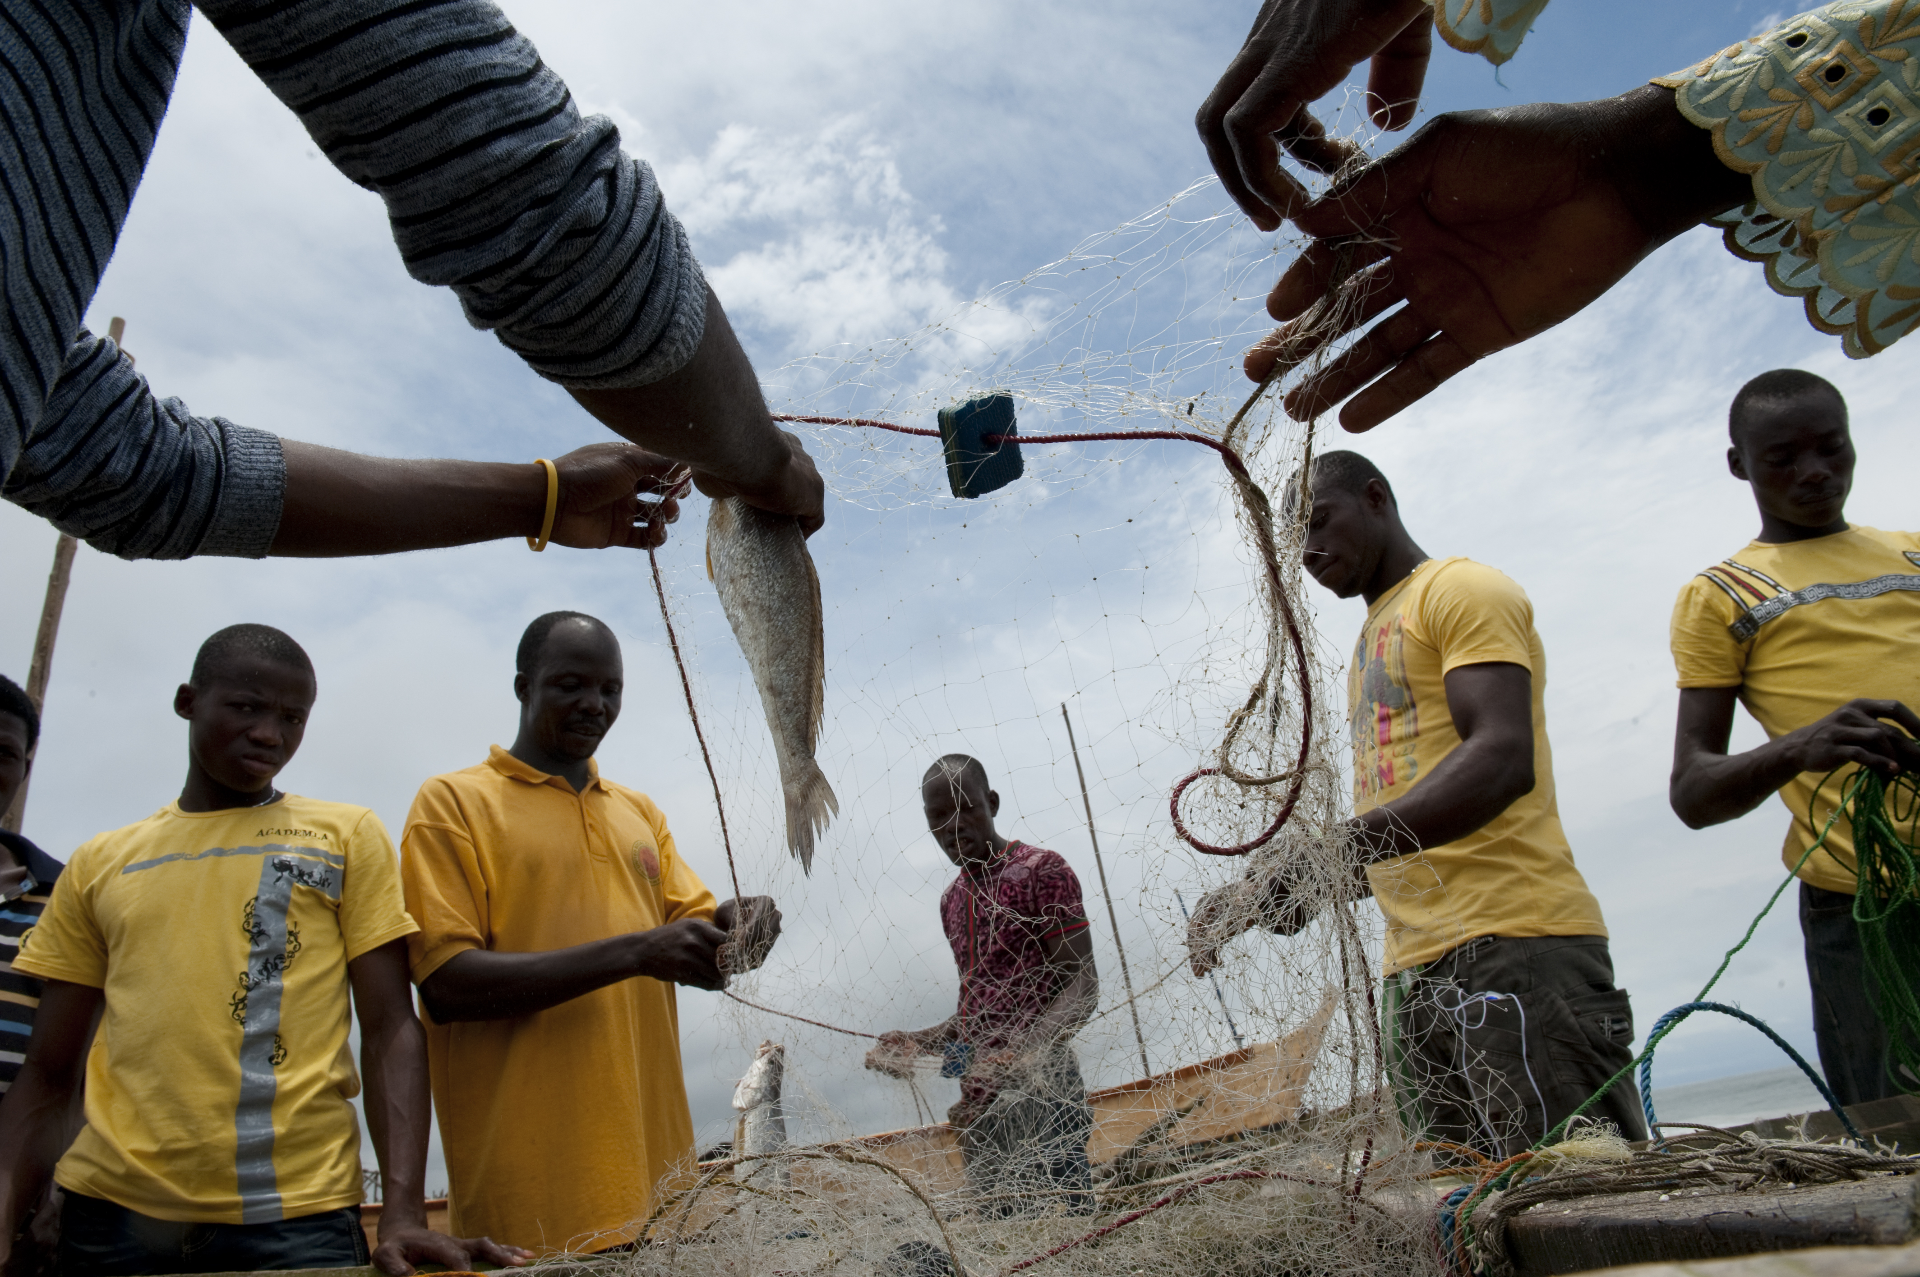
CLD’s Guiding Principles
Enhancing Transparency
Encouraging Participation
Localizing Accountability
Building
Local capacity
Improving Equity

Slide 4
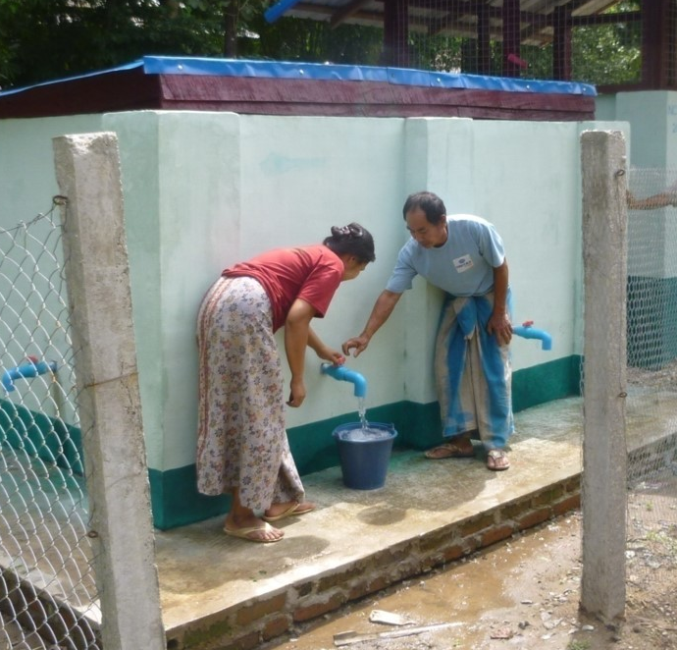
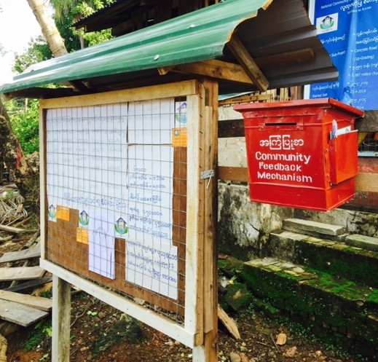
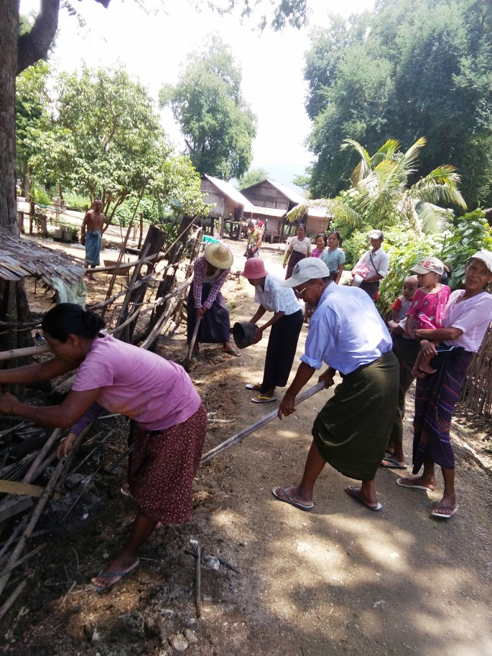
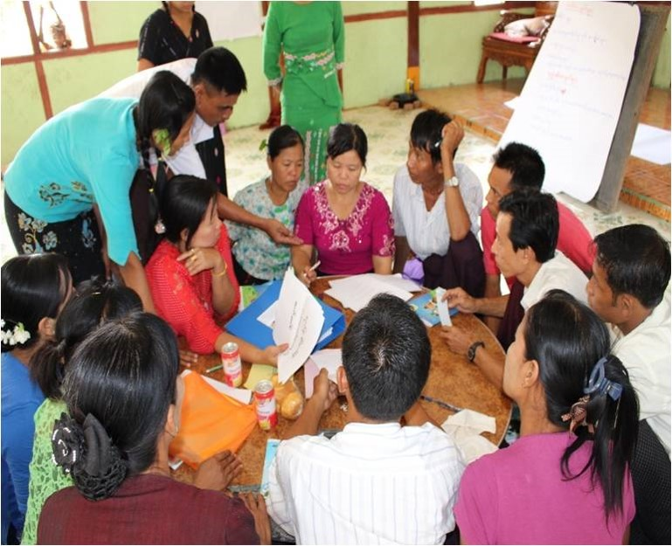
CLD programs generally include these features
Community Focus
Community Control of Resources
Participatory Monitoring
Community involvement in implementation and O&M
Participatory Planning

Slide 5
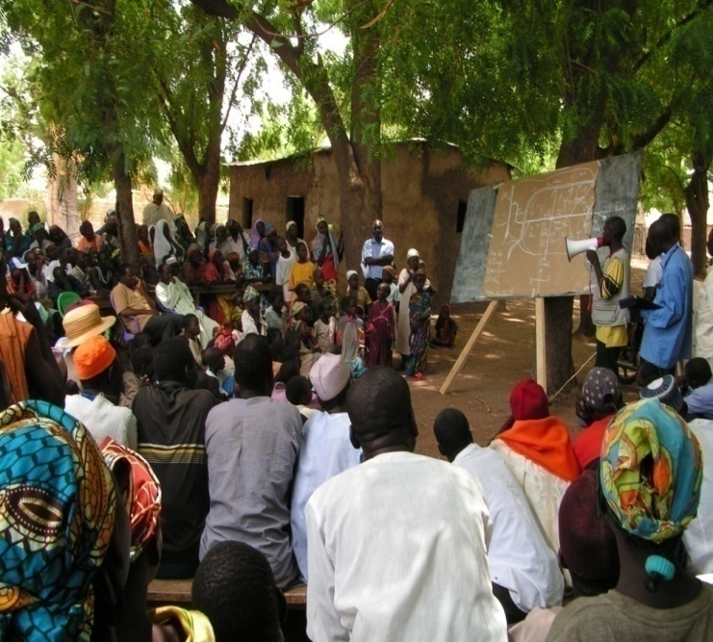
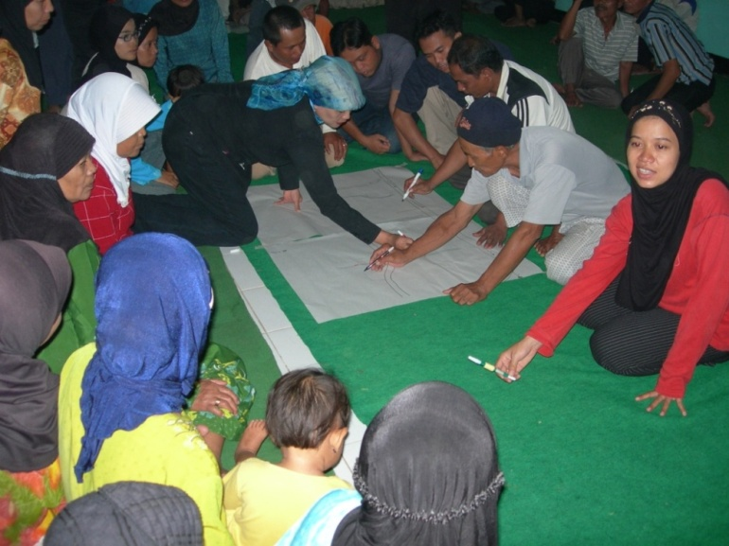
CDD WB Global Portfolio at a Glance
373
Ongoing
projects in
93 countries
$42.4
Billion
in active
financing
$6.4
Billion in
new lending
in FY22
9%
of overall
World Bank
lending
Current as of June 2022

Slide 6
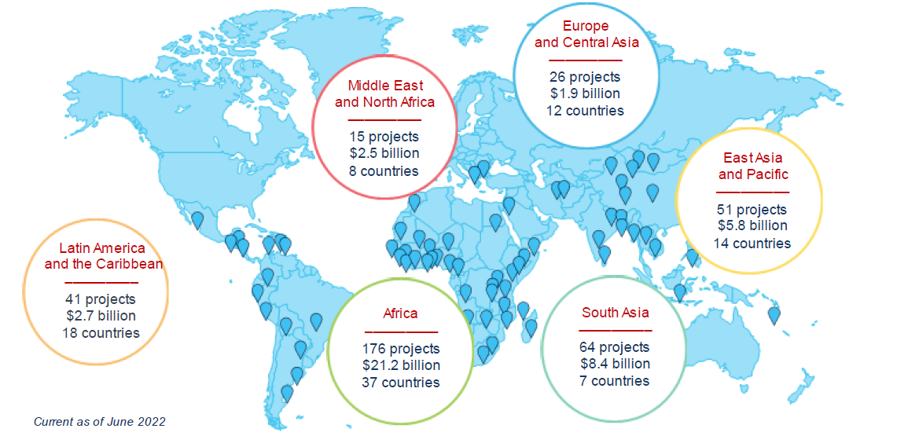
CDD Worldwide Reach

Slide 7
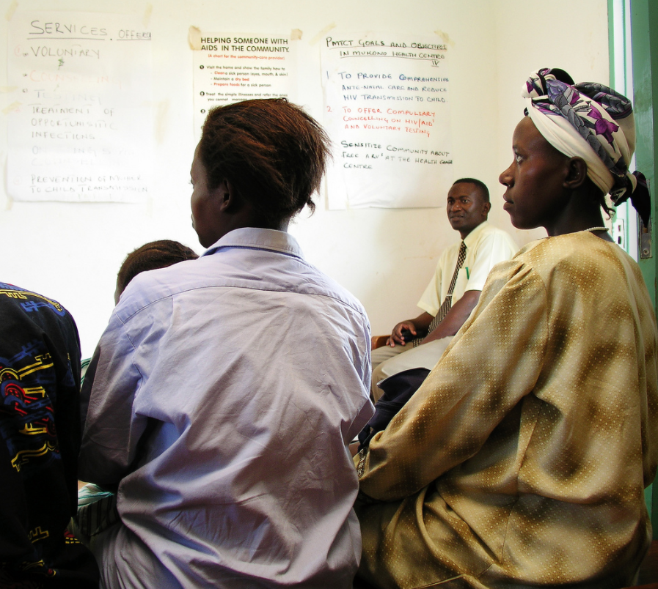
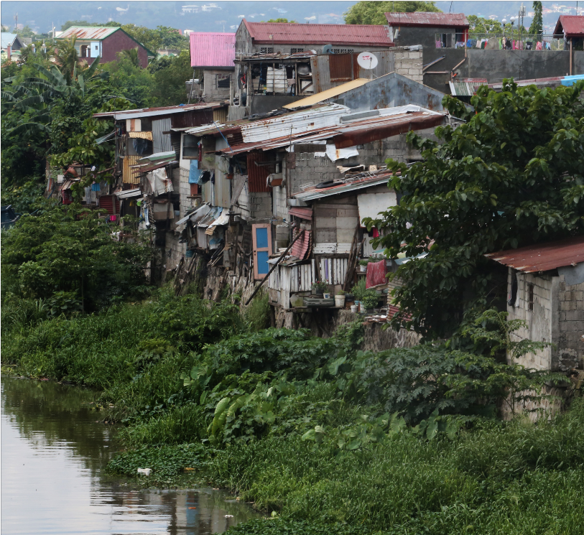
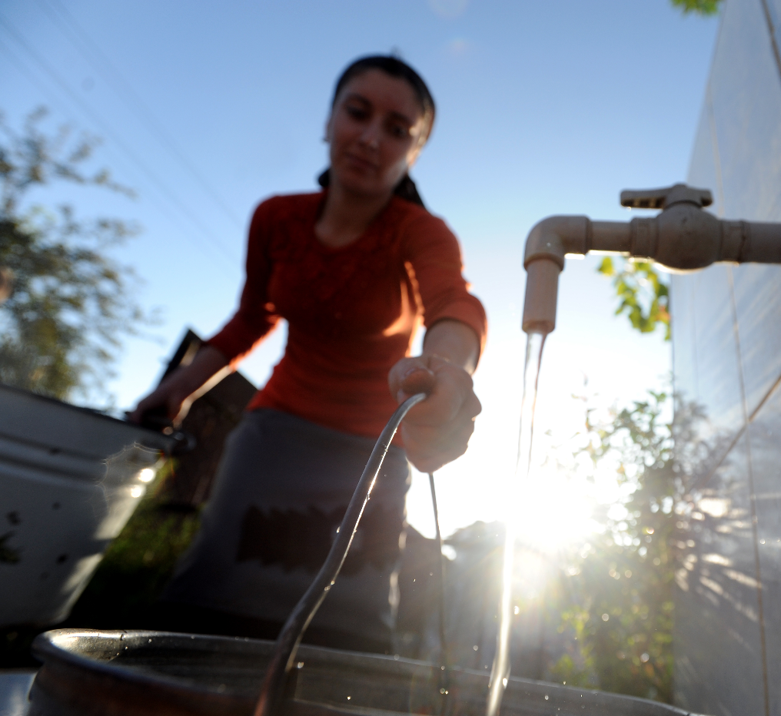
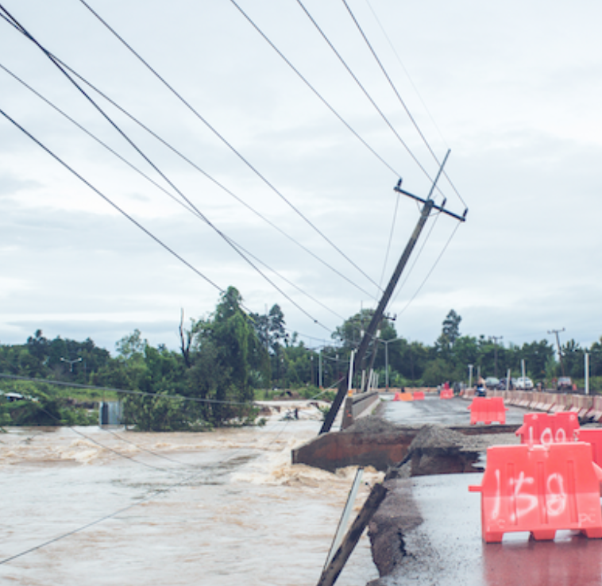
Opportunities for CLD Globally
Strengthen linkages
with local governments
Foster local economic development in particular for vulnerable groups
Increase focus in FCV settings and Lagging Regions
Support community climate resilience

Slide 8
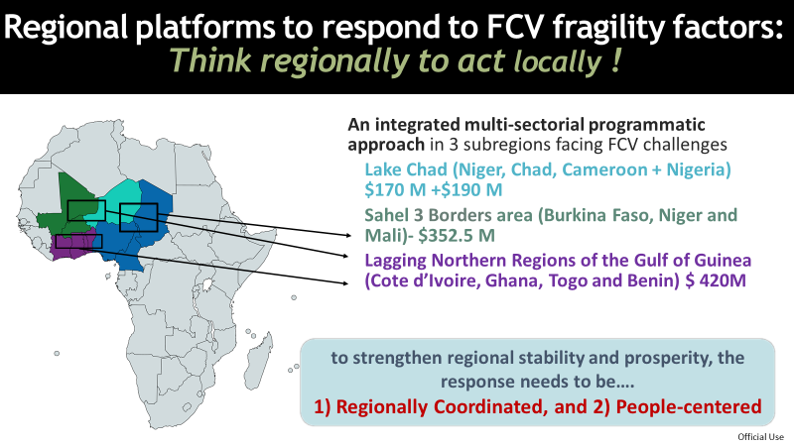
CLD in FCV
Stay Engaged (b) support local recovery
(c) prevent and build local resilience

Slide 9
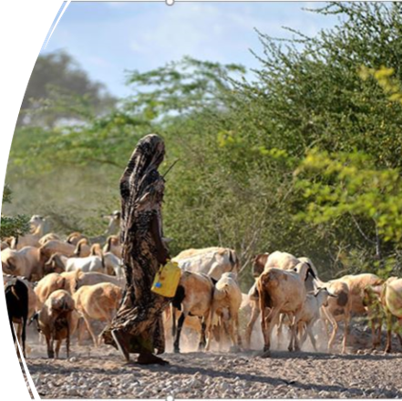

CLD and Climate Resilience
Locally Led Climate Action (diagnostic, financing, monitoring)
Local Climate Finance Monitoring
Creating local awareness and closing feedback loop on climate action

Slide 10
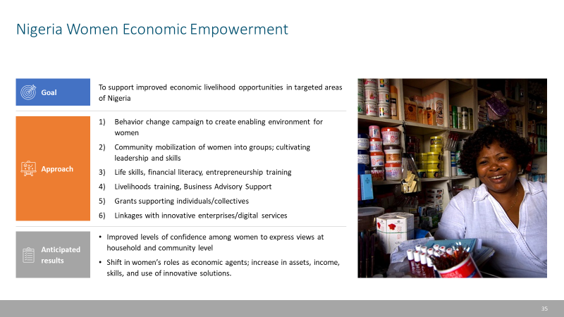
CLD and Inclusion

Slide 11
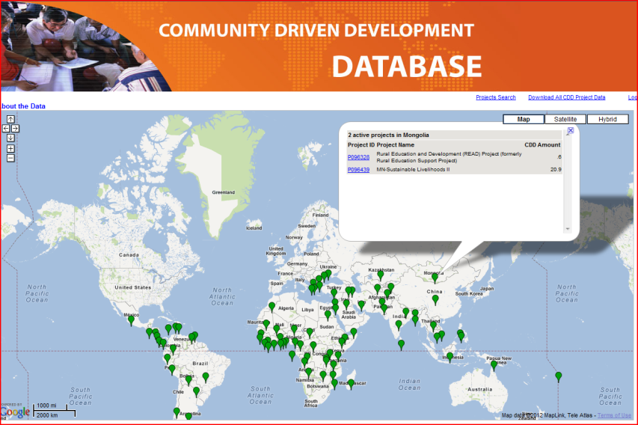
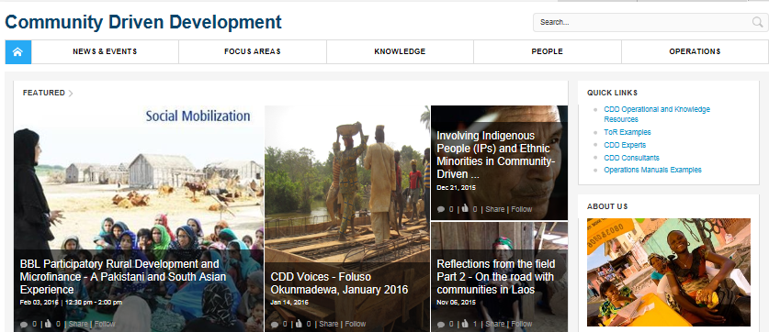
Learn more, and join the conversation
On the intranet, type “CDD” in your browser.
From outside the Bank:
http://www.worldbank.org/en/topic/communitydrivendevelopment
https://collaboration.worldbank.org/content/sites/collaboration-for-development/en/groups/community-driven-development-global-solutions-group.html
Contact us at:
cddgsg@worldbank.org

