Slide 1
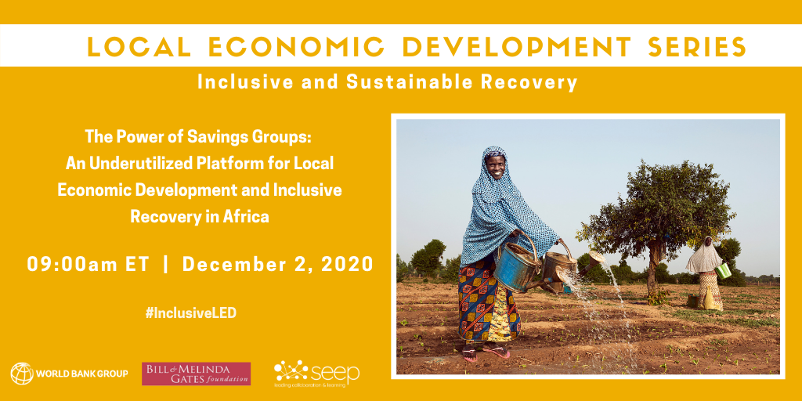

Slide 2
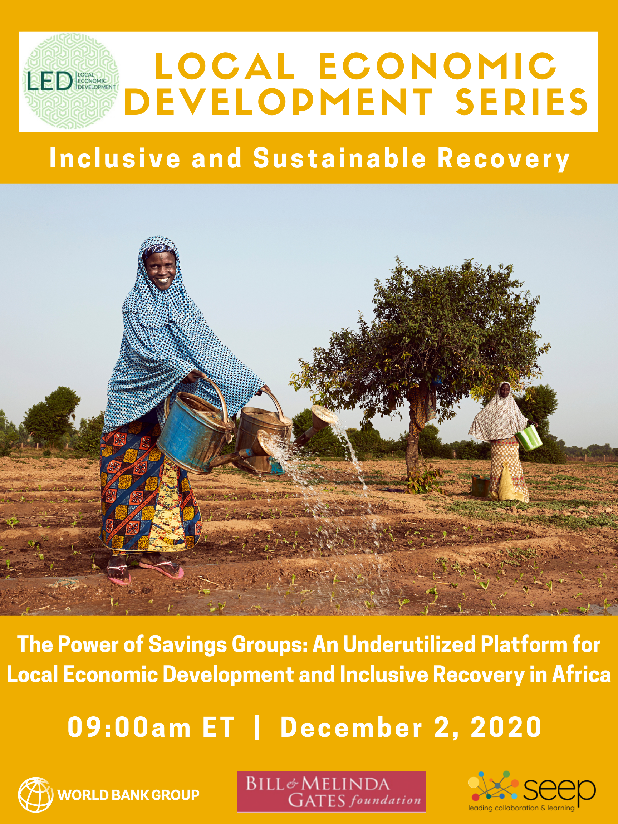
Webinar Structure
Opening remarks:
Helene Carlsson Rex, Practice Manager, Social Sustainability and Inclusion Global Practice, World Bank
David Panetta, Program Director, Savings Groups, The SEEP Network
Fireside chat
Moderator:
Sybil Chidiac, Senior Program Officer, Bill and Melinda Gates Foundation
Speakers:
Aisha Rahamatali, Senior Advisor, Economic Justice and Rights Action Coalition, CARE International
Japheth Muli, Chief Operations Officer, East Africa, Hand in Hand International
Angeline Munzara, Senior Advisor, External Engagement & Savings Groups, World Vision International
Brian Ssebunya, Senior Technical Advisor, Enterprise Development and Employment, International Rescue Committee
Edwin Ocharo, Senior Projects Officer, Kenya Post Office Savings Bank
Closing remarks:
Shobha Shetty, Practice Manager, Agriculture and Food Global Practice, World Bank

Slide 3
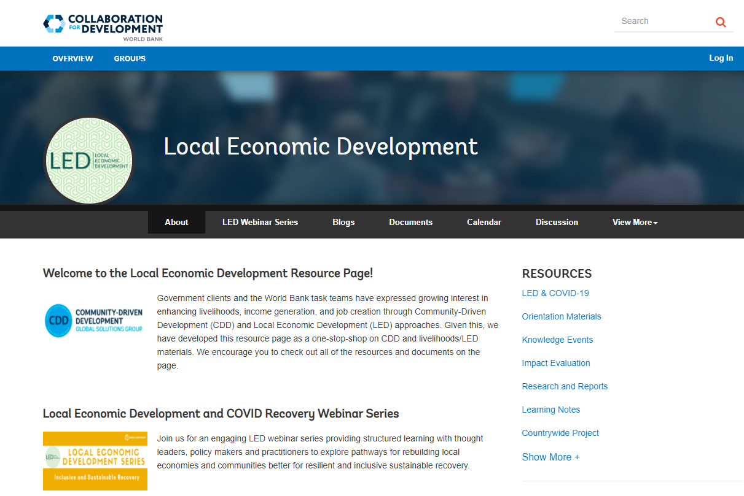
Visit the LED Resource Page for Useful Materials
https://tinyurl.com/WBLED

Slide 4
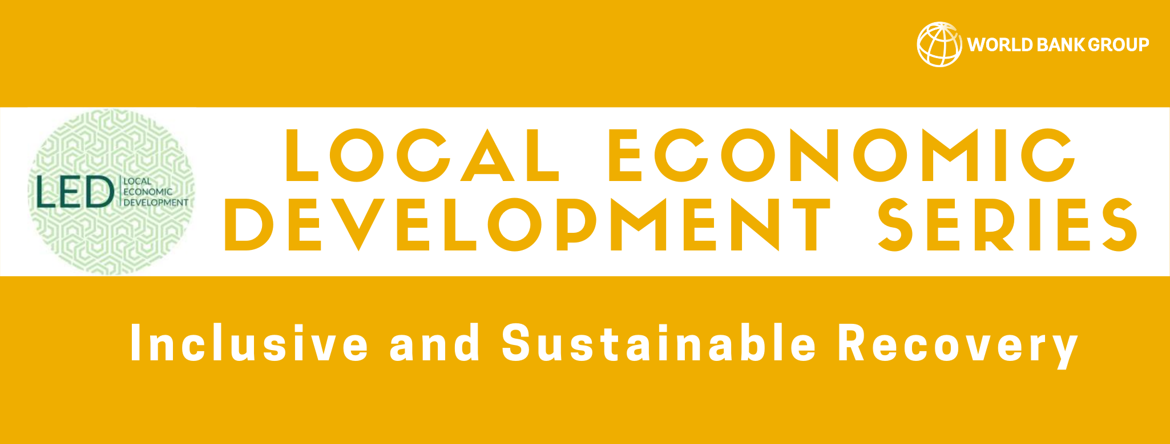
Helene Carlsson Rex
Practice Manager, Social Sustainability and Inclusion Global Practice
World Bank

Slide 5
David Panetta
Program Director, Savings Groups
The SEEP Network

Slide 6

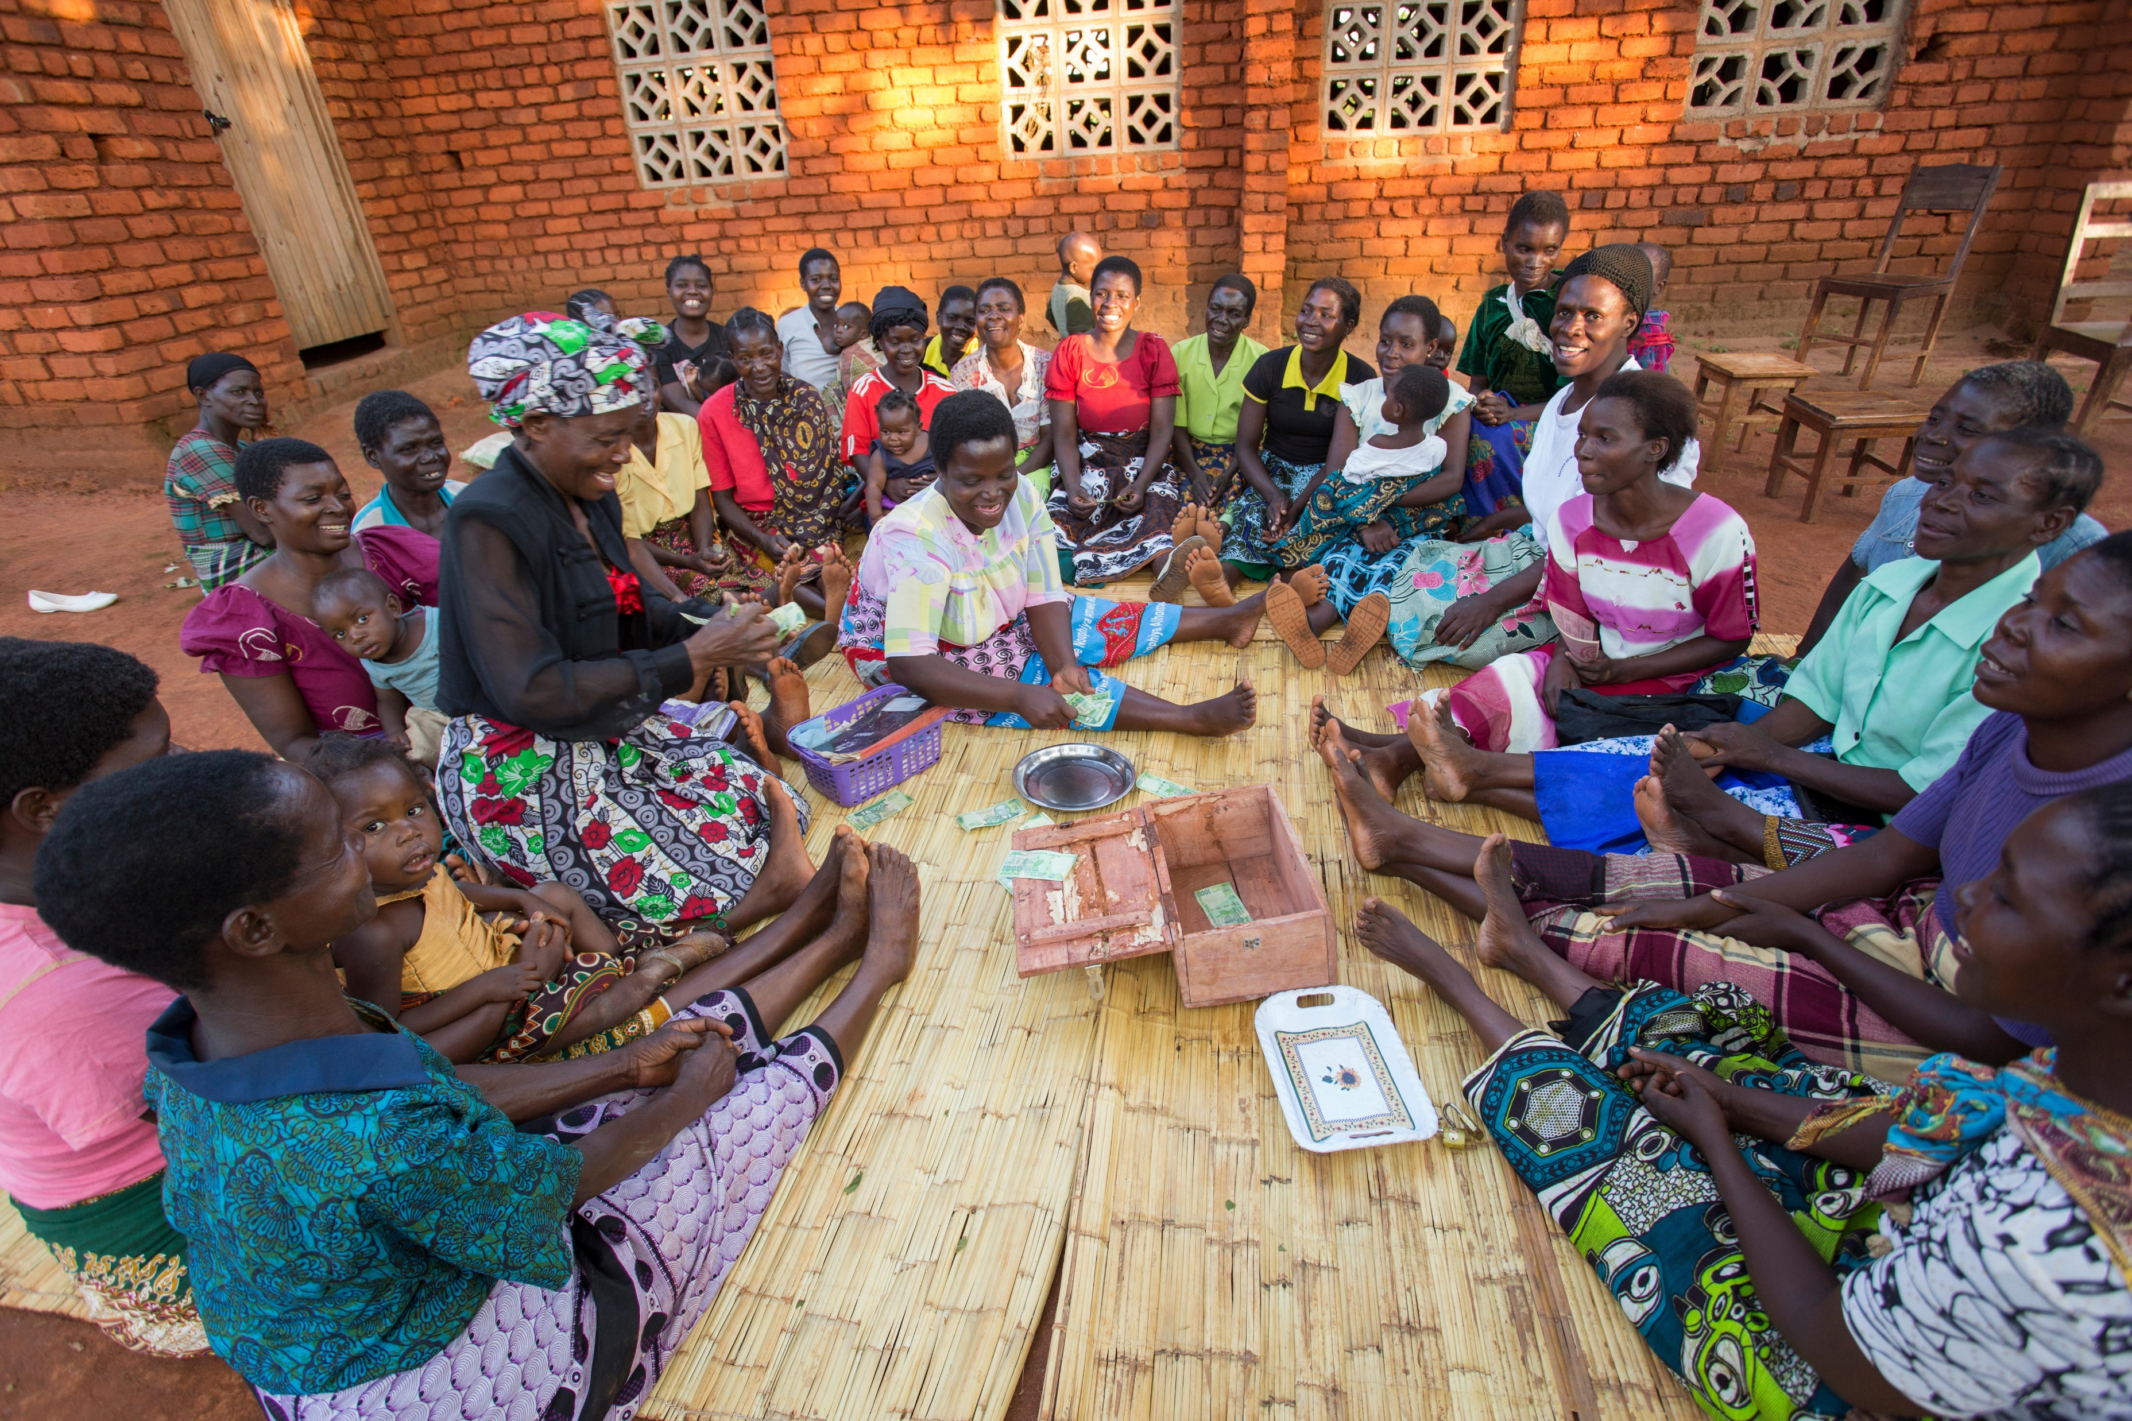
SAVINGS GROUPS
A quick overview of the sector
Over the past 25 years, development organizations have supported 20M individuals to join Savings Groups, across 75 countries
  85% in Africa
  80% of members are women
Based on this work, a growing body of long-term research estimates that there are 20-30M active members of Savings Groups across Africa

Slide 7
SAVINGS GROUPS
A review of the evidence
Savings
Access and use of credit
Investment in IGAs
Food consumption and security
Self-confidence
Market and social support networks
Assets
Investment in education
Women’s decision-making power
Leadership
Income

Slide 8
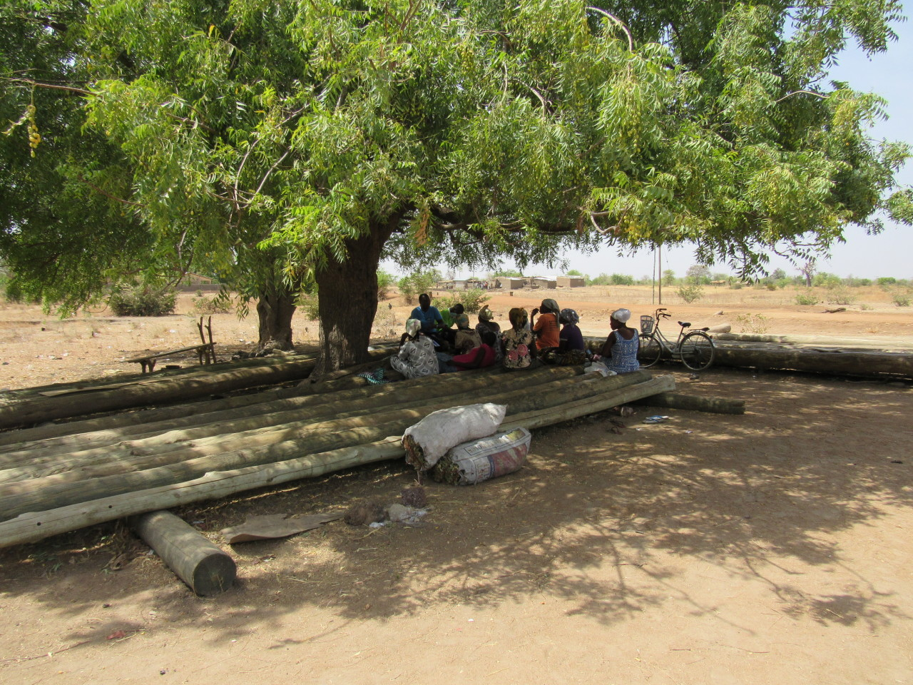
SAVINGS GROUPS
Underutilized…how?
Fragmentation of the sector
Engagement of groups as discrete delivery channels – short-term project objectives
There is untapped potential….and a bigger opportunity here.

Slide 9
Sybil Chidiac
Senior Program Officer, Gender Equality
The Bill & Melinda Gates Foundation

Slide 10
Aisha Rahamatali
Senior Advisor, Women Economic Justice and Rights Action Coalition
CARE International

Slide 11
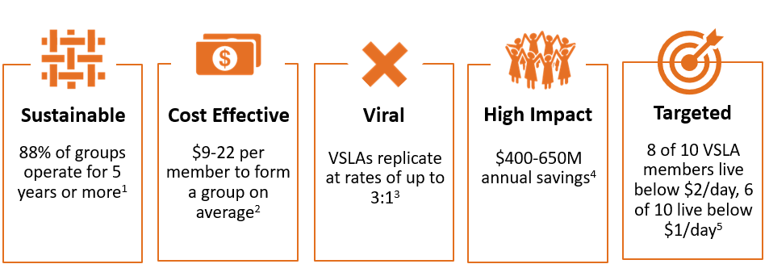
Savings Groups – Demonstrated Scalability
CARE has supported 10.2M women and men across 54 countries to form VSLAs
Notes:
in order to end poverty and reach the sustainable development goals, we need to reach the 650M people who live under $1.25 a day. Between 60 and 80% of VSLA members live between $1 and $2/day. So VSLAs directly reach the poor and extreme poor.
VSLAs also deepen the impact of any programs we build on it, but it’s ripe for scale because in contrast to any number of other poverty reduction efforts, VSLAs are a proven model for sustainability. 88% of VSLAs stay together for 5 years or more.
The value proposition to invest in VSLA-enabled programs is that it will ensure
you're engaging the last mile in terms of global poverty (e.g. low-income women),
b) you're building a stable / resilient foundation on which other complimentary interventions can easily be layered,
c) you're getting this for less than $22 / person and
d) it's going to self-replicate, bringing your cost / member down even further.

Slide 12
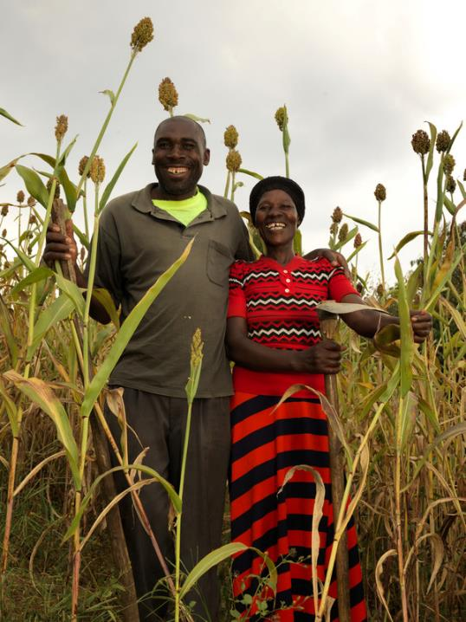
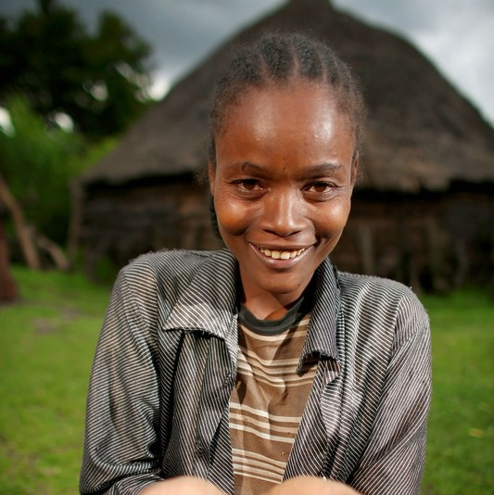
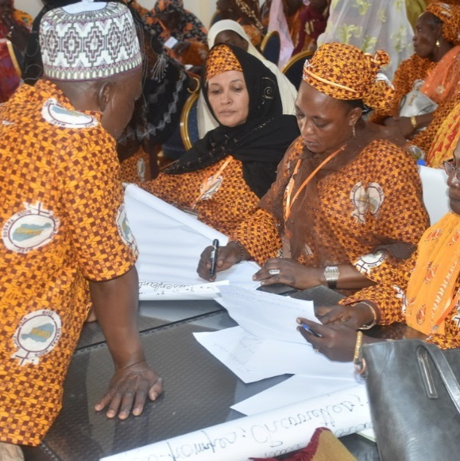
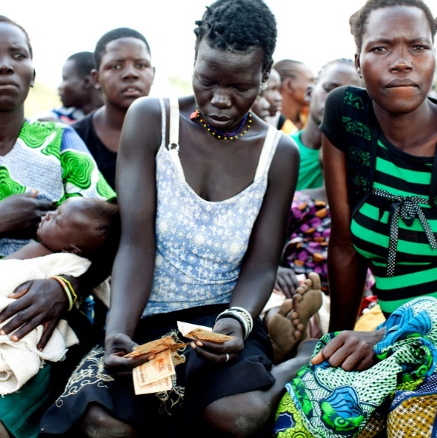
VSLAs – A Platform for Impact
Reducing GBV
Improving Food Security
Elevating Women’s Voices
Enhancing Local Economies
VSLA + Couples Dialogues + Community Activism
55% decline in domestic violence
20% increase in incomes
VSLA + Cash Transfers + Food and Nutrition Package
80% increase in food security
84% increase in incomes
12x increase in savings
VSLA + VSLA Networks + Political Training
900% gain in women in local office since 2011
67% come up through the CARE program
VSLA + FSPs & Agribusiness + Gender Committees
2x women’s household influence
86% increase in HHs eating >2 meals / day
Notes:
By ensuring that the SG are not perceived as a financial inclusion tool only, but as major driver for women economic empowerment and platform for improving health, tackle GBV, nutrition, agricultural productivity and a space for women collective action and participation.
To be successful and inhibit women’s full economic participation, in addition to economic interventions such as (e.g. entrepreneurship training, access to finance), it is key to focus as well on social norms:
CARE’s experience shows for instance that tools like household gender dialogues and engaging ‘role model’ men can enable VSLAs to achieve much greater impact and achieve structural change. In Rwanda for eg we have observed a reduction of GBV by 55% in CARE program areas.
Engaging adolescent girls and combining VSLAs with health interventions prevented hundreds of child marriages in Ethiopia and supported married adolescent girls to increase influence within their household
Engaging Savings Groups in networks in Niger has also enabled women to use their voices, defend their rights, and participate in decision making processes at local, national and regional levels. Leading to Women being elected in public office at a higher number. In the upcoming elections we are seeing many of them (with a big number from SGs) running.
In a place like Rwanda, which has some of the highest rates of gender-based violence in the world, CARE works with mature VSLA members to introduce couples dialogue to address HH social norms around intimate partner violence. And those a combination of financial access and couples dialogue, we saw a 55% reduction in intimate partner violence along with a 20% increase in incomes.
In the GRAD program in Ethiopia, which works with 65,000 households to graduate them off of long-term food assistance, we worked with VSLA members to graduate 80 of these households into longer term food security so that they no longer have to rely on cycle after cycle of food distributions. CARE also helped these households learn new farming methods and engage in new income generating activities to increase incomes over 84% on average.
Through our women on the move initiative in West Africa, we have seen the power of women who come together through VSLAs and connect with each other to build a vast network of women who advocate collectively to affect policy change along a range of issues. These women are also running for office and in Niger, we have seen a 900% increase in women holding position in local office - 67% of these women were VSLA members.

Slide 13
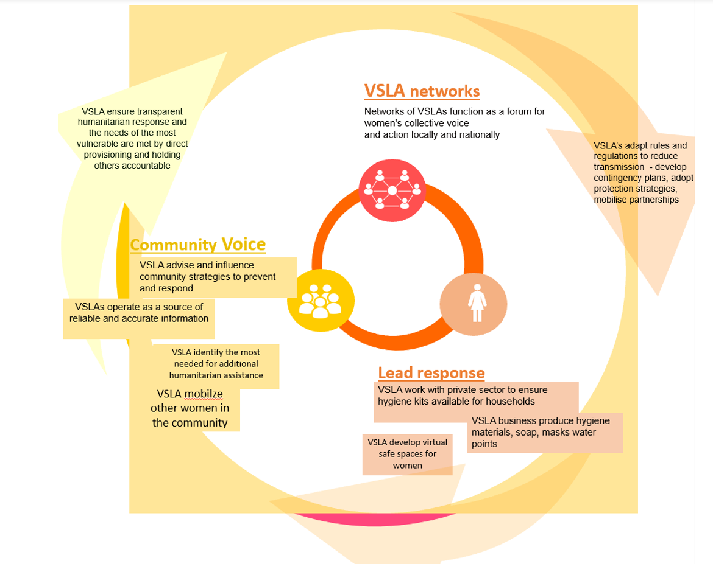
Savings Groups - Women Responding to Crisis
Livelihoods are shrinking faster for women: 55% of the women report income loss as one of the biggest impacts, compared to only 34% of men. They are also having a harder time accessing safety nets when they lose their jobs.
Women prioritize food security: 41% of women and 30% of men report lack of food as a key impact on their lives.
Mental Health is a major concern for women: 27% of women report mental health as a key impact of COVID-19—compared to only 10% of men. They point out especially point to skyrocketing unpaid care burdens as a source of this stress, in addition to worries about livelihoods, food, and health care.
Notes:
Reference to different research: Building forward report, RGA, also listening to women:
CARE is listening to women have surveyed over 10,000 women across 38 countries to find out :
How women and girls are being impacted by COVID-19
How women and girls are adapting to the crisis
What support or action women and girls want to see in support of their efforts
How responses to these questions vary by context and demographic group
How responses to those questions are evolving over time
We have already seen the impact of VSLAs as first responders during a crisis:
Existing VSLAs are often first responders.
In Haiti after Hurricane Matthew^{[1]}, VSLA members cashed out their savings to contribute $40,000 to recovery efforts supporting their communities.
Engaging existing VSLAs can ensure response and recovery are tailored to women’s priorities and needs
VSLA members in DRC pooled their savings to assist IDPs fleeing inter-ethnic conflict and provided 15 houses for three months along with daily meals for 300 IDPs.^{[2]}
^{[1]} http://www.cashlearning.org/downloads/pa00t2bx.pdf
^{[2]} https://www.careaction.org/blog/5-minutes-inspiration-solidarity-and-savings-graduate-families-out-poverty
Supporting new VSLA formation can support recovery and be combined with acute humanitarian action (e.g. cash transfers).
CARE began implementing VSLAs in Yemen at the height of conflict in 2017. Combined with sustained cash transfers over 9 months has helped groups meet immediate needs while preparing for future shocks.
A pilot project in Idlib, Syria with 30 groups (500 people) was comprised of host community members, IDPs, farmers and business owners. People who participated in VSLAs were mostly neighbors and saved $25K in one year.
^{[1]} http://www.cashlearning.org/downloads/pa00t2bx.pdf

Slide 14
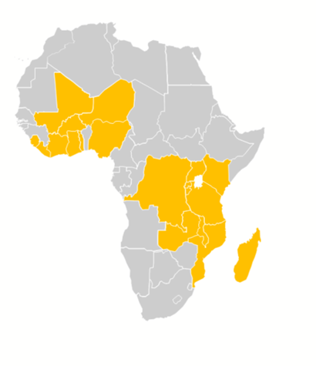
VSLAs Scaling Through Governments
Governments are the most promising path to creating Savings Groups and at scale
74 government initiatives with an explicit Savings Group component
Across 20 countries
By 38 government institutions
Ministries of finance and planning, agriculture and natural resources, youth, women, gender, children, labour, social protection, social affairs, local government, cooperatives, rural development, officers for prime ministers and presidents, community development and central banks
Defragment SG Ecosystem
Convene stakeholders who can scale and support Savings Groups that are gender transformative
Strengthen technical capacities
Create Savings Groups with planned pathway to women empowerment from the beginning

Slide 15
Japheth Muli
Chief Operations Officer, Eastern Africa
Hand in Hand International

Slide 16





OUR MODEL
1.
2.
3.
4.
Notes:
- We see local economic development and women’s empowerment as happening through entrepreneurship and employment.
- Our 4 step model….
- This model has been rolled out in 14+ countries, achieving scale in vastly different contexts.
- This creates a systemic approach for grassroots led development with women at its centre.

Slide 17








IMPACT
REACH
305,000
micro-enterprises
410,000
jobs
SHORT-TERM OUTCOMES
100% of Savings Groups still meeting after 9 months
Incomes increased over 30%, on average
LONG-TERM OUTCOMES
95% still apply training after 2 years
95% report improved quality of life
COVID-19
RESILIENCE
95% had savings to help see them through
54% cited enterprise finance as most important need
Notes:
Reach: 305,000 enterprises and 410,000 jobs in Kenya since 2010. More worldwide.
9 months after training: 100% of savings groups still meet and incomes are up by 100% on average
Up to 2 years after leaving our programmes: 95% of members are still using the training and 95% report an improved quality of life based on their participation in the programme
When Covid 19 hit: 95% of our members had savings to help them through lockdowns and income loss. However after 3 months of lockdown resources had eroded significantly and 54% of members noted that finance to help them restart their enterprise was one of their biggest needs.

Slide 18




COVID-19
EMERGENCY
RESPONSE
(3 MTHS)
Provided soap, facemasks to 25,000 members.
Reached 75,000 more via mobile, SMS to deliver vital health messages, signpost to health services and counter false narratives.
SUPPORTING GRASSROOTS, MARKET-LED RESPONSE
Provided advice, training on business adaptation strategies, pivoting to produce in-demand items such as facemasks and soap.
Urban: micro-enterprise accelerators
Rural: regenerative agriculture, circular economies
LONG-TERM
ADAPTATIONS
Notes:
During COVID 19 our team was able to leverage connections with Self Help Groups to reach people quickly and effectively. Even in the period where we had to operate almost entirely remoted
Short term, we focused on supporting enterprises to operate where/how they could, and to pivot their output towards products that were essential during lockdown and which served to protect households during the pandemic
Longer term, the pandemic has intensified our focus on programme adaptations and interventions that effectively consolidate income gains for members, and support resilient local markets as opposed to relying on global value chains.

Slide 19


WORK WITH GOVERNMENT
WORK WITH
GOVERNMENT
Agricultural programmes
Agricultural Sector Development Program (ADSDP)
Kenya Agricultural & Livestock Research Organization (KALRO)
COVID-19 response
Ministry of Health
National, county governments
HOW
GOVERNMENT
CAN HELP
Co-ordinate efforts of currently disparate NGOs, thematically and geographically.
Involve Savings Groups in local planning and decision-making.
Provide NGOs with funds, mandate to implement large-scale entrepreneurship programmes on the ground.
Notes:
To be added

Slide 20
Angeline Munzara
Senior Advisor, External Engagement & Savings Groups
World Vision

Slide 21
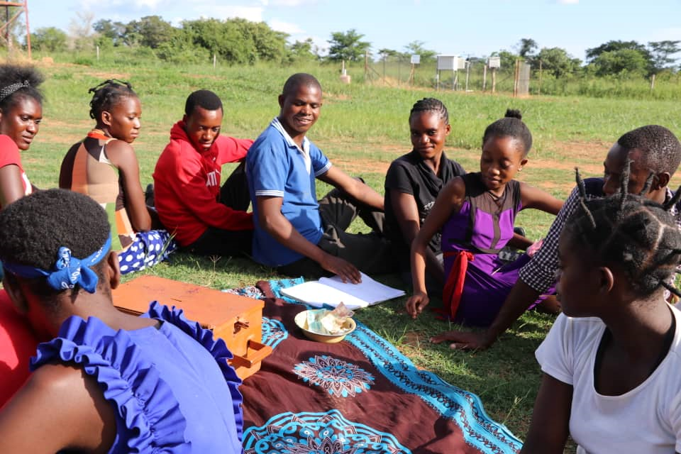

Savings Groups
A bedrock for COVID-19 economic response and recovery
PR0GRAM MODELS
  Standalone Savings Groups
  SGs + Child Protection Embedded Education
  SGs + Women Economic Empowerment
  SGs + Formal Finance (bank linkages)
  SGs + Targeted Cash & Voucher Assistance
Over 60,000 groups in 34 countries​
with over 1.3 million members
(80% are women) ​
​
Members include over 500,000 caregivers looking after 1.2 million children.​
70% of these groups are in Africa. ​

Slide 22
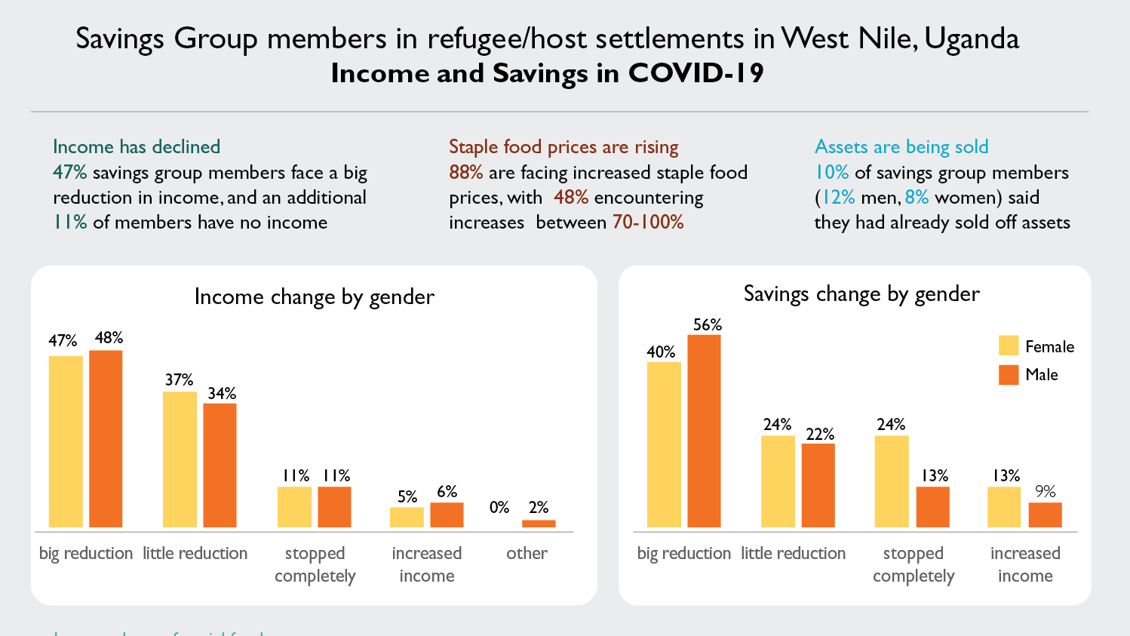

Slide 23
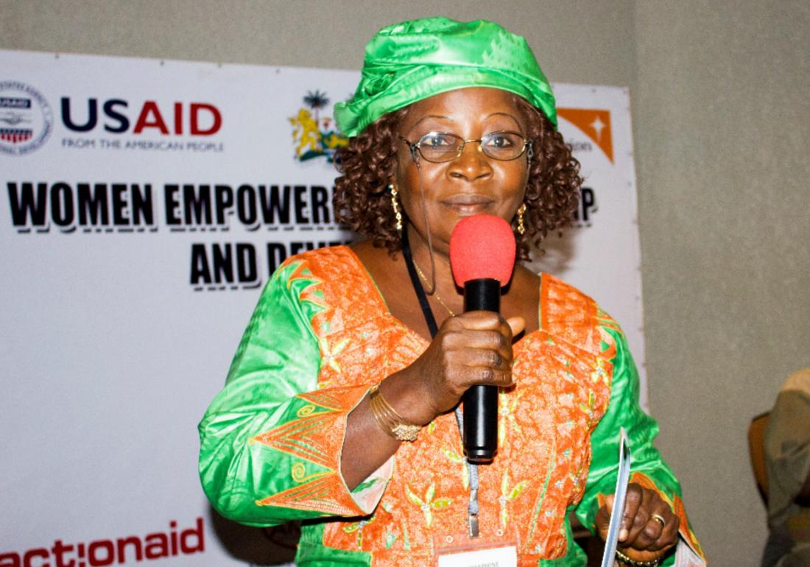
SCALING UP WHAT WORKS
INTEGRATED S4T PROGRAMMING BUFFER ECONOMIC EFFECTS OF PANDEMICS
KEY S4T OUTCOMES DURING EBOLA
Loans for 42,000 small traders (80% women)
70% of funds used for fees, food and medical expenses for over 40 000 children.
CP education - 20% drop in child marriages.
52% less risk of women being exposed to physical violence, due to increased income
CONCLUSIONS
In the absence of government CSSP, Savings Groups provide a local safety net
Stand-alone SGs are essential but not sufficient to build resilience (integration is key)
Savings Groups have the potential to protect past gains and contribute to SDGs (2, 3, 4, 5, 8, 10, 16)
TIME is NOW to scale up and engage Savings Groups for local economic development and inclusive recovery
Hon Josephine Makieu: S4T group member

Slide 24
Brian Ssebunya, Ph.D
Senior Technical Advisor, Enterprise Development and Employment
International Rescue Committee

Slide 25

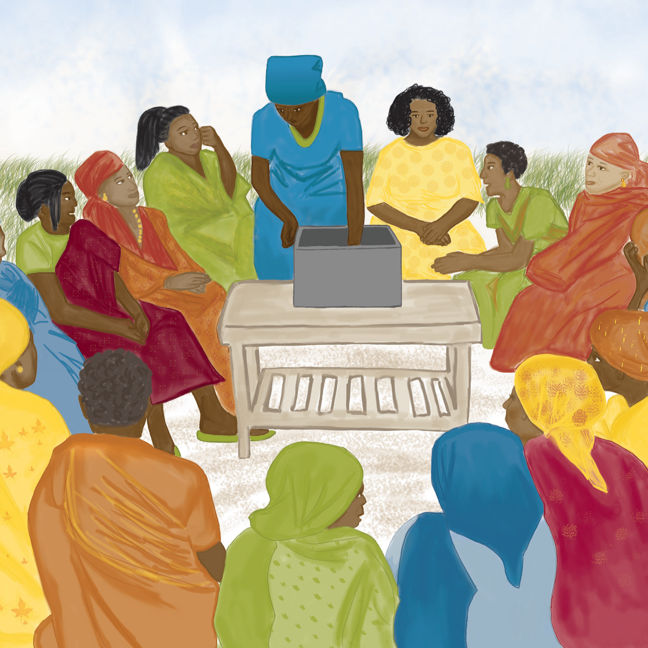
Leveraging Saving Groups for
Emergency Preparedness and Response
Savings Groups are a pillar of IRC’s Economic And Social Empowerment (EA$E) approach for women
    Savings Groups & financial literacy
    Business skills
    Gender discussion series
In FY19, IRC supported 41,700 members (78% female) who saved over US$2.2M
The IRC’s cash-first strategy for emergency response recognizes the social protection role of SGs for members
  In FY19, US$29.5M distributed to 160,000 HHs

Slide 26
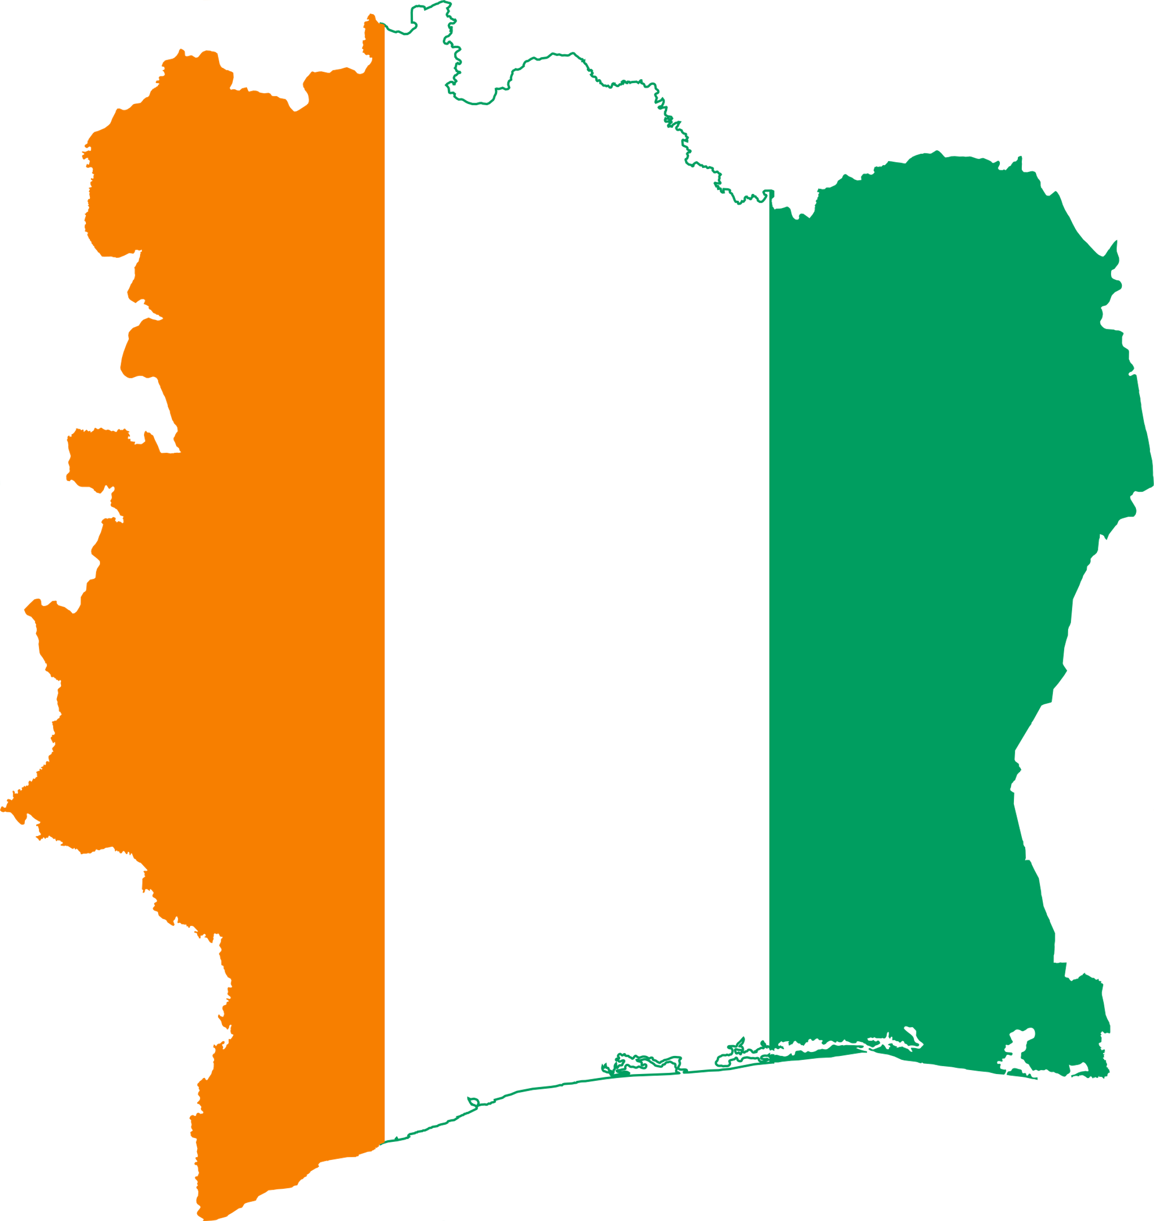


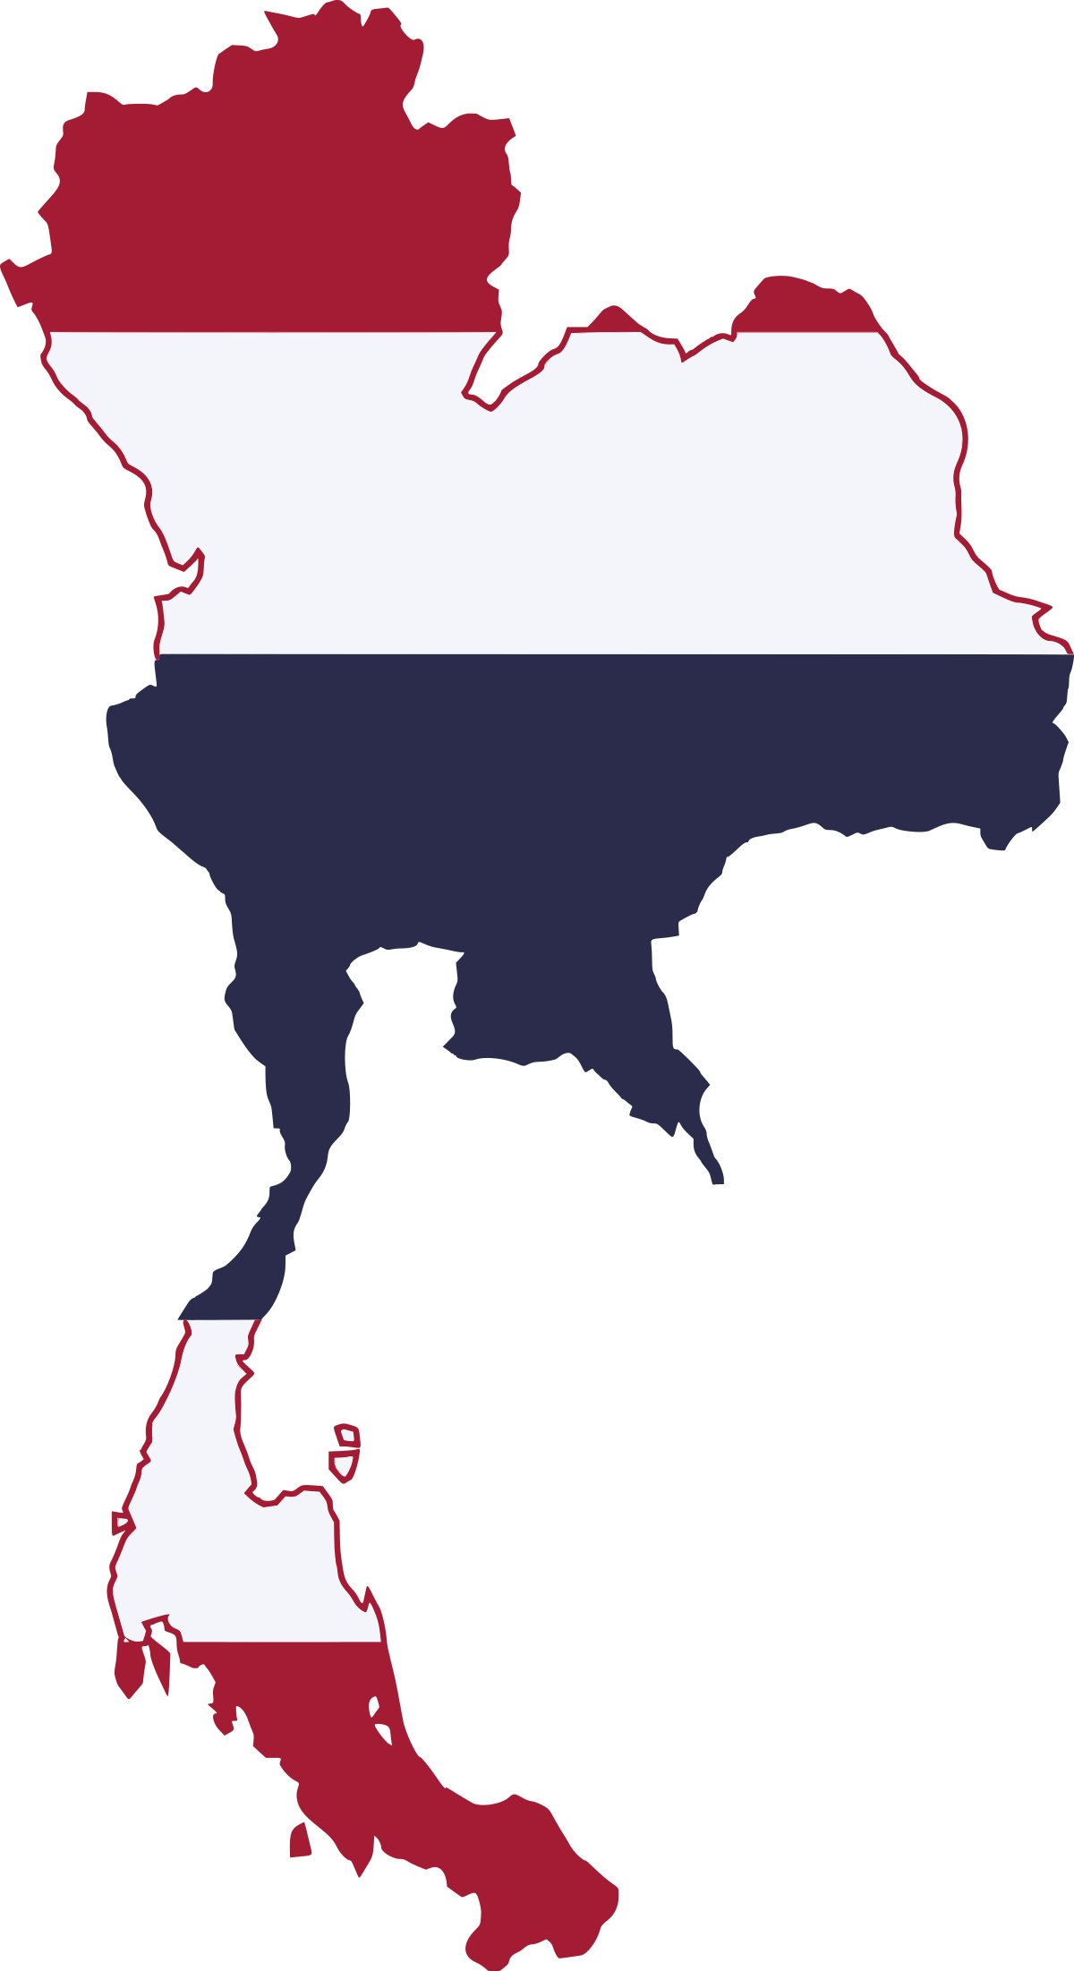


Savings Groups and COVID-19 response
Savings Groups serve as key emergency resources
for members and their communities
Côte d'Ivoire – social funds used to purchase and distribute PPE to member households
        Sierra Leone – SGs began group farming and subsistence gardening
Uganda – leveraged their online network to share health information, transitioned to intra-group business marketing and support
        Thailand, Syria, Afghanistan – mobilized members to quickly start PPE production

Slide 27
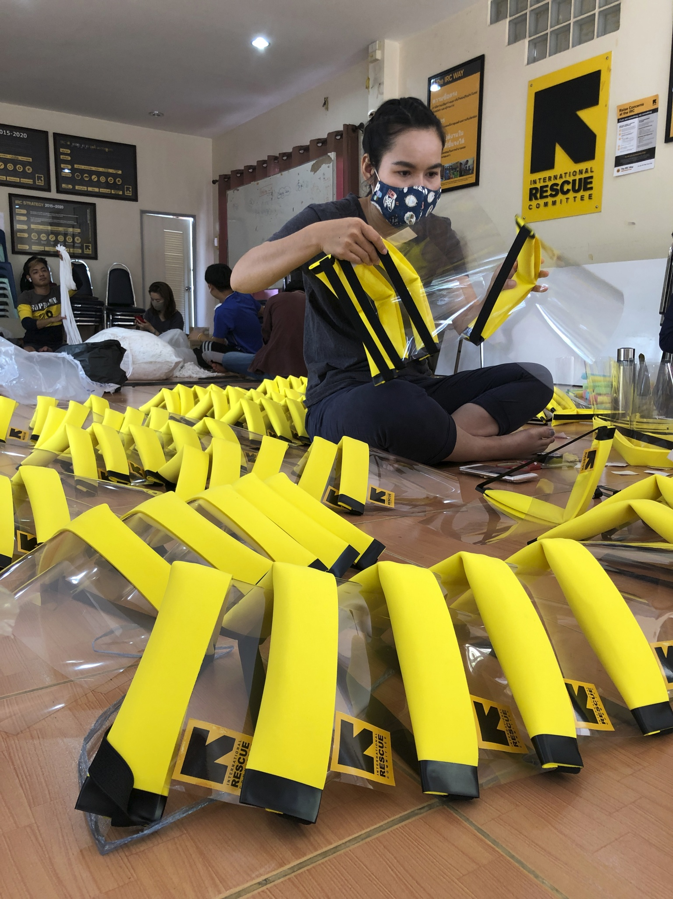
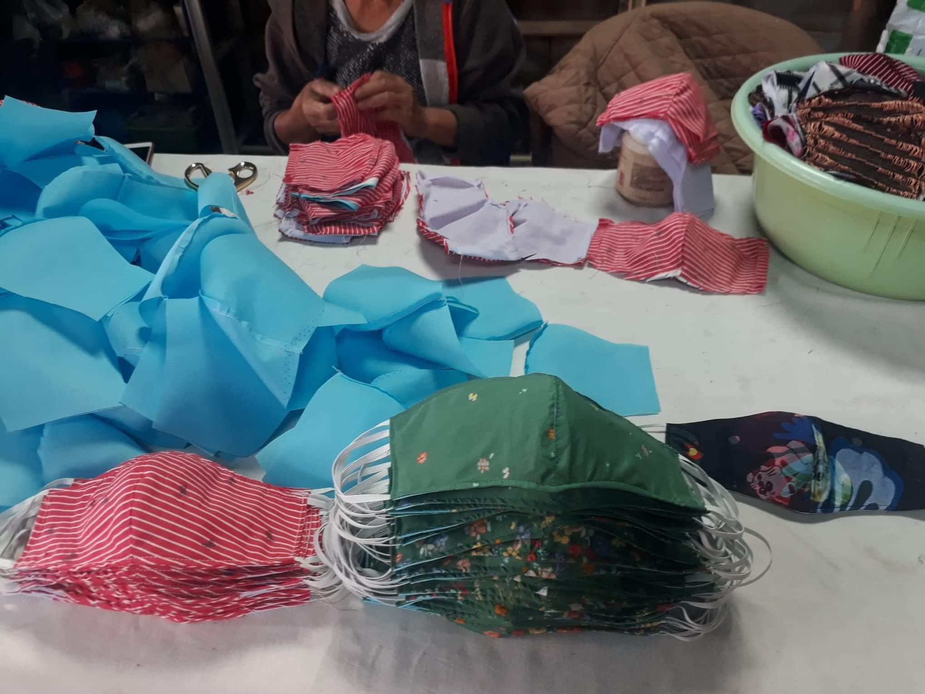
CONCLUSIONS
SGs increase resilience of members – savings for future emergencies and basic insurance in times of crisis
SGs are a building block for group entrepreneurship, and combatting harmful social and gender norms
SGs provide community leadership and serve as trusted sources of information and support during crises, and can be leveraged for risk communication and community engagement (RCCE)

Slide 28
Edwin Ocharo
Senior Projects Officer,
Kenya Post Office Savings Bank

Slide 29
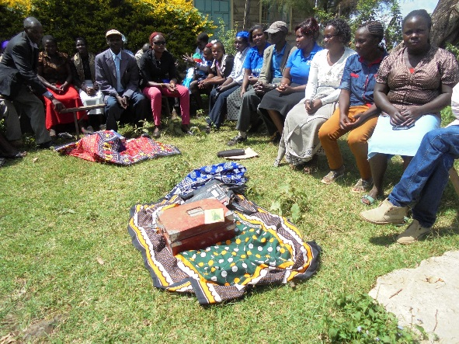

Savings Groups and Financial Inclusion –
OUR APPROACH
Savings Groups fit within KPOSB’s legislative mandate – inculcate a savings culture amongst Kenyans
Market potential – market surveys indicate 11% excluded from formal financial services, while 6% use Savings Groups
  Estimated market of around 8M people
Existing entry points – opportunities for segment entry through partnerships (NGOs and county governments)
New business line, created in 2016, targeting Savings Groups through digital technology (mChama)

Slide 30
RESULTS
INSTITUTION
  In three years, 58,500 new accounts in previously unserved market
    8,500 group accounts: balance of $1.2m
    50,000 individual accounts: balance of $5m
      Avg savings increased from $0.10 in 2016, to $100 in 2019
  Sustainability: less than 1% group attrition over 3 years
CLIENT
  Demonstrable individual and group investments in housing, livelihoods and agriculture
  Local advocacy to meet needs or influence development programs relating to healthcare, education, and water management

Slide 31
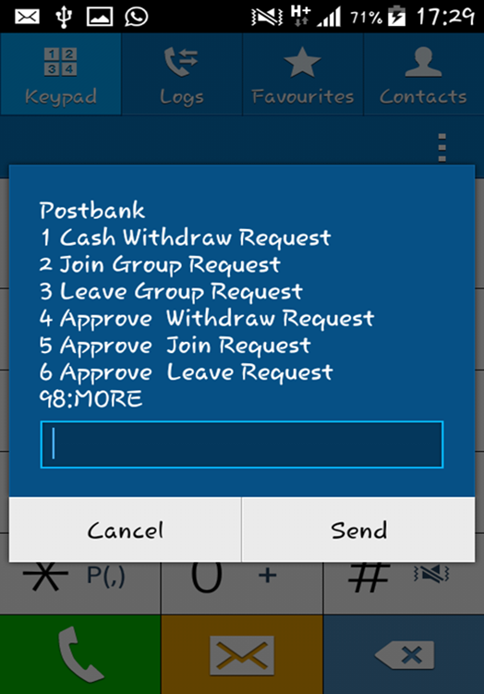
Savings Groups and Financial Inclusion –
KEY LESSONS
Partnerships – with NGOs, county governments, technology provider, MNOs
Price sensitive market, with small margins – scalability is important
Simple and appropriate technology for customer acquisition, service and CICO
  Average cost of acquisition of under $5/group
Strategic commitment by the FSP to target the segment

Slide 32
Sybil Chidiac
Senior Program Officer, Gender Equality
The Bill & Melinda Gates Foundation

Slide 33
Angeline Munzara
Senior Advisor, External Engagement & Savings Groups
World Vision

Slide 34
Brian Ssebunya, Ph.D
Senior Technical Advisor, Enterprise Development and Employment
International Rescue Committee

Slide 35
Japheth Muli
Chief Operations Officer, Eastern Africa
Hand in Hand International

Slide 36
Edwin Ocharo
Senior Projects Officer,
Kenya Post Office Savings Bank

Slide 37
Aisha Rahamatali
Senior Advisor, Women Economic Justice and Rights Action Coalition
CARE International

Slide 38
Shobha Shetty
Practice Manager, Agriculture and Food Global Practice
World Bank

Slide 39
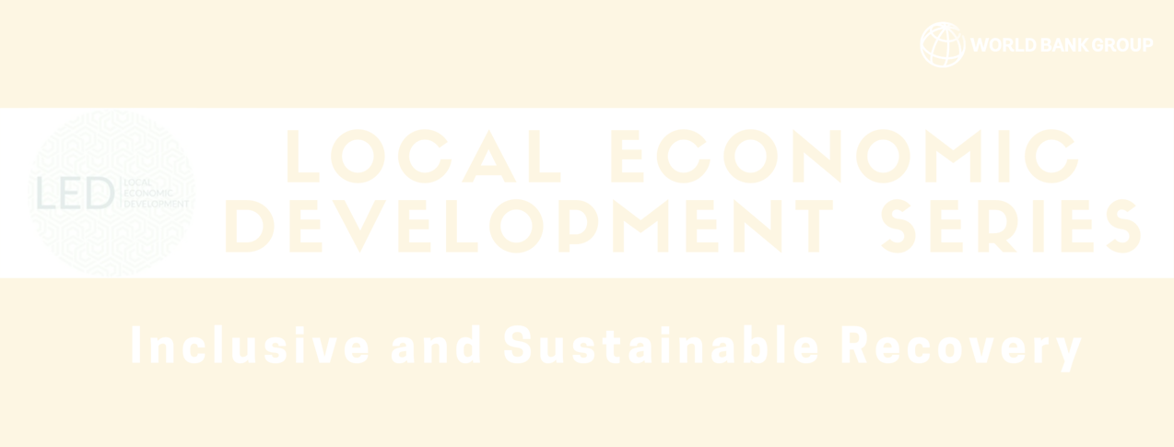
Upcoming Events
Webinar #5
January
Date and Time TBA

