Slide 1
Co-hosted by the World Bank’s Social Sustainability and Inclusion Global Practice; Ministry of Local Government, Decentralization and Rural Development; National Development Planning Commission; Northern Development Authority; Development Partners, and World Bank’s Community and Local Development Global Solutions Group
GHANA SOCO PROJECT WEBINAR SERIES Webinar #1: How Can We Promote a Coordinated Development Approach in Northern Ghana?
Thursday, December 15, 2022 2:00 pm - 3:30 pm (Ghana time) | 9:00 am -10:30 am (EST) @zoom

Slide 2
Webinar Agenda
Moderator:
Dr Sulemana Abdulai, Board Chair, Northern Development Authority (NDA)
Opening Remarks:
Dhruva Sahai, Acting Country Director, World Bank Ghana CMU
Nicolas Perrin, Task Team Leader Regional SOCO Project, World Bank
Brief Introduction of Ghana SOCO Project:
Ashutosh Raina, Task Team Leader, Ghana SOCO Project, World Bank
George Aidoo, Project Coordinator, Ghana SOCO Project, MLGDRD
Fireside Chat:
Samuel Seth Passah, Director, Local Governance and Decentralisation, MLGDRD
Dr Hippolyt Pul, Board Member, NDA
Angeline Nguedjeu, Peace and Development Advisor, UN
Peter Aidoo, Development Coordination Officer, UN
Jason Smith, Director, Office of Democracy and Governance, USAID
Question & Answers:
Closing Remarks:
Marian W. A. Kpakpah, Chief Director, MLGDRD

Slide 3
Opening Remarks
Dhruva Sahai, Acting Country Director, World Bank Ghana CMU

Slide 4
Opening Remarks
Nicolas Perrin, Task Team Leader Regional SOCO Project, World Bank

Slide 5
Think regionally to act locally

Slide 6
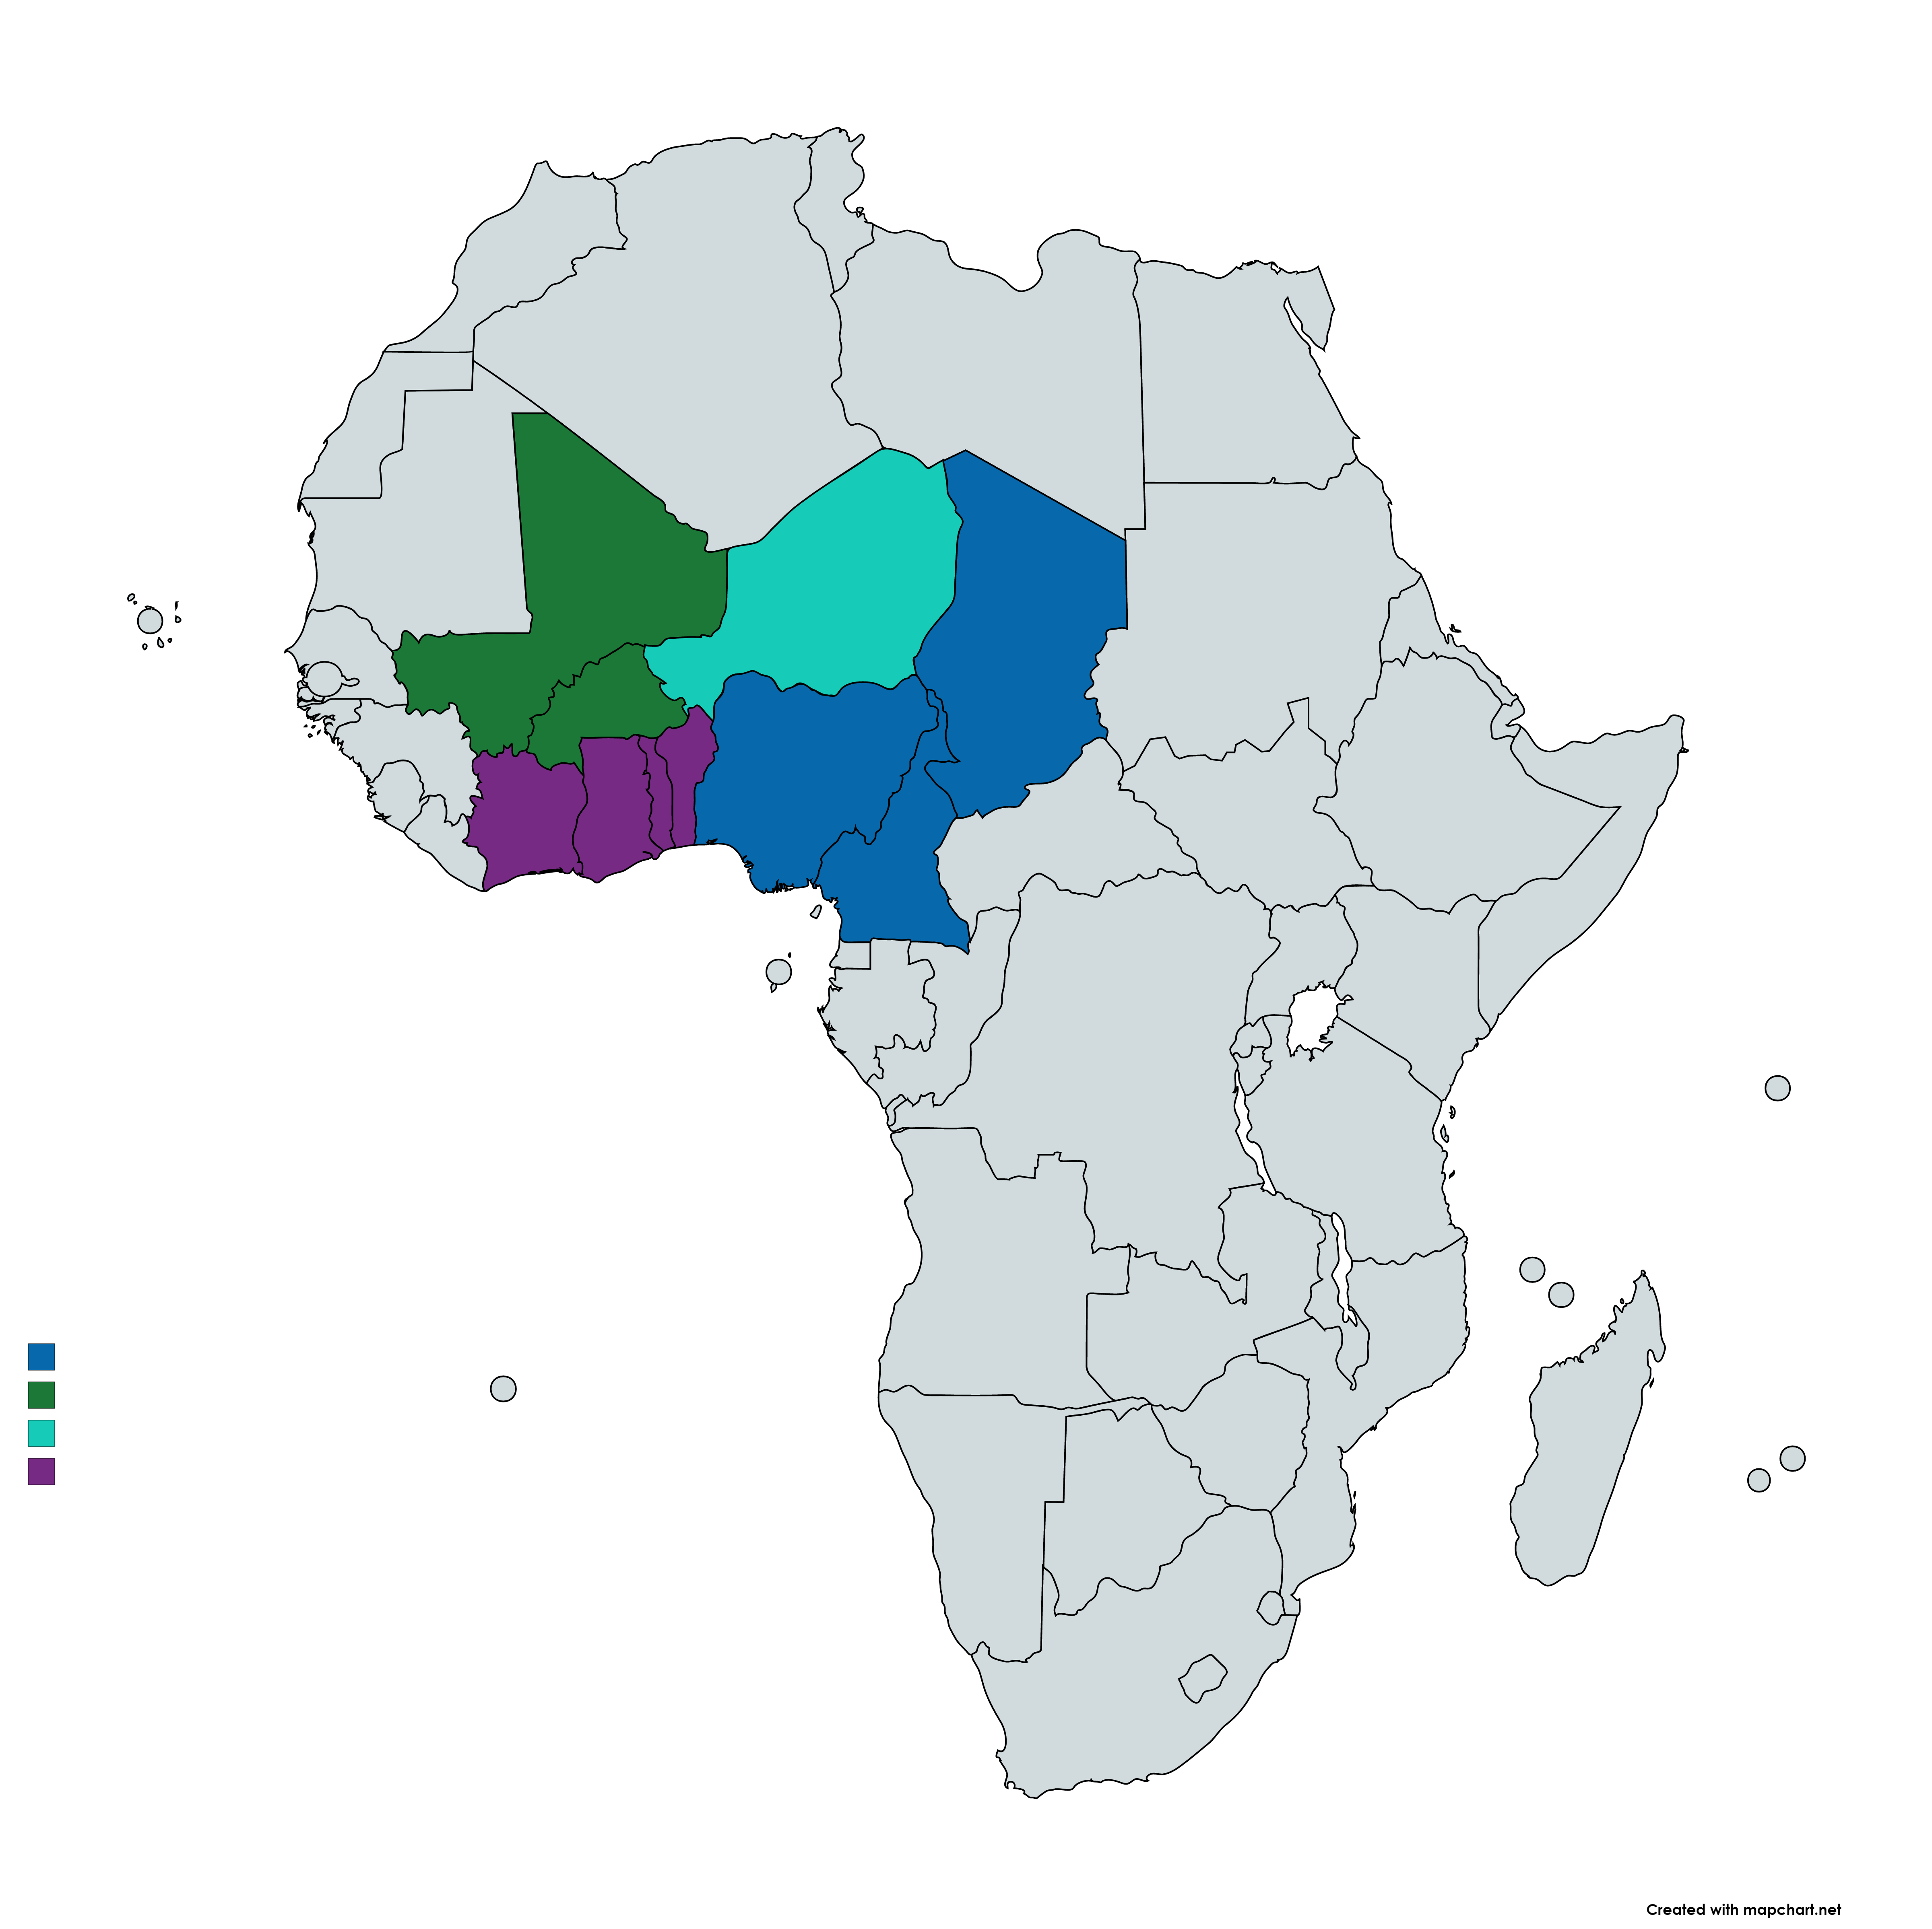
Regional Community Local Development and dialogue in Lake Chad, Sahel and Northern Regions of the Gulf of Guinea – Think regionally to act locally
Deteriorating context in those hotspots accelerated over the past years, regional response is becoming crucial to address the situation. Those operations are catalytic to support strategic dialogue and integrated approaches in fragile zones in lagging areas
Project design was guided by FCV drivers & security situation analyses and considerations on how to address root causes
Lack of social cohesion and trust
Sahel 3 Borders area (Burkina Faso, Niger and Mali)- $352.5 M
Lake Chad (Niger, Chad, Cameroon + Nigeria) $170 M +$190 M
Northern Regions of the Gulf of Guinea (Cote d’Ivoire, Ghana, Togo and Benin) $ 450M
Limited voice and resilience, especially of vulnerable groups
Ineffective institutions and regional dimension of fragility
to strengthen regional stability and prosperity, the response needs to be….
1) Regionally Coordinated, and 2) People-centered

Slide 7
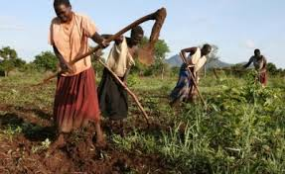
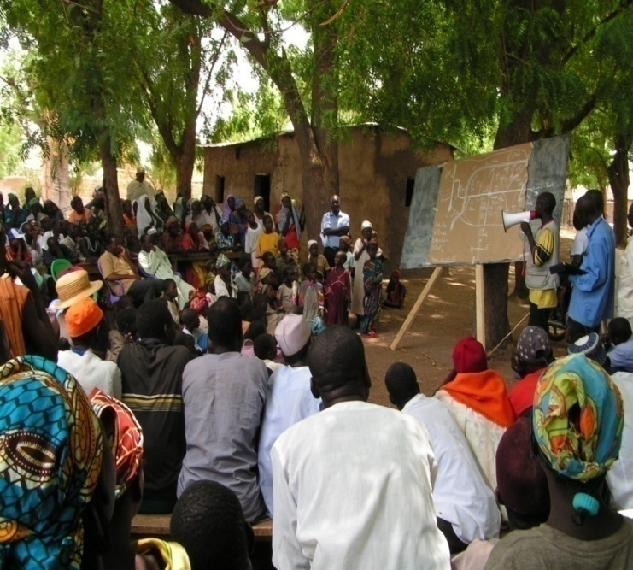
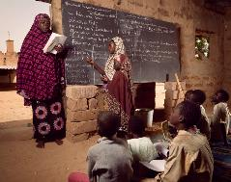
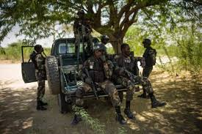
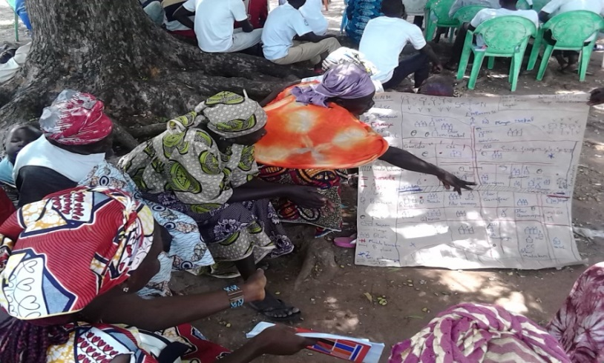
Key Points
Deteriorating context in Sahel and west Africa has accelerated over the past year, regional response is becoming crucial to address the situation.
Those operations are catalytic to support strategic dialogue and integrated approaches in fragile zones.
Bank Strategic engagement in fragile hotspots: PROLAC to re-engage on RSS for LC, 3 borders in emergency areas in Sahel, SOCO to prevent spread of Sahel risks to Gulf of Guinea
People Centered Investments (CLD) at regional scale: Different models of community and Local Development based on national and regional contexts.
Integrated local level resilience action in Lagging Regions: Cross sectoral collaboration, focus on local resilience – CC diagnostics and integrated sustainable approaches-, front line of climate action ( vulnerable hotspots and groups resilience, NRM and livelihood, monitoring FCV/CC nexus,etc)
Social Cohesion & Prevention across Borders: follows social cohesion framework ( bonding, bridging, linking) by focusing on processes (social inclusion, youth, gender, CLD, mediation) and concrete activities (livelihood, infrastructure, dialogue)
Joint knowledge and Learning Agenda for Regional Strategic Coordination : KMP ( local and regional institutions capacity building, data collection, digital solutions, strategic dialogue with AFD, UN, AU, Canada – parallel financing- , Germany, Sweden, G5, etc)
The projects adopt a risk-based approach building security risks in their design (area coding, SMP, MOD, Digital innovation, etc)

Slide 8
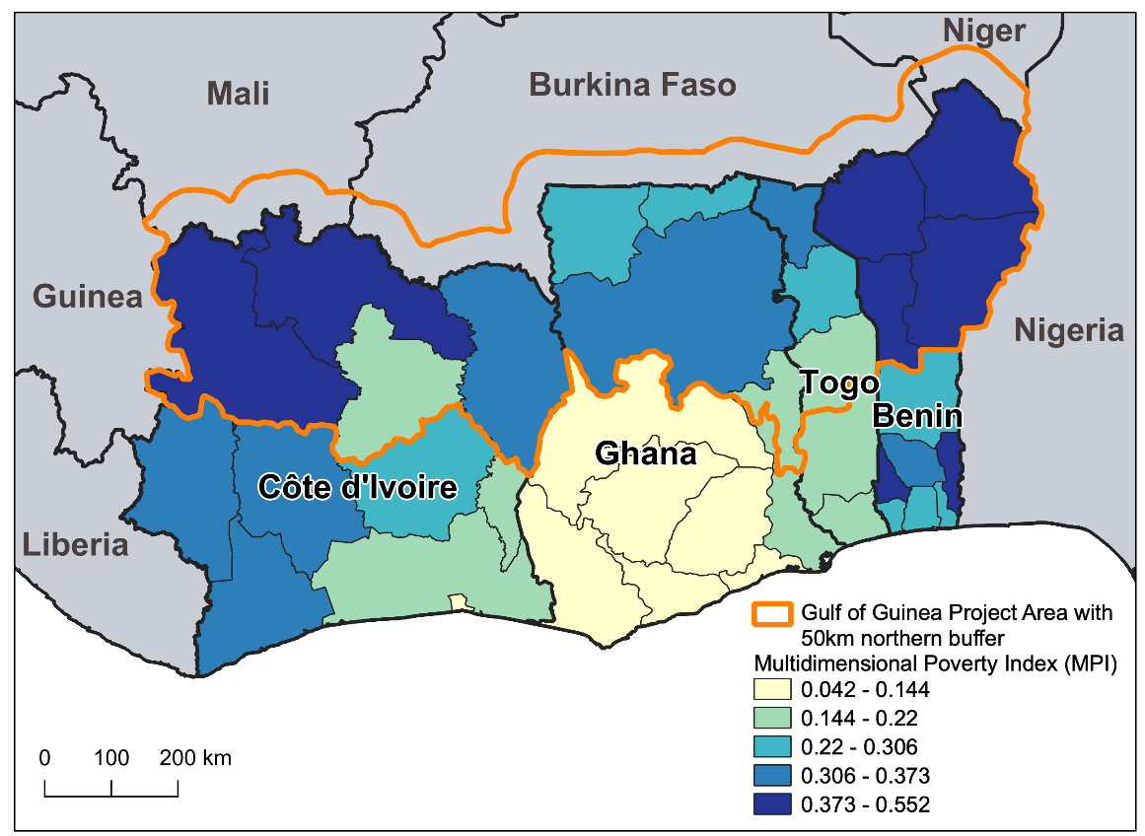
Gulf of Guinea Northern Regions Social Cohesion (SOCO) Project
Context: Northern lagging areas of Gulf of Guinea countries (Cote d’Ivoire, Ghana, Togo, and Benin) are increasingly facing:
FCV Spillover risks from the Sahel
Perception of exclusion originating from insufficient state presence, higher poverty rate, insufficient decentralization, lower access to basic services and markets, and lack of voice and insufficient participation in decision-making processes - exacerbate vulnerabilities
High risk to climate change impacts poses another regional threat (dependent on subsistence agriculture)
COVID shocks/risks could exacerbate such structural drivers of FCV.
Objective: to improve regional collaboration and the socioeconomic and climate resilience of border-zone communities in the target northern regions of the Gulf of Guinea countries exposed to conflict and climate risks.
Target beneficiaries: Over 16 million people living in at-risk communities – to proactively prevent the spread of conflict from the Sahel, reduce vulnerability to climate change, and strengthen local institutions, economic opportunities, and public trust.
Financing: Total IDA US$ 450 million
 | Cote d’Ivoire | Ghana | Togo | Benin | TOTAL
National IDA | 50M USD | 50M USD | 20M USD | 30M USD | 150 M USD
Regional IDA | 100M USD | 100M USD | 40M USD | 60M USD | 300 M USD
TOTAL | 150 M USD | 150 M USD | 60 M USD | 90 M USD | 450 M USD

Slide 9
SOCO project can support future rural development engagement in Northern Ghana
SOCO’s proposed integrated rural development pilot/innovation in 3 districts could be instrumental for pioneering the rural development engagement model in Northern Ghana
SOCO project has the necessary staffing and logistics in place at the national, regional/zonal, district, and community levels to support the last-mile delivery for the rural development engagement in Northern Ghana.
SOCO project is supporting scoping study, digital knowledge platform, BBL series, digital data fellowship initiative and conference focused on Northern Ghana. These initiatives could play a very important role in addressing knowledge gaps and building an enabling ecosystem for rural development engagement in Northern Ghana
SOCO Project can also contribute greatly to women’s economic empowerment and Country Climate and Development Reports (CCDR) agendas in Northern Ghana

Slide 10
Brief Introduction of Ghana SOCO Project:
Ashutosh Raina, Task Team Leader, Ghana SOCO Project, World Bank
George Aidoo, Project Coordinator, Ghana SOCO Project, MLGDRD

Slide 11
Ghana Northern Regions Social Cohesion (SOCO) Project
Total financing: $150 million
Geographic focus:
6 regions: Northern, North East, Oti, Savannah, Upper East, and Upper West
48 districts (approximately 80% of all the districts in the North)
Implementing agency:
Ministry of Local Government, Decentralization, and Rural Development (MLGRD)
Working also with National Development Planning Commission, Ministry of Youth and Sports; Ministry of Gender, Children and Social Protection etc.

Slide 12
Project Components - Overview
Component 1: Investing in Community Resiliency and Inclusion (USD 112.5M, 75%)
Sub-Component 1.1
(USD 84M):
Community investments for strengthening local resilience and inclusion
Sub-Component 1.2
(USD 22.5M):
Strategic economic investments for climate-resilient economic development
Component 2: Building foundation and capacity for inclusive and resilient communities (USD 15M, 10%)
Component 3: Regional Coordination Platform and Dialogue (USD 7.5M, 5%)
Component 4: Project Management (USD 15M, 10%)
Component 5: Contingent Emergency Response Component (CERC) (USD 0)
Sub-component 1.3
(USD 5.6M)
Youth engagement and social cohesion activities

Slide 13
Key Milestones
Board approval: March 31, 2022
Cabinet and Parliamentary approvals; Financing agreement signed: August 22, 2022
Project effectiveness: October 25, 2022
Sensitization/orientation of all 48 Districts completed
Key project staff recruited, PIM prepared, Annual Work Plan and Budget prepared
Project was officially launched on November 25, 2022
Implementation activities have started in Districts
Strong political support for the successful implementation of the project at all levels of the Government – national and subnational. There is deepened multi-sector collaboration on the project

Slide 14
SOCO is acting as a catalyst for a coordinated approach and Integrated development in Northern Ghana
SOCO covers around 80% of districts in Northern Ghana
Foster a comprehensive multi-sectoral and multi-partner response and enhance coordination and monitoring (Avoid silos)
Collaborating with NDA and all the major Development Partners (DPs)
Scoping study – August 2022 to April 2023
Digital Knowledge Platform – April 2023
BBL/webinar Series – from Dec 2022-March 2023
Development Partner workshop in April 2023
Conference on Northern Ghana
Digital data fellows' initiative in July 2023 to promote a data-driven and evidence-based approach
Promoting a Local Economic Development (LED) and Integrated Rural Development approach
Investing in building LED public-private partnership platform at the local government level
Collaborating with relevant WB-financed projects and government flagship initiatives
Piloting intensive LED and integrated rural development approach in a few SOCO districts in the next 2-3 years
Supporting Innovations
Social Cohesion
Climate resilience
Cross-border initiatives
Digital innovations
Youth empowerment
Women’s economic empowerment
Social Risk Management

Slide 15
Fireside Chat:
Samuel Seth Passah, Director, Local Governance and Decentralisation, MLGDRD
Dr Hippolyt Pul, Board Member, NDA
Angeline Nguedjeu, Peace and Development Advisor, UN
Peter Aidoo, Development Coordination Officer, UN
Jason Smith, Director, Office of Democracy and Governance, USAID

Slide 16
Question & Answers

Slide 17
Closing Remarks:
Marian W. A. Kpakpah, Chief Director, MLGDRD

Slide 18
GHANA SOCO PROJECT WEBINAR SERIES Webinar #2: How can we Promote Local Economic Development in Northern Ghana?
Wednesday, February 15, 2022 2:00 pm - 3:30 pm (Ghana time) | 9:00 am -10:30 am (EST) @zoom
Thank you

