Slide 1
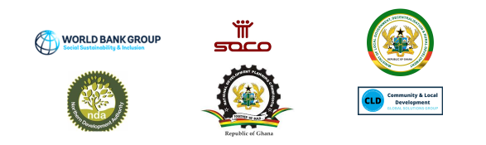
GHANA SOCO PROJECT WEBINAR SERIES Webinar #2: How can we Promote Local Economic Development in Northern Ghana?
March 22, 2022 2:00 pm - 3:30 pm (Ghana time) | 10:00 am -11:30 am (EST) @zoom

Slide 2
Welcome and webinar overview by Chair & Moderator:
Dr. Kodjo E. Mensah-Abrampa, Director-General, National Development Planning Commission, Government of Ghana

Slide 3
Webinar Agenda
Chair & Moderator:
Dr. Kodjo E. Mensah-Abrampa, Director-General, National Development Planning Commission, Government of Ghana
Opening Remarks:
Pierre Laporte, Country Director, World Bank, Ghana CMU
Speakers:
Miriam Nana Ama Amoah, Head of Decentralisation Unit, MLGDRD
Ashutosh Raina, World Bank, Task Team Leader Ghana SOCO Project
Fireside Chat with Panelists:
Dr. Kwadwo Ohene Sarfoh, LED Consultant
Issifu Salifu, Development Planning Officer, East Mamprusi Municipal District Assembly
Desmond Duametu, Productive Inclusion Specialist, Ghana Productive Safety Net Project
Dr. James Kwame Mensah, University of Ghana Business School
Moritz Mang, Advisor, Digital Transformation, GIZ
Humu-Hani Adam, Representative, WEE-North Alinea
Closing Remarks:
Marian W. A. Kpakpah, Chief Director, MLGDRD

Slide 4
Opening Remarks:
Pierre Laporte, Country Director, World Bank, Ghana CMU

Slide 5
Speakers:
Miriam Nana Ama Amoah, Head of Decentralisation Unit, MLGDRD
Ashutosh Raina, World Bank, Task Team Leader Ghana SOCO Project

Slide 6
A national Local Economic Development Policy and Operational Manual developed in 2013, provide a framework and guideline for MMDAs to incorporate LED related activities and interventions in their Medium-Term Development Plans (MTDP) for implementation.
The need to successfully implement the LED Policy 2020 through broader stakeholder engagements and strong coordination for LED planning and implementation
The update of the Policy, Local Economic Development Policy (2020) and Action Plan will build on the successes and further address the gaps of the former Local Economic Development Policy (2013).
INTRODUCTORY SLIDE
The goal of the Policy is:
“to promote a conducive environment at MMDA level for sustained local business growth, decent employment opportunities and economic empowerment for all Ghanaians”.
The vision of this Policy is stated as follows:
“Resilient, inclusive and collaborative local economies for sustained business growth contributing to local income generation and decent job creation.”
Strong local economies that support a wealthy, inclusive, sustainable, empowered, and resilient Ghana, or in short, a W.I.S.E.R. Ghana.

Slide 7
NATIONAL CONTEXT
Coordinated Programme addresses the three interconnected elements of sustainable development: economic development, social inclusion, and environmental sustainability
.
Coordinated Programme of Economic and Social Development Policies (2017- 2024) Agenda for Jobs: Creating Prosperity and Equal Opportunity for All
Developing a business-friendly mindset among public sector agencies and the importance of Local Economic Development in facilitating economic growth and job creation at the local level
Consistent with National Sector Policies and legal frameworks such as the National Decentralisation Strategy (2020-2024)
.

Slide 8
SITUATIONAL ANALYSIS || CHALLENGES
A Situational Analysis conducted on the Local Economic Development Policy of 2015 revealed seven (7) main challenges that were encountered during Policy implementation
Weak understanding of Local Economic Development and its potential benefit for their district.
Inadequate Consultation on local economic development approaches
Inadequate clarity about the leadership in Local Economic Development policy steering and implementation.
Weak Inter-Ministerial coordination for policy steering and mainstreaming.
CHALLENGES
Imperfect nature of public-private partnerships at the local level.
Insufficient facilitation support from the centre to MMDAs for Local Economic Development planning and implementation.
Near absence of adequate information management and monitoring

Slide 9
LED POLICY AND ACTION PLAN (2020) || GUIDING PRINCIPLES
INFORMAL SECTOR
LEADERSHIP
PARTNERSHIPS
INNOVATION
Leadership and change management
Public-Private Partnerships and Dialogue
Digitisation
9
2
4
7
3
6
10
1
8
TERRITORIAL PLANNING
COMMITMENT
INCLUSVITY
IDENTIFY THE PROBLEM
Commitment of relevant Stakeholders.
Gender Equality, Equity and Inclusiveness
Territorial integration and market
Local Economic Development (LED) is not one-size-fits-all
SUSTAINABILITY
Environmental Sustainability

Slide 10
LED POLICY AND ACTION PLAN (2020) – POLICY OBJECTIVES
OBJECTIVE 1:
ENSURE EFFECTIVE LED COORDINATION AT ALL LEVELS
OBJECTIVE 2:
STRENGTHEN CAPACITIES AT MMDA LEVEL EFFECTIVEFOR LED GOVERNANCE
OBJECTIVE 3:
IMPROVE ACCESS TO ADMINISTRATIVE AND TARGETED FISCAL INCENTIVES
OBJECTIVE 4:
PROMOTE THE LOCAL AREA TO ATTRACT BUSINESSES AND INVESTORS AND TO FACILITATE ACCESS TO INFORMATION
OBJECTIVE 5:
IMPROVE ACCESS TO ECONOMIC INFRASTRUCTURE AND SUPPORT INDUSTRIALISATION
OBJECTIVE 6:
FACILITATE ACCESS TO PRODUCTIVE ASSETS SUCH AS LAND, WATER AND OTHER NATURAL RESOURCES
OBJECTIVE 7:
SUPPORT ACCESS TO FINANCE FOR BUSINESSES, COOPERATIVES AND VULNERABLE GROUPS
OBJECTIVE 8:
SUPPORT ACCESS TO TRAINING AND ENTREPRENEURIAL SKILLS DEVELOPMENT
10

Slide 11
RELEVANT POLICY OBJECTIVES ALIGNED TO THE SOCO OBJECTIVES
OBJECTIVE 01
OBJECTIVE 06
OBJECTIVE 08
Ensure Effective Led Coordination At All Levels.
Support Access To Training And Entrepreneurial Skills Development.
OBJECTIVE 05
Facilitate Access To Productive Assets Such As Land, Water And Other Natural Resources.
OBJECTIVE 02
Improve Access To Economic Infrastructure And Support Industrialisation.
OBJECTIVE 07
Strengthen Capacities At MMDA Level For Effective Led Governance
Support Access To Finance For Businesses, Cooperatives And Vulnerable Groups.
08
01
05
06
02
07

Slide 12
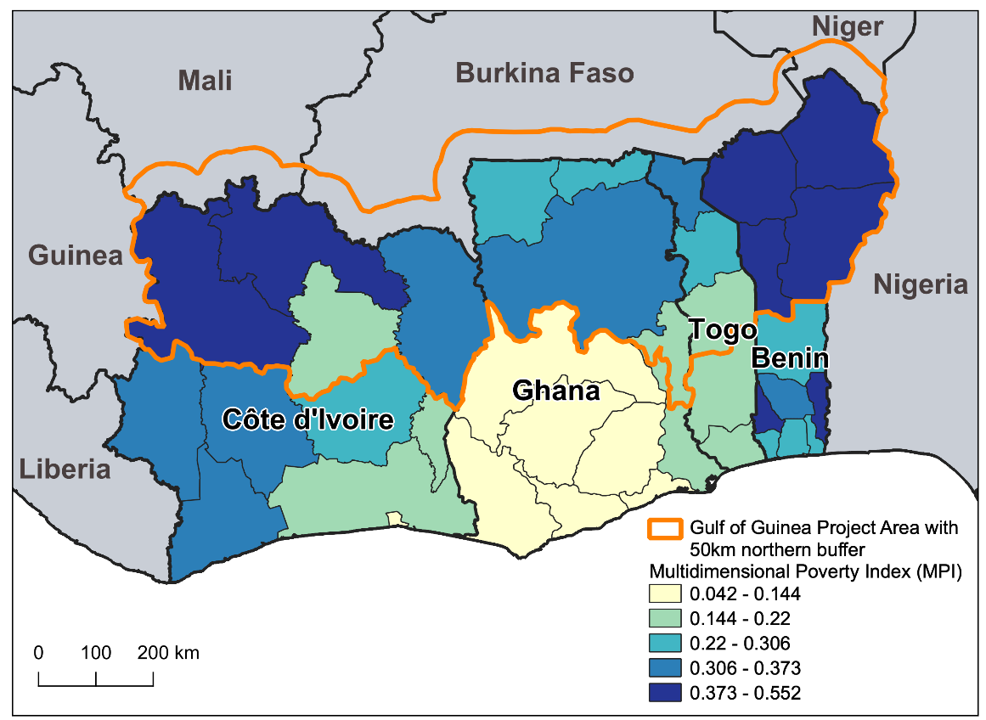
Gulf of Guinea Northern Regions Social Cohesion (SOCO) Project
Objective: to improve regional collaboration and the socioeconomic and climate resilience of border-zone communities in the target northern regions of the Gulf of Guinea countries exposed to conflict and climate risks.
Focus: To proactively prevent the spread of conflict from the Sahel, reduce vulnerability to climate change, and strengthen local institutions, economic opportunities, and public trust.
Financing: Total IDA US$ 450 million
 | Cote d’Ivoire | Ghana | Togo | Benin | TOTAL
National IDA | 50M USD | 50M USD | 20M USD | 30M USD | 150 M USD
Regional IDA | 100M USD | 100M USD | 40M USD | 60M USD | 300 M USD
TOTAL | 150 M USD | 150 M USD | 60 M USD | 90 M USD | 450 M USD

Slide 13
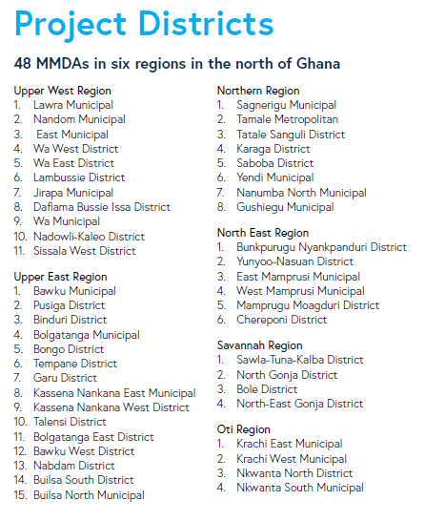
Ghana SOCO Project
Total financing: $150 million
Implementing agency:
  Ministry of Local Government, Decentralisation, and Rural Development (MLGDRD)
  Working also with National Development Planning Commission, Ministry of Youth and Sports; Ministry of Gender, Children and Social Protection etc.
Project approved on March 31, 2022
Project Launched on November 25, 2022
Implementation started in 48 districts

Slide 14
Project Components - Overview
Component 1: Investing in Community Resiliency and Inclusion (USD 112.5M, 75%)
Sub-Component 1.1
(USD 84M):
Community investments for strengthening local resilience and inclusion
Sub-Component 1.2
(USD 22.5M):
Strategic economic investments for climate-resilient economic development
Component 2: Building foundation and capacity for inclusive and resilient communities
(USD 15M, 10%)
Component 3: Regional Coordination Platform and Dialogue
(USD 7.5M, 5%)
Component 4: Project Management
(USD 15M, 10%)
Component 5: Contingent Emergency Response Component (CERC) (USD 0)
Sub-component 1.3
(USD 5.6M)
Youth engagement and social cohesion activities
LED Sub-Component
(USD 22.5 Million)

Slide 15
SOCO as a conduit for operationalizing the Local Economic Development Policy and Action Plan (2020) in Northern Ghana
SOCO covers around 80% of districts in Northern Ghana
Foster a multi-sectoral and multi-partner response and enhance coordination and collaboration (Avoiding silos)
Collaborating with NDA
Scoping study – May 2023 – to inform collaboration with various programs across multiple sectors
Digital Knowledge Platform – June 2023
BBL/webinar Series – ongoing
Partnerships with Development partners to support a coordinated approach in North of Ghana:
Various Development Partners have expressed interest to work with the SOCO project to support a coordinated development approach in North of Ghana to maximize the finance for development and to create large scale transformative impacts in target districts.
The project team has met and discussed with UN, USAID, UK FCDO, High Commission of Canada; Royal Norwegian Embassy, WFP, IOM and UNCDF.
Deep dive workshops with select development partners in May 2023
Conference on coordinated development approach in Northern Ghana in later part of 2023 (with NDAp

Slide 16
Through SOCO project, the LED Policy will be operationalized in Northern Ghana
Promoting a Local Economic Development (LED) and Integrated Development approach
Strengthen implementation architecture for LED at the MMDA level
Establish LED public-private partnership platform at the MMDA level
Promote partnerships with the private sector and financial institutions
Leverage digital technologies and innovations
The project will select a few SOCO districts initially (with strong implementation readiness; prior LED experience; and/or sited close the Zonal Coordinating Offices [ZCOs] for technical support) to undertake more intensive LED approach to serve as a good model/ proof of concept in operationalizing the national LED policy and Practitioners’ Manual.

Slide 17
Fireside Chat:
    Dr. Kwadwo Ohene Sarfoh, LED Consultant
    Issifu Salifu, Development Planning Officer, East Mamprusi Municipal District Assembly
    Desmond Duametu, Productive Inclusion Specialist, Ghana Productive Safety Net Project
    Dr. James Kwame Mensah, University of Ghana Business School
    Moritz Mang, Advisor, Digital Transformation, GIZ
    Humu-Hani Adam, Representative, WEE-North Alinea

Slide 18
Closing Remarks:
Marian W. A. Kpakpah, Chief Director, MLGDRD

Slide 19
THANK YOU
THANK
YOU

