Slide 1
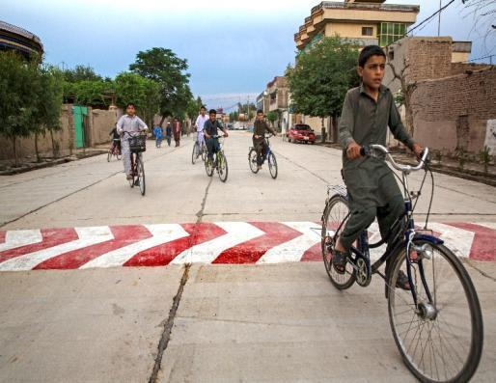
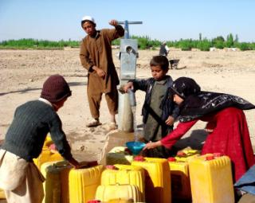
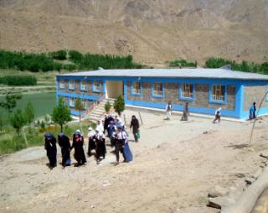
Government of Afghanistan
Citizens’ Charter
December 2016

Slide 2
Afghanistan’s Macro-Strategy
Rebuilding core state functions
Using the budget to execute policy
Promoting inter-ministerial solutions to development problems
Using National Programs to integrate across society and build sustainability
Top-down, bottom-up strategies for accountability

Slide 3
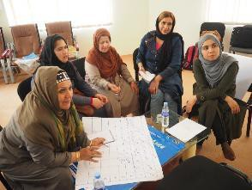
NSP: A Highly Successful CDD
Covered 38,000 communities
Very popular
Low corruption rates
Quality infrastructure
Women’s participation
Sustained over 15 years
Notes:
A core part of the CCEP will be to strengthen citizens’ monitoring and their ability to report problems. The project will develop simple citizens’ scorecards to be completed by CDCs and social monitors to report upon the minimum service standards.
Several studies are planned related to service delivery, CDC institution strengthening, Gender study, social inclusion, social accountability, and technical quality audits. The Project will also explore the possibility of an evaluation to examine the nexus between quality of service delivery and social cohesion, an under-researched area in the global conflict literature.

Slide 4
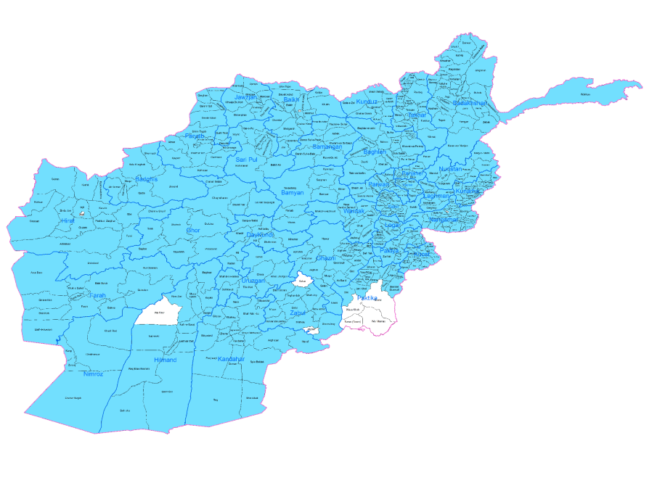
Current Reach of CDCs (blue)

Slide 5
BUT NOT WITHOUT PROBLEMS
NO LINK TO TECHNICAL SERVICES LIKE HEALTH OR EDUCATION;
LACK OF JURIDICAL STATUS FOR COUNCILS
UNPREDICTABLE FINANCING
ROUGH AND READY TARGETING
BLOCK GRANTS AND NOTHING MORE

Slide 6
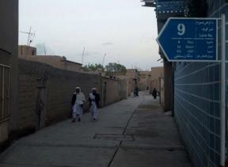
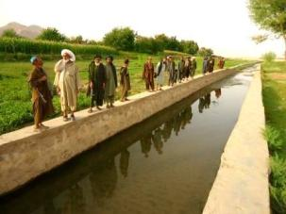
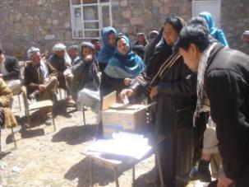
Government Options
Continue NSP but with improvements?
Re-design to bring in other ministries and services?
Notes:
Question is whether improved services increase legitimacy

Slide 7
Why Change?
Evaluation of NSP shows few governance spillovers
But on the other hand…..
Fuzzy global literature on service delivery/state legitimacy linkage
Notes:
So a first argument is that CDCs have already shown they can do more at less cost and over wide areas. The technocratic rationale.
But the hope is also there that better services will increase state legitimacy.
Apex support means that it might be possible

Slide 8
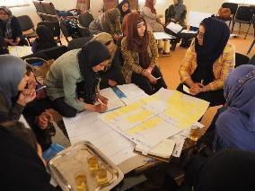
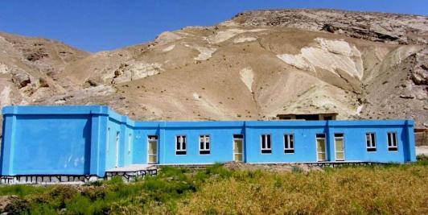
Objectives of the Charter
Break the cycle of fragility and violence, by deepening the legitimacy of the Afghan state
Reduce poverty by providing universal access to a core set of basic services

Slide 9
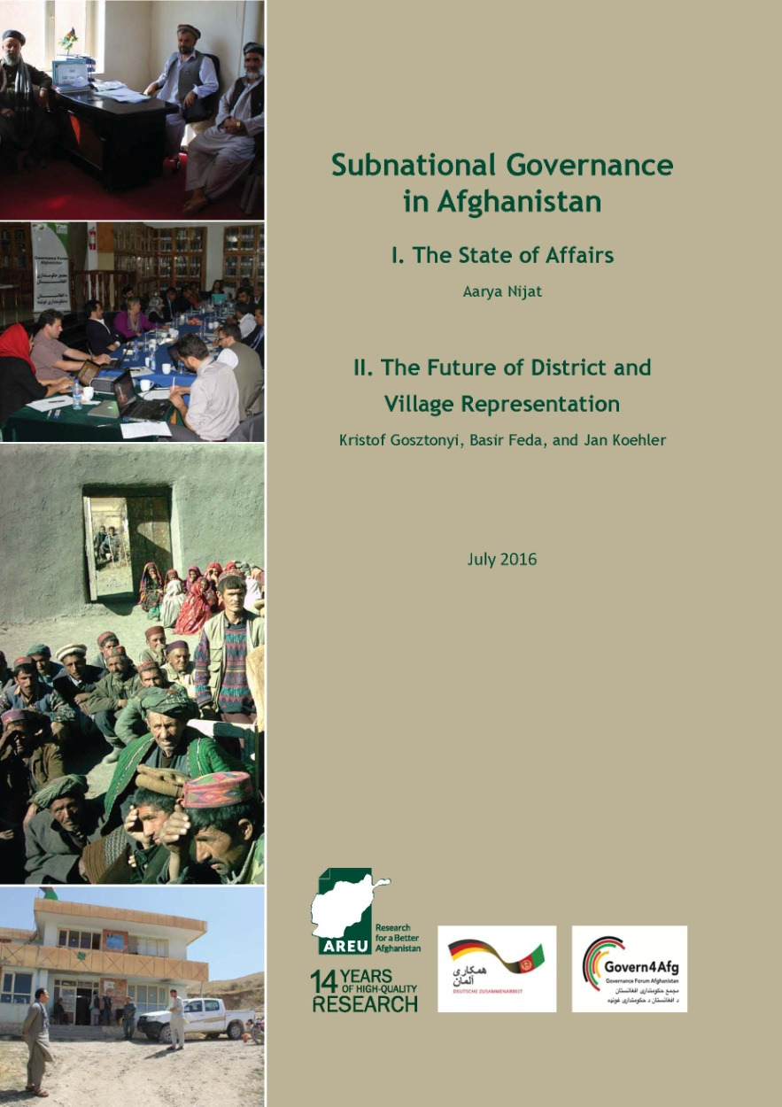
Community Engagement and State Legitimacy
Enable provision of quality service delivery
Community ownership
Link villages to formal government structures
Grievance redress
Mitigating risks
Notes:
15 years base to work from

Slide 10
INNOVATIONS
WHOLE OF GOVERNMENT APPROACH (7 Ministries)
BUILT AROUND ACHIEVING NATIONAL STANDARDS INSTEAD OF DISBURSING GRANTS
ALIGNED WITH PUBLIC FINANCIAL MANAGEMENT REFORM
INCENTIVIZING MINISTRY PERFORMANCE

Slide 11
Core Features of Citizens’ Charter
CDCs become the central body for all development interventions at the local level
Social Inclusion, with a strong focus on vulnerable groups, informal urban settlements, and the reintegration of returnees and IDPs
Standardization of minimum service provision, with adaptations to regional differences
Governors write annual performance contracts with line ministries that feed into national budgeting decisions
Community monitoring of line ministry performance and spending, reporting to PCs and Governors
Re-allocations based on performance (full alignment with PFM roadmap).

Slide 12
Minimum Service Standards
Rural Areas
Access to Clean Drinking Water Minimum of one water point per 25 households
Access to Rural Infrastructure - choice of: Road Access - within 2km walking distance from nearest accessible rural road Electricity - 100W per household Small-scale irrigation - includes any of: Intakes (for secondary/tertiary canals); water divider; water control gates; syphon; water reservoir up to 10,000 M3 capacity; rehabilitation or construction of small Irrigation canal; protection wall; Gabion wall; aqueducts; Super passage.
Quality education in government schools Teachers will have at least grade 12 education Students will have 24 hours of education in grade 1-3, 30 hours of education in grade 4-6 and 36 hours of education in grade 7-12 (per week)
Delivery of Basic Package of Health Services Health facilities will comply with required opening hours (8am to 4pm); required staffing requirements; and provide mandated services

Slide 13
What Will CDCs Receive?
All CDC’s to benefit from Capacity Development in planning, financial management, participation, monitoring, and dispute resolution
Rural CDCs to receive Investment Funds from line ministries for small infrastructure projects.
Urban CDCs to receive Block Grants to deliver small infrastructure and service projects.
Recurrent Grant to CDCs for operations and maintenance

Slide 14
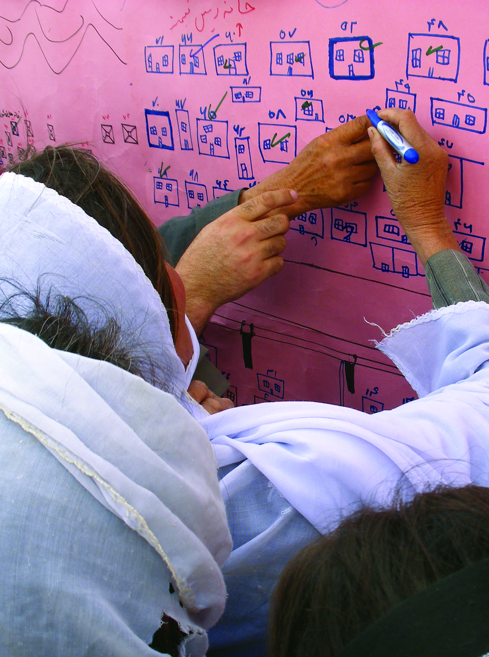
What Citizens Will Provide
Safety of government and CSO staff
Contributions in cash and kind
Cash books and financial reports
Inclusive CDC development plans
Annual audits and accountability statements to CDC members and governors
Maintenance

Slide 15
Oversight
Citizens’ Monitoring and Scorecard
Mobile applications for reporting and grievance redress
Satellite imagery to validate infrastructure gaps and service delivery outputs
Third Party Monitoring
Quarterly reports to the Office of the President and Ministry of Finance on the achievement of the service
Quantitative and qualitative studies and evaluations
Notes:
A core part of the CCEP will be to strengthen citizens’ monitoring and their ability to report problems. The project will develop simple citizens’ scorecards to be completed by CDCs and social monitors to report upon the minimum service standards.
Several studies are planned related to service delivery, CDC institution strengthening, Gender study, social inclusion, social accountability, and technical quality audits. The Project will also explore the possibility of an evaluation to examine the nexus between quality of service delivery and social cohesion, an under-researched area in the global conflict literature.

Slide 16
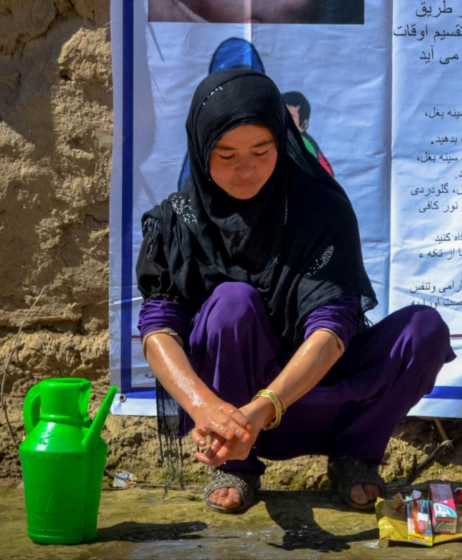
Expected Results
8.5 million people will be reached through the Citizens’ Charter first phase.
3.4 million people will gain access to clean drinking water.
Improvements to quality of service delivery
Increases in citizen satisfaction and trust in government
35% return on investment for infrastructure projects

Slide 17
Thank You

