Slide 1
Community-Driven Development GSG Annual Meeting ~ GSURR Forum
November 2016

Slide 2
Agenda & key questions to be answered
Status of the CDD Portfolio
CDD GSG Update
Regional team issues, concerns and feedback
Wrap-up/next steps
What have we done?
What are we planning to do?
How can we do it better?
What specific help do your regions or sectors need?
How can we work better as a GSG for you and our clients?

Slide 3
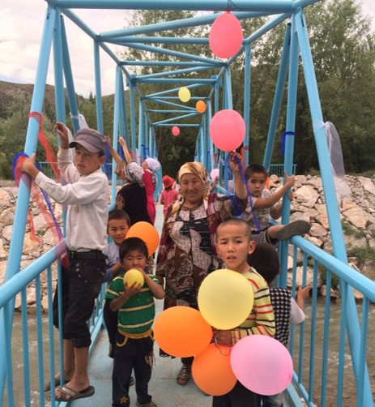
World Bank CDD Portfolio (as of July 2016)
177 active projects, of which 77% are in IDA or IDA/Blend countries
In 73 countries, of which 22% are FCV.
$2.4 billion new lending in FY’16
$17.3 billion in total active financing*
Averaging $2.8 billion/year for past 10 years; 7.1% of overall Bank lending
* Excluding Trust Funds, Government funding and other co-financing

Slide 4
CDD is used all over the world
Europe and Central Asia
11 projects
$531 million
6 countries
Middle East and North Africa
7 projects
$353 million
4 countries
East Asia and Pacific
21 projects
$3.2 billion
8 countries
Africa
73 projects
$5.1 billion
32 countries
South Asia
41 projects
$6.4 billion
7 countries
Latin America and the Caribbean
24 projects
$1.7 billion
15 countries
Current as of July 2016

Slide 5
CDD Portfolio Overview and Trends
Regionally, SAR & AFR have largest portfolios
By sector, AGR has largest portfolio, followed by SURR, Water & SPL
Portfolio reflects versatility of platform (livelihoods, basic services, FCV)

Slide 6
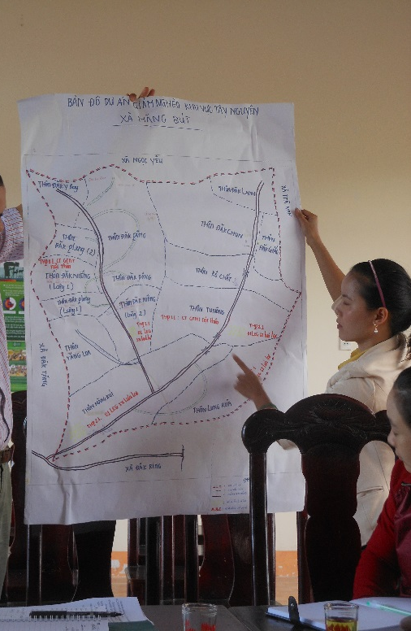
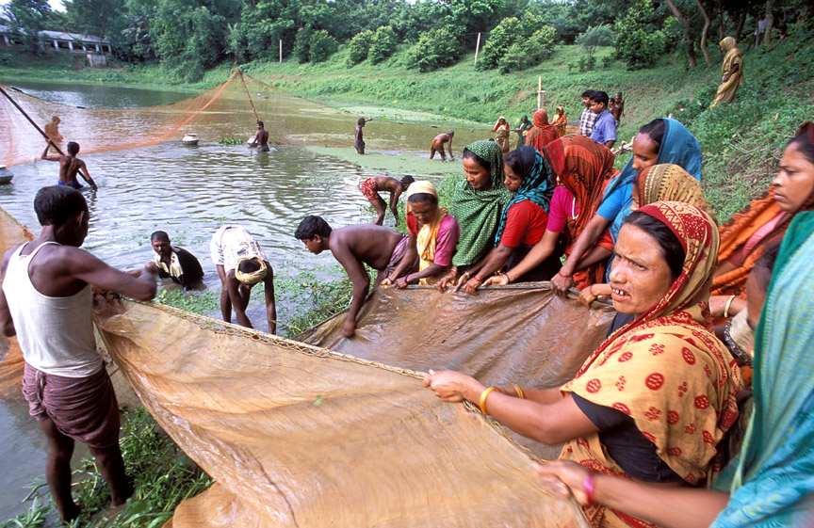
What is the CDD GSG?
GSURR hosts the CDD GSG and Community of Practice (CoP). The CDD GSG and CoP cut across 10 different GPs
The CDD GSG has approximately 300 members, and is one of WB’s largest, with more than half non-SURR
The CoP, also one of the Bank’s largest communities of practice, has approximately 880 members, with 35% external to the WB, including academics, international development partners, and non-governmental organizations

Slide 7
CDD GSG Strategy
The CDD GSG will build a high quality operations portfolio and analytical agenda aimed at greater impact on the ground.
At the end of 3 years, a successful CDD GSG will have:
A growing and transformational suite of operations which will help millions of poor, marginalized communities participate in their own development and access basic services
World class analytical pieces which will move the knowledge frontier forward
Recognized best pool & network of global talent on CDD

Slide 8
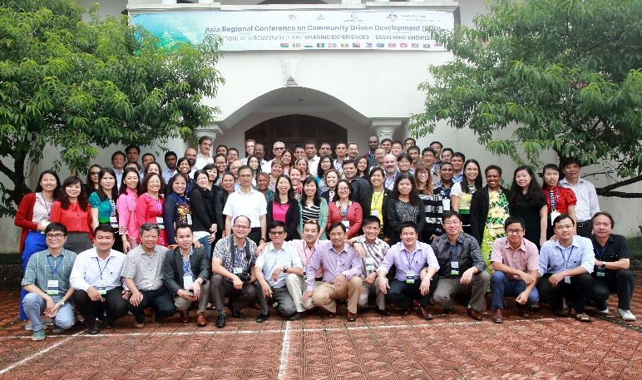
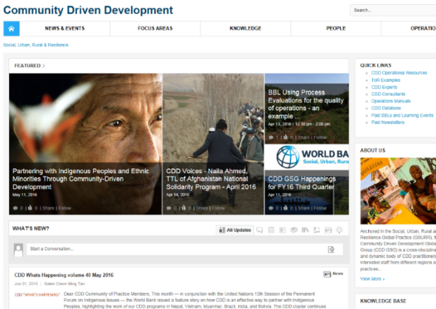
GSG Year-in-Review (2016)
GSG Strategy Note
International Conferences (Morocco, S. Korea, Vietnam)
On-going and new communications (newsletter, blogs, “voices” and “fresh from the field”)
User-friendly resources (help desk, d-base, library)
Websites (GSG and new C4D)
BBLs, etc. (DRM, s/guards, IPs, Syria, Myanmar, etc.)
Staff building and support (Core course, mentoring)
Direct ops. support (Afghan, Zambia, Panama, etc.)

Slide 9
GSG Survey Monkey Results
What topics would you like to see highlighted this year through workshops, learning events, etc.?*
75% voted for local economic development/jobs/livelihoods
46% voted for further training and knowledge work on CDD and FCV, and in Urban contexts
Much smaller numbers called for support on DRM and IPs
Other areas mentioned included WASH, nutrition/early childhood dev., spatial development/decentralization/working thru LGUs
Broadly consistent with survey of Asia teams and government counterparts (29)
* 43 GSG respondents

Slide 10
FY’17 Knowledge, Learning & Staff Support
Resource library, websites (“new” C4D!), helpdesk, newsletter, other communications
BBLs emphasizing key areas of demands (livelihoods, FCV/displacement, urban, DRM, IPs?)
Trainings and Knowledge Exchange (core course, int’l conference on CDD and FCV, Advances in M&E, 4th annual Asia regional conference, …tbd)
Joint efforts with partner GSGs/GPs (AG-l/hoods, SPL, ENV, Urban, etc.)
Mentoring (follow-up and new)

Slide 11
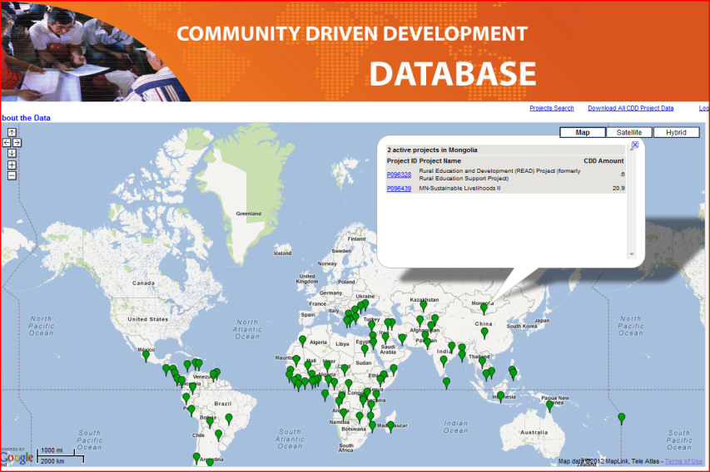
GSG Resources
Internal CDD GSG site (knowledge resources, consultant roster)
“cdd”
Contact us at
cddgsg@worldbank.org
CDD database Portfolio
“cdddb”

Slide 12
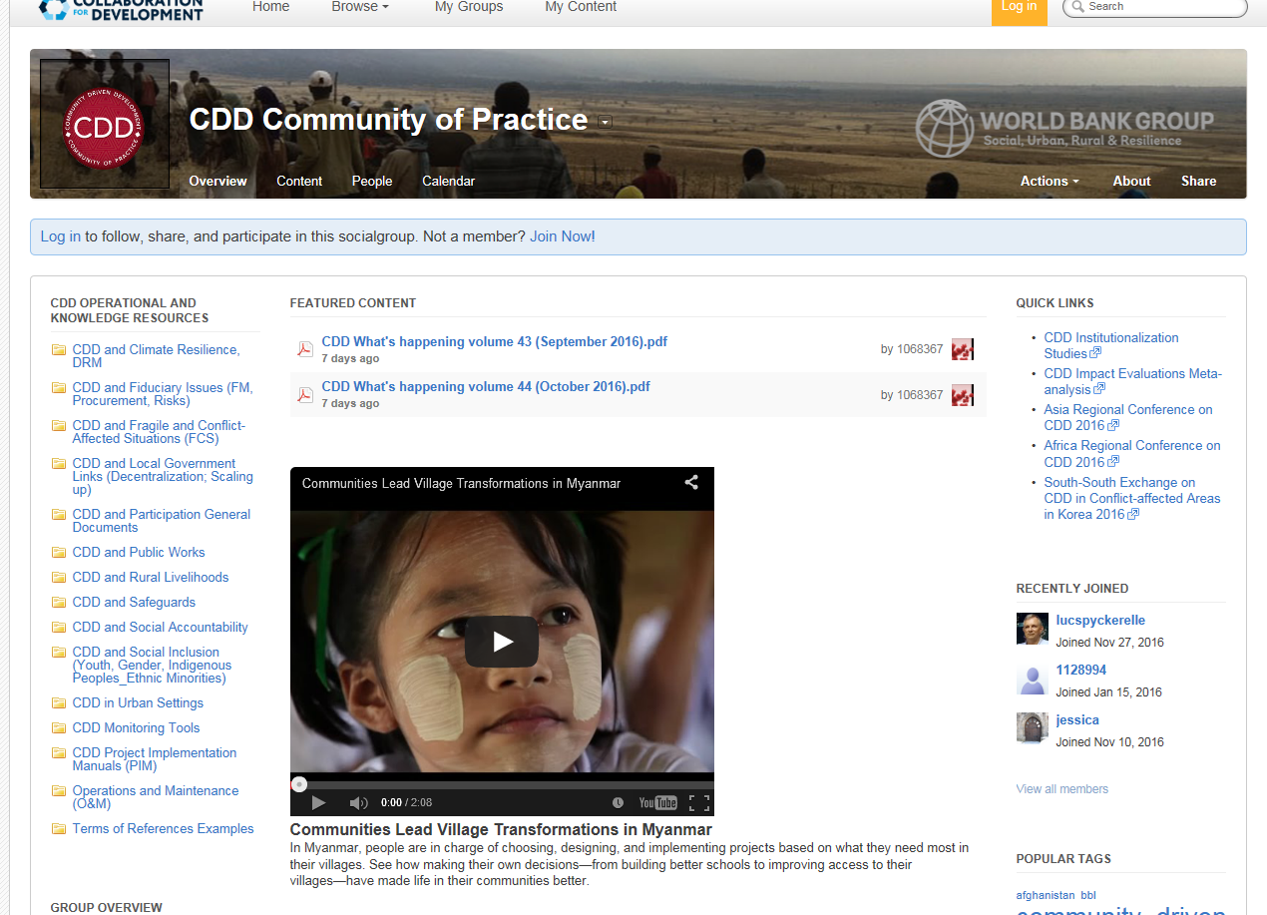
Collaboration 4 Development (C4D)
Externally accessible site aiming to enhance knowledge sharing with government teams and other development partners working on and interested in CDD – to be launched soon!

Slide 13
Thank you

