Slide 1
MkSIF
Government interventions
through community engagement to
ensure better living conditions for
IDPs in Azerbaijan

Slide 2
Scale of the problem
Refugees: During 1988-1992, about 250 thousand Azerbaijanis were forcibly expelled from their historic homelands in Armenia
in 1990, about 50 thousand Ahiska (Meskhetian) Turks who were displaced from Central Asia were also provided with refuge in Azerbaijan
IDPs: About 700 thousand Azerbaijanis who used to live in Nagorno Karabakh, as well as 7 adjacent regions (Agdam, Jabrail, Fuzuli, Kalbajar, Gubadli, Lachin, and Zangilan) were forcefully displaced from their permanent settlements

Slide 3
Where do they live?
Despite the fact that, nearly 30 percent of IDPs were provided with new houses and apartments in newly constructed settlements, remain of them still residence in inappropriate conditions.

Slide 4
How do they survive?
Households wealth :
Share of IPDs considered as a poor is almost the same than the rest of population.
However, households wealth strongly depends on areas of the settlement. IDPs living in rural areas, are likely to be assessed as a more vulnerable than those who settled in Baku and other towns.
Unemployment:
According to surveys and assessments unemployment rate is significantly higher than the resident population.
Dependence on assistance:
According to the 2008 LSMS, 73 percent of IDPs reported that government assistance is their main source of income.

Slide 5
How the GoA responds
to the problem?
Through implementation of state-financed initiatives
Through community engagements

Slide 6
Social protection initiatives
Improving living conditions: By 2016, the GoA financed the construction of 95 new settlements and buildings with appropriate social and economic infrastructure.
Social assistances: IDPs are being provided with “bread money” on a monthly basis.
Tax privileges: IDPs are freed to pay any tax from their benefits.
Payment for communal services: Within the predetermined limits, IDPs enjoy free of charge communal services.
University level education: Young IDPs enjoy free education tuition fee.

Slide 7
Key messages and questions
IPDs settled in public buildings, remote areas have high risk of non-access to social and economic infrastructure, and some available infrastructures are in poor condition by far
Almost all adult IDPs have any kind of skills obtained and used in their place of origin
Because of various circumstances, young IDPs have a limited access to vocational curriculums
IDPs engaged in small-size entrepreneurship have limited access to microcredit services
How to ensure a better access to improved social and economic infrastructure?
How those skills can be sharpened and used to make a life better?
How young IDPs can obtain new professions within the limited finance?
How communities can be involved and benefit from this process?
How communities can easily access to microcredit?

Slide 8
Internally Displaced Person Living Standards and Livelihoods
Project (2012-2016)
Jointly financed by the Government of Azerbaijan and the World Bank
3 main components of the project
A
Community micro projects
B
Renovation of public buildings
C
Livelihood programs

Slide 9
Community engagements
Communities may vary such as IDP communities and mixed communities composed of IDPs and local residents.
Community mobilization initiatives help communities to assess their resources and needs.
Institutional building is the key phase of community mobilization process.
Women’s equally participation is a must.
Community mobilization is an ongoing process and that will lead communities to further corporation with other potential donors.

Slide 10
Some basic facts about community engagement
More than 700 communities have been mobilized under the Project activities.
To ensue women’s active participation is a challenge. However nearly 65% of all members of communities' management groups are composed of women.
Baseline and impact data revealed the fact that, there is a high level of trust between IDPs and non-IDPs residences. However, that level certainly increases after joint community engagements.

Slide 11
Improving access to the social and economic
infrastructures through community engagement
Between 2012-2016 totally 410 community sub-projects were
completed (of which, 307 community micro-projects and renovation
of 103 collective centers).

Slide 12
How IDPs communities may
become less depended on
external assistance?

Slide 13
Internally Displaced Person Living Standards and Livelihoods Project has a component C which includes particular activities to tackle these issues:
Sub-component C1
Income Generation Programs (IGP)
Sub-component C3
Microfinance programs (MFP)
Sub-component C2
Youth Support Programs (YSP)

Slide 14
Income Generation Activities (IGP)
Most vulnerable IDP communities were determined
262 poor communities were identified as a target
Assessment on skills they have and particularity the area they settled was conducted
Mobilization of community was held
Business development trainings were organized
Community-based legal entities were registered
Grants for start-up were allocated
Intensive participation of women was ensured

Slide 15
IGP beneficiaries’ main areas of interest
Cattle
Sheep
Crop production
Retail shop
Beekeeping
Poultry
Café/restaurant
Beauty salon
Bakery
Shoe-making
Carpet making
Car wash

Slide 16
Youth Support Program (YSP)
1300 young IDPs were selected
Market survey upon selection of vocational occupations was implemented
Series vocational and business development trainings were organized
Necessary tools and equipments were provided

Slide 17
Achievements of
IGP and YSP

Slide 18
Microfinance Programs (MFP)
1862 microcredit loans were disbursed to poor IDPs via non-bank credit unions
Necessary activities were implemented for non-banking organization engaged in this program to build their capacity
Through trainings knowledge among women in entrepreneurship was improved

Slide 19
Achievements of MFP
Return rate is almost 100%
The most common business is cattle husbandry
Amount of household monthly income of beneficiaries increased from 435 AzN to 665 AzN
Almost 90% of beneficiaries are interested in taking new loan after paying back the current one

Slide 20
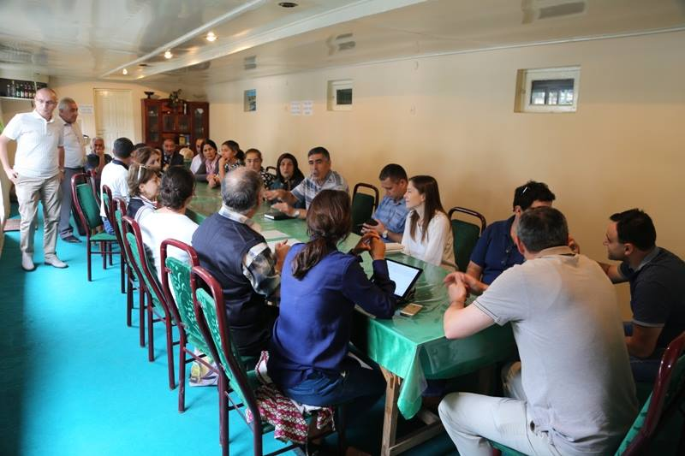
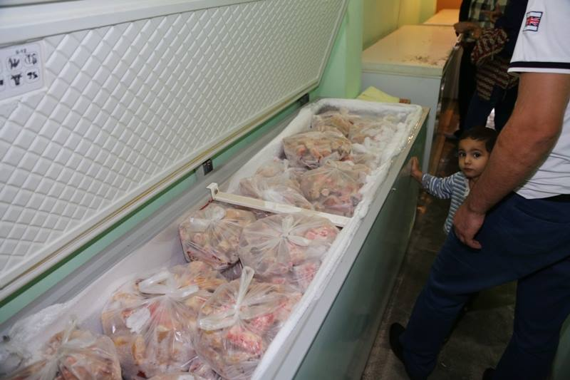
Some success stories (IGP)
Café / catering service
A community that is contained of members of 6 households has been running their catering service for almost 2 years now. SFDI allocated nearly 9000 AzN (about US$ 11 500) as a start-up fund and this amount was used for purchasing necessary equipments.
Community render a restaurant based service and as well as mobile catering service in the Weekend Bazaar that is usually organized in Barda city.
The amount of profit made by the community during the last 9 months, is about 4200 AzN (US$ 5400). 70 percent of profit was spent for expansion of current business and the rest is deposited in the community’ bank saving account.

Slide 21
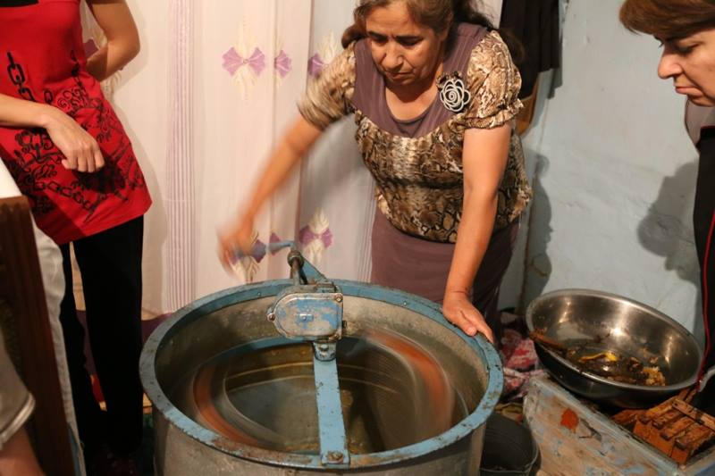
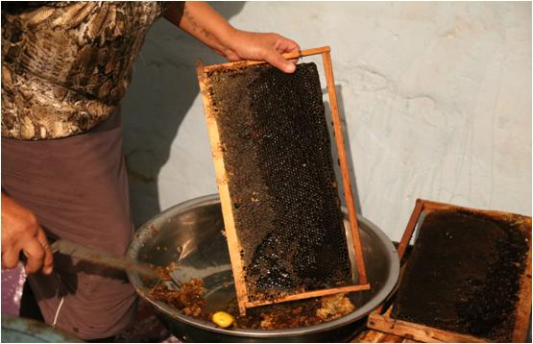
Some success stories (IGP)
Beekeeping
A group of IDPs originally from Kalbadjar region and currently settled in Yevlakh district defined as a target community within the IGP.
Families from this group has a relevant skills in beekeeping and used to be engaged in the same business before the forcibly movement.
During the 2015, the community’s net profit was 3200 (US$ 4000). Almost all profit was devoted to expansion of business, e.g. buying new bees, bee hive, etc.

Slide 22
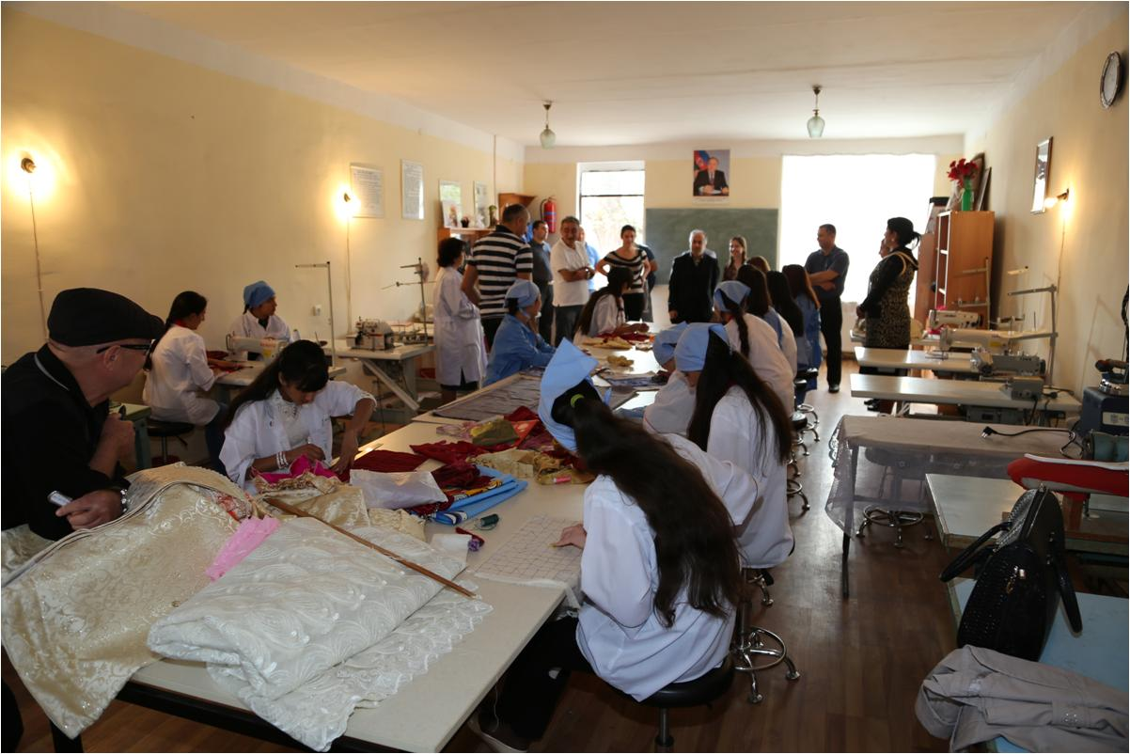
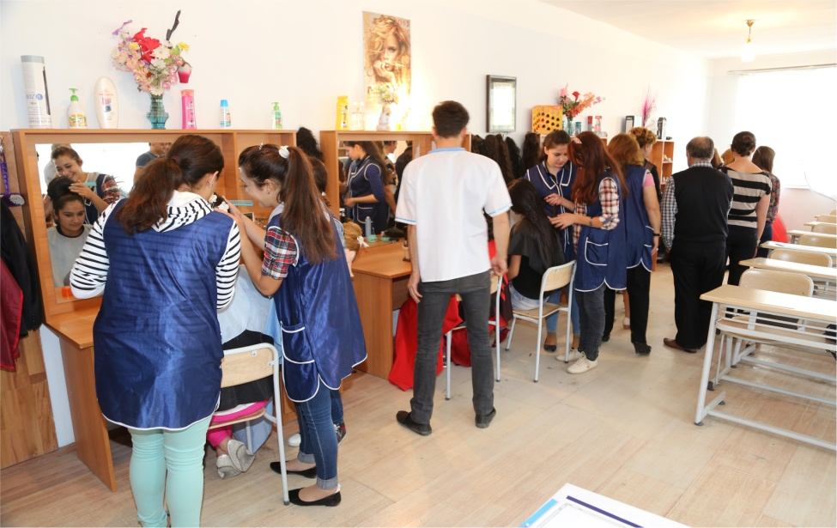
Some success stories (YSP)
Tailoring
Nearly 30 young IDP girls from Ganja city and surrounding regions who showed their interest in tailoring joined to series of trainings within the YSP. 6 months of intensive training session included lessons delivered by the professional tailors and 3 months computer course.
Hairdressing
Hairdressing is one of the most required and demanded professions among YSP beneficiaries. Women trained in this procession can easily provide services based in their home of residence.

Slide 23
Cost-benefit analysis
The Report on the issue whether the project intervention is worthwhile from community and society perspectives drafted by an independent consultant has reveled the fact that, due-to the nature of the Component – focusing on income generation activities, the highest net benefit and the highest rate of return are for Component C. As it can be seen from chart below, 77 percent of project net present value will be made by component C.

Slide 24
Who we are?
Social Development Fund for IDPs
Founded in December 6, 1999 and has been jointly financing by
the Government of Azerbaijan and the World Bank
The State Oil Fund of
the Republic of Azerbaijan
World Bank

