Slide 1
Building Legitimacy in Conflict-affected and Fragile States
Eileen Babbitt, PhD

Slide 2
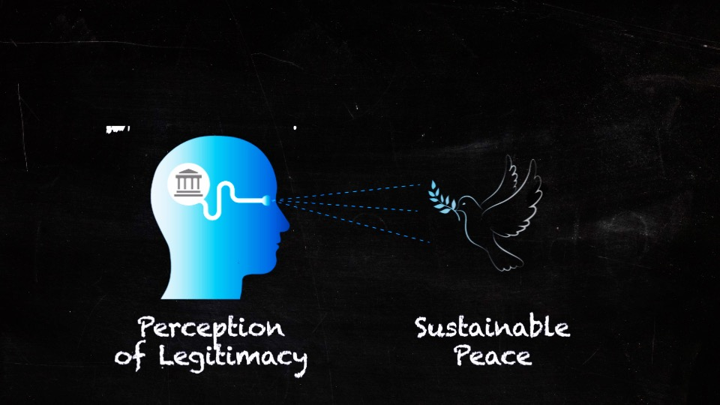
Why Legitimacy?
Perception leads to regime resilience and increased capacity
Connected to peace:
voluntary rather than
coerced or ‘bought’
support
Sources hard to define, hard to measure

Slide 3
Legitimacy Defined
Popular acceptance of a governing authority’s right to exercise that authority
Subjective, not objective
Internal, not external
Multiple levels of governance

Slide 4
Sources of Legitimacy
Input/process
Output/performance
Tradition, religion,
identity, ideology…

Slide 5
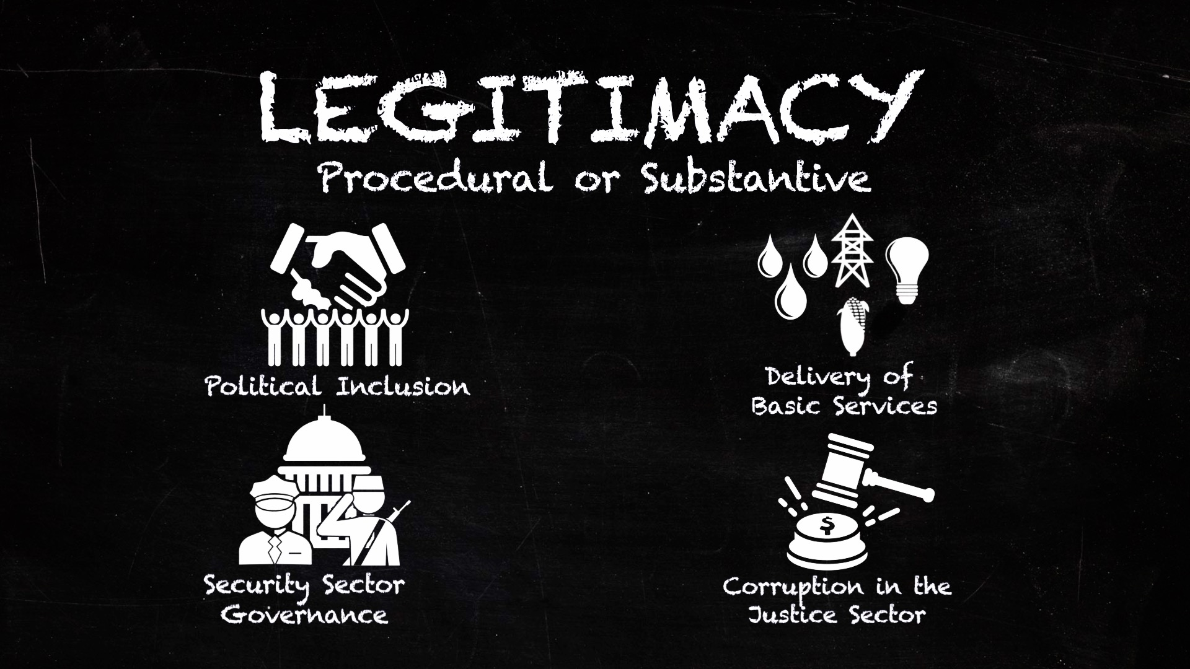
Four Working Groups

Slide 6
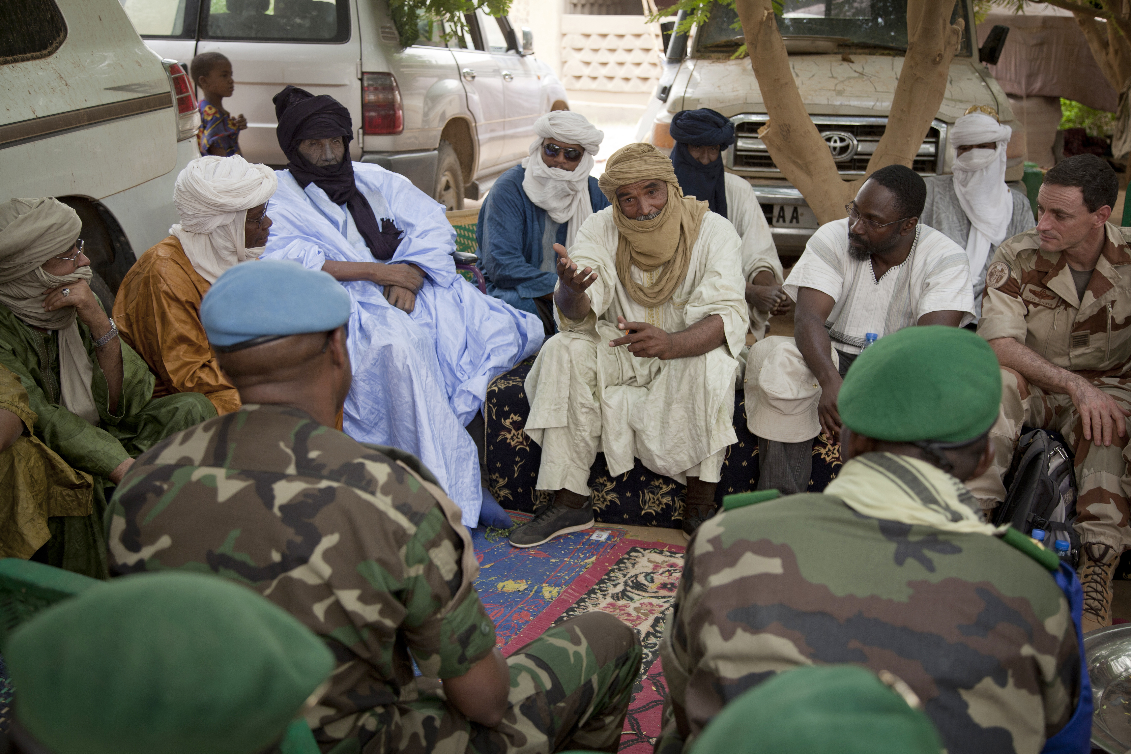
Political Inclusion: Input legitimacy
Quality inclusion: ability of included actors to make meaningful contributions,
be respected, taken seriously
Leads to outcomes per-
ceived as legitimate; more
durable
The “who” and “how”
need to be carefully constructed

Slide 7
More Information
http://fletcher.tufts.edu/Institute-for-Human-Security

