Slide 1
Generasi Long Term Impact Evaluation
November 2016

Slide 2
GENERASI SEHAT CERDAS
In 2007, Generasi was introduced to provide communities with block grants to target 12 health and education indicators. The location was randomly assigned in 5 provinces
After 30 months program implementation, the evaluation show following result :
Generasi improve health and education indicators
Significant effect in malnutrition
Disadvantaged areas benefited most
NTT had 21% reduction of malnutrition children
In 2010, the program was expanded to 6 new provinces and Incentivized grants were expanded to all Generasi sub-districts

Slide 3
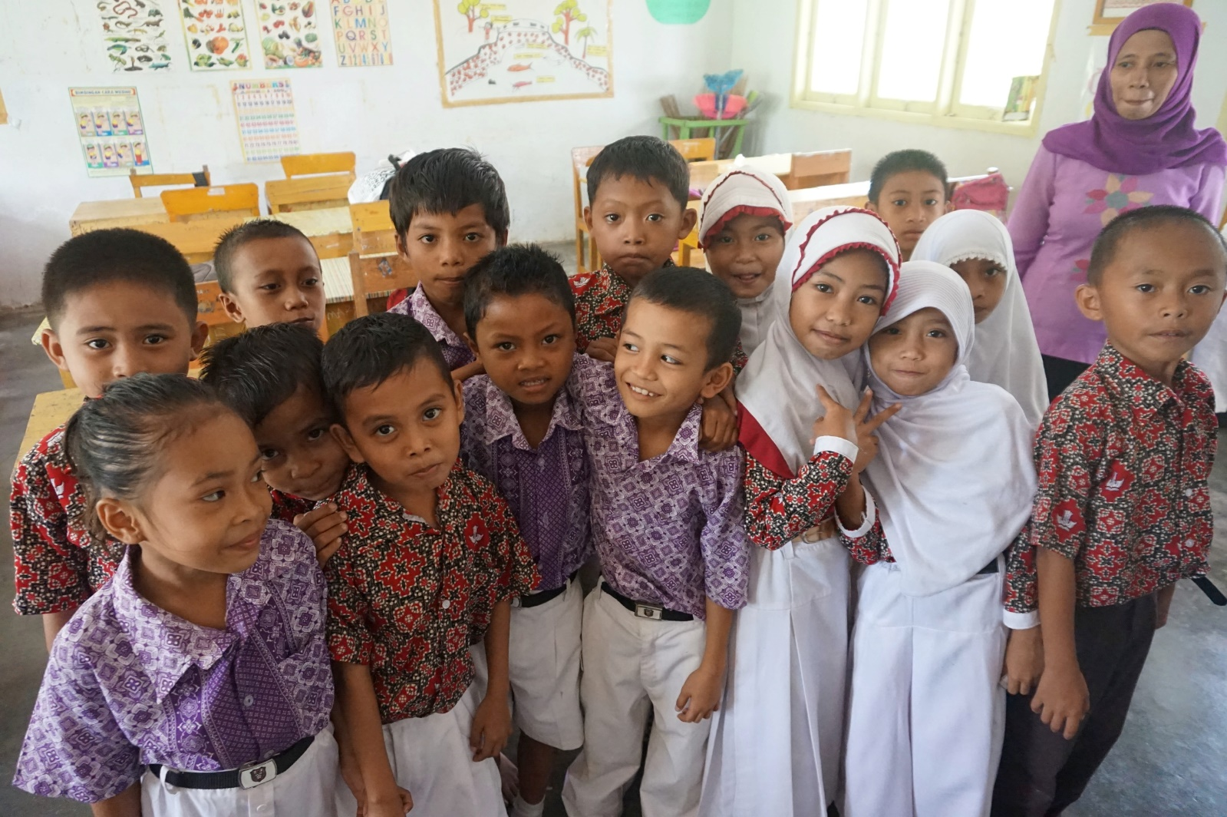
An opportunity to measure long-term impact
Generasi expansion to new areas instead of control sub-districts has meant that the original randomization is largely preserved: most of the original control areas are intact.
No crowding out effects: local governments have not diverted additional resources to control sub-districts because of their lack of Generasi funding.
Few studies measure long-run impact of community empowerment. The average CDD evaluation measures 3.1 years of program intervention.
A rare opportunity to measure the effect of intervention lasting 9 years.
Since 2015, much larger village funds are available. It is important to provide evidence to GoI of the importance of utilizing village funds for health and education

Slide 4
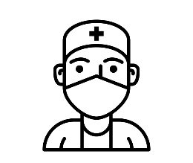
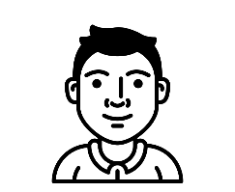
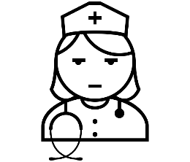
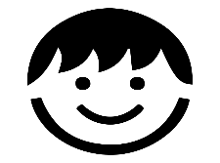
Objectives of Generasi Long Term IE
Estimating the impact of community block grants on:
Reduction of malnutrition on children 0-12 years old
Cognitive capacity and student learning assessment
The quality of maternal, child health and education services.
The management of health and education resources and the links between service providers, community and the government.
Estimating relationship among facilitation, community participation and service utilization
Community Participation | Facilitation | Service Utilization
Facilitator
Bidan
Puskesmas
Puskesmas
Bidan

Slide 5
Methodology and Survey design
The main data will come from a set of surveys of households, village officials, health service providers, and schools, with supplements from Generasi MIS. The survey will cover all 300 sub-districts from original Generasi randomization.
We will survey a panel of schools and health facilities
(puskesmas, posyandu cadres, midwives).
In 2016 round :
Anthropometrics measured by health workers
Ravens test (pattern recognition) to assess children's’ cognitive abilities.
Qualitative study with videography
Outcomes likely to be detected
Higher level of service utilization.
Reduction of acute malnutrition due to increased service utilization

Slide 6
Timeline
Time | Activity
October 2016 –Mid January 2017 | Data Collection
Januari – April 2017 | Data cleaning
End of January 2017 | Qualitative report + videography
May 2017 | Data analysis

Slide 7
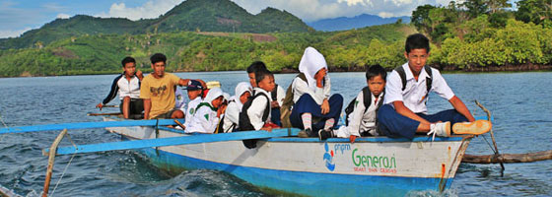
Terima Kasih

