Slide 1
Improving
Teacher Performance
and Accountability in
Remote Areas
(KIAT Guru)
Technical Assistance for the Ministry of Education and Culture (MoEC) and the National Team for the Acceleration of Poverty Reduction (TNP2K), Office of the Vice President of the Republic of Indonesia
November 30th, 2016

Slide 2
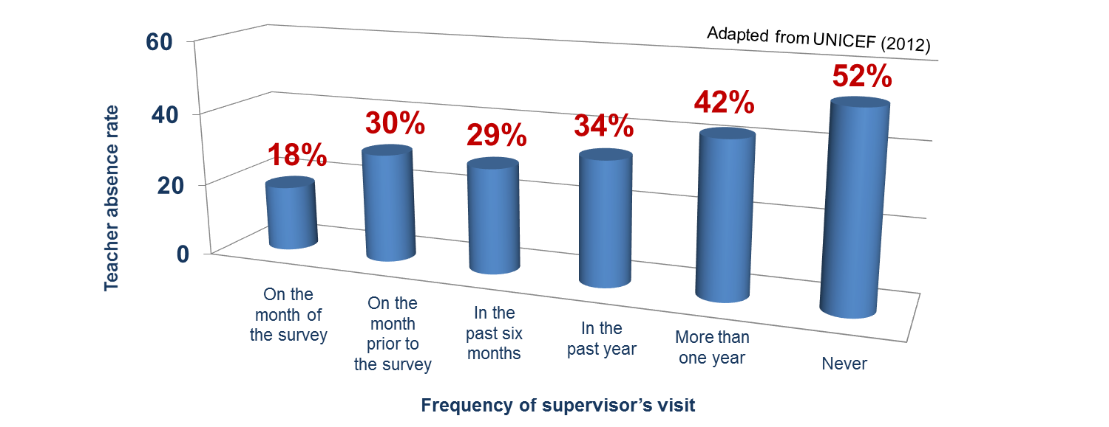
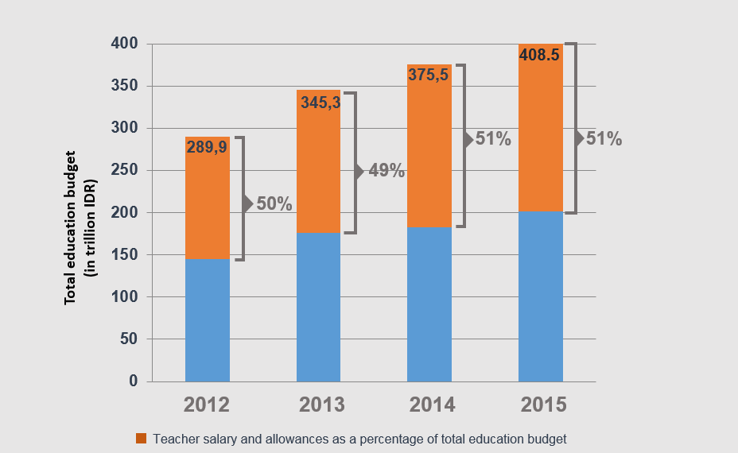
Background
Teacher absenteeism rate correlates with frequency of monitoring
Fifty percent of education budget is allocated for teachers’ salary and allowances
Teacher absenteeism of elementary school teachers in remote area is double the national rate (ACDP, 2014)
District governments are constrained in resources and capacity to monitor teachers in remote schools, which correlate with high teacher absenteeism rate (UNICEF, 2012)
Total government budget for teacher salary and allowances in 2016 reached USD 16 billion, around 10% of total national budget

Slide 3
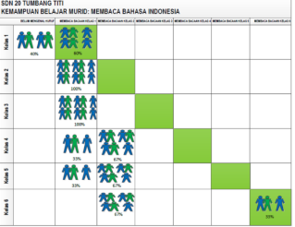
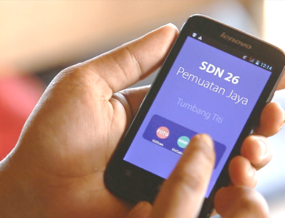
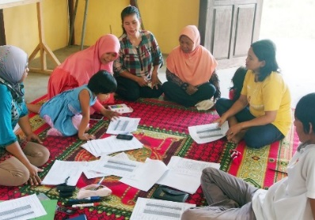
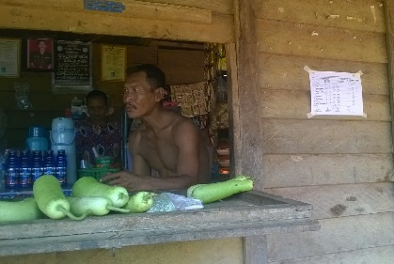
Theory of Change
Teacher absence and poor performance
Problem
Lack of support & monitoring from district government
Lack of performance-based reward/ sanction
Community Empowerment:
Service agreement
Community Score Card
Pay for Performance based on:
Presence
Quality of service
Intervention
Reported at village and district
Improved teacher presence
Improved teacher service performance
Impact
Improved student learning outcomes

Slide 4
Impact Evaluation Design
Group 1
Community empowerment
Group 2
Community empowerment
+ Pay for performance based on presence
Group 3
Community empowerment
+ Pay for performance based on service quality
Group 4
Control group
Measuring impacts:
Group 1 vs. 4: Contribution of community empowerment
Group 1 vs. Group 2 & Group 3: Contribution of pay for performance
Group 2 vs. Group 3: Which formula is more effective ?

Slide 5
Monitoring, Learning, and Evaluation
Activities & Timeline
Impact evaluation in 270 villages
Implementation in 200 villages

Slide 6
Behavior Experiment
Three rounds of Public Good Games and Public Good Games with Punishment, with parents and teachers as participants, first anonymously, then with revealed identity
Trends in:
  Willingness to contribute
  Willingness to stick to an agreement
  Willingness to sanction non-conforming team members
Source: Fehr & Gaechter (2000)

Slide 7
Political Economy Analysis
Policy issuance and implementation at the district level relating to distribution of resources (teachers, incentives) and specific to the interventions
Stakeholder relations, decision making process, and power dynamics at the village level

Slide 8
Pre-Pilot “Findings” from 10 schools
Group 1
Group 2
Group 3
Data from 10 schools (TNP2K, 2016)
% teacher presence based on KIAT Kamera
community
scorecard
community
score on teacher presence
% of teacher allowance paid
IE in 270 schools aim to answer which will be more effective: Community Empowerment with or without Pay for Performance?

Slide 9
Acknowledgement:
The project was initiated by TNP2K (the National Team for the Acceleration of Poverty Reduction, Office of the Vice President of the Republic of Indonesia) and MoEC (Ministry of Education and Culture, Republic of Indonesia), with funding from DFAT (Department of Foreign Affairs and Trade, Government of Australia)
Design team:
Chris Bjork, Professor of Educational Studies, Vassar College
Arya Gaduh, Assistant Professor, Department of Economics, University of Arkansas
Menno Pradhan, Professor in Project and Program Evaluation for International Development VU University and University of Amsterdam
Jan Priebe, Researcher, University of Göttingen

