Slide 1
National Rural Livelihoods Project (NRLP)
Notes:
NOTE:
To change the image on this slide, select the picture and delete it. Then click the Pictures icon in the placeholder to insert your own image.

Slide 2
NRLP: Project Background
Project Duration: June 2011 – June 2018
Project Outlay: USD 500 million – About 75% (USD 350 million) spent on capitalization of community institutions and promotion of next generation economic activities
Implementing Agency: Ministry of Rural Development, Government of India
Objective of the Project: To establish efficient and effective institutional platforms of the rural poor that enables them to increase household income through sustainable livelihood enhancements and improved access to financial and selected public services.
Geographical Spread: Implemented in 575 blocks spread across 162 districts in 13 high poverty States
Outreach: More than 8.8 million rural poor women mobilized into 750,000 Self Help Groups
Key learnings from NRLP replicated in all 29 States and 5 Union Territories of the country under National Rural Livelihoods Mission (NRLM) – Government of India has invested about USD 3.8 billion since 2011-12 under the Mission

Slide 3
Problems the project is trying to solve
Lack of Effective Institutional Platforms for the Poor
Access to Institutional Finance
Neglect of Small Holder Agriculture
Low Participation of Poor in Organized Sector Jobs
Limited Access to Safety-Nets and Entitlements
Absence of Last Mile Service Delivery and the Supply Side Failure

Slide 4
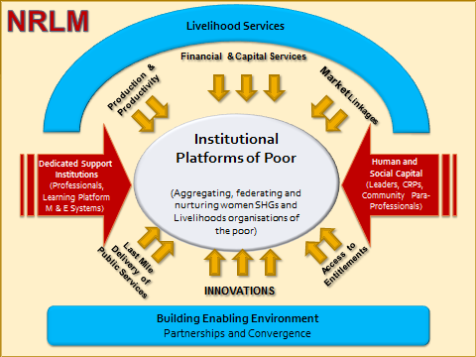
Promoting Local Economic Development

Slide 5
Pillar 1 : Promotion of Sustainable Institutions of the poor
A three-tier community architecture set up across all State Missions
These institutions participate effectively in local governance and development (Panchayati Raj Institutions)
CBOs mediate livelihood concerns and social issues affecting the poor on a 24X7 basis
They also facilitate access of the poor to entitlements and public services
2928 Cluster Level Federations
CLFs (30-40 VOs each)
50000 Village Organizations
(10-15 SHGs each)
750,000 Self Help Groups
(10–20 members each)

Slide 6
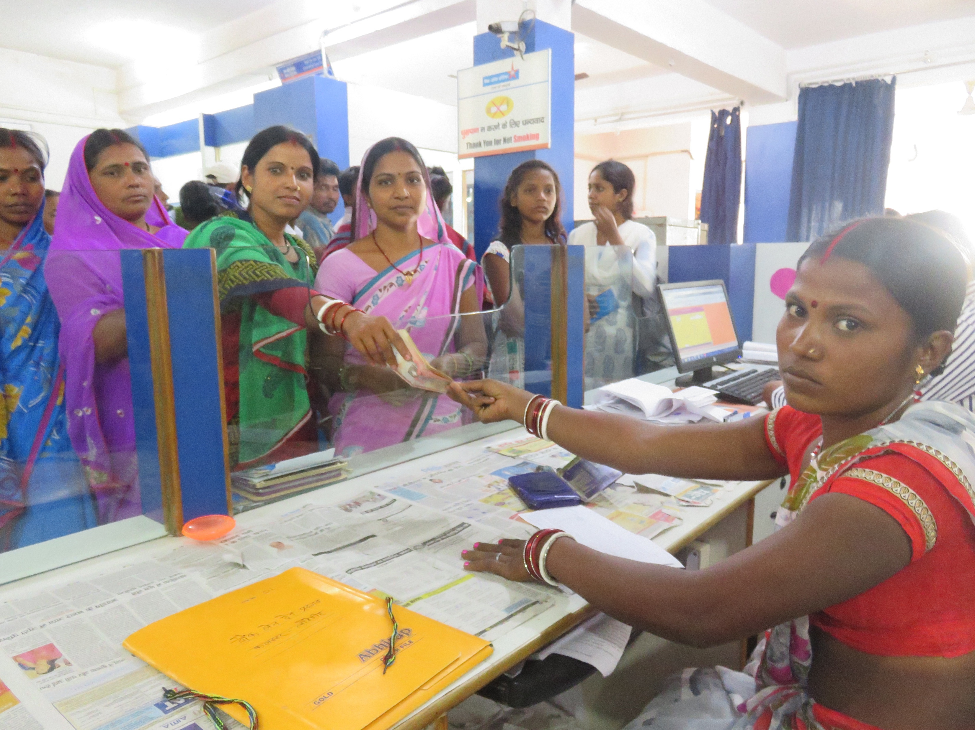
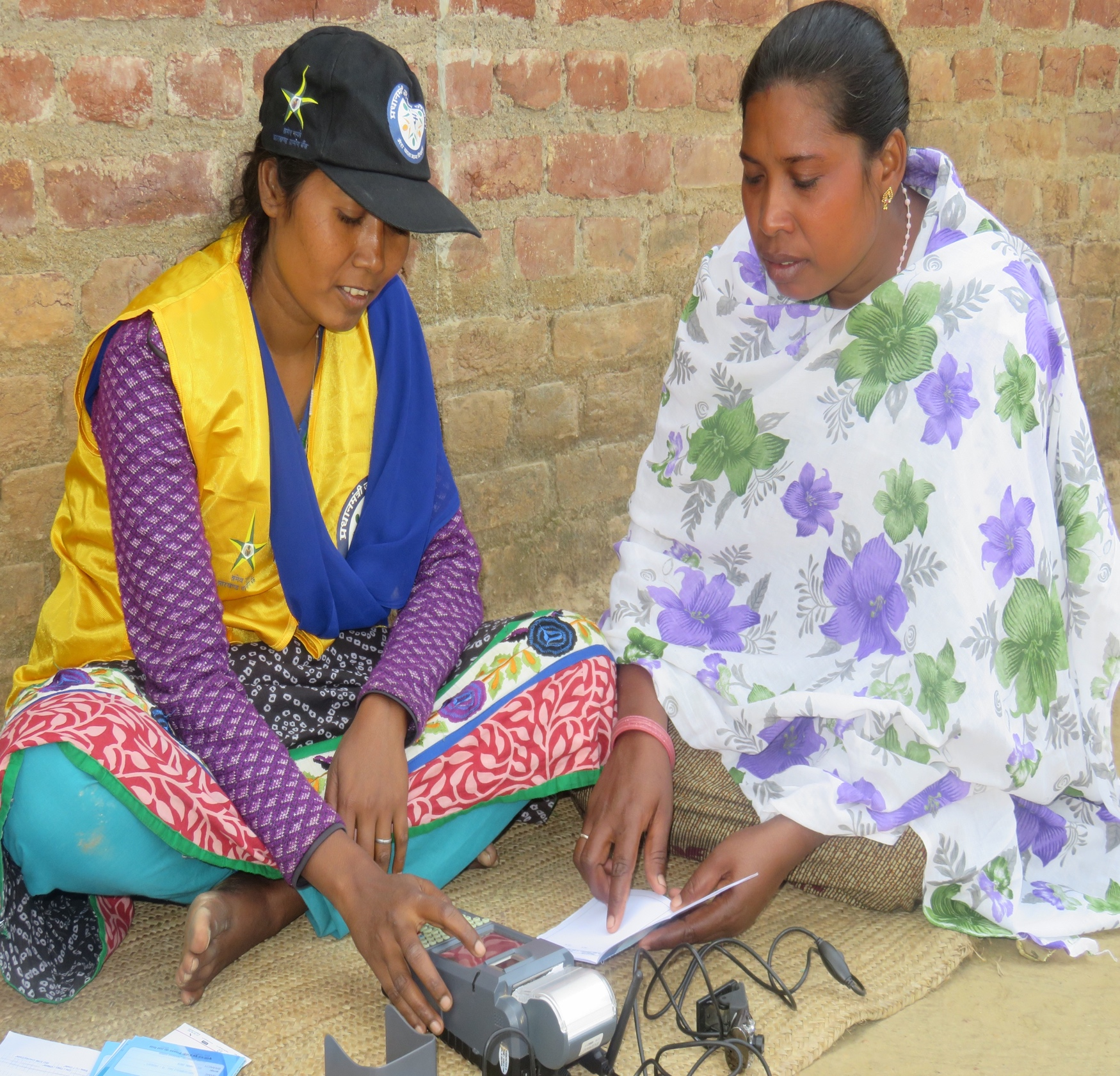
Pillar 2: Financial Inclusion
Significant efforts made to alleviate supply and demand side constraints affecting on-lending by banks – Both the size and quality of the loan portfolio have shown a marked improvement
SHG members have been trained as Banking Correspondents to provide last mile delivery of financial services – Transactions amounting to nearly USD 28 million completed in FY 18-19 alone

Slide 7
Pillar 3: Promotion of Sustainable Livelihoods
Enable every poor household:
to cope with vulnerabilities – debt bondage, food insecurity, health shocks and migration
to have two or more sustainable farm/non-farm income
Focus on strengthening existing sources as well as promotion of new sources of income
Promotion of opportunities in emerging markets – micro-enterprises, self-employment, skill based employment etc.
Training for Self Employment
Training for Wage Employment
Farm
Non Farm
Skill Based
Start up Village Entrepreneurship Program
Aajeevika Gram Express Yojana
Access to sustainable productivity enhancement services in Agriculture and Livestock
Value chain development for access to markets

Slide 8
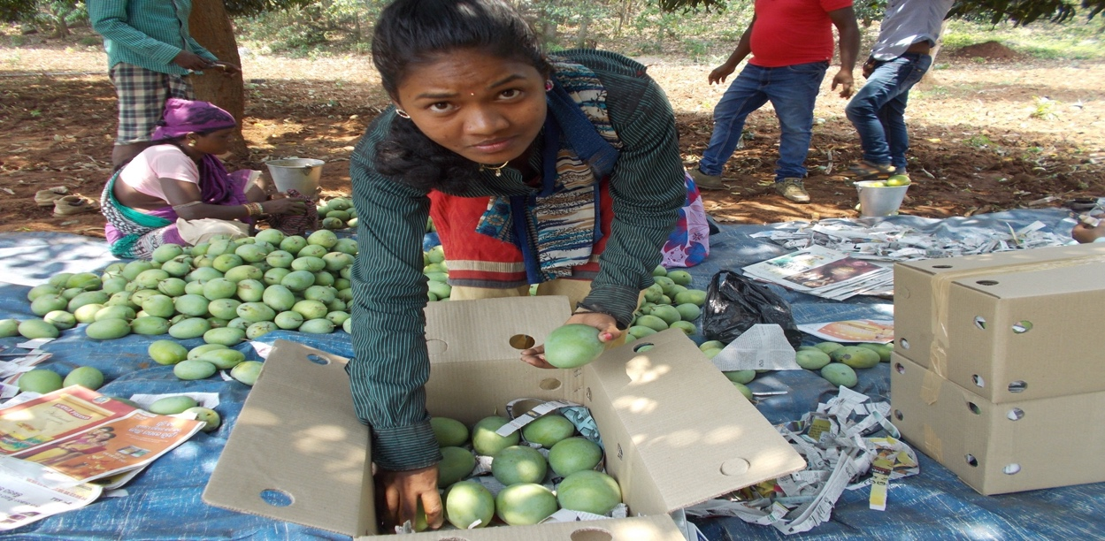
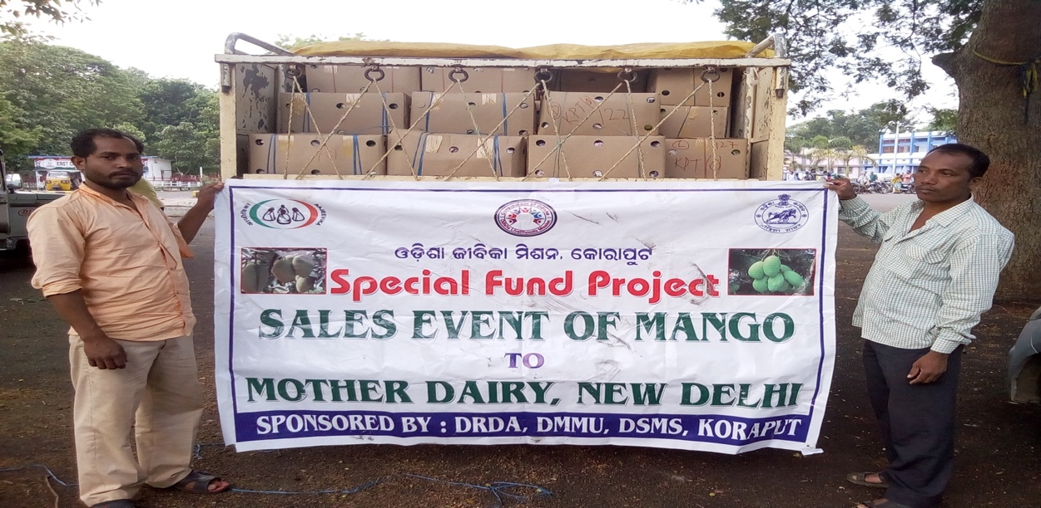
Pillar 3: Promotion of Sustainable Livelihoods
Instituted value chain approach across specific commodities in multiple States viz. Maize, Mango , Floriculture, Dairy, Goat etc. – Over 1.1 lakh women have been covered under this intervention
Floriculture Cluster : 3,500 women farmers annual turnover of US $ 1 million - Maharashtra
Maize Cluster : 10,000 farmers with an annual turnover of nearly US $ 2 million - Listed on the National commodity exchange
Mango Cluster : 6,300 women mango producers into a Producers’ Company with annual turnover of US $260,000.

Slide 9
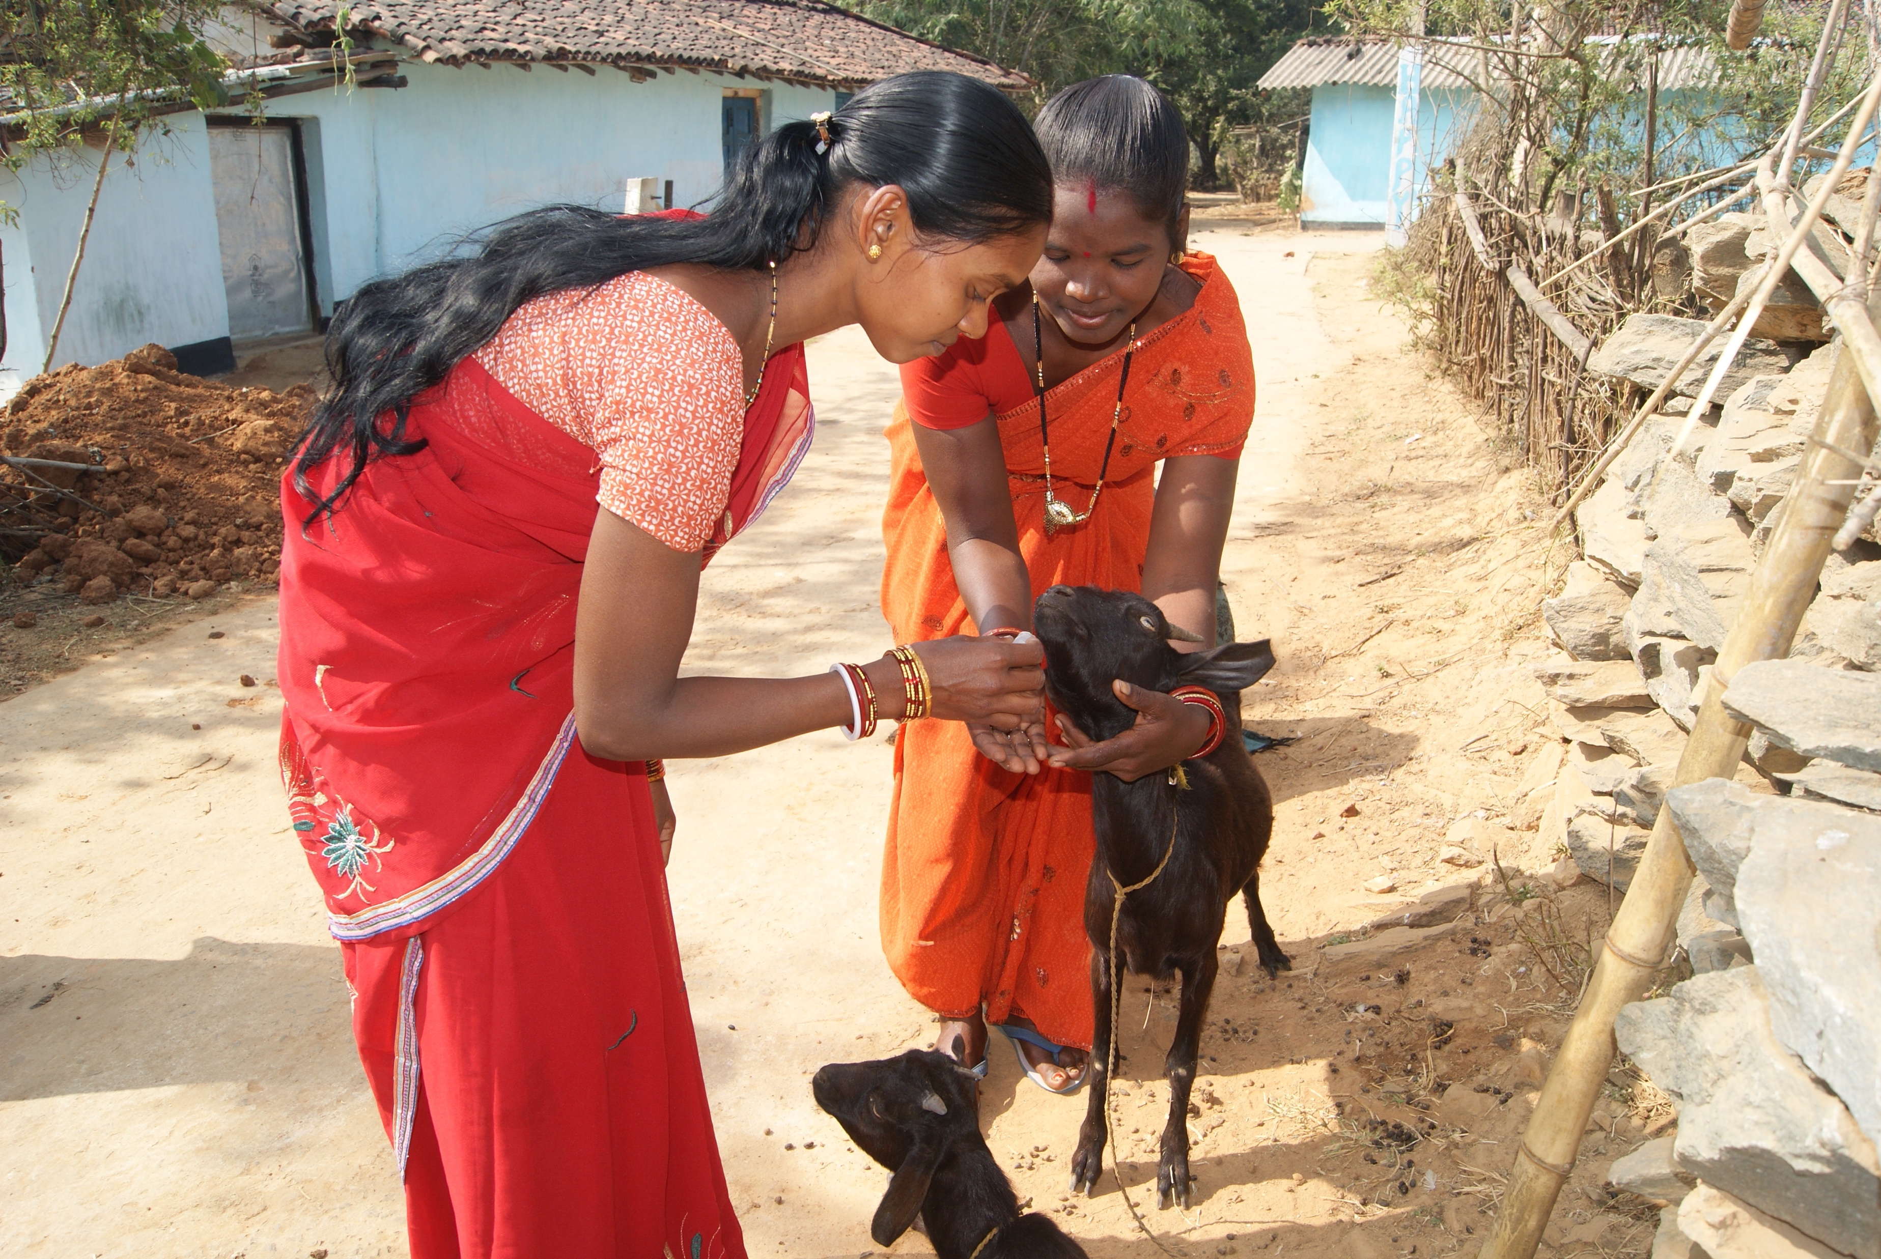
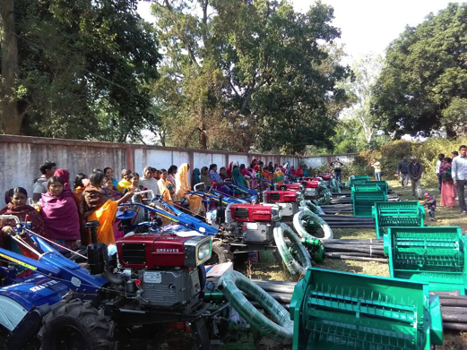
Pillar 3: Promotion of Sustainable Livelihoods
Creation of community-led livelihood extension services – More than 22000 Community Resource Persons trained and deployed to scale up the livelihoods interventions
Established Custom Hiring Centers / Community Managed Tool Banks in multiple States - Small and marginal famers provided access to farm equipment and services such as soil testing, cold chain management at a nominal rate

Slide 10
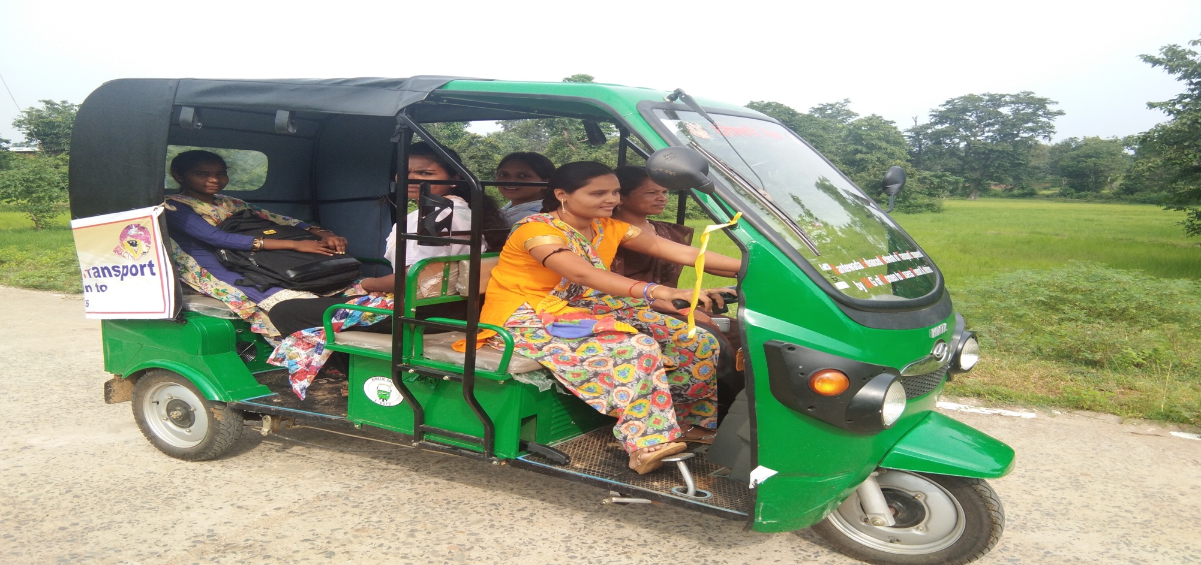
Pillar 3: Promotion of Sustainable Livelihoods– Non-Farm Livelihoods
Start Up Village Entrepreneurship Programme
Launched in 2014 to promote rural start-ups in farm/off-farm sectors
Over 16,000 enterprises supported under SVEP
Aajeevika Grameen Express Yojana (AGEY)
Launched in April 2017 to provide safe, affordable and community monitored rural transport services to connect remote rural villages

Slide 11
Pillar 4 : Social Development & Convergence
The platform of Social Capital mobilized has been used to promote the well being and improve their quality of life, in convergence with relevant Government programmes
Over 42,000 differently-abled people have been successfully rehabilitated through access to appropriate health care, entitlements and sustainable livelihoods in Tamil Nadu
Pilot interventions in Maharashtra has shown increase in diet diversity of women and children. The model is now being scaled up to cover the entire State.
Social capital has also been used to address issues of exclusion e.g. rehabilitation women being branded as witches in the State of Jharkhand and inclusion of over 60000 women belonging to the most vulnerable community in the State of Bihar

Slide 12
Independent assessment of NRLM
Independent assessment of NRLM by brought out the following results :
Significant growth in livestock assets in treatment households
Total (net) household incomes in treatment areas were approximately 22% higher than those in control areas
Treatment households are significantly likelier to opt for savings in formal institutions
Households in treatment areas, on an average, have a higher loan size (nearly 67% more than the loan sizes for control households) and are more likely to borrow from formal sources of credit
An impact evaluation study of NRLP, led by 3ie and Stanford University will be commissioned shortly

Slide 13
Challenges
Lack of quality Human Resources at the State, District and Block levels continues to be a constraint in scaling up of economic activities such as creation of FPOs, promotion of organic cultivation etc.
Inadequate number of Technical Support Agencies which have sectoral experience in implementing the higher order initiatives at scale
Availability of financial models suitable to the requirements of the enterprises is limited.
Instituting systems for monitoring and evaluation in the poorest of areas presents a significant challenge

Slide 14
Lessons Learned
Create market driven models
Placement of quality manpower critical
Focus on building commodity-wise market understanding and linkages
Ensure integration of risk mitigation strategies
One size doesn’t fit all – develop customized strategy for each State/Region
Role of community workers vital for success of any CDD project

Slide 15
Thank You!!

