Slide 1
The Lao PDR,
Poverty Reduction Fund
Livelihood Linked Nutrition (LN)
Fourth Conference on Community Driven Development
Colombo, Sri Lanka
Somsack Chandara,
30th Mach 2018
Supported By:
MAF Logo

Slide 2
Project Background
Current Phase (PRF III: 2017-2019) with 0.9 US$ out of 30.6 Million US$ ( Basic Infrastructure and Community Development Planning)
The Total Budget for Livelihood Linked Nutrition Component is accounted 5 Million US$ (2,4 US$ for Phase One 2012-2015 and 1,7 US$ for AF 2015-2016 and for Phase III (2017-2019 with 0.9 US$).
Executive Agency : Poverty Reduction Fund, Ministry of Agriculture and Forestry
Provide assistances to beneficiaries to start or further develop nutrition sensitive livelihood activities production of small livestock and home gardens, and increase their capacity to manage their livelihood activities and to improve dietary diversity and food intake of target groups

Slide 3
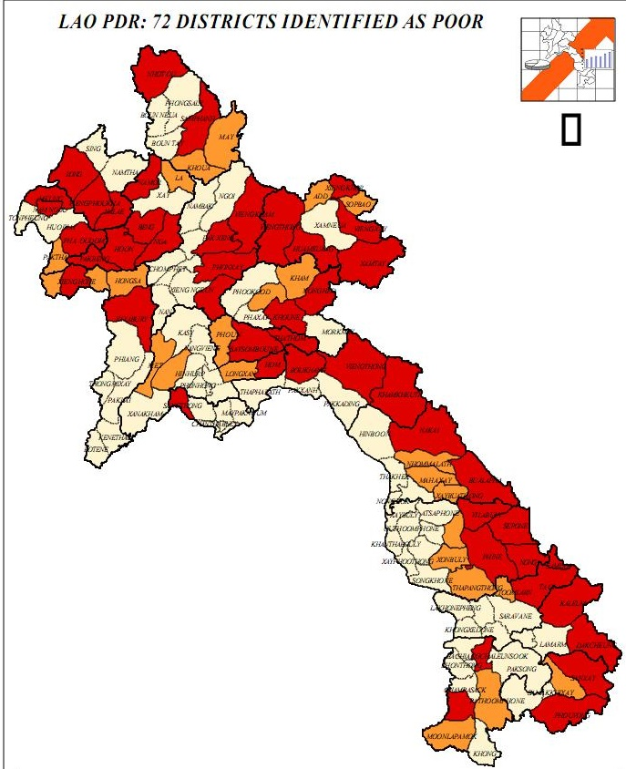
Project Target Areas
Houaphanh Province, 4 districts (out of 8) , 92 villages out of 192 villages
Hiem District
Son District
Huameuang District, and
Xiengkhor District
Savannakhet Province 4 districts out of 15 district. 73 covered villages out of 149 villages.
1. Sepone District
2. Nong Districts, and
3. Thaphanthong District

Slide 4
Activities and Achievements
Livelihood Activities :
Formation of SHG including:
SHG Committee,
Village SHG Management Committee (VSMC)
Providing Seed Grant via Village Savings & Credit Fund
Capacity Building in bookkeeping and accounting, and
Occupational trainings in Livestock, Agriculture and Weaving
Livelihood Achievements:
915 SHG were formulated with 10,220 among these 914 SHG with 9,825 members still functioned (8,580 female members).
2,742 SHG Committees and 1,320 VSMC received training in Bookkeeping and Accounting
Seed Grant of $1,039,261.34 provided to 165 target
More than 10,000 members received occupational trainings in Livestock, Agriculture and Weaving before receiving loans

Slide 5
Outcomes on L&N sub-components as of Feb 2018
Intermediate Results Indicators
Number of individuals with livelihood investments using loans from SHGs (Number) annual coverage 8,000 members vs baseline 4,500 members
# of individuals with livelihood investments using loans from SHGs
% of SHGs with NPLs 4% and below
Results vs Indicators
Established 915 SHGs with close to 10,220 as members (85% women) in 165 villages,
Villages and out of 98% of Seed grants were loan to 9,962 members (85% female members).
More than 9,000 members invested IGA by taking loans in 2017
Repayment rate from 7 districts reached up 68% in 2017
Outstanding loan 32%
Household Income increased by 45% mainly from poultry and weaving activities

Slide 6
Nutrition
Activities:
Established Village Nutrition Centers (VNCs) in 23 villages
Provide financial supports & trainings on nutrition to VNC committees and members
Provide supplementary meals (all meals are cooked by members)
Promoting home gardening in VNCs
Working in partnership with District Health provide monthly training to MCH in VNC

Slide 7
Progress and Results Vs. Expected Outcomes
Special meals: Improved nutrient intake in mothers and children during the 1,000 day window and in poorest of the poor (POP) households.
Home garden: Increased consumption of micronutrient foods, medical herbs and spices:
More than 70% of VNC members established and maintained home garden and raising f poultry in small scale for household consumption and surplus for selling.
Livelihood linked nutrition education: Villagers understand their nutritional problems in practical terms and will act on their livelihood practices to solve them.
“Learning how to cook” was the sweet spot for changing food consumption practices.

Slide 8
Constrains and Challenges
SHG, Saving & Credit scheme module is under piloting concept
Unclear policy, diversified implementing approaches , causes of confusion at lower levels e.g executive body/staff and getting lost (Saving & Credit schemes, regulation, by-law, too many bookkeeping )
Ambitious coverage 165 villages, more than 900 SHG and 10,000 members with limitation of staff
Too remote and scattered villages
Low Participation from poorest families and exclusive
Language Barrier and illiteracy, numeracy especially ethnic females
Low ownership in contribution and taking in ownership
Delaying in repayment with potential NPL
Complexity of Bookkeeping systems vs illiteracy, numeracy
Infrastructure to and from villages ( inaccessible in raining season)
In-appropriated and inadequate equipment

Slide 9
Solutions
Mainstreaming PRF’s 6 Principles (Simplicity, Community Participation and Sustainability, Transparency and Accountability, Wise Investment, Social Inclusion and Gender Equality, Siding with the poorest
Simplify all approaches, tools, regulations which are based on Lao Context for encouragement of Participation of the Poor.
More Capacity Building for staff and Beneficiaries ( leaders, Champion families)
Social Inclusive for maximum community participations
Improvement MIS and Data Collection and Entry
Application of good modality of village saving & credit scheme like village bank,
improvement of existed SHG saving schemes to become village fund and upgrading to Village Bank
Collaborate with potential Microfinance Agencies in Laos

