Slide 1
Ministry of Agriculture, Livestock and Irrigation Department of Rural Development Myanmar National Community Driven Development Grievance Handling Mechanism 5-June-2017

Slide 2
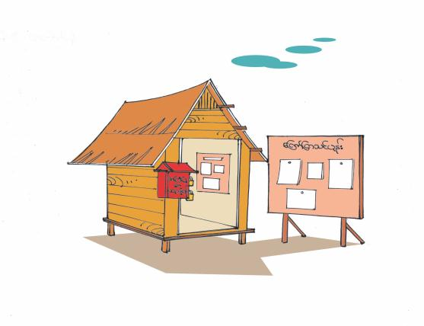
Grievance Handling Mechanism
In NCDDP
Naypyitaw

Slide 3
Grievance and Accountability
Transparency and accountability are core components of the NCDDP. To this end, the project has established a grievance handling mechanism (GHM).
The goal of the GHM is to:
strengthen accountability to beneficiaries and provide channels for input by project stakeholders at all levels.
provide a mechanism that allows for the identification and resolution of issues affecting the project, including misconduct of staff, misuse of funds, abuse of power, and other improper behavior.
reduce the risk of corruption and serves as an important feedback and learning mechanism for project management by increasing transparency and accountability.

Slide 4
GHM in NCDDP
Accessible to all, including ethnic, religious, and other special groups.
Focuses not only receiving and recording complaints but also on how complaints are resolved.
supported by an information campaign and training program.
Respected and trusted grievance focal points (one male and one female) are elected in each village, who together form the Village Tract Grievance Committee, and
dedicated staff are assigned to handle grievances in each township, state/region and at the union level.

Slide 5
Principles
Project stakeholders are those who are likely to be directly or indirectly affected positively or negatively by the project.
Project stakeholders have, among others, the following rights under the project:
Right to information;
Right against inappropriate intervention by an outside party;
Right to a project free of fraud and corruption.

Slide 6
Who can make grievances?
Any stakeholders (including villagers, contractors, project staff, authorities, and other involved parties) may file a grievance if s/he believes one or more of these rights have been infringed, or if any of the project’s principles and procedures has been violated.

Slide 7
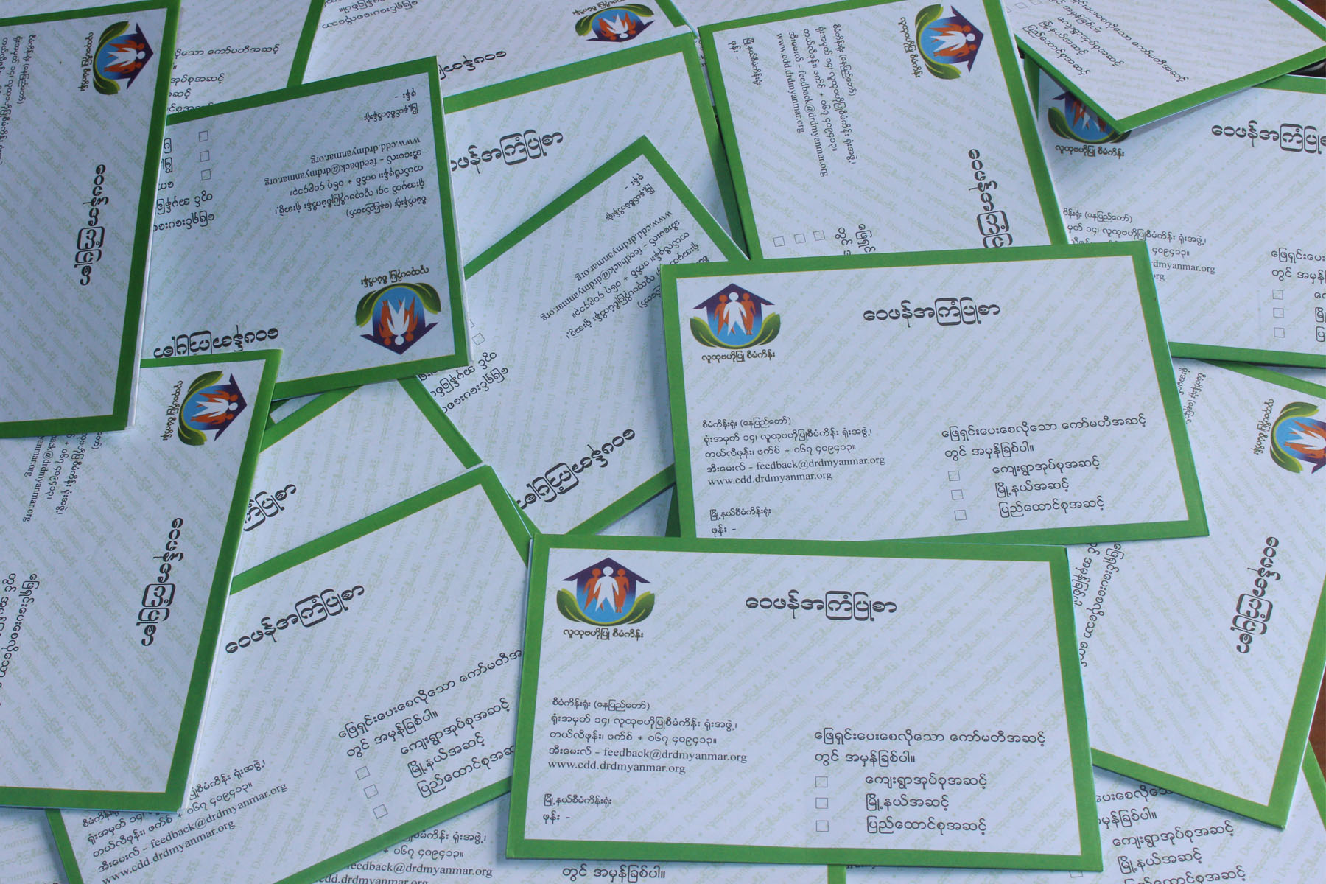
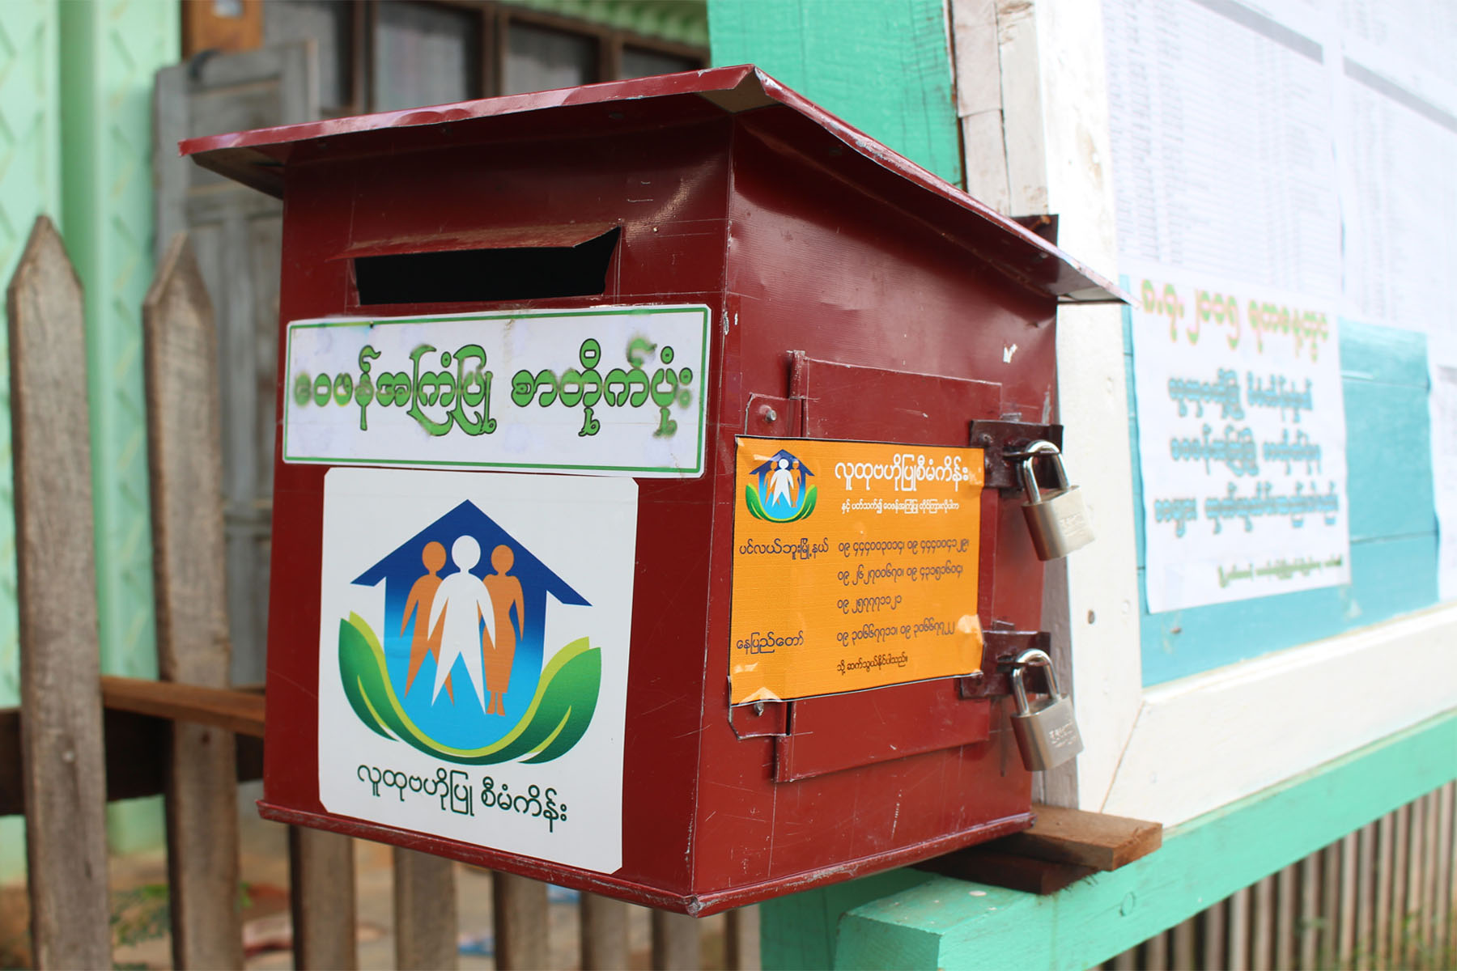
Channels for Filing Grievances
Suggestion Box
Telephone
Electrical Media( Email, Facebook etc..)
Community Meeting
Grievance Focals
In Person

Slide 8
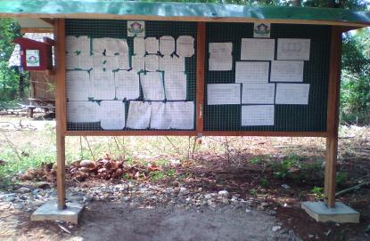
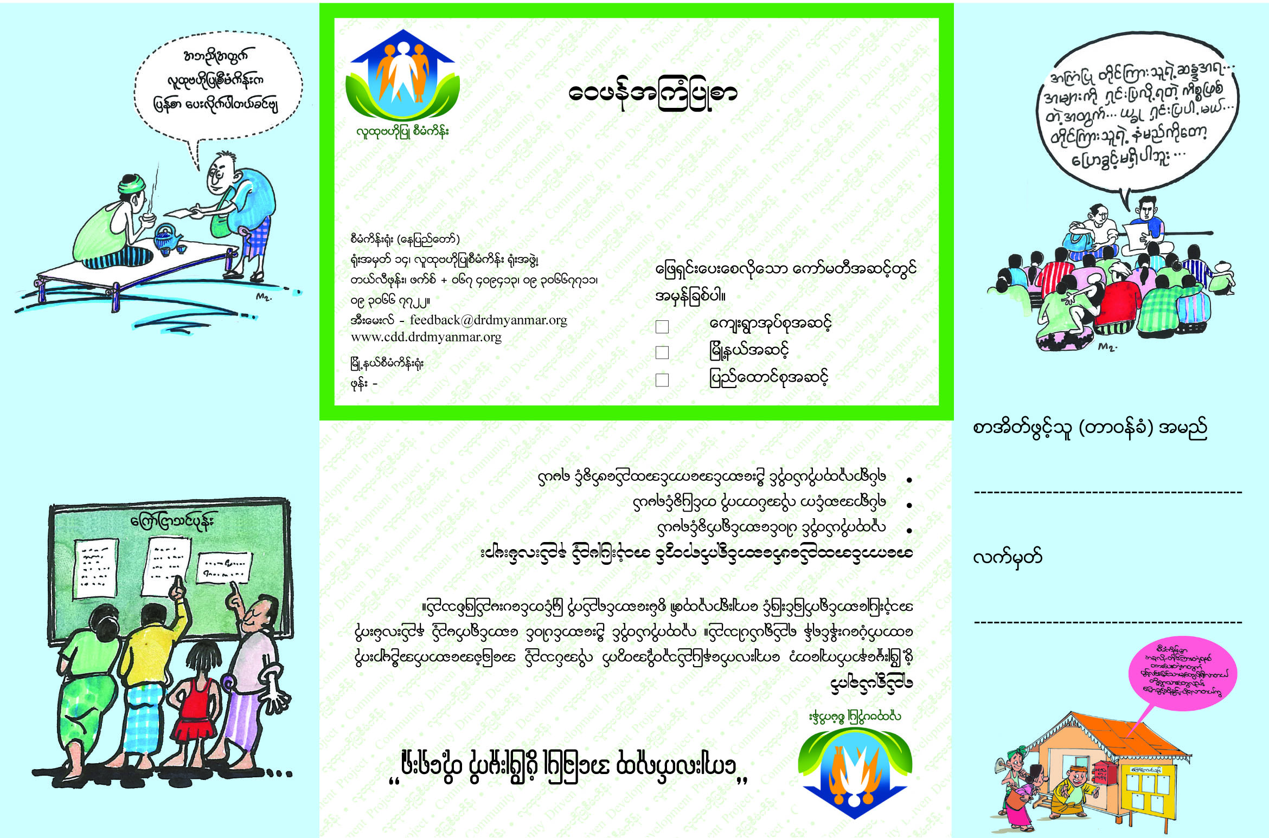
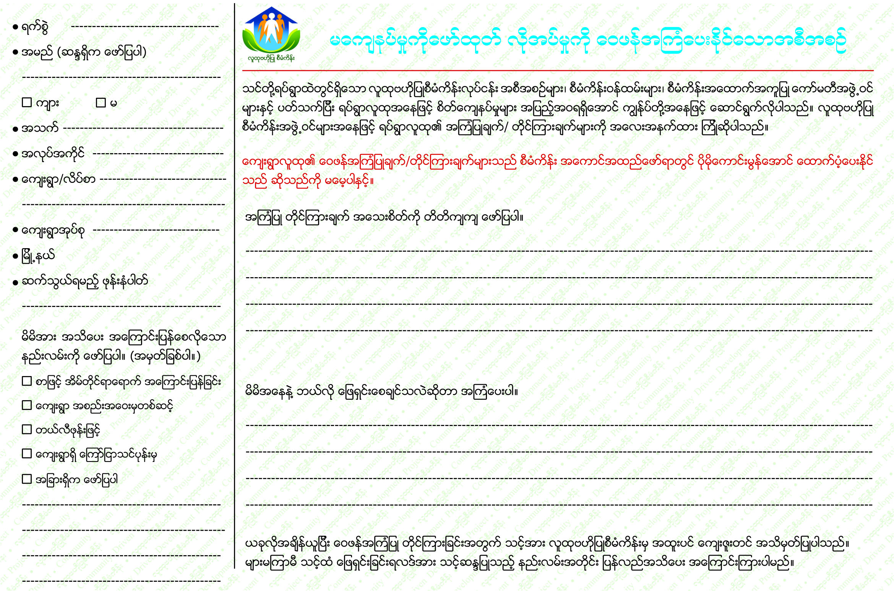
Channels for Filing Grievances

Slide 9
Confidentiality
Grievances are disclosed publicly, but no one who files a grievance is identified unless they self-identify. The identity of all those who have filed grievances is treated with confidentially.
If the complainant is known, the grievance focal person communicates the action to her/him.
If the action is considered unsatisfactory, the complainant may file a new grievance.
There is no charge for filing a grievance.

Slide 10
Grievance Training

Slide 11
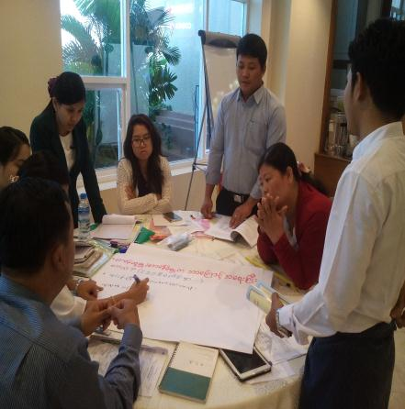
Group Work

Slide 12
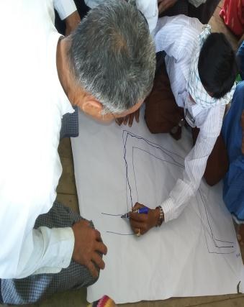
Grievance Training at Village Tract Level

Slide 13
Time frame
The timeframe for responding to a grievance should not exceed four weeks from the time the grievance is originally received. Grievances should be resolved within three months of receipt.
Grievances are resolved locally, at the lowest level, if possible. If not, they are “escalated” or sent up to a higher level within three months.

Slide 14
Documentation
The DRD union/township data entry staff enters the agreed action in the management information system (MIS)
The person assigned to handle grievances interviews the person who filed the complaint. S/he documents the actions taken at the location where the complaint originated and discloses the response or the resolution taken for the case.

Slide 15
Process
The grievance handling process involves five steps are as follow;
Intake ( In PC-9 form)
Sorting
Verification
Action
Follow-up

Slide 16
Grievance Categories
No | Categories
1 | General Inquiry
2 | Violation of project policies, guidelines or procedures
3 | Violation of contract/ agreement
4 | Misuse of funds
5 | Improper intervention
6 | Force majeure
7 | Suggestion
8 | Appreciation
9 | Others

Slide 17
Code of Conduct – 5 Dos
Be honest and responsible in your job.
Be open and transparent in your actions.
Observe the laws of Myanmar.
Observe the rights of everyone.
Respect the community and engage equally all women, men, disabled persons, the poor, and any ethnic or religious groups.

Slide 18
Code of Conduct – 5 Don’ts
Don’t take bribes or gifts, money, goods, materials for personal use.
Don’t falsify documents.
Don’t give contracts to friends or relatives.
Don’t use or abuse the project for personal gain.
Don’t hire children under 15 years of age for sub-project construction. And don´t exploit labor.

Slide 19
Sanctions
Anyone involved in project implementation, who is found to be in breach of the code of conduct, is subject to disciplinary action.
Sanctions may be imposed on individuals, groups (such as village tract project support committee and village project support committees) and private contractors.

Slide 20
International Support Mission(ISM) visited to Pinlebu Township, Kyauk Inn Kone Village for Grievance Assement (2017)

Slide 21
ISM meet VPSC members and villagers at Pinlebu Township for Grievance Assement(2017)

Slide 22
All Cycle grievance letter Received and resolved
No | Total Received | Total Solved | %Solved
Cycle I | 318 | 318 | 100%
Cycle II | 1348 | 1348 | 100%
Cycle III | 5279 | 5276 | 99.9%
Cycle IV | 332 | 319 | 96%
Total | 7277 | 7261 | 99.8%

Slide 23
All Cycle grievance letter Received and resolved

Slide 25
Thank for your attention
cdd.drdmyanmar@gmail.com (CDD Project)
kokhy@drdmyanmar.org (Project Manager)
gho.cdd@gmail.com (Grievance Handling Officer)
nyinyisoecdd@gmail.com (Grievance Handling Team)
Grievance Team’s Phone No: 0930667711/22
Presented by Nyi Nyi Soe

