Slide 1
qualitative research methodologies improving quality of CDD operations
Philippines, National Community Driven Development Program

Slide 2
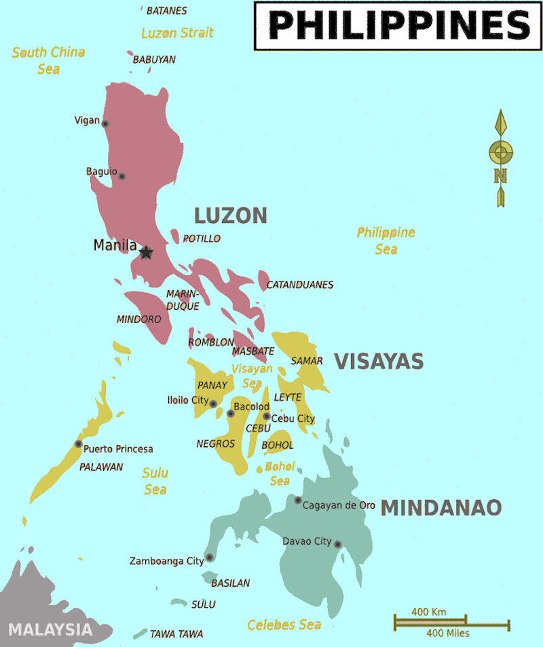
PHILIPPINES – NATIONAL CDD PROJECT
Long-term engagement (2002)
$1 bn. Program, covering over 50% of the country (2014-2019)
Targeted at municipal level (poverty + disaster)
Mostly supports community access to services/basic infrastructure such as school classrooms, health centers, day care centers, water supply systems, etc.
New features – Disaster Response

Slide 3
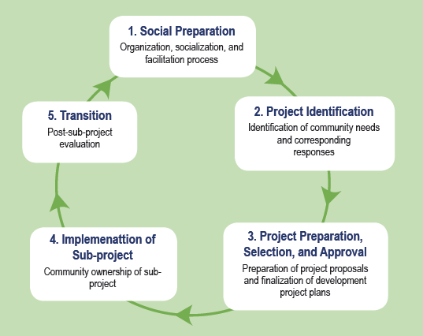
Philippines – national CDD Project Sub-project cycle
Facilitated community mobilization
Community prioritization of projects
Open menu system of projects (with a negative list of ineligible activities).
Direct fund release to community accounts
Community management of funds, procurement, and implementation of projects

Slide 4
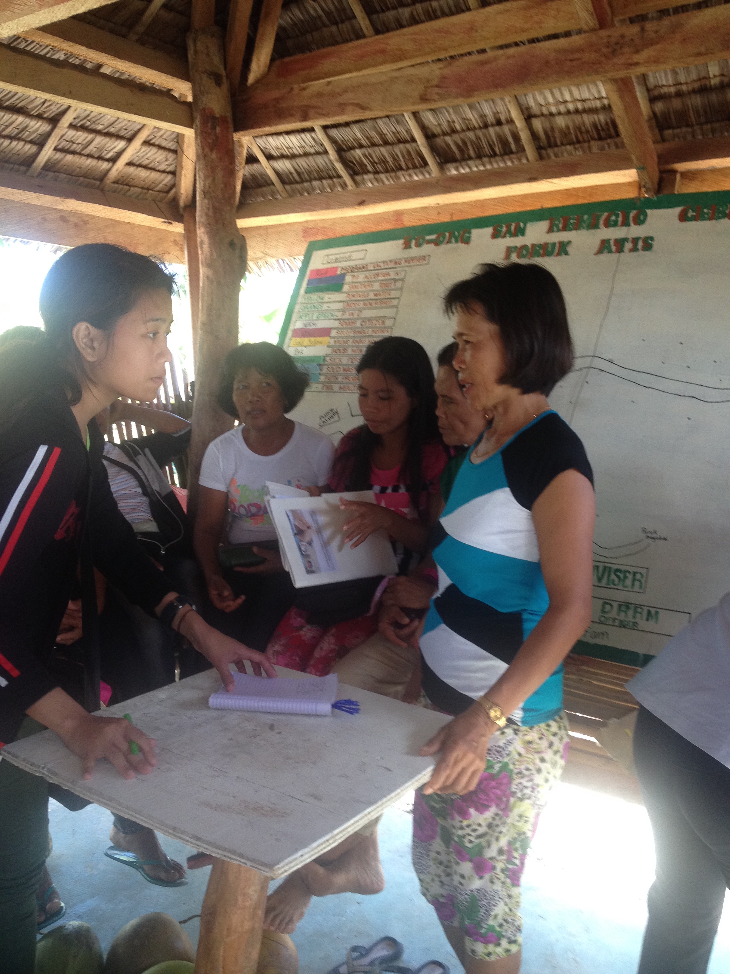
Assessing implementation quality What questions
Expansion of the program with new staff and functions at all levels
Response to typhoon Haiyan accelerating implementation
Basic training before roll-out
Is quality being maintained with expansion?
What systems may require strengthening

Slide 5
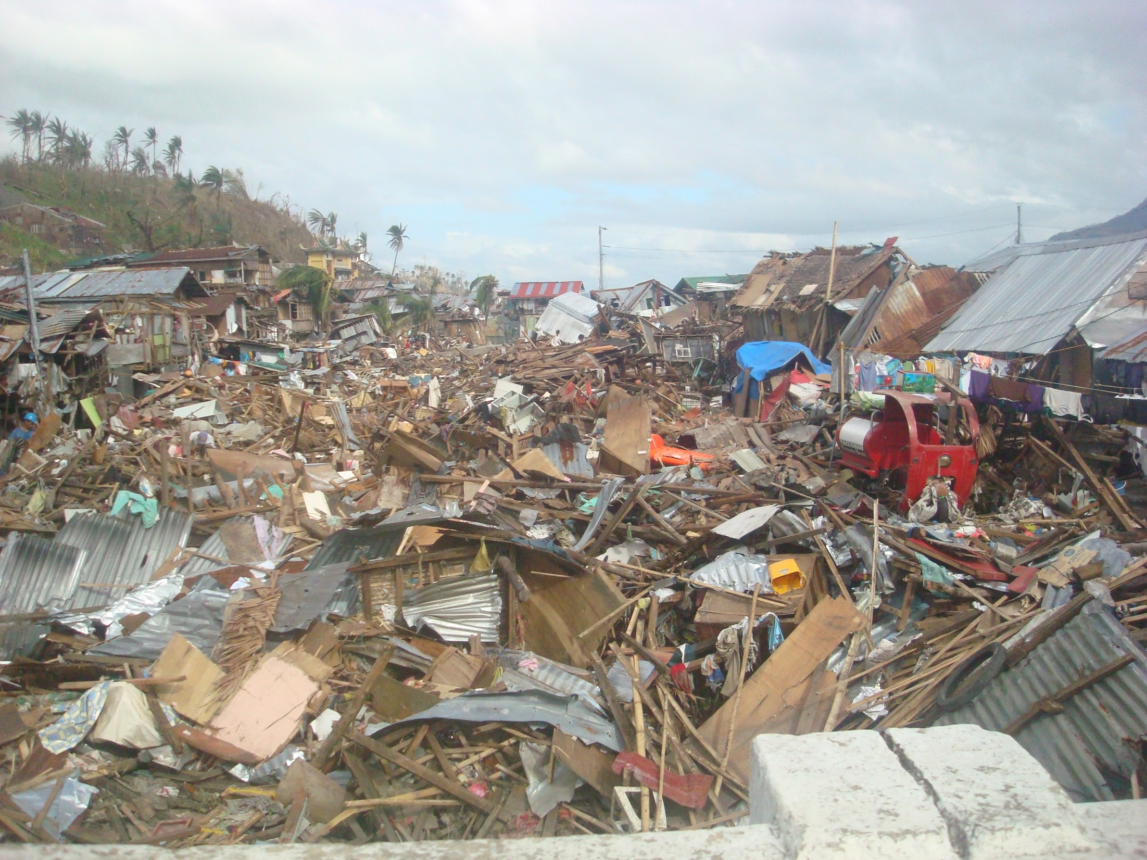
Assessing implementation quality What questions
New disaster response modality introduced in Haiyan affected areas
New accelerated procedures and guidelines
Is the new modality well adapted to context/needs?

Slide 6
Assessing implementation quality HOW?
Multiple sub-projects (14,000 in Cycle 1)
Assessing quality of the implementation process
Timely information to make changes to operational guidelines
Qualitative research approaches/real-time observation
Periodic feedback to Department of Social Welfare
Used to review guidelines and manuals

Slide 7
Process evaluation Methodology
Site selection: 4 municipalities/ 8 communities targeted during the 1st year of implementation
4 with previous KC experience
4 new areas
Important to be aware of the limitations of the methodology
Old KALAHI municipalities | Municipalities new to the program
Tanauan, Leyte Amantillo Logero | Marabut, Western Samar Toong Tacup
Tapaz, Capiz San Roque Atipolo | San Remigio, Cebu Roxas 8 Libertad
Notes:
Given the main objectives of a process evaluation in the CDD case, the sampling for site selection is purposeful and focuses on key features of the areas selected that could potentially influence implementation.
In the NCDDP case, all of the areas are disaster affected, since the research focuses on assessing the implementation of the fast tracked disaster risk response procedures;
included the variation of areas with or without CDD experience;
and included remote areas with indigenous peoples populations or the presence of conflict, factors that could also influence pace of implementation. The team expected that in experienced and more accessible areas, implementation would be smoother.

Slide 8
Process evaluation Methodology – qualitative approach
4 research teams immersed in the field for 14 months
FGDs and KII
Review of secondary data, Minutes of Meetings & recall interviews
Participant observation
Participatory social mapping
Notes:
Qualitative participatory approach
4 research teams immersed in the field for 14 months
participatory social mapping
participant observation in all ACEAC stages/activities and community meetings
FGDs with community beneficiaries, KIIs with multiple key stakeholders

Slide 9
Process evaluation Methodology – qualitative approach
Key areas of focus | Main questions (examples)
Social Preparation | Information about the project at community level
 | Collection of data on disaster impacts
 | Selection of community volunteers (in old and new areas)
 | Grievance redress system
Prioritization | Process followed and level of community engagement
 | Influencing decision-making and the role of local governments (in old and new areas)
Sub-project development | Technical support provided, role of engineering team and time required for reviews
 | Training of volunteers and clarity of procedures
Implementation | Selection of participants for paid labor component
 | Supervision and ensuring quality of construction/Operation and maintenance arrangements
Institutional set-up and capacity building | Quality of facilitation and engineering support Role of the municipal teams and involvement of municipalities, local government

Slide 10
Process evaluation Methodology
Remote areas: lack of experienced researchers for field immersion
Need for additional training/supervision
Impact on quality of the initial analysis (detailed field notes/generalizations)
Ensuring researchers maintain neutrality
Regular coaching
Several rounds of progress reports to discuss how information was being processed and analyzed
Close supervision (to provide guidance on qualitative research methods)
Feedback sessions with DSWD to de-brief periodically on key findings
Notes:
Since some of the targeted sites were located in remote areas, and required field teams that could speak the local dialects, it was difficult to find experienced researchers to carry out the work.
While the immersion in the field was key to allow them to gather all the necessary information, it also provided the challenge of keeping inexperienced researchers neutral and objective in their analyses and avoiding their tendency to intervene in the processes, as they got acquainted with NCDDP field staff and communities.
Regular coaching and weekly reporting to the research coordinators helped to address these challenges.
Closer supervision of the two research coordinators, as well as the World Bank’s team, was therefore crucial. We conducted at least four rounds of supervision missions, providing in-site training to the PE coordinators and field teams.
The methodology also included periodic meetings between the research team and DSWD; quarterly reports and presentations; and DSWD periodical discussions of the findings with its regional teams as part of a broader process where regions meet to discuss implementation and propose adjustments.
Used participant observation of all activities
Risk of “the Hawthorne Effect” (the bias caused by the presence of observers around)
“Blinding or double blinding” was not possible to do and therefore not tried in the PE

Slide 11
Some selected Findings Systems and procedures
Focus area | Key issues
Training and staffing | Additional training needed for front line teams (IP/Conflict)
 | Tendency for facilitators to steer communities to less technically complex Sub-Projects
 | Community volunteers require closer orientation on procedures Intensive support by Community Facilitators needed
 | Mentoring by experienced staff helpful but tendency to replicate older process (KALAHI-CIDSS) Overload of staff working on multiple CDD projects (e.g. Tanauan)
Guidance on procedures | Good understanding of basic processes and of new approach to calculate community grant (but… in SR alternative formula modified the 50% damages allocation focusing on social service facilities common to all in order to arrive at equitable grant allocations for all barangays)
 | Preparation of budgets and technical specifications for Sub-Projects was challenging multiple revisions required Exemption list not well understood (e.g. chapel in Tanauan)
 | Implementation time-frame was not reduced as intended
Notes:
General 10 day training provided to all teams but this was not sufficient to make staff fully “proficient” on project procedures. Specific training on IP facilitation and facilitation in conflict affected areas was needed/not provided
Particular hard time completing technical specifications of subprojects and providing adequate budgetary allocation for subproject specifications. Since the roll out of NCDDP in the disaster areas was also fast, some forms and specification were being changed by DSWD throughout preparation, which added to the confusion and delays.
San Remigio
Alternative formula modified the 50% damages allocation focusing on social service facilities common to all in order to arrive at equitable grant allocations for all barangays.
Priority needs are identified by letting sitios/puroks group themselves and agree on their priority needs during BA1.
Each sitio and purok proposed their needs to the whole BA1 assembly. The whole community voted on the sitio or purok needs.
Tanauan
The proposed SP rehabilitation of barangay chapel and construction of socio-cultural center was prioritized during BA1.
No guidance in DROM relative to the possibility that barangay chapel needed an exemption memo from DSWD as it was included in the negative list of regular CEAC.
Exemption memo from DSWD referred to San Roque proposed SP not as Barangay Chapel but as place of congregation and therefore qualified for ACEAC SP.
Tanauan
Carry-over of Committees and CVs from previous KC-NCDDP project modalities
Scheduling and prioritization of various modalities led to “freeze” or “hold” order of NCDDP so the ACT could focus on MCC, alleviating the pressure on ACT and CVs and the community
4. Tapaz
The ACT during social preparation stage had no AC so MAC was doing the work of AC.
AC was hired after the first stage of ACEAC implementation.
Brgy Captain of Brgy of Libertad initiated a meeting with Brgy Captains of Wright and Katipunan to propose a joint SP.
The lead barangay of the joint SPs is identified based on the proximity of barangay to the proposed SP
4. Tapaz
Technical and budgetary reasons cited as reasons for choosing the SP and not priority needs of the community.
Innovations include:
Combined membership from the 3 barangays of BAC, BSPMC, and other CVs and committees;
Conducting a special PDW in Barangay Libertad to accommodate CVs and committee members from Brgys Wright and Katipunan who were not invited to attend the municipal PDW

Slide 12
Process evaluation Community participation and engagement with local government
Focus area | Key issues
Community participation | High participation rates (including female participation)
 | Facilitation and community mobilization approaches with good results (remote areas)
Linkages with Local Governments | More than whether community was old/new to the process, municipal capacity and engagement impacted quality and pace of implementation
 | Some municipalities/Mayors influencing community decision making and choice of Sub-Projects (e.g. Tapaz pushing for 13 bgy joint project)
Grievance Redress | System is in place
 | Awareness of how it works/feedback is provided needs to be improved
Notes:
LGU engagement/support:
. Some barangays were strongly supported by their respective municipal governments, particularly in San Remigio and Tanauan, where LGUs provided technical and financial support.
In San Remigio, the LGU constructed a KC-NCDDP building next to the municipal hall, complete with office furniture, equipment, and supplies solely for the use of ACT. In addition, the LGU hired 10 MCTs to work full-time in the KC-NCDDP ACEAC Project and to support the ACT. The municipal LGU and the DSWD-hired teams worked in close coordination with each other.
In Tanauan, the LCE designated and seconded several regular employees of the LGU to work full-time in support of ACT in implementing the ACEAC sub-projects. They were reassigned from their regular functions to work full-time as counterpart for ACT.
In Marabut, the LCE committed to support implementation of all DSWD projects. However, the 11 MCT members designated as ACT counterpart continue to work as full time LGU personnel, with additional MCT functions.
San Remigio: Priority needs are identified by letting sitios/puroks group themselves and agree on their priority needs during BA1.
Each sitio and purok proposed their needs to the whole BA1 assembly. The whole community voted on the sitio or purok needs.
3. Tanauan
The proposed SP rehabilitation of barangay chapel and construction of socio-cultural center was prioritized during BA1.
No guidance in DROM relative to the possibility that barangay chapel needed an exemption memo from DSWD as it was included in the negative list of regular CEAC.
Exemption memo from DSWD referred to San Roque proposed SP not as Barangay Chapel but as place of congregation and therefore qualified for ACEAC SP.
Carry-over of Committees and CVs from previous KC-NCDDP project modalities
Scheduling and prioritization of various modalities lead to “freeze” or “hold” order of NCDDP so the ACT could focus on other projects such as MCC, alleviating the pressure on ACT and CVs and the community, but delaying NCDDP
4. Tapaz
The ACT during social preparation stage had no AC so MAC was doing the work of AC.
AC was hired after the first stage of ACEAC implementation.
Brgy Captain of Brgy of Libertad initiated a meeting with Brgy Captains of Wright and Katipunan to propose a joint SP.
The lead barangay of the joint SPs is identified based on the proximity of barangay to the proposed SP
13 upland barangays allegedly influenced by LCE, ACT, and MCT to do a joint subproject, i.e., a farm -to-market road; TF and MCT instrumental in convincing Roxas 8 to prioritize solar street lights in favor of water system and road improvement despite these two subprojects ranking as first and second priority, while street lights ranked third in list of priorities. Technical and budgetary reasons cited as reasons for choosing the streetlights as priority.
4. Tapaz
Technical and budgetary reasons cited as reasons for choosing the SP and not priority needs of the community.
Innovations include:
Combined membership from the 3 barangays of BAC, BSPMC, and other CVs and committees;
Conducting a special PDW in Barangay Libertad to accommodate CVs and committee members from Brgys Wright and Katipunan who were not invited to attend the municipal PDW

Slide 13
Process evaluation operational modifications
Focus area | Key recommendations
Procedures | Simplification of processing requirements/documents to be submitted with SP proposals (including on different certificates on environmental impacts) Requirements are too “heavy” for disaster response
 | Revised DROM manual: (i) clearer guidance; and (ii) “scenarios” for facilitators
 | Focusing on IP and Conflict modules in future cycles
Staffing and training | Refresher courses Breaking training down into smaller modules/timing of delivery Training municipal teams as well as project teams Further reviewing the ratio of facilitators/technical staff

Slide 14
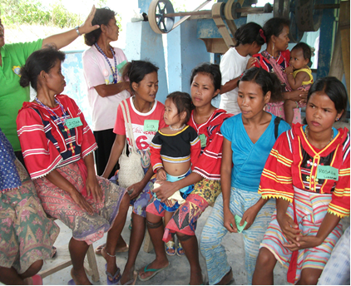
Process evaluation questions for cycle 2 &3
Inclusion of vulnerable groups
Transitioning from disaster recovery to “regular” sub-project cycle
NCDDP implementation in conflict affected areas

Slide 15
Thank you

