Slide 1
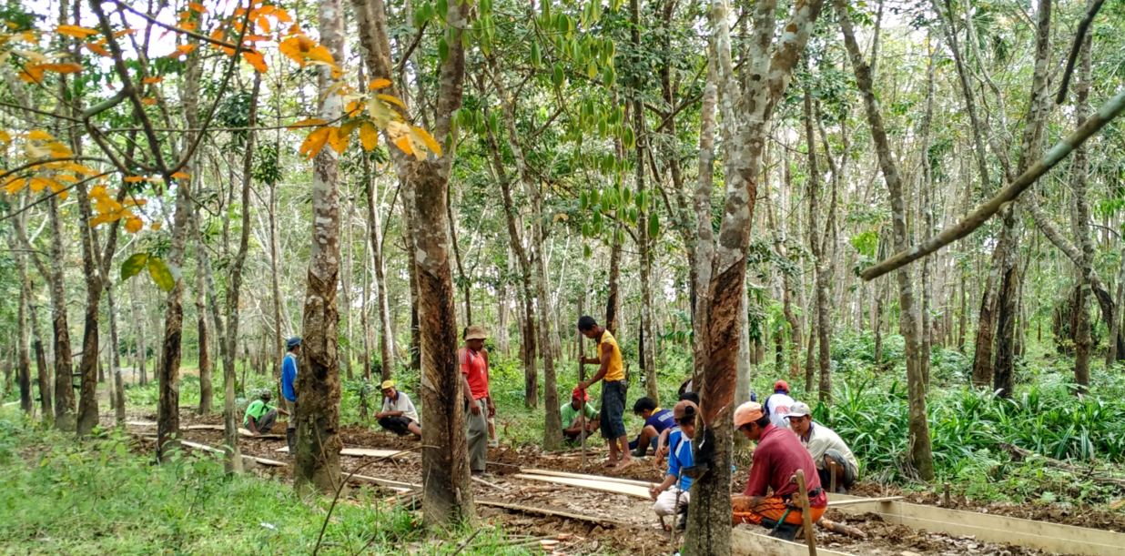
“Sentinel Villages” – Observing Village Governance and Community Empowerment under the Village Law in Indonesia

Slide 2
The Indonesia Village Law builds on 16 years of CDD and extends decentralization to villages
KDP 1998-2007: response to financial crisis in post authoritarian context
Cushion impact: money to villages, citizen voice and choice in their own development
PNPM 2008-2014: national scale up
PNPM Generasi 2008-2017: pilot to reach specific health and education MDGs
Results: 12% consumption gain for poor HHs, productive infrastructure (135 ths km roads), health (decrease in malnutrition), education (increased school attendance), +65 million employment days

Slide 3
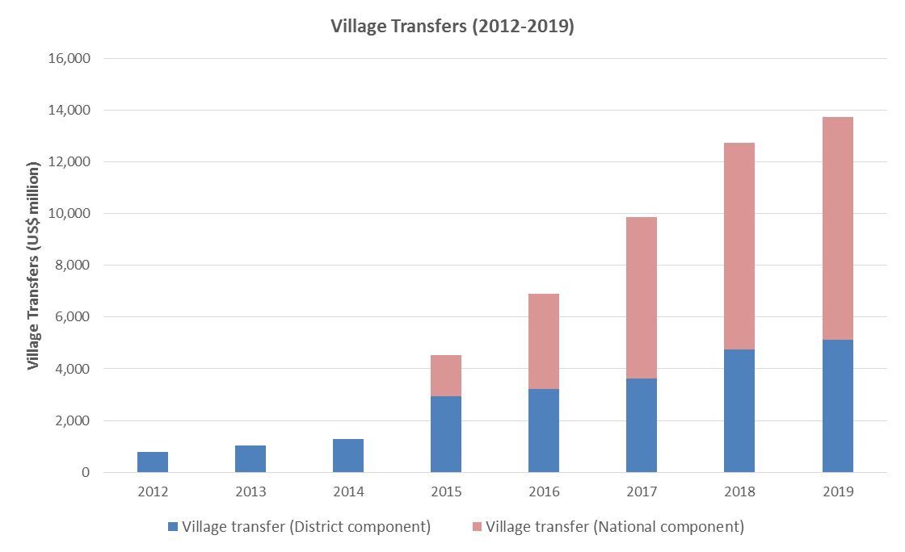
Village Law bring in massive scale – both in # of villages and $ of village transfers

Slide 4
Why this study?
VL as “continuation” of CDD – participation, transparency, accountability
KDP and PNPM has not affected governance at district and village levels:
Operating outside of government system for > 15 years (!)
Very inward looking (“PTO-minded”)
Seen as “project” by village government and community
Small size of village funds at that time – not worth to try implement any kind of good governance practices
Opportunity to observe directly at district & village levels for the first 2 years of VL implementation whether the CDD principles are being followed and if so how/why
Notes:
Unprecedented WB involvement in drafting of the Law!
Also try to see the “so-what” of implementing CDD principles in VL in terms of impacts felt by the communities and local governments – cannot conduct IE since the implementation of VL was conducted all at once in the whole country

Slide 5
“CDD Principles” in Village Law (1)
Participation:
Article 3 – one of the main principles in village governance
Article 54 – community representative in village forum
Transparency:
Article 27 – village head must provide written information to community on village administration at the end of each fiscal year
Article 68 – community has right to ask and get information on village government
Article 82 – community has right to get information on village development planning and implementation; village government must inform community on various village planning documents and village budget

Slide 6
“CDD Principles” in Village Law (2)
Accountability:
Article 68 – community has right to oversee/supervise village government activities, including in village development
Article 82 – community has right to participate in village consultative forum to provide inputs/comments on village development reports prepared by the village government

Slide 7
“Sentinel Villages” Study
Observing the implementation of CDD principles in VL for 2 years (2015 – 2017)
With intention to answer the questions of :
Whether adherence to good governance principles can help improve management of village resources to benefit community; and
What are the factors that influence the practice of participation, transparency and accountability principles in VL
Mixed-methods:
quantitative (surveys of individual, households, village aparat, BPD members, village activist, health and education personnels);
qualitative (FGDs, direct observation, in-depth interview); and
process monitoring (field researchers stay in research areas for 18 months)
Locations: 5 districts in 3 provinces (Jambi, Central Java, NTT); 112 villages for quantitative (random); and 10 villages for qualitative (purposive)
Notes:
Locations follow another longitudinal study – the Local Level Institutions

Slide 8
Quantitative Sampling Approach
Sampling approach:
The survey based on initial calculations, will be conducted in 100 villages. The number of villages in each district is determined by the proportion of the total villages in each district. A total of 12 villages were added to oversample villages in Merangin and Ngada.
For logistical reasons, it was decided that a total of four villages will be visited within each kecamatan (sub-district). Consequently, adjustments in the numbers of villages per district were made to ensure that the latter are multiples of four.
Kecamatans are randomly selected within each district. Within each kecamatan, four villages are randomly drawn. Subsequently, one dusun (hamlet) is randomly selected within each village.
Twenty households were randomly drawn based on the most recent list of households from hamlet heads. Two adult household respondents (one man and one woman) were selected based on some selection protocol.
Respondents:
2,240 households, comprising 1,841 households represented by two respondents and 399 households by one respondent
4,081 adult household member respondents, comprising 2,125 women and 1,956 men
112 Village Heads
112 BPD Heads
112 Hamlet Heads
222 community activists, 224 health sector workers, and 192 education sector workers
Notes:
Locations follow another longitudinal study – the Local Level Institutions

Slide 9
Study Hypotheses
H1: Participation, information transparency, and accountability will remain low in the first year of implementation but will improve over time, especially when/where facilitators and village council are active
H2: Improved participation, transparency and accountability will lead to more responsive village government (VG) over time, reflected in village fund allocation that corresponds to community’s needs and in higher satisfaction towards VG performance
H3: Participation, transparency, accountability and responsiveness of VG will be stronger in places where the community was actively involved in participatory development projects (such as PNPM) and where village council/other local institutions were able to hold VG accountable in the past

Slide 10
Timeline
Time | Activities
September – October 2015 | Baseline qualitative
March – April 2016 | Baseline quantitative
September 2015 – June 2017 | Ongoing process monitoring
March – April 2017 | Endline quantitative
September – October 2017 | Endline qualitative

