Slide 1
Social Cohesion and Community-Driven Development in Fragile Environments:
Lessons from Kyrgyz Republic and Beyond
Tilman Brueck, ISDC
Damir Esenaliev, SIPRI
Arslanbek Miiashev, AKF Kyrgyzstan
10 May 2017
Washington D.C.

Slide 2
Part One: Key Concepts
Tilman Brueck, ISDC

Slide 3
CDD and Social Cohesion
CDD
Development
SoCo

Slide 4
Social Cohesion: National Level

Slide 5
Social Cohesion: Community Level

Slide 6
Social Cohesion: Individual Level

Slide 7

Data for SoCo Impact Evaluation
Data requirements
  fine-grained, individual-level, panel data
  accounting for the different domains of SoCo
  especially including subjective indicators
Data availability
  SoCo project data based on Life in Kyrgyzstan Study
  nationally representative, individual-level panel study
  8000 people in five waves since 2010
  research-led and open access
  www.lifeinkyrgyzstan.org
  Twitter: LiK_Study

Slide 8
Part Two:
Social Cohesion Index in Kyrgyzstan
Damir Esenaliev, SIPRI

Slide 9

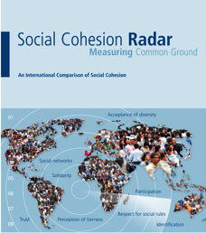
Concept of Cohesion for the Index
Concept of Social Cohesion Radar is adapted: Quality of interactions among members of community
Three domains
  Resilient social relations
  Positive emotional connectedness to community
  Pronounced focus on common good
Possible causes or effects
  Wealth, inequality, ethnic diversity
  Well-being
Source: ttp://www.mtcsp.org.uk/media/6021/
ga_recommunitycohesion503.jpg

Slide 10
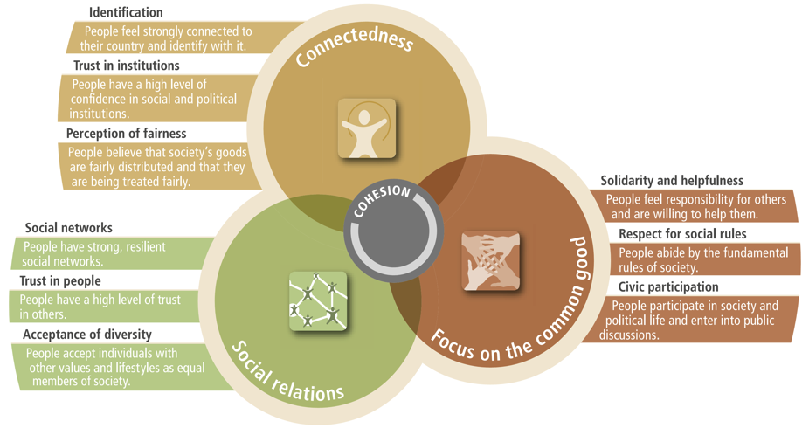
Three Domains, Nine Dimensions

Slide 11
Steps of the Index Calculation
Indicator selection…
…through face validity and exploratory factor analysis:
42 indicators, 3-8 per dimension
Scale standardization from 0 to 10
Aggregation from individual level…
…to village and sub-district levels
Measurement of dimensions…
…mean of respective indicators per dimension
0 to 2 | > 2 to 4 | > 4 to 6 | > 6 to 8 | > 8 to 10

Slide 12
Overall Index and Dimensions at Baseline

Slide 13
Overall Index and Dimensions at Baseline
Moderate levels of social cohesion in aggregate
However, variation across domains and dimensions
  Highest scores are in:
    Identification
    Acceptance of diversity
  Lowest scores are in:
    Social networks
    Solidarity and helpfulness
These results led to fine tuning of the intervention

Slide 14
Potential Determinants and Outcomes
 | Correlation with Social Cohesion Index
 | r | p
Proportion of community population employed | 0.573 | ***
Proportion of 16-17 year olds attending school | 0.385 | **
Number of languages of communication | 0.495 | ***
Main routes to communities are paved | 0.343 | *
Household size | 0.319 | *
Possession of a mobile phone | 0.438 | **
Communities with mobile phone service | 0.399 | **
Frequent disruption to electricity in last 12 months | -0.346 | *
Satisfaction with household’s standard of living | 0.480 | ***
Satisfaction with health | 0.310 | *

Slide 15
Index at baseline and midline
Overall increase in the index, from 6.4 to 7.0 in a scale
All three domains and nine dimensions saw improvement
The control communities gained a little more than the pilot communities

Slide 16
Summary
In this research project, we test whether and how community driven development fosters social cohesion
The project uses randomised experimental approach to identify the impact on social cohesion
This social cohesion index is an innovative output of the project
Has been helpful for programming in targeting specific dimensions
We will construct the index at individual level for the whole country using LiK 2016 data

Slide 17
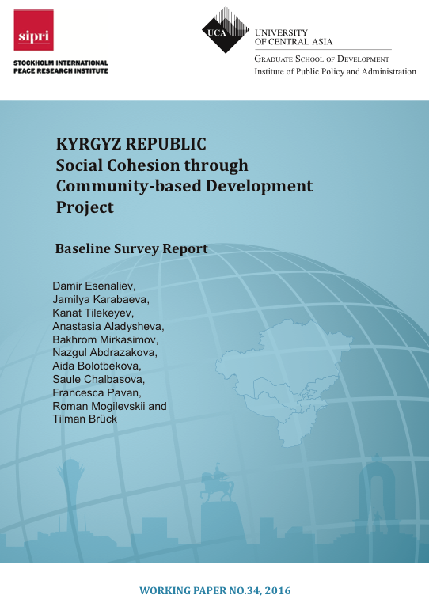
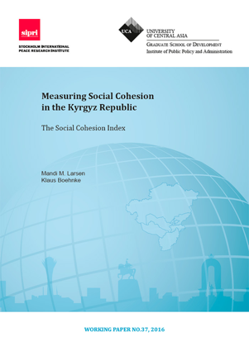
Thank you!
http://ucentralasia.org/Research/IPPA_Publications

Slide 18
Part Three:
Programming Innovations
Arslanbek Miiashev, AKF Kyrgyzstan

Slide 19

Community Driven Development PLUS
CDD PLUS – Creating micro community engagement processes within the CDD framework.
Community mobilization
Community-led action
Forming working groups;
Mapping of local actors;
Identify action items needed;
Disseminate information and knowledge.
Organize mass events to attract actors and stakeholders;
Involve media;
Reporting.
Awareness raising
First dialogue;
Stakeholder mapping;
Community based needs assessment;
Capacity building of stakeholders on community development.

Slide 20
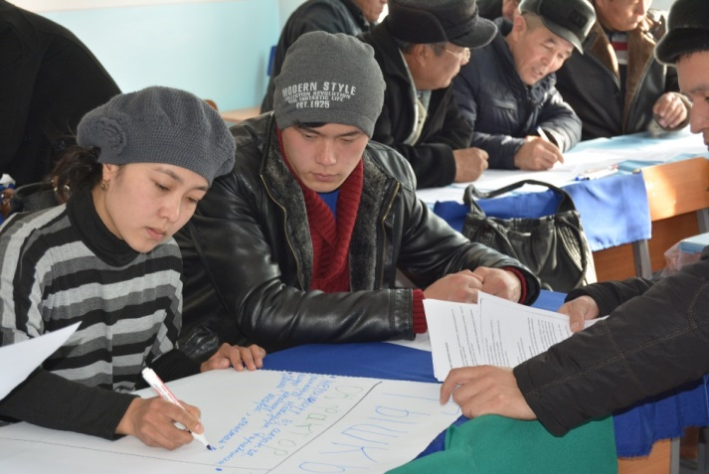
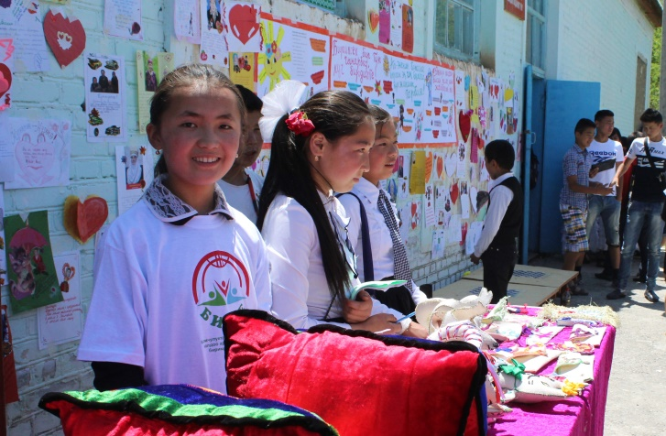
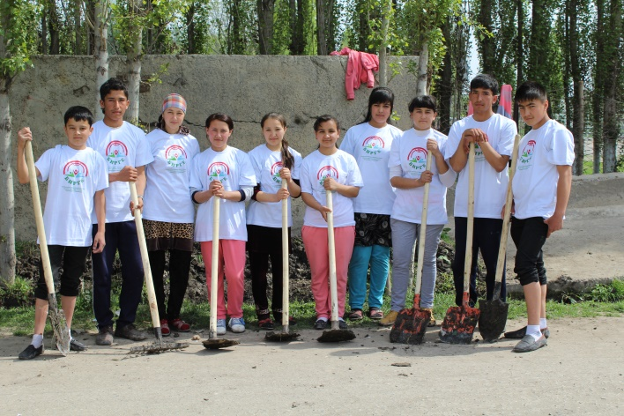
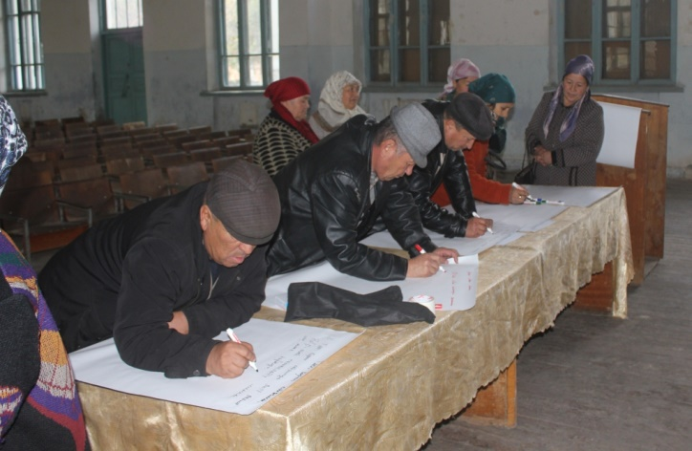
Awareness raising
Objective: Sensitize target groups on social cohesion issues and promote collective actions
Inputs: Presentation, Brainstorming, Community Mobilization
Bring together youth and formal institutions to identify actions to address social issues in their community
Examples of activities:
-Raise community awareness on local self-governance;
-Organize volunteer community services;
-Fundraising activities to support vulnerable groups;
-Enabling children’s access to local libraries .
Notes:
Overall, participants agreed on the relevance of the findings and identified low access to information in the community as a key constraint consequencing lowest scores in the Social Cohesion Index – Dimension 1.1. Social Networks and Dimension 3.1. Solidarity and helpfulness.

Slide 21
Enabling children’s access to local libraries
Mobile library: The idea is to create a system to provide access to books for children from vulnerable children.
Inputs: Community based needs assessment, awareness raising, crowd funding, networking
Community stakeholders involved: School Parliament, parents, teachers, community volunteers, LSGs, and community
OUTPUTS:
  Book collection event organized;
  163 books collected;
  Separate premise provided by school.
OUTCOMES:
  Increased involvement of young people and parents in the live of the local community;
  Reduced number of conflicts between parents and teachers;
  Increased social interaction and integration of vulnerable children and their parents into the community;
  Increased interest in learning among students;
  Promoted popularity of reading, improved reading skills in children.
Notes:
Overall, participants agreed on the relevance of the findings and identified low access to information in the community as a key constraint consequencing lowest scores in the Social Cohesion Index – Dimension 1.1. Social Networks and Dimension 3.1. Solidarity and helpfulness.

Slide 22
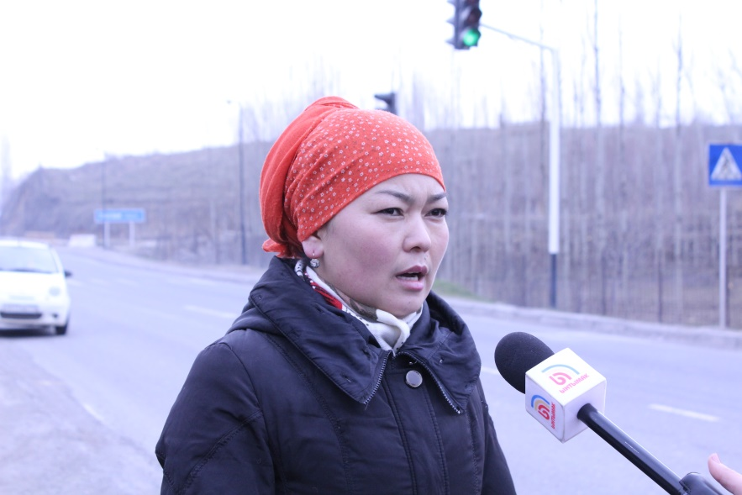
Forum theaters
“Theatre is a form of knowledge; it should and can also be a means of transforming society. Theater can help us build our future, rather than just waiting for it.” Augusto Boal.
Forum theater is a recognized method to solve social problems, protect human rights, promote social justice, through dialogue, and raise community awareness of existing problems
"We have analyzed each of the problems in detail and decided to go with the road accident problem and the need to install a traffic light. In fact, we wanted to draw the attention of village residents to the necessity of some action on our part to be able to solve this problem. Schoolchildren are at particular risk as they have to cross the road on their way to school; every one of them can get into an accident”.
A young person, 17 years old
Steps:
Mapping of youth formal and informal groups;
Master class;
Training on forum theater;
Community performance.

Slide 23
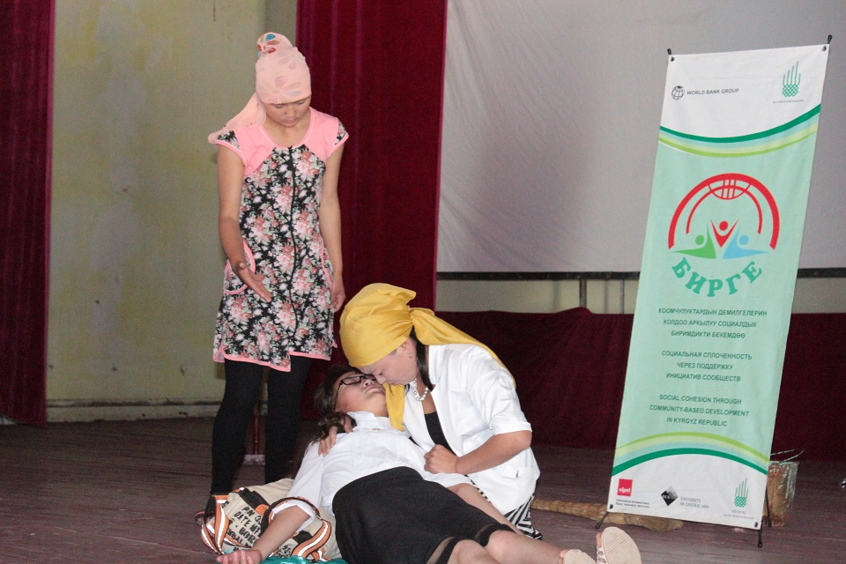
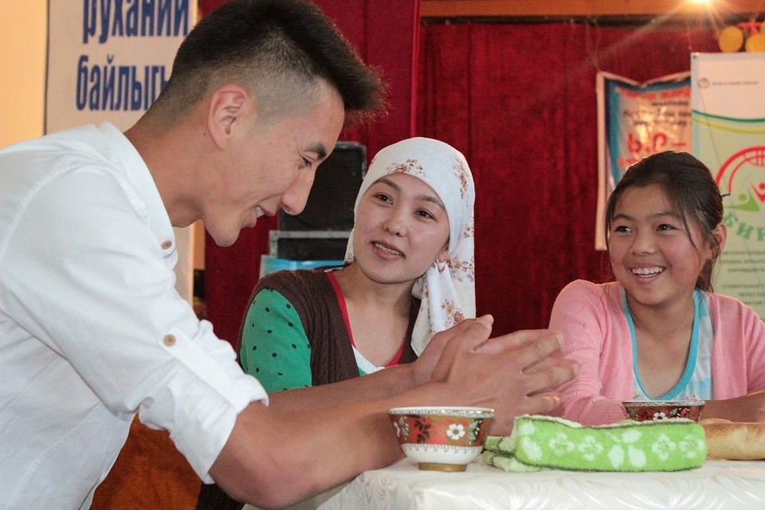
Forum theaters
Objective: To create an opportunity for community to come together to discuss community problems and develop community-driven solutions
Community issues discussed:
- Unequal access to natural resources;
-Adverse impact of migration for youth;
-Early marriages;
-Role of local self-governance and population in solving local issues.
Outputs:
-Use of social networks to mobilize funds;
-Technical assistance gained from government institutions;
- More than USD 2,400 raised from Kyrgyz diaspora in Russia.
Outcomes:
- Allowed youth to express their views on issues affecting social cohesion in their communities and propose solutions;
-Informed local authorities on measures that can be implemented to consolidate social cohesion from a youth perspective.

Slide 24
Thank you!
Aga Khan Foundation Kyrgyz Republic
Arslanbek Miiashev
Local Governance Program Manager
E-mail: arslanbek.miiashev@akdn.org

