Slide 1
Taking Stock of Community Driven Development in Fragile and Conflict Situations: Lessons Learned from the First Generation
5 December 2016

Slide 2
Intended to update global evidence base and elaborate on lessons learned from five CDD projects in FCS
Advantages of CDD in FCS
Rationale and Structure of Presentation
Global evidence base of CDD in FCS
Challenges for National Governments
Advantages of CDD
Governance Impacts
Lessons learned from five projects
Afghanistan, National Solidarity Program
Myanmar, National Community Driven Development Project
Philippines, KALAHI-CIDSS/Mindanao Trust Fund
Nepal, Poverty Alleviation Fund
South Sudan, Local Governance and Service Delivery Project

Slide 3
Defining Community-Driven Development
Advantages of CDD in FCS
What is CDD?
Community‐ driven development (CDD) is an approach that emphasizes community control over planning and management of resources
Community participation inherently valuable, but can also often lead to a better use of resources geared toward meeting the needs of communities
Government-sponsored, but departs from traditional approaches to development by enabling communities and local institutions—rather than central governments—to take the lead in identifying and managing community-level investments

Slide 4
Governments face multiple, compounding challenges in fragile and conflict situations
Advantages of CDD in FCS
The Challenge for National Governments
Many types of needs:
Physical reconstruction of economic and service infrastructure
Revitalization of economic activity
Support to vulnerable populations
Institutional strengthening and arrangements
Breakdown of social bonds within and between communities and of the social contract between the citizens and the government
Compounding these challenges, national governments are confronted with high expectations to deliver services quickly, a lack of government presence in peripheral areas, contested legitimacy, and difficult logistics.

Slide 5
CDD is a useful tool for governments in FCS to reach large numbers of poor communities directly
Advantages of CDD in FCS
Minimal institutional burden enables CDD projects to deploy quickly in FCS contexts (IEG)
Emphasis on local project staff and communities enables project to remain active when conflict resumes (Sudan, Indonesia, Nepal, Afghanistan)
CDD can deliver benefits relatively efficiently and cost effectively compared to other modes of service delivery (Philippines, Indonesia, Nepal)
Successful cases of poverty reduction, poverty targeting, and increased access to services (Indonesia, Nepal, Philippines)
Visible government ownership (Afghanistan, Philippines)

Slide 6
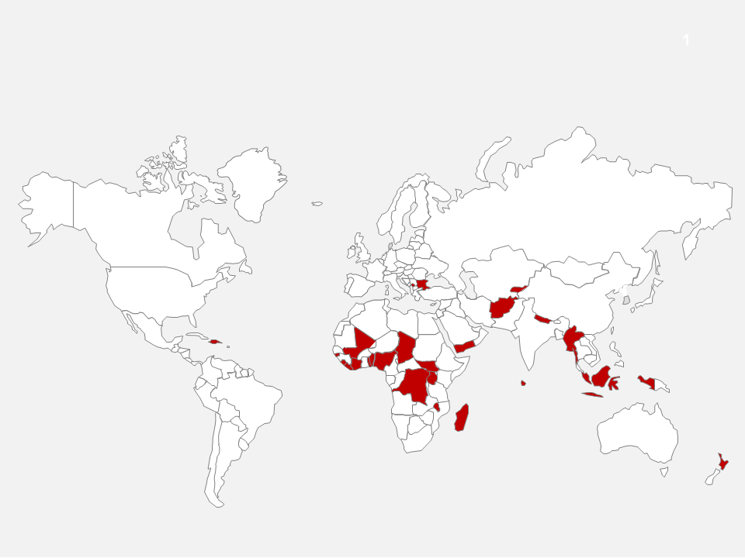
CDD has become one of the primary operational instrument through which the World Bank supports governments in FCS
CDD Footprint in FCS
CDD operations are currently active in twenty-five different FCS countries, representing $8.5 billion of total financial support

Slide 7
Global evidence of the governance impacts of CDD in FCS have typically been mixed
Governance Impacts
Theoretically, governance impacts may include:
improved social capital
more accountable and responsive community-state interactions
Building citizens’ trust and legitimacy in the state
spillovers to non-project areas of state-society interaction
Empirically, observations have been mixed:
Positive effects: Indonesia, Sierra Leone, Afghanistan
But no effect observed in other contexts: Mindanao, Nepal, Aceh

Slide 8
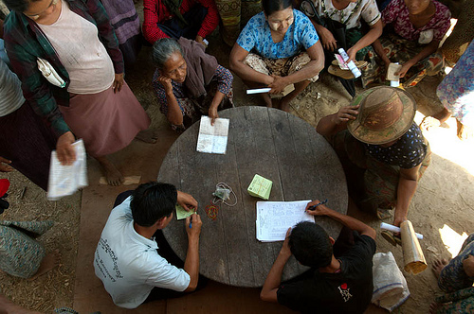
Emerging global longitudinal evidence seems to confirm the relative importance of how communities are engaged in service delivery
Governance Impacts
Evidence from Afghanistan highlights the importance of repeated interactions with communities and government institutions for achieving governance effects
Global evidence demonstrates that how communities are engaged in service delivery seems to matter more than what services they receive, at least for governance outcomes

Slide 9
Analytics and adaptive learning
Lessons from Five Countries
Variety of analytic strategies for conflict and political economy assessments
Large-scale, formal needs assessment (Sudan), as well as informal knowledge stock-taking in countries where the project team has strong existing understanding of the context (Myanmar, Philippines)
No perfect design; be upfront about initial design imperfections and commit to adaptive learning
social audits, multi-stakeholder reviews
Proactive consultations and communications strategy
Engagement with existing NGOs, civil society, and non-state armed actors (Philippines, Myanmar)

Slide 10
Lessons from Five Countries
Think big, start small
For long-term sustainability, it is critical to embed the project in a national strategy and develop a clear road map for operating at national scale from the start
Afghanistan, Nepal, Philippines, Myanmar
To get there, it may be useful in FCS for CDD programs to test the initial design in non-conflict areas; important to treat as a first phase, rather than a pilot
Myanmar, Sudan

Slide 11
Balance adherence to core principles with flexible implementation
Lessons from Five Countries
Core principles include community participation in decision over resources
If local bodies are not representative, how does the project accommodate principles of inclusion?
e.g. village development committees in Myanmar
non-state armed actors
On other issues, it is important to allow for flexibility given inherent volatility in FCS contexts. This can lead to new priorities and opportunities—e.g. shift from decentralization to social inclusion in Nepal.

Slide 12
Achieving positive impacts on poverty and governance require adequate time and resources that are not always available in FCS
Lessons from Five Countries
Lessons from Philippines and Myanmar show that poverty and non-poverty impacts depend on adequate level of resources for productive investment
Afghanistan and Philippines experience demonstrates the importance of for multiple rounds of grants for governance effects
However, where macro-fiscal conditions constrain options for grant size and frequency, alternatives models for streamlining service delivery mechanisms and focusing on key basic services may be useful; e.g. Afghanistan Citizens Charter

Slide 13
Areas for further research: the role of community facilitators and the use of new technologies
Lessons from Five Countries
As key interface between project and communities, community facilitators and facilitating partners are especially important in areas of contested legitimacy and historically limited state presence
Facilitators in FCS require techniques to manage and facilitate powerful actors in the communities who may try to dominate or influence the project; more research needed on local decision making processes
Social media technologies open up new avenues for citizen-government interaction; this can improve transparency and accountability--e.g. Myanmar Facebook page

