Slide 1

Role of MICOOPE Guarantee Fund
Guatemala
November 2020

Slide 2
Our role
We are a non-profit civil society, under autoregulation focus we protect the deposits of the members.
Membership is voluntary.
Each entity pays a quarterly fees.
The use of the MICOOPE brand requires the deposits protection by the MICOOPE Guarantee Fund.

Slide 3

Who we are?
25 CU’s
Central liquidity box
MICOOPE guarantee fund
Insurance carrier
Strengthen trust in the Cooperatives of the MICOOPE System

Slide 4
What are our functions?
CU’s
Assess the normative compliance
Appraise de risk management
Members
Guarantee the return of share deposits up to $12,500
We ensure the solidity, stability and solvency of each of the MICOOPE cooperatives
Delinquency rate
Quality assets
Debtor & depositor concentration
Liquidity level
Operative risk management
Capital level & Equity position

Slide 5
On going projects and principal challenges
Implementing the Based Risk Supervision
Training and specialization the supervision team
Improve IT for supervision
Strengthen the international relationships with other financial supervisors
Approve the financial cooperatives Act

Slide 6

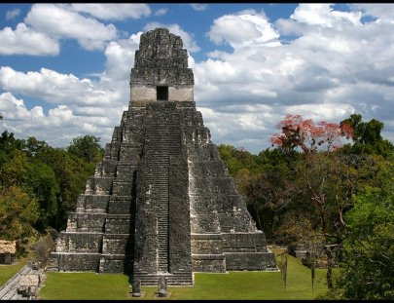
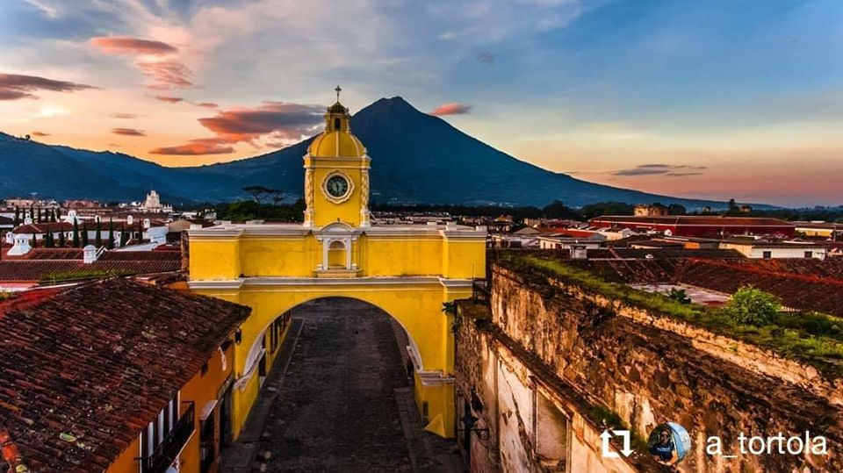

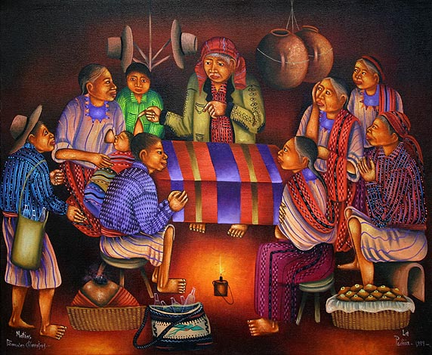
Thanks for your attention
Billy Manuel Rodas
Director of Supervision and Analytics
MICOOPE Guarantee Fund
brodas@fondomicoope.com
Photo by Mayan Toons

