Slide 1
The cooperative Rabobank
Hans Groeneveld
11 November 2020

Slide 2
Rabobank is member of large cooperative banking family
2

Slide 3
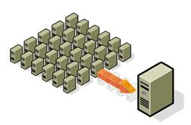
Convergence in governance and organisational structures of cooperative banks
3
3

Slide 4
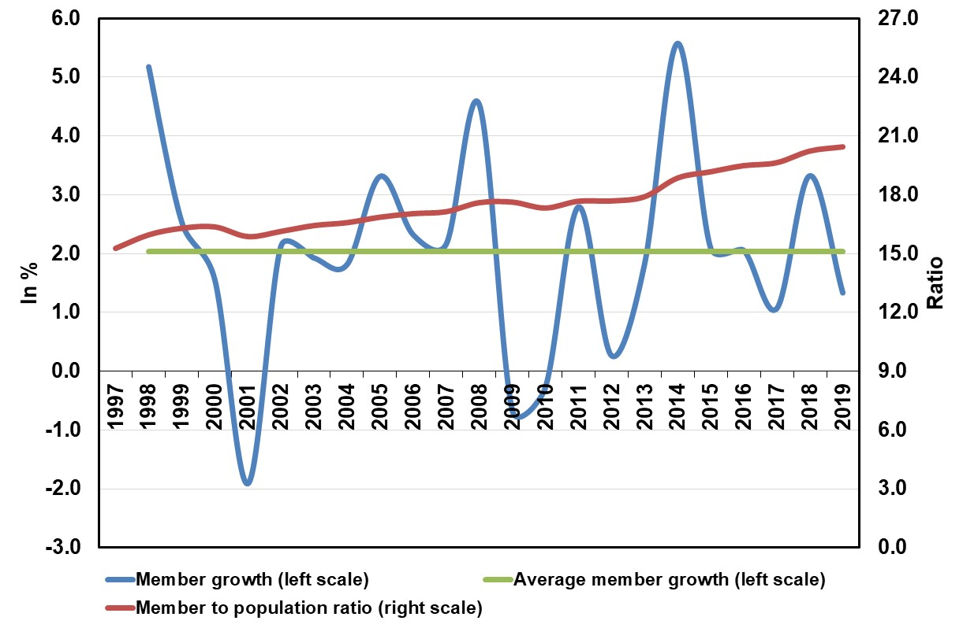
Members and member-population ratio
4

Slide 5
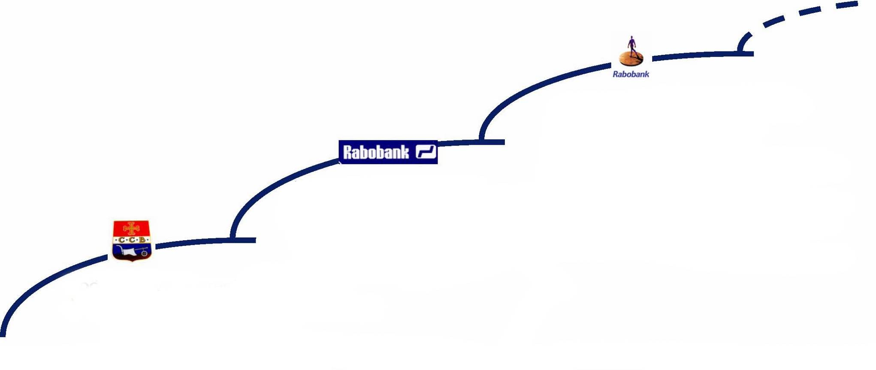
Rabobank’s governance and organisational evolution in a nutshell
All Finance banking in Netherlands and international focus on F&A
Merger with Interpolis (Insurance) and
strategic alliance with Robeco
(investment)
Acquisition of PIBA Bank (Australia)
1996 Establishment Rabobank International
1995-98 Great Cooperative Debate
- Abolition of limited member liability
Partnership with Eureko (Achmea)
2013 Libor affair: integration Rabobank
International and Rabobank Nederland
2014 Great Governance Debate
One Cooperative Bank:
- Merger local Rabobanks and central
cooperative
- One balance sheet & banking license
- Abolition of delegated supervision
2019 Cooperative Renewal
Banking for the Netherlands
Banking for Food
Bank
Retail banking in NL and first steps abroad
1952 Delegated supervision from Dutch central bank to central institutions
1960 Start serving private individuals (a.o. savings & mortgages)
1969 Establishment of DLL (Leasing Company)
1972 Merger of the Raiffeisen and Boerenleenbank into Rabobank
1980 - Cross guarantee scheme
- Triple A-rating
- Opening of first international branch in
New York
1982 Compensation schemes
Mature retail bank
1960s start of salary payment through bank accounts in the Netherlands:
new segments -> private individuals
also in urban areas
1895 First Credit Cooperative in Naaldwijk
1898 Foundation of cooperative central
institutions (CCRB+CCB)
- Central monitoring by CCRB and CCB
- Knowledge support for local banks
- Liquidity management
1900 Full reservation of net profits and
full member liability
Rural bank for farmers and rural SMEs (no private individuals)
Processor
5

Slide 6
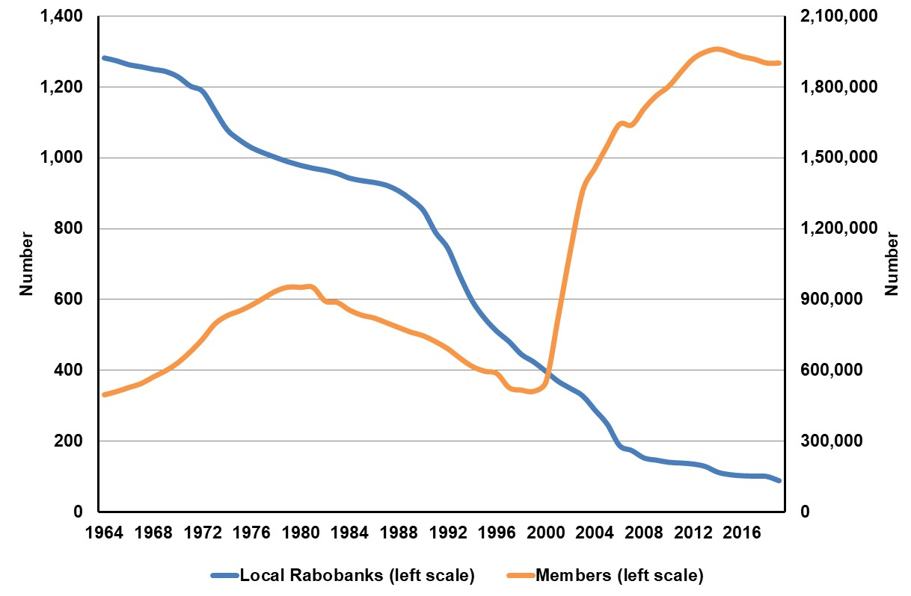
Number of local Rabobanks and members
Continuous reduction of # local banks:
Scale increase of customers (SMEs)
Competition
Efficiency increase
Risk management (compliance costs)
Digitalisation
Et cetera
Challenges
Social capital (connections with local communities and members)
Local embeddedness
Autonomy of local banks
Checks and balances in organisation (governance)
Distinguishing nature and orientation
Cooperative attitude of employees
6

Slide 7
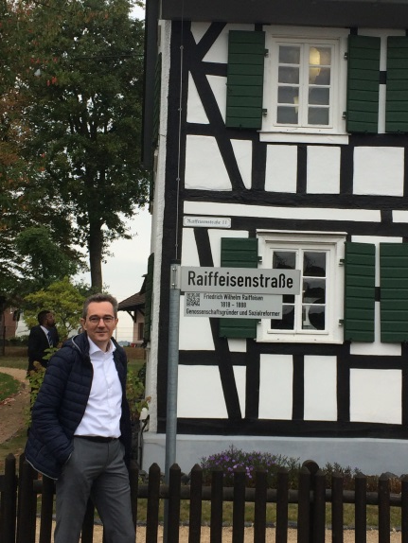
For more information:
hans.groeneveld@rabobank.nl

