Slide 1
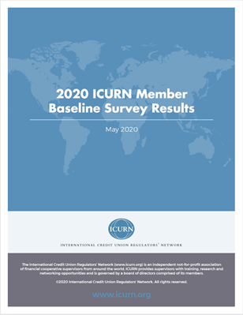
Deposit Insurance for
Financial Cooperatives:
A Global Overview
Dave Grace | October 14, 2020

Slide 2
Scope of Survey
31 supervisors from 22 countries on 6 continents took the survey
Notes:
Benchmarking report covers 49 areas and is extensive and insightful

Slide 3
Deposit Insurance: Availability
Notes:
The largest difference among G20 and non-G20 supervisors was in this area. We don’t see this same lack of coverage of bank deposits in non-G20 countries.

Slide 4
Financial Coops: Important Deposit Takers
Country | CFI Deposits as % of GDP | CFI Markets Share of Deposits
Korea | 36.6 | 31.6
Belize | 19.8 | 23.9
Barbados | 19.0 | 16.7
Kenya | 3.5 | 15.8
Canada | 15.4 | 14.9
Trinidad & Tobago | 5.3 | 14.4
Ireland | 5.4 | 10.7
Poland | 5.7 | 9.7
USA | 6.3 | 9.4
Thailand | 6.7 | 8.4
India | 5.5 | 8.0
Brazil | 2.9 | 7.8
Guatemala | 2.5 | 5.9
Benin | 0.4 | 3.7
China | 5.5 | 3.0
Uganda | 0.4 | 2.3
Mexico | 0.6 | 2.2
Moldova | 0.3 | 0.9
Albania | 0.4 | 0.7
Colombia | 0.2 | 0.6
South Africa | 0.0 | 0.0
Average | 6.8 | 9.1
Sources: IMF 2019 Financial Access Survey, CU Annual Report 2019
Notes:
This difference is not because financial coops are small and un-important in non-G20 countries. Some markets such as France, Japan and Germany the coop banks play an even more important role.

Slide 5
Countries without DI for Financial Coops
Country | CFI Deposit as % of GDP | CFI Deposit Marketshare
Korea | 36.6 | 31.6
Belize | 19.8 | 23.9
Barbados | 19.0 | 16.7
Kenya | 3.5 | 15.8
Canada | 15.4 | 14.9
Trinidad & Tobago | 5.3 | 14.4
Ireland | 5.4 | 10.7
Poland | 5.7 | 9.7
USA | 6.3 | 9.4
Thailand | 6.7 | 8.4
India | 5.5 | 8.0
Brazil | 2.9 | 7.8
Guatemala | 2.5 | 5.9
Benin | 0.4 | 3.7
China | 5.5 | 3.0
Uganda | 0.4 | 2.3
Mexico | 0.6 | 2.2
Moldova | 0.3 | 0.9
Albania | 0.4 | 0.7
Colombia | 0.2 | 0.6
South Africa | 0.0 | 0.0
Average | 6.8 | 9.1

Slide 6
Private Deposit Insurance for Fin. Coops
Country | CFI Deposit as % of GDP | CFI Deposit Marketshare
Korea | 36.6 | 31.6
Belize | 19.8 | 23.9
Barbados | 19.0 | 16.7
Kenya | 3.5 | 15.8
Canada | 15.4 | 14.9
Trinidad & Tobago | 5.3 | 14.4
Ireland | 5.4 | 10.7
Poland | 5.7 | 9.7
USA | 6.3 | 9.4
Thailand | 6.7 | 8.4
India | 5.5 | 8.0
Brazil | 2.9 | 7.8
Guatemala | 2.5 | 5.9
Benin | 0.4 | 3.7
China | 5.5 | 3.0
Uganda | 0.4 | 2.3
Mexico | 0.6 | 2.2
Moldova | 0.3 | 0.9
Albania | 0.4 | 0.7
Colombia | 0.2 | 0.6
South Africa | 0.0 | 0.0
Average | 6.8 | 9.1

Slide 7
A Mixed Bag
Canada, Ireland, US, China, Albania, Colombia, Benin
Korea, Guatemala, Mexico
Belize, Barbados, Kenya, Thailand, Trinidad, South Africa, Uganda, Moldova
Notes:
This difference is not because financial coops are small and un-important in non-G20 countries.

Slide 8
Deposit Insurance: Operation of Scheme

Slide 9
Coverage vs Banks

Slide 10
Funding of a Scheme

Slide 11
Risk Premiums for Deposit Insurance

Slide 12
Payout Time

Slide 13
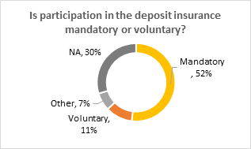
Required Participation in a Scheme

Slide 14
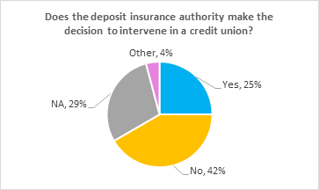
Powers of an Insurer

Slide 15
Concluding Thoughts
Deposit insurance is the “original” consumer protection.
Financial inclusion is great, but we are oftentimes encouraging inclusion into institutions that don’t sufficiently protect consumers.
The existence of deposit insurance for financial cooperatives is still deeply insufficient.

Slide 16
Thank you
Download full report at icurn.org
Dave Grace, Executive Director, ICURN
dgrace@icurn.org

