Slide 1


Including women in Cooperatives Financial Institutions: an uphill battle or good business?
April 2021

Slide 2
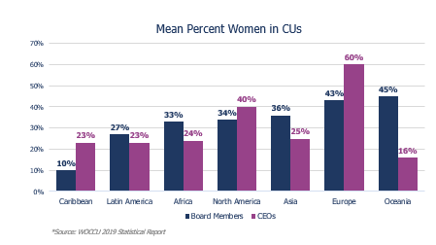
There is not much data on women and CFIs

Slide 3
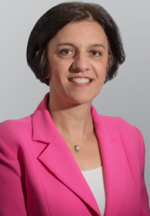
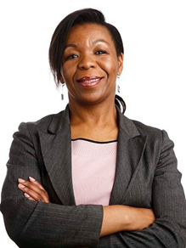
Eleni Giakoumopoulos
Program Director
Global Women's Leadership Network
World Council of Credit Unions
Ndaya Beltchika
Lead Technical Specialist on Gender,
Targeting and Social Inclusion
IFAD

Slide 4
We selected 3 CFIs networks
 | Mann Deshi | CIF | FED Invest
Country | India | West Africa (Benin, Togo, Senegal, Mali, Burkina Faso) | Albania
Members | 30 000 | 4.5 million | 78 000
Assets | 85 million USD | 1.5 bn USD | 57 million USD
Approach | Women-only | Mixed Specific products Group approach | Mixed No specific products Household

Slide 5
We explored 3 dimensions of inclusion
 | Mann Deshi | CIF | FED Invest
% women in members | 100% | 38% | 37%
% women in employees | 75% | 47% | 70%
% women at the Board | 94% | 28% | 50%
How to interpret these numbers?

Slide 6
We benchmarked these CFIs to other financial institutions in their country
Some CFIs are less inclusive of women compared to other financial institutions

Slide 7
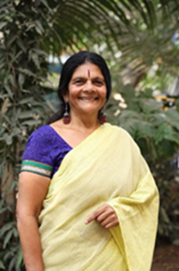
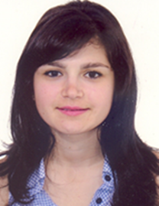
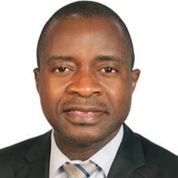
Chetna Sinha,
Founder and Chairperson of the Mann Deshi Mahila Bank and the Mann Deshi Foundation
Mathieu Soglonou,
Director General,
Confederation of West African Financial Institutions (CIF)
Albana Beta,
Head of Legal Department,
FEDInvest

Slide 8
Structure of the webinar
The “Why and How” of including women in financial cooperatives
What’s the potential of digitization to improve women inclusion?
Recommendations to cooperatives and Governments

Slide 9
Emerging recommendations to Governments

Slide 10
Emerging recommendations to Financial Cooperatives

Slide 11
Stay tuned
April 26-29: Mercy Corps AgriFin Annual Learning Event
April 27: Gender Impact and Learning
April 28: Designing for Gender Transformation and Equity
April 28: WWB's Empowering Women on a Journey Towards Digital Financial Capability
OTHER WEBINARS/BLOGs from center of Excellence?

