Slide 1
Integrated traffic laws enforcement – important response to road safety challenges
Sven-Olof Hassel, FINLAND
Chief SuperIntendent retired

Slide 2
The role of Traffic enforcement
Exceeding speed limits, drink or distracted driving and failure to wear a seat belt are still the leading causes of death and serious injury on European roads

Slide 3
Planning Traffic enforcement
Set enforcement plans with yearly targets for numbers of checks and compliance with traffic laws, in particular addressing the priority areas of speeding, drink and drug driving, illegal use of mobile phone, red-light running, failing to wear seat belts, child restraints or helmets.
Share those enforcement plans with the European Commission to facilitate the exchange of best practice on enforcement across the EU.

Slide 4
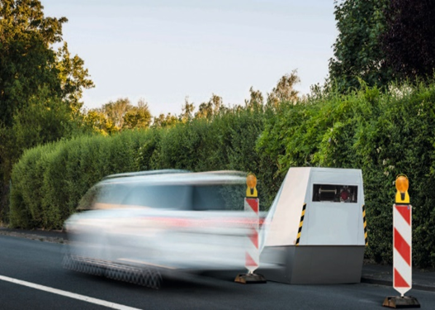
Visible or invisible enforcement ?
For example England, Scotland, Sweden and Norway use mainly visible enforcement strategy.
Unvisible automatic speed enforcement is
common for instance in France and.
Finland.

Slide 5
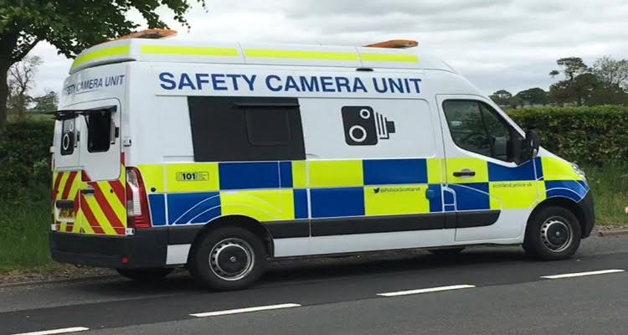
UK Automatic Mobile SPEED Enforcement

Slide 6
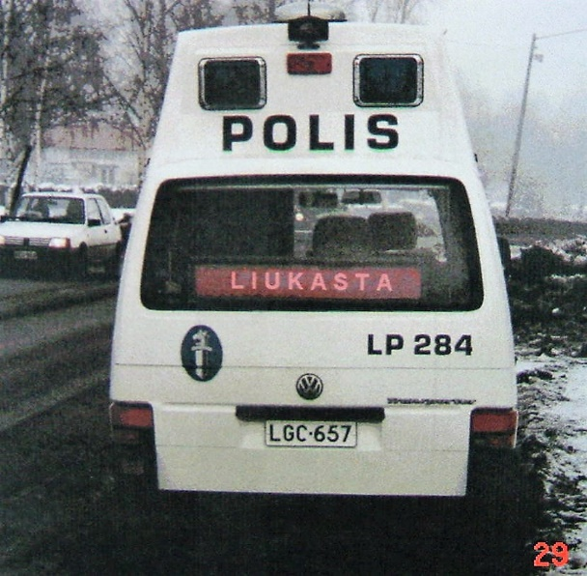
display

Slide 7
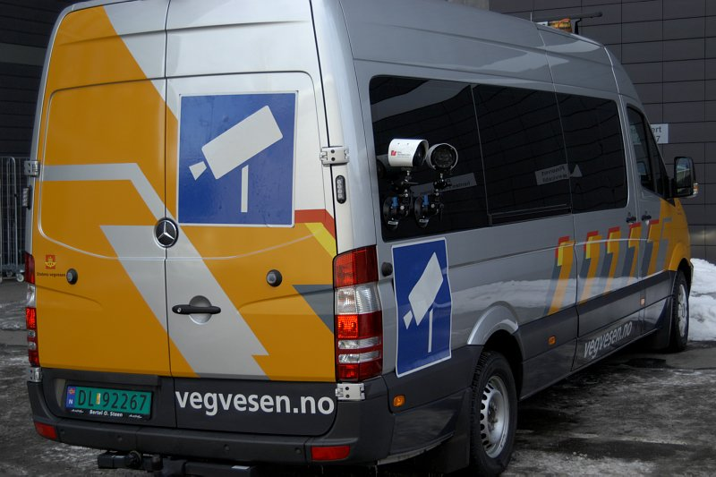
Automatic number plate reCognition NORWAY

Slide 8
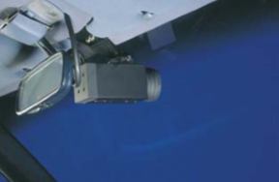
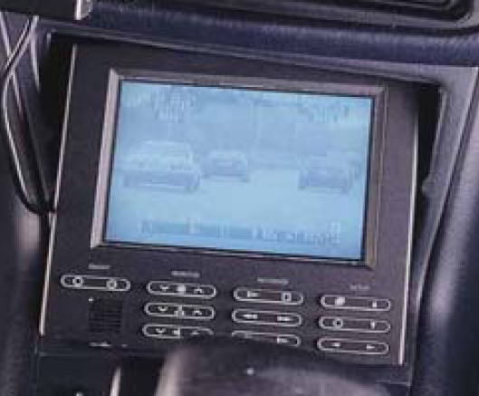
MANUAL Speed enforcement laser, RADAR, Time – Distance measuring device + ANPR

Slide 9
AUTOMATIC fixed SPEED ENFORCEMENT SWEDEN The signes are located apprOx. 300 metres before the camera

Slide 10
Close driving Enforcement
Close driving is very risky and can cause serious crashes.
The safe distance for following another vehicle varies depending on various factors including vehicle speed, weather, visibility and other ...
Close driving is very difficult to enforce.

Slide 11
Too close driving can cause very serious crashes Extremely difficult to enforce

Slide 12
TAILGATING enforcement
Could probably be combined with automatic speed section control in the future.

Slide 13
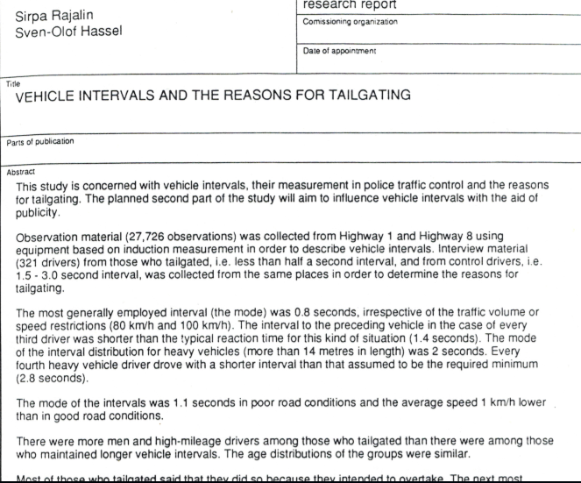
Reasons for tailgating, study

Slide 14
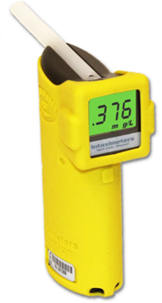

Slide 17
THANK YOU

