Slide 1
Eastern Partnership
Road Safety Action Plan
Brussels, March 27, 2018

Slide 2
EaP Region & EU Countries Fatality rates (deaths per 100,000 inhabitants), 2016
EaP average = 9.7
Target: Reduction of fatality rate by 25% by 2020
EU average = 5.1

Slide 3
EaP Region Fatality rates (deaths per 100,000 inhabitants), 2010 and 2016

Slide 4
Socio-economic losses of the EaP region, 2016
Country | Annual Deaths, 2016 (national statistics) | Population, 2016 | 2016 GDP per capita [1] (current $) | Annual Value of Road Crashes [2] ($) | Annual Value of Road Crashes (% GDP)
Armenia | 267.00 | 2,924,820.00 | 3,614.70 | 231,629,976.00 | 2.2%
Azerbaijan | 759.00 | 9,762,270.00 | 3,878.70 | 706,543,992.00 | 1.9%
Belarus | 588.00 | 9,507,120.00 | 4,989.40 | 704,104,128.00 | 1.5%
Georgia | 581.00 | 3,719,300.00 | 3,865.80 | 539,047,152.00 | 3.7%
Moldova | 308.00 | 3,552,000.00 | 1,900.20 | 140,462,784.00 | 2.1%
Ukraine | 4,687.00 | 45,004,640.00 | 2,185.70 | 2,458,650,216.00 | 2.5%
Total EaP: | 7,190.00 |  |  | 4,780,438,248.00
^{[1]} The World Bank. 2016. goo.gl/MDRbRM
^{[2]} Based on: International Road Assessment Program. 2008. True Cost of Road Crashes: Valuing Life and the Cost of Serious Injury. United Kingdom.

Slide 5
Stage 1: Establishment of RWGs
The three representatives per country assigned to each of the three RWGs
Kick-off meeting with the RWGs members
Stage 2: Benchmarking
Carry out country surveys, gather additional info & summarize results
Identify strengths and weaknesses of the EaP countries based on self-reporting
Stage 3: Development of the EaP Road Safety Cooperation Framework
Formulate the specific objectives, achievable by the end of year 2019
Draft national action plans to support implementation of objectives
Identify supporting actions that involve potential support of the Transport Panel Secretariat
Receiving high-level political commitment to the key road safety priorities identified
Road safety working groups
IN FOCUS
Stage 4: Implementation
Implementation of the priority activities identified via the EaP Road Safety Cooperation Framework
Regional Working Group 1
Road Safety Management, Coordination and Crash Data System Improvement
Regional Working Group 2
Speed Management and Enforcement
Regional Working Group 3
Safety Engineering and Black Spot Management

Slide 6
Scope of work
EaP Road Safety Cooperation Framework
Supporting measures | Timeline | Identified supporting actions needed
Working Group 1
Establish a high-level coordination structure (road safety council / committee) in each EaP country, to set strategic direction, coordinate policies and programs and monitor progress in engagement of the government administrations and other road safety stakeholders towards achievement of the national road safety goals. | End of 2018 | WB team to verify the situation in EaP and share results EaP countries to assure the structures are in place and meeting regularly.
Develop and adopt detailed regulations in each EaPC on crash data-base including: CADaS-based data sets and structures required for stakeholders, access by stakeholders and general public (following open data principles) and collection procedure across the country | End of 2018 | WB team to share international good practices and country case studies of data-bases WB team to verify status of crash and other data-bases and publish the results via EaP website WB team to support development of action plans in all EaP countries WB team to organize study trip to 1-2 countries to support transfer of knowledge and experience EaP countries to initiate implementation of action plans
Working Group 2
Involve professional road user groups (public admin, emergency services, Police, bus, taxi) NGOs and celebrities in promoting seatbelt use | End of 2018 | WB team to facilitate exchange of international good practices in involving key social partners in seatbelts use promotion and enforcement, including during study trip. EaP countries to improve involvement of key social groups in their promotion and enforcement of seatbelt use
Adopt legislation reinforcing seatbelt use at front- and backseats | End of 2018 | EaP countries to adopt legislation on seatbelt use and enforcement

Slide 7
Scope of work
Supporting measures | Timeline | Identified supporting actions needed
Working Group 3
Identify which road infra procedures from the Directive 2008/96 and how effectively are used in EaP countries | End of 2018 | WB team to share international good practices and country case studies in implementation of the Directive 2008/96 WB team to verify status of implementation of the Directive 2008/96 in EaPCs and publish the results via EaP website EaP countries to commit and begin introduction of the Directive 2008/96 into their legislation and practice
Safety impact identified (preferably quantified) for at least one priority road investment project per each EaP country. | End of 2018 | WB team to prepare a workshop module presenting WB tool for early road safety impact assessment of road investment project and training in its use. Each EaP country to analyse safety impact assessment for at least one of the priority project from extension of TEN-T network in their respective countries as identified jointly with EC and TPS
Identifying the degree of preparation, implementation and sustainability of Black Spot type programs in EaP countries | Mid-2018 | TPS to verify status of black spot treatment programs in all EaP countries and publish the results via EaP website EaP countries to commit to institute at least medium-term Black Spot type programs.
Accessibility of non-confidential crash data to the road administrations assured | End of 2018 | Each EaP country to assure efficient exchange of crash data between crash data-base holder and road administration (with IFIs support), with emphasis on assuring reliable data on crash locations
Identification of at least top ten blackspot locations in each EaP country | End of 2018 | TPS to share general good practices on defining black spots and selecting priority locations for treatment. Each EaP country to adopt definitions and identify at least top ten black spot locations for improving safety in short to medium-term.

Slide 8
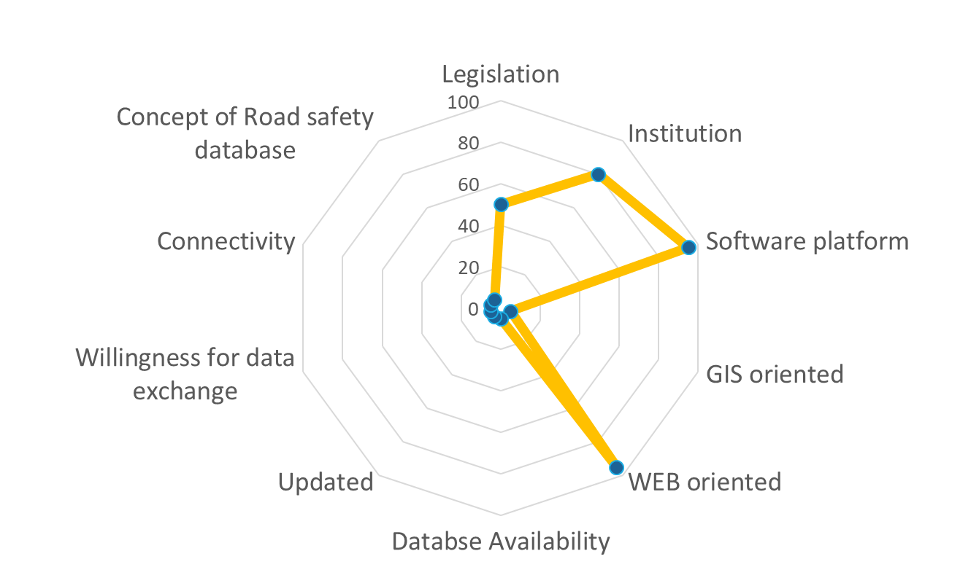
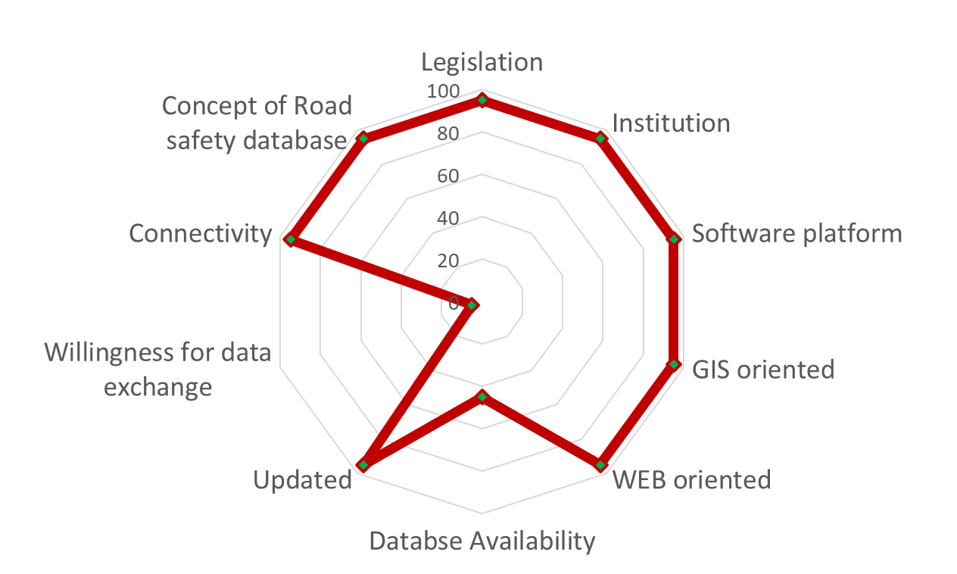
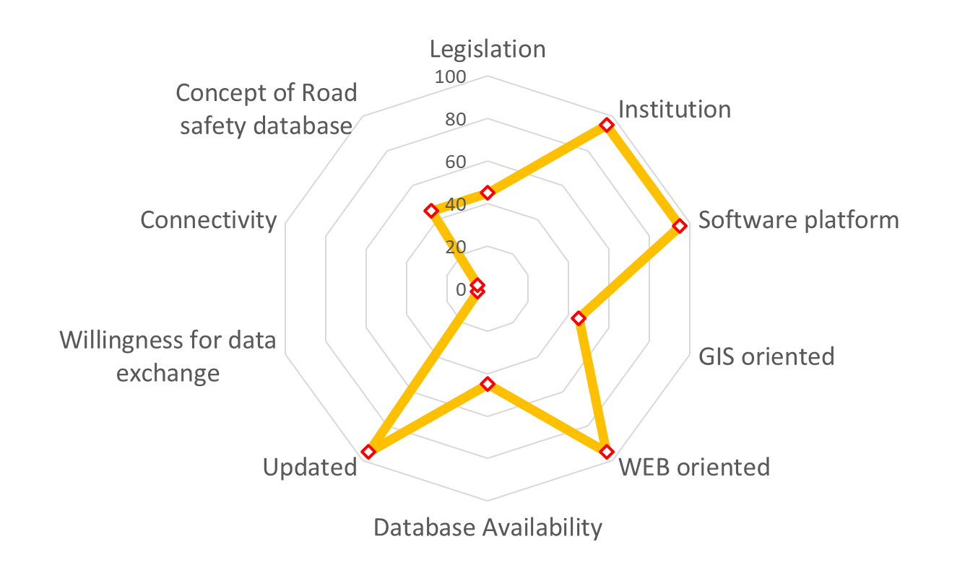
Crash data system benchmarking assessment
Armenia
Belarus
Moldova

Slide 9
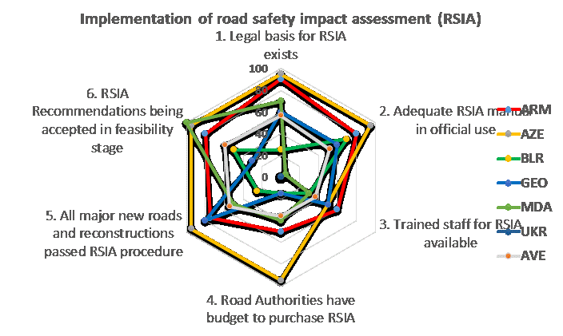
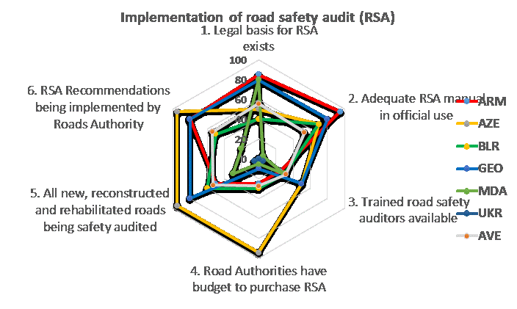
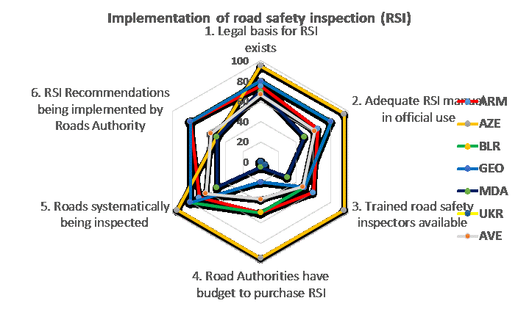
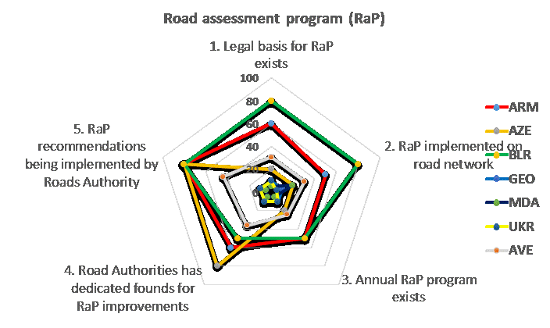
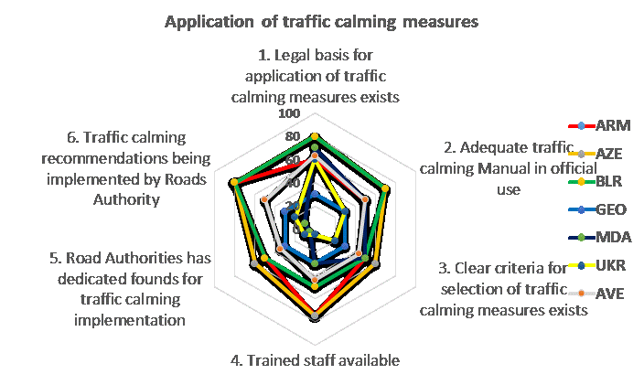
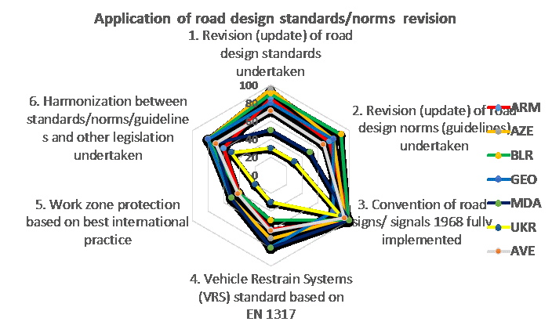
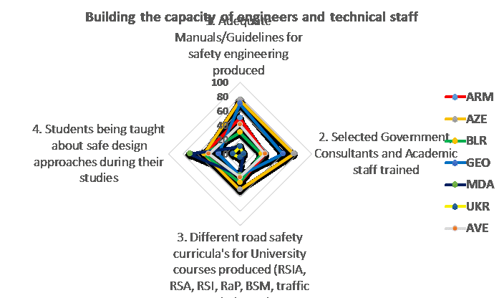
Road safety infrastructure benchmarking assessment

Slide 10
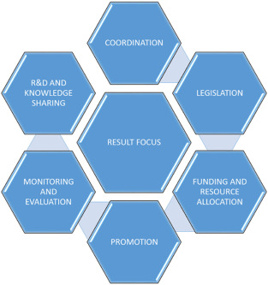
Cross-country recommendations for implementation/next steps
What needs to be done now (within next 2 years):
Enabling actions (e.g. Lead Agency for Road Safety, Road Safety Secretariat, crash and safety data system for monitoring and evaluation etc.)
‘Quick wins’ projects: (improving traffic rules enforcement e.g. excessive speeding, drink-driving, seatbelts use, insitututing modern type of infrastructure program focusing on „black spots”)
Building capacity for road safety management
Institutional Management Functions

Slide 11
Phased implementation
Phase One (Establishment) - immediately:
Establishment of the Lead Entity (could be a standalone office under the political office of the Prime Minister). The key advantage of this is a very strong political signal for a major new road safety effort.
Establishment of Professional Secretariat to continuously support the Lead Entity to ensure the implementation of activities and follow-up of road safety policies. Possibly as an Interim Arrangement to develop a National Road Safety Programme Group (NRSPG) to form the core of the future Lead Entity in advance of it’s formal establishment.
Phase Two (Development) – 2018-2019:
Specifications are prepared for internal reforms and for multilateral/bilateral technical assistance projects:
Implementation of crash and safety data systems reform;
Safety legislation reform plan;
Improving road traffic laws enforcement, training and equipment project etc.
Phase Tree (Delivery of Projects – 2019+)

Slide 12
Supporting actions of the EaP Transport Panel Secretariat
Support the three EaP Working Groups’ activities through specialist experts
Support in proper use of allocated resources and seeking external financing for road safety (grants, MDBs etc.)
Assistance in implementing ‘quick-wins’:
speed reduction: enforcement measures focusing on automatic system and infrastructure procedures (audits, inspoections etc.) and standards – traffic calming)
improving seat belt wearing rate (front and rear)
structured program of elimination of the worst ‘black spots’ and dangerous locations on road network
Assistance in capacity building (e.g. training, study tours etc.)

